Slide 1
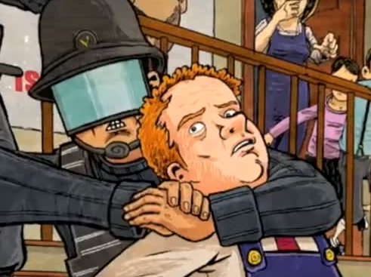
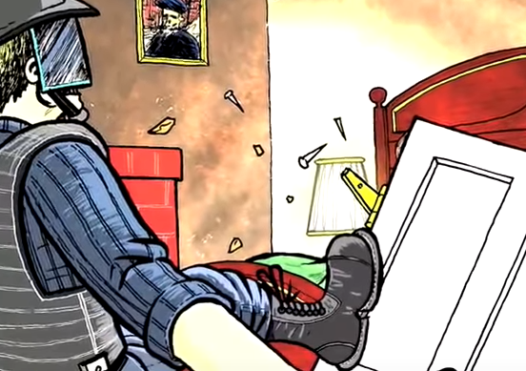
2.10
What is the deal with the “beautiful” Prole? Why does Winston find her attractive? (219-20).
Lit analysis: What is Orwell’s purpose for including this?
Is the language Orwell uses about women misogynistic?
Where was the telescreen?
Who betrayed Winston and Julia?
What questions does this leave us with?

Slide 2
3.1(225-239)
How is Winston tortured at the Ministry of Love?
What is jail like? Who is there?
Lit analysis: What effect does Orwell create by putting a Prole woman in jail with Winston? (think to juxtaposing with the last Prole woman Winston was thinking about in 2.10). (227).
Is it ironic how Oceania treats criminals? (227).
Discuss both the men Winston knows who are imprisoned with him at the Ministry of Love? Why Parsons? Is anyone safe?
How bad is Room 101? How is Orwell building tension for it?
What bombshell does Winston learn?
Lit analysis: Ultimately, is 3.1 funny or dramatic? How does Orwell weave both elements into his narrative?

Slide 3
“Beautiful” Prole Prole in jail at Miniluv p. 219 p. 227

Slide 4
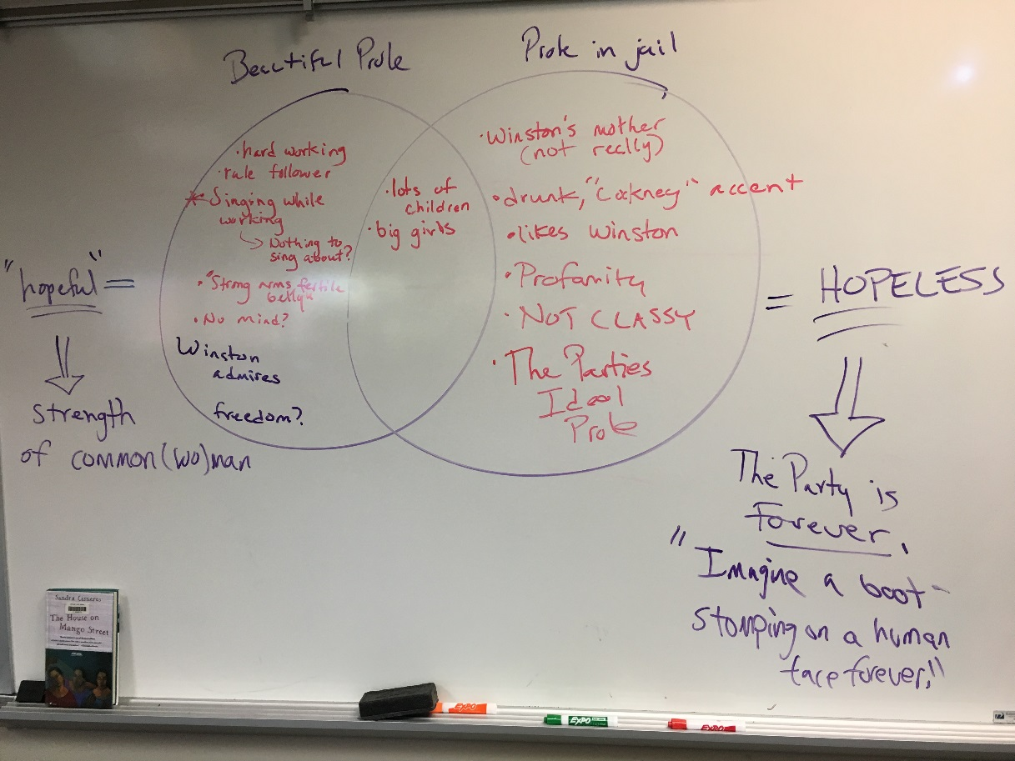

Slide 5
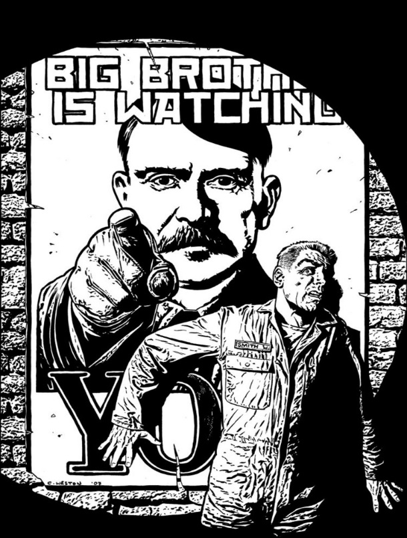
ONE + TWO [salient points] review:
Create a poster that includes specific facts, and quotes to summarize and analyze your topic from section ONE and TWO of 1984. Finalize your work with what you believe Orwell’s purpose is (feel free to conjecture).
The importance of Language
Privacy and Totalitarianism
Revisionist History/Truth
The Value of Sex to Humanity

