Slide 1
Brave New World: chapter 10 (146-7)
In the first two pages of chapter 10, what literary techniques does Huxley use to illustrate his fears?
____ Imagery?
____ Diction?
____ Tone?
____ Mood?
What is he afraid of?

Slide 2
Huxley’s afraid of Bees! Wait, he’s afraid of efficiency dehumanizing people. Notice how everything is on schedule.
THE HANDS of all the four thousand electric clocks in all the Bloomsbury Centre’s four thousand rooms marked twenty-seven minutes past two. “This hive of industry,” as the Director was fond of calling it, was in the full buzz of work. Every one was busy, everything in ordered motion. Under the microscopes, their long tails furiously lashing, spermatozoa were burrowing head first into eggs; and, fertilized, the eggs were expanding, dividing, or if bokanovskified budding and breaking up into whole populations of separate embryos. From the Social Predestination Room the escalators went rumbling down into the basement, and there, in the crimson darkness, stewingly warm on their cushion of peritoneum and gorged with blood- surrogate and hormones, the foetuses grew and grew or, poisoned, languished into a stunted Epsilonhood. With a faint hum and rattle the moving racks crawled imperceptibly through the weeks and the recapitulated aeons to where, in the Decanting Room, the newly-unbottled babes uttered their first yell of horror and amazement.
The dynamos purred in the sub-basement, the lifts rushed up and down. On all the eleven floors of Nurseries it was feeding time. From eighteen hundred bottles eighteen hundred carefully labelled infants were simultaneously sucking down their pint of pasteurized external secretion.
Above them, in ten successive layers of dormitory, the little boys and girls who were still young enough to need an afternoon sleep were as busy as every one else, though they did not know it, listening unconsciously to hypnopædic lessons in hygiene and sociability, in class-consciousness and the toddler’s lovelife. Above these again were the playrooms where, the weather having turned to rain, nine hundred older children were amusing themselves with bricks and clay modelling, hunt-the-zipper, and erotic play.
Buzz, buzz! the hive was humming, busily, joyfully. Blithe was the singing of the young girls over their test-tubes, the Predestinators whistled as they worked, and in the Decanting Room what glorious jokes were cracked above the empty bottles! But the Director’s face, as he entered the Fertilizing Room with Henry Foster, was grave, wooden with severity. (146-7).

Slide 3
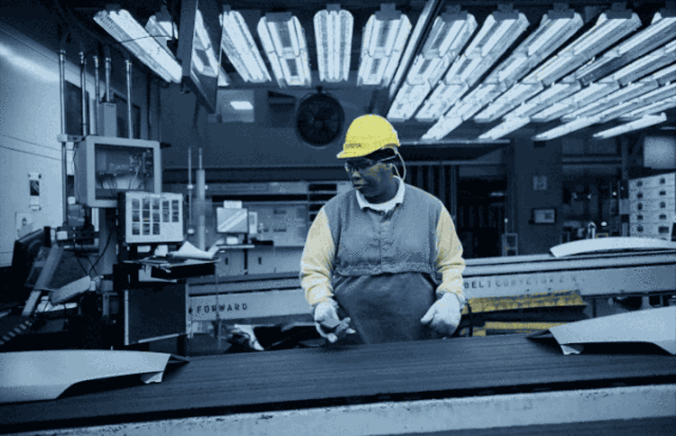
How have we seen other dystopian texts handle efficiency? How was the Party ‘efficient’? The Lobster?
How is the idea of the efficiency of the assembly line applied in chapter 1 & 2 of Brave New World?
Hypothesize: What would make efficiency and the assembly line a fear that many dystopian authors have in common? Explain with some detail.
What would make it scary?

Slide 4
Optimization Definition:
the action of making the best or most efficient use of a situation or resource through data or analytics.
Where are ‘data’ and ‘analytics’ used for oppressive ends?

Slide 5
Optimization: activate prior knowledge
What are some of the ways that you use data—probably tracking something on a “smart” device—to optimize your life/make your life more efficient?
When do you see other individuals doing so?
Are there any times when trusting your gut instinct works better than analyzing data?

Slide 6
NYT Opinion Article: “A Sucker is Optimized Every Minute”
Read the article. Don’t write on the packet; it is a part of a class set and I’ll collect it.
Make useful notes that respond to the following questions in your Journal:
What is the article’s thesis?
What does the author of this article say that “optimization” is and why is it “pernicious” (harmful) to individuals and society?
What specific contemporary real-world examples does the author put forth in this article of the sort of societal efficiency that Huxley and Orwell show in their fiction to be damaging?

Slide 8
Atlantic article: “Why You Never See Your Friends Anymore”
Read the article.
What is the article’s thesis?
How can ‘productivity’ and ‘efficiency’ be used to control people? How has this happened throughout history?
How does this relate to our current schooling/coronavirus situation?
Does America have a healthy relationship with work?

Slide 9
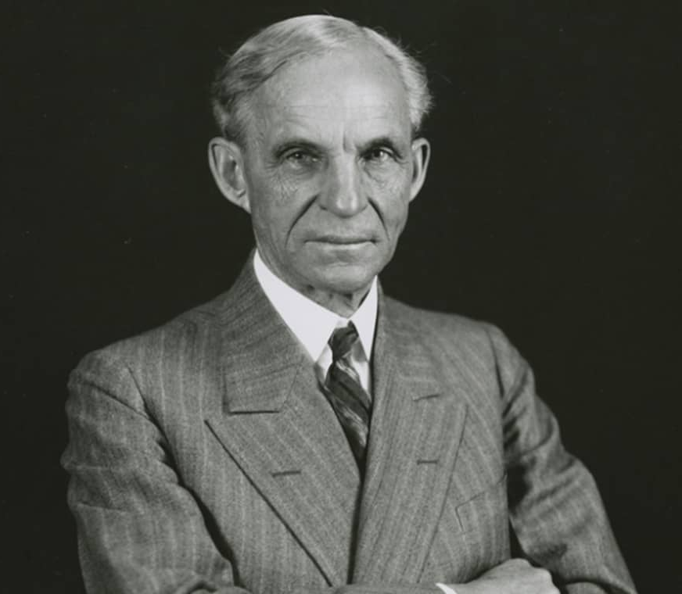
What do you know about Henry Ford?
"Understanding Henry Ford is more than a puzzle; it is a pursuit."
-Henry A. Wise Wood, The New York Times, May 17, 1916

Slide 10
What is Ford saying about innovation or human nature with the following quote?

Slide 11
“History is bunk” It isn't an urban myth: Henry Ford really did say: "History is bunk."
It is somewhat ironic that Henry Ford's words - "history is bunk" - are now a part of the historic record. What is not clear from most writings about Henry Ford is the context in which he gave his views of history. I hope to remedy that defect somewhat.
Most information about Henry Ford's views on history are of no historical value: we already know that he did not place any value whatsoever on historical studies. What we don't know is why. He also said: "History is myth." He said that to Henry A. Wise Wood, of which, more below. As to the "history is more or less bunk", he is quoted as using those exact words in the Crawfordsville Review, June 6, 1916. It was long after that, in 1921 that he made the widely cited statement: "History is bunk.“
Ford was a master of the debate-stifling “Ford flurry.” The technique is simple: make as many ‘statements of fact’ as possible in the time or space allowed and then claim victory in the debate for every point not refuted by your opponent. Henry A. Wise Wood, a noted historian and author of books such as Money Hunger, reported an interview with Henry Ford which shows Ford to have been something of a conspiracy theorist.
Notes:
http://www.science20.com/chatter_box/henry_ford_quote_history_bunk-79505

Slide 12
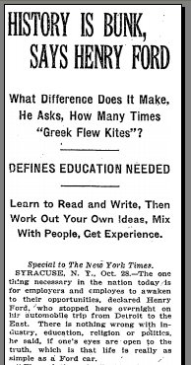
Primary Source Documents:
New York. May 15, 1916-To the Editor of The New York Times: On May 8. while in Detroit for the purpose of speaking on preparedness, I spent several hours with Henry Ford. I found Mr. Ford eager to talk about national defense, but unwilling to discuss it. While volleying his assertions with great rapidity, he refused to pause long enough to permit any one of them to be examined and dealt with. To facts which I submitted he responded with a brief word of dismissal or with a sweeping denial that they were facts: sometimes with the remark that he could not consider them because he himself did not know them to be facts. ... When In our " discussion " or a nation's need for defensive strength history was appealed to, Mr. Ford replied that he did not believe in history, that history was of the past and had no bearing upon the present and that, there being nothing to be learned from it, history need not be studied nor considered. The American Revolution he refused to have touched upon, saying that the Revolution was " tradition," that he did not believe In tradition.

Slide 13
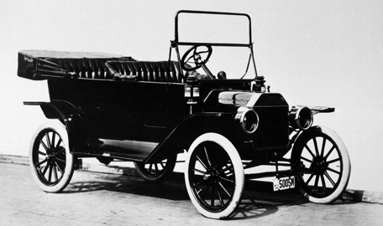
Henry Ford as boss
During its first five years the Ford Motor Company produced eight different models, and by 1908 its output was 100 cars a day. The stockholders were ecstatic; Ford was dissatisfied and looked toward turning out 1,000 a day. The stockholders seriously considered court action to stop him from using profits to expand. In 1909 Ford, who owned 58 percent of the stock, announced that he was only going to make one car in the future, the Model T. Other shareholders sued but Ford bought them out for absolute control.

Slide 14
Henry Ford as boss
In 1914 the Ford Motor Company announced that it would henceforth pay eligible workers a minimum wage of $5 a day (compared to an average of $2.34 for the industry) and would reduce the work day from nine hours to eight, thereby converting the factory to a three-shift day. Overnight Ford became a worldwide celebrity. People either praised him as a great humanitarian or excoriated him as a mad socialist. Ford said humanitarianism had nothing to do with it.
Previously profit had been based on paying wages as low as workers would take and pricing cars as high as the economy would bear.
Ford, on the other hand, stressed low pricing (the Model T cost $950 in 1908 and $290 in 1927) in order to capture the widest possible market and then met the price by volume and efficiency.

Slide 15
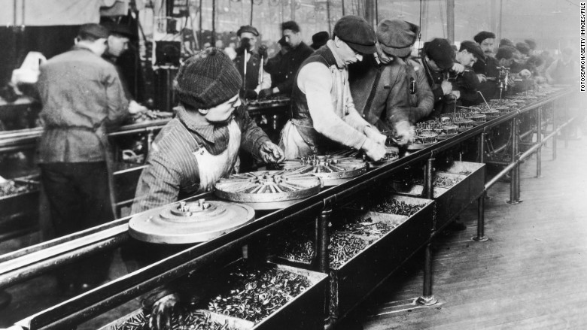
Factory workers for Ford

Slide 16
Article: “Henry Ford and the source of our fear”
“Henry Ford left us much more than cars and the highway system we built for them. He changed the world’s expectations for work. While Ford gets credit for “inventing the assembly line,” his great insight was that he understood the power of productivity.
Ford was a pioneer in highly leveraged, repetitive work, done by relatively untrained workers. A farmer, with little training, could walk into Ford’s factory and become extraordinarily productive in a day or two.
The focus on productivity wouldn’t be relevant to this discussion except for the second thing Ford did. He decided to pay his workers based on productivity, not replacement value. This was an astonishing breakthrough. When Ford announced the $5 day (more than double the typical salary paid for this level of skill), more than 10,000 people applied for work at Ford the very next day.
Instead of paying people the lowest amount he’d need to find enough competent workers to fill the plant, he paid them more than he needed to because his systems made them so productive. He challenged his workers to be more productive so that they’d get paid more.
When there’s a line out the door of people waiting to take your job, weird things happen to your head. The combination of repetitive factory work plus high pay for standardized performance led to a very obedient factory floor. People were conditioned to do as they were told, and traded autonomy and craftsmanship for high pay and stability.”
NOTE: The minimum wage in the USA would be over $22 an hour if it had tracked PRODUCTIVITY

Slide 17
Ford’s Anti-Semitism
A close friend recalled a camping trip in 1919 during which Ford lectured a group around the campfire. He "attributes all evil to Jews or to the Jewish capitalists," the friend wrote in his diary. "The Jews caused the war, the Jews caused the outbreak of thieving and robbery all over the country, the Jews caused the inefficiency of the navy…"

Slide 18
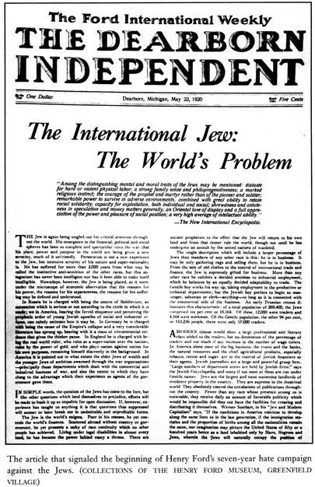
Ford emerged as "a respected spokesman for right-wing extremism and religious prejudice," reaching around 700,000 readers through his newspaper.
Ford is the only American mentioned favorably in Mein Kampf, although he is only mentioned once.
Supposedly, Ford regretted these feelings after WWII and had a stroke upon seeing Conc. Camp footage.

Slide 19
Sinclair Broadcasting
https://theconcourse.deadspin.com/how-americas-largest-local-tv-owner-turned-its-news-anc-1824233490
“Fairness Doctrine”: policy in the US requiring television and radio broadcasters to present contrasting political views (“both sides”) viewpoints on controversial issues of public importance.
Existed between 1949 and 1987
In Red Lion Broadcasting Co. v. FCC, 395 U.S. 367 (1969), the U.S. Supreme Court upheld (by a vote of 8-0) the constitutionality of the fairness doctrine
Removed during Ronald Reagan’s presidency, the FFC stated that the doctrine ‘hurt the public interest and violated free speech rights guaranteed by the First Amendment.’

Slide 20
Synthesis: Henry Ford & BNW
Select three or more quotes from chapter 3-5 that mention “Ford”
What do you learn about Ford or the values of the society Huxley portrays in Brave New World from each quote?
What does the inclusion of Henry Ford as god in Brave New World tell us about Huxley’s fears for the world?

