Slide 1
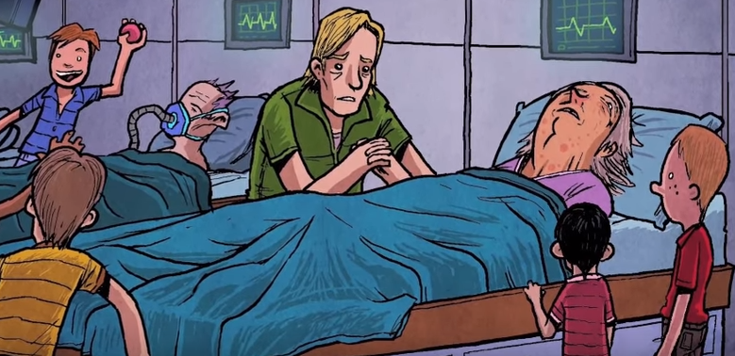
Chapter 14 [198-207]
Why isn’t death terrible for those in the civilized world? What does this mean for the individual person?
TV, as we know it, did not exist in 1931– what is Huxley’s TV like? Is it similar to the telescreen?
Why is Linda dying? What is she dying of? How does she react to John?
What memories flood over John as he stands before his mother? What is important about these memories?
How important is memory to civilization for World State? How important is memory to civilization in dystopian texts?
Why are the Delta children in the hospital?

Slide 2
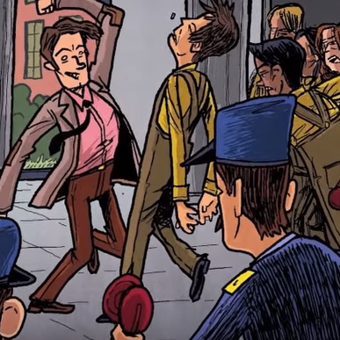
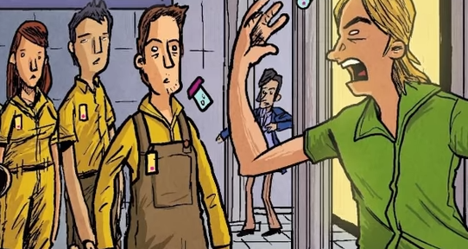
Chapter 15 [208-216]
How is the Shakespeare allusion ‘Brave New World’ used here? What is different about how Huxley uses it here? What does it mean now?
Why does John decide to interfere with the soma distribution? Why does John say it is poison? Do you agree?
What does John think of the Deltas he speaks to?
What do Bernard and Helmholtz play here? What does this add to their characterization?
How does the soma riot end? What does it mean to be happy and good?

Slide 3
Review Questions:
How has Bernard Marx changed from chapter 1? Chapter 5?
What has made him more cowardly and orthodox? Why
How has John the Savage changed from chapter 7?
How has Huxley shown us the true control soma has over people?

