Slide 1

Overview narrated by Smith
I forgot to say don’t forget about social class and the rampant consumerism conditioned into people

Slide 2

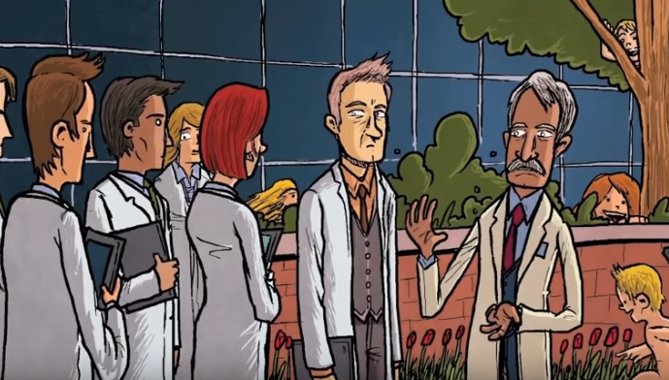
Chapter 3 reread the preview from yesterday– it continues the DHC talking with the students from chapter 1 and 2
Why are kids encouraged to engage in “Erotic Play”?!?! (*developmentally this is actually very natural)
Explain: “when you’re not accustomed to history, most facts do sound incredible”?
After the top of page 34 (book version) the story gets jumbled out of order.

Slide 3
Chapter 3 of BNW has 4 different scenes jumbled together (plus the opening you already read)
Lenina Crowne and Fanny Crowne in the women’s locker room of their dorm* (because World State rejects all family, everyone lives in dorms with shared bathrooms).
Mustapha Mond (a “World Controller”) and the Director of Hatcheries and Conditioning (the DHC, he’s been leading the students around The Central London Hatchery and Conditioning Center since chapter 1, but you knew that).
A conditioning center’s audio teaching sleeping children about their role in society (part of the fear of Pavlovian conditioning)
Henry Foster, Bernard Marx, and an Assistant Predestinator talking about all the hot tea.
Each of these scenes reveals important World State context and information, plus introduces 3 of the 5 main characters.

Slide 4
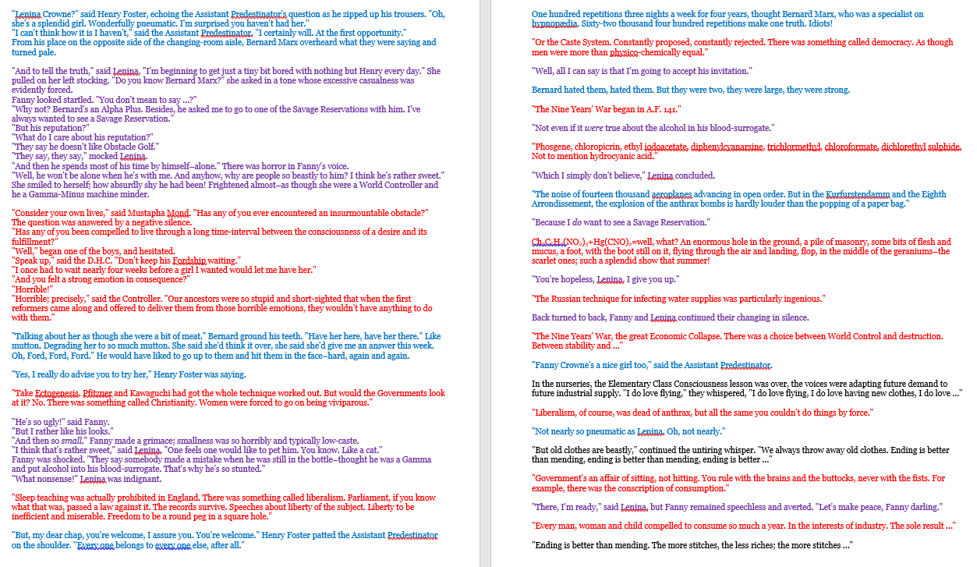
Chapter 3 of BNW in your book…
(but it’s way longer)
}
Why would Huxley do this?? If you tried reading it as a challenge, or are curious, send Smith an email and we can talk!

Slide 5


Alone or with a partner from your small discussion group choose one task:
[due to TurnItIn.com by Thursday at 11pm]
Make a characterization graphic, chart, or web with everything we learn in Chapter 3 about:
  Mustapha Mond (the World Controller) (chunk B)
  Lenina Crowne (chunks A & D)
  Bernard Marx (chunks A & D)
Create a ‘Gentleman’s Handbook’ and/or a ‘Proper Lady’s Guide’ to the Social Norms of World State (chunks A, B, C, & D).
  How does Huxley portray masculine attitudes towards women?
  How does Huxley portray feminine attitudes towards men?

Slide 6
Chapter 3 thinking questions
Describe the interpersonal sexual culture in World State.
  What do you think “pneumatic” means in the context Huxley is using it?
  What is a “vibro-vacuum” machine? Why does Lenina return from it “like a pearl illuminated from within, pinkly glowing”? (Hint: it is not something you would do in a public locker room)
  How does Huxley portray masculine attitudes towards women?
  How does Huxley portray feminine attitudes towards men?
  What is the role of sexual promiscuity in supporting World State? How can lots of meaningless sex dehumanize?
  How is World States’ attitude towards sex different than our own?
    Why and how do they avoid pregnancy?

Slide 7
Chapter 3 discussion questions
Describe Mustapha Mond.
  What is his relationship to history?
  How is this like/unlike O’Brien and 1984? (he is basically O’Brien)
  How is he “corrupting”?
  What propaganda did World State need to create stability?
  What is “Soma”?
Describe Bernard Marx.
  How is he ‘abnormal’? How does he not fit in?
  Juxtapose Bernard Marx with Henry Foster.
Describe Lenina Crowne.
  What is Fanny’s advice for Lenina?
  What is unusual about her relationship with Henry Foster?
  What does she want with Bernard Marx?

Slide 8
Chapter 3 discussion questions
How did World State become the way it is?
  How important is Henry Ford?
  What things have they suppressed?
  What happened during the Nine-Years War?
  Why is it important to have everything a person wants in World State?

Slide 9
Male/Female Social Norms
Chapter 4:
Lenina “was a popular girl and, at one time or another, had spent a night with almost all of them.” (Huxley 57).
“‘I’d simply love to come with you for a week in July,’ she went on. (Anyhow, she was publicly proving her unfaithfulness to Henry. Fanny ought to be pleased, even though it was Bernard.) ‘That is,’ Lenina gave him her most deliciously significant smile, “if you still want to have me.’” (Huxley 58).
“As though I’d been saying something shocking, thought Lenina. He couldn’t look more upset if I’d made a dirty joke-asked him who his mother was,” (Huxley 58).

