Slide 1
BNW chapter 4.1
What do you think life would be like for the Epsilon-Minus Semi-Moron? What does Huxley’s tone (attitude) make us feel?
Are they “human”? What would life be like as an Epsilon-Minus Semi-Moron? How different are they from Bernard and other Alphas?
How does Huxley develop the sexual culture of World State?
Benito Hoover “put away the soma bottle, and taking out a packet of sex-hormone chewing gum, stuffed a plug into his cheek and walked slowly away” (Huxley 60).
How powerful is the Hypnopæda? What does Lenina say that she was conditioned to say?
What is Lenina’s relationship like with the men around her? With Bernard?

Slide 2
The Epsilon-Minus Semi-Moron:
He flung open the gates. The warm glory of afternoon sunlight made him start and blink his eyes. “Oh, roof!” he repeated in a voice of rapture. He was as though suddenly and joyfully awakened from a dark annihilating stupor. “Roof!”
He smiled up with a kind of doggily expectant adoration into the faces of his passengers. Talking and laughing together, they stepped out into the light. The liftman looked after them. “Roof?” he said once more, questioningly. Then a bell rang, and from the ceiling of the lift a loud speaker began, very softly and yet very imperiously, to issue its commands.
“Go down,” it said, “go down. Floor Eighteen. Go down, go down. Floor Eighteen. Go down, go.”
The liftman slammed the gates, touched a button and instantly dropped back into the droning twilight of the well, the twilight of his own habitual stupor. (Huxley 58-9).

Slide 3
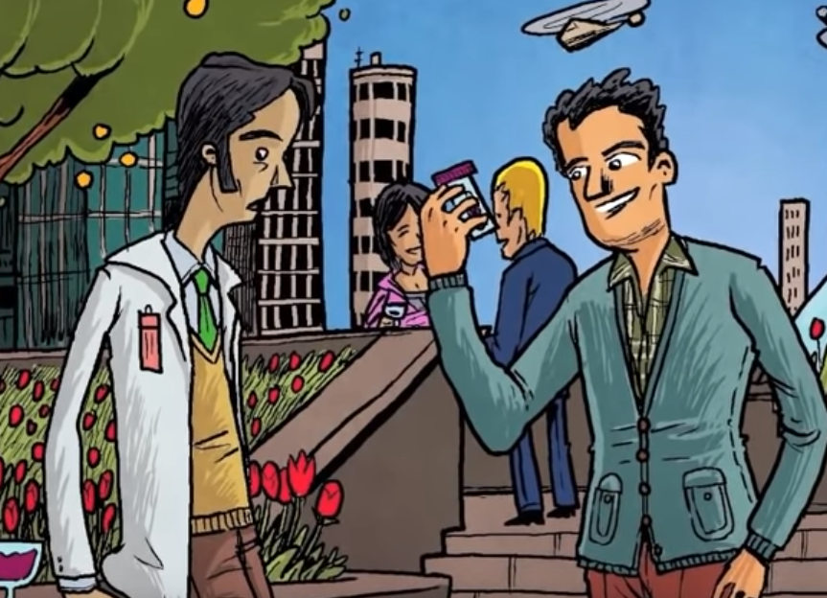
BNW chapter 4.2 & 4.3
How different is Bernard from other Alpha-Plus men? Like Henry Foster, the D.H.C., or Helmholtz Watson?
Describe Helmholtz Watson.
How is he both slightly-unorthodox, yet still the antithesis (opposite) of Bernard Marx?
What is Soma?

