Slide 1
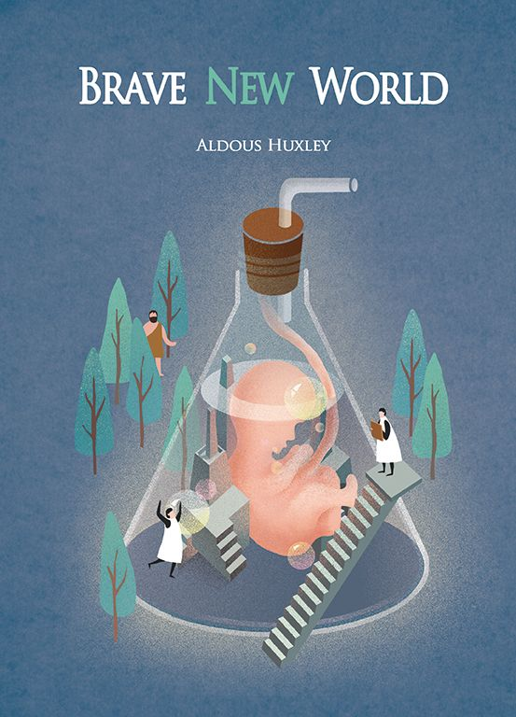
Brave New World cover artwork
Prepare to actively read by identifying potential themes and modern elements Huxley is warning his audience about based on the covers included.
On Tii, under the discussion tab, is an optional place for you to share your thinking or list your favorite cover.
No dinosaur indicates this (Tii) is optional, not graded. [You still have to look at them.]

Slide 2
What do these covers tell you about the book?

Slide 3
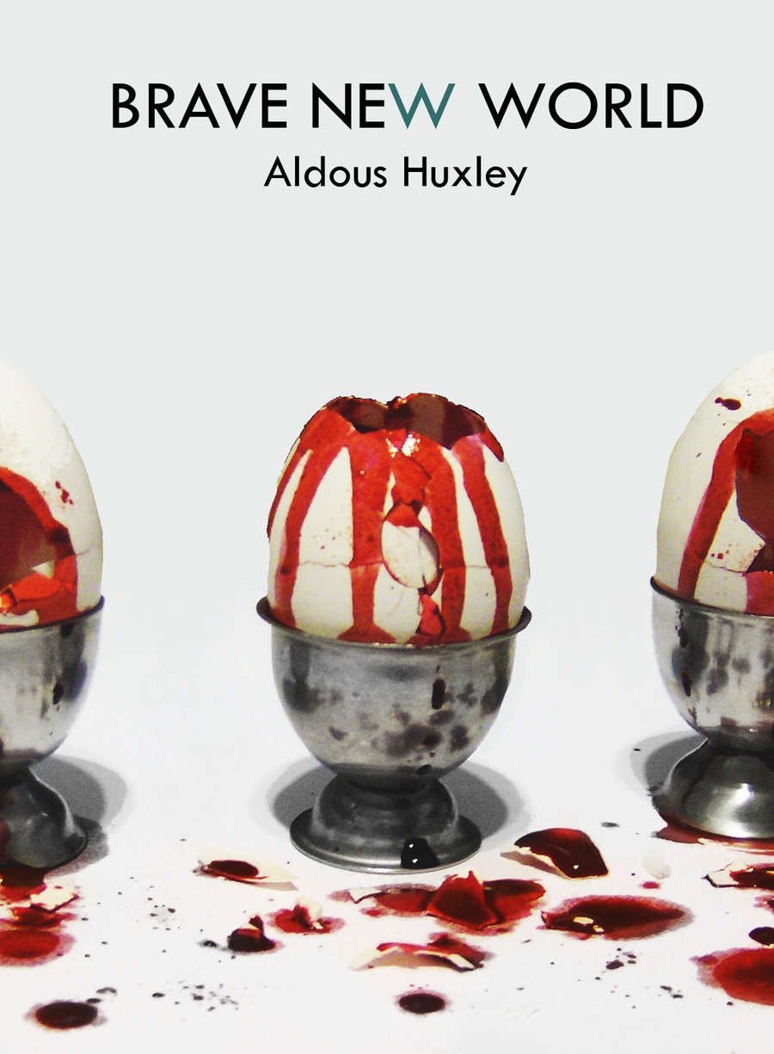
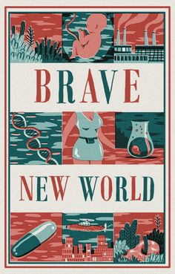
What do these covers tell you about the book?

Slide 4
What do these covers tell you about the book?

Slide 5
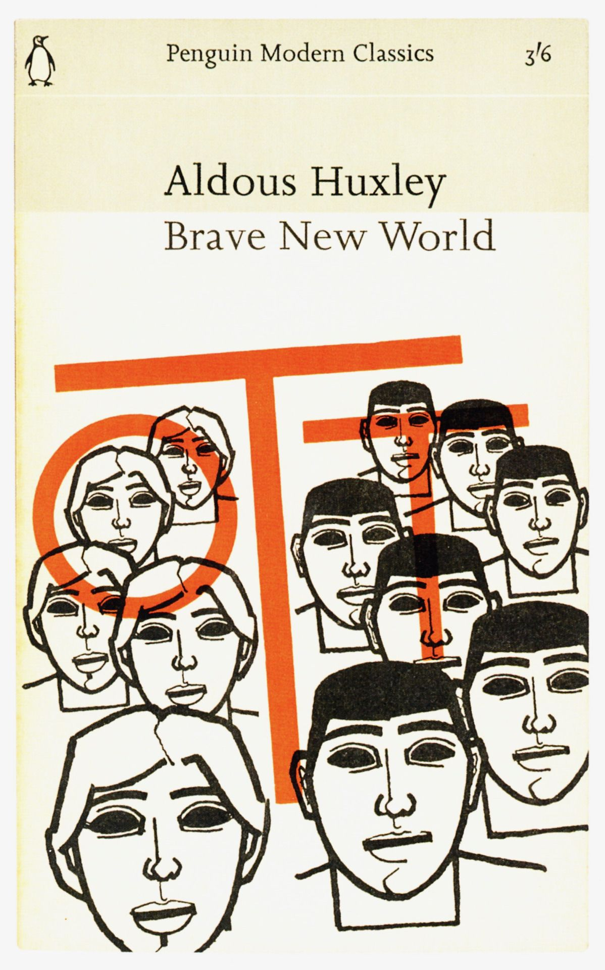
What do these covers tell you about the book?

