Slide 1
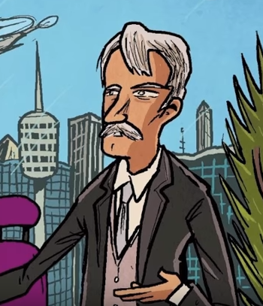
Brave New World 16 (217-229)
Task: create a poster to display Mustapha Mond’s reveal on one of the following thematic topics. Additionally analyze Huxley’s dystopian commentary.
Happiness
Art
Science
Intelligence
Stability/Instability

Slide 2
Brave New World 16 (217-229)
Why is Shakespeare banned in World State? Does it matter if it were banned? Is Othello better than feelies?
What does Helmholtz want to do?
Where does art come from? Is Mustapha Mond correct?
Is MM correct: “Actual happiness always looks pretty squalid in comparison with the overcompensations for misery… happiness is never grand”? What does he mean?
Is MM’s description of World State as a true, better than any alternative, Utopia convincing to you?
What happened to a society of all Alphas? What about in real life?
Is science subversive? What does MM mean?
Why would World State not vaporize the unorthodox? Why is violence not the best tool for them?

Slide 3
Chapter 17 [231-]
Do you like the inconveniences of life? Which suboptimal moments have turned out to have value for you?
How does the freedom to be unhappy compare to the right to be happy? How does it compare to the freedom to say 2+2=4?
Why does “nothing cost enough here”? Do you agree with John?
Why does Huxley refer to John as “the savage” now?
How does MM represent Huxley’s social commentary? John?
What is the VPS? Why is it important? Do we need to express these feelings in life?
What do you know about the Victorian attitude towards:
Life?
God?
Relationships?
Sex?

Slide 4
Chapter 16-17
Is BNW an utopia?
What is the evidence for and against?

Slide 5
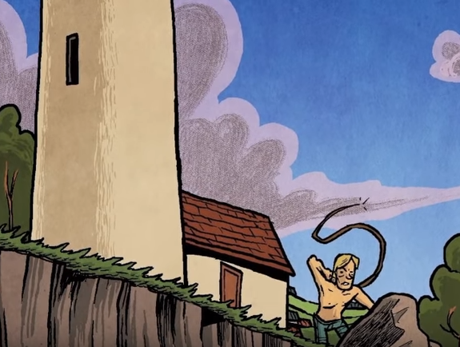
Chapter 18 []
Why does John go to the lighthouse?
What is the fate of each of the main characters?
How does John purify himself at the lighthouse? Why does he do so?
How does media doom John?
How does Lenina act when she sees John at the lighthouse?
What happens to John when the crowd begins to imitate his behavior?
How does the crowd respond? What happens that evening? What becomes of Lenina?
What is the significance of the ending of the novel? What message does Huxley give us about the world through this resolution?

