Slide 1
The New Yorker: “After Empire” by Ruth Franklin
Thinking about the history of slavery, racism, and (as you know it) African history in general; why is Chinua Achebe so concerned with his African identity as a writer and critical of those who he sees as too westernized?
What mistakes did early reviews of Achebe’s Things Fall Apart make? How does this article both complement and criticize Achebe?
How does this article show that language and Igbo Tradition is important to Things Fall Apart?
What was Achebe’s purpose for writing Things Fall Apart? Why does Achebe show both good and bad sides of the Igbo people?
What does the paragraph about Heart of Darkness reveal about the real world of literary analysis, literary critique, or judging literature from the past?

Slide 2
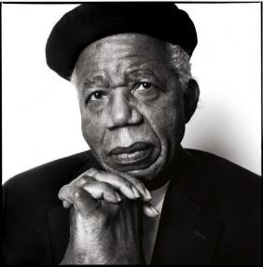
Chinua Achebe
Born 1930 in Nigeria; died March 21st, 2013
Writes about the breakdown of traditional African Culture in the face of European Colonization in the 1800s. Does not necessarily view colonialism as completely evil.
Achebe is trying not only to inform the outside world about Igbo cultural traditions, but to remind his own people of their past and to assert that it contained much of value.
Also sought to educate his fellow Nigerians about their culture and traditions.
Wants audience to appreciate complex African society, rather than viewing it as “savage” or “bizarre.”
He wants readers to see cultural similarities and appreciate the Igbo.
Achebe HATES the stereotype of Africa as undifferentiated “primitive” and the willingness for people to accept European judgments about African history and culture.
Chinua Achebe has been described as a “social novelist” in that he believes literature can create social change.

Slide 3
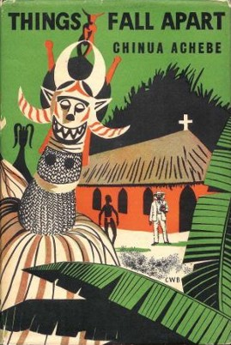
Okonkwo is a member of the Igbo people.
Traditionally, the Igbo lived in villages based on lineage; the male heads of household were all related through their fathers. A prosperous man would have two or three wives, each living in her own hut within the family compound.
Because of their proximity to West African ports, many Igbos were captured and enslaved by European and African slave traders. In 1807, the British Parliament outlawed the slave trade, and many British merchants began trading in palm oil and other goods.
The British missionary and military presence increased, with the aims of converting Africans to Christianity, enforcing the ban on slave trading, and protecting British economic interests. Things Fall Apart takes place during this early period of British colonization.

Slide 4
Early Western Views of Africans: the creation of ‘blackness’ and ‘the other’
By the sixth century B. C. economic and military contact between Africa and Greece was fairly common and several Greeks, most famously Herodotus, prepared "traveler's reports" that included discussion of Africa. Herodotus's reports, which intermingled experience and myth, reported the presence of "dog-eared men" and headless men with eyes in their chests (Miller 1985).
Primarily Greeks did not view Africans through a racial lens of skin-color.
While other Greek authors did not even give Africans human form, Herodotus described a broad range of human beings in Africa running from the noble to the beastly, influencing much of what followed in the Ancients' construction of the African other. For instance, Diodorus also described different types of Africans ranging from the relatively civilized Egyptians to Africans who were savages wearing no clothing, sharing wives, and sporting long nails like the claws of beasts (Snowden, 1970; Miller, 1985).

Slide 5
Early Western Views of Africans: the creation of ‘blackness’ and ‘the other’
Before and after Colonialism in the 1500s, European analysis of Africans in writing promoted ‘savagery,’ hyperbolized black skin, low intelligence, and a division of all Africans into two categories: human and inhuman.
The process always has been defined and driven by the interests and needs of Europe, with little attention given to the point of view of the Africans or reality.
Jordan (1974) notes that it was only around the 1680s, after contact with peoples of color, that Europeans begin to identify themselves as "white." Others have seen that it is by defining the African other as a "black body" that the European identified itself as a "white soul.“
Because the social construction of the African “other” emphasized fabricated difference symbolized by the African's black skin color most Europeans were able to avoid too serious a contemplation of the complexity of real differences within human being.

Slide 6
Early Western Views of Africans
In large part, it is this discourse - along with its many normative trappings portraying Africans as sinful heathens or undeveloped primitives with a lesser intelligence - that frames even representations of Africa today.
As many have previously noted, blackness and primitive savagery came together in the European mind as opposed to Whiteness and civilization.
Kovel (1970) argues brilliantly that the negative connotations of the color black are part of the infrastructure of the European psyche. Using Freudian theory, he shows that Europeans think of death and dirt as being dark, black. Kovel suggests that the African's black skin became a "secondary symbol" symbolizing the repressed negative experiences - grounded in the blackness of death and "dirt" (feces) - of white Europeans.
He proposes very persuasively that the negative meanings of blackness shared by most Europeans derived from unconscious fears of their own deaths. Death was fantasized and feared as the dark unknowns at the boundary of European life and whiteness came to symbolize Christian Europe's virtuous and disciplined superego. Thus blackness became the color of death and sin while whiteness represented life and virtue.

Slide 7
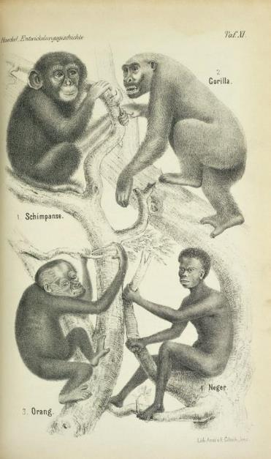
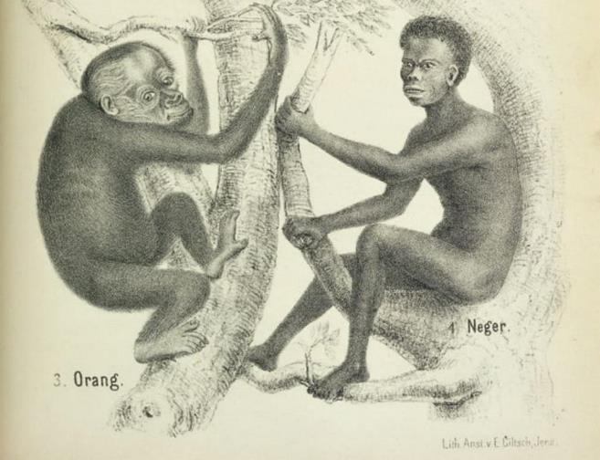
Comment on the scientific and artistic flaws in this image and speculate as to why the artist made the choices they did.

Slide 8
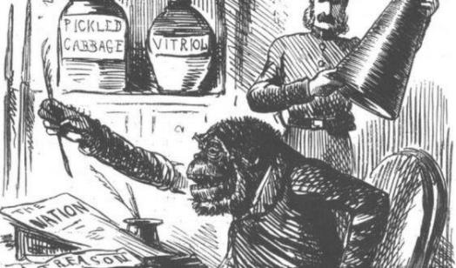
This use of “race” or “otherness” as a political tool to dehumanize and exploit people is the norm throughout history.
Muslims in medieval Europe were transformed from military enemies into non-humans. The renowned theologian, Bernard of Clairvaux, who co-wrote the Rule for the Order of the Templars, announced that the killing of a Muslim wasn’t actually homicide, but malicide—the extermination of incarnated evil, not the killing of a person. Muslims, Islam, and the Prophet were vilified in numerous creative ways, and the extraterritorial incursions we call the Crusades coalesced into an indispensable template for Europe’s later colonial empires of the modern eras.
Literature justifying England’s colonization of Ireland in the twelfth century depicted the Irish as a quasi-human, savage, infantile, and bestial race—a racializing strategy in England’s colonial domination of Ireland that echoes from the medieval through the early modern period centuries later.

Slide 9
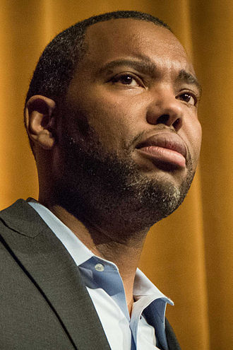
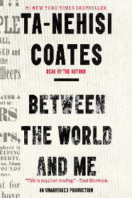
Genius Grant Winner Ta-Nehisi Coates:
Between the World and Me
Written as a letter to the author's teenage son about the feelings, symbolism, and realities associated with being Black in the United States. Coates explains to his son the "racist violence that has been woven into American culture."
Coates draws from an abridged, autobiographical account of his youth in Baltimore, detailing the ways in which institutions like the school, the police, and even "the streets" discipline, endanger, and threaten to disembody Black men and women. The work takes structural and thematic inspiration from James Baldwin.
Unlike Baldwin, Coates sees white supremacy as an indestructible force, one that Black Americans will never evade or erase, but will always struggle against.
NYT Best Seller
Pulitzer Prize Finalist
NAACP Book of the Year

Slide 10
Considering that, comment in writing on the following quote from Genius Grant Winner Ta-Nehisi Coates:
“But race is the child of racism, not the father. And the process of naming ‘the people’ has never been a matter of genealogy and physiognomy (“person's facial features or expression, especially when regarded as indicative of character or ethnic origin”) so much as one of hierarchy. Difference in hue and hair is old. But the belief in the preeminence of hue and hair, the notion that these factors can correctly organize a society and that they signify deeper attributes, which are indelible—­this is the new idea at the heart of this new people who have been brought up hopelessly, tragically, deceitfully, to believe that they are white. These new people are, like us, a modern invention. But unlike us, their new name has no real meaning divorced from the machinery of criminal power.”

Slide 11
Considering that, comment in writing on the following quote from Genius Grant Winner Ta-Nehisi Coates:
“But all our phrasing—race relations, racial chasm, racial justice, racial profiling, white privilege, even white supremacy—serves to obscure that racism is a visceral experience, that it dislodges brains, blocks airways, rips muscle, extracts organs, cracks bones, breaks teeth. You must never look away from this. You must always remember that the sociology, the history, the economics, the graphs, the charts, the regressions all land, with great violence, upon the body.”

Slide 12
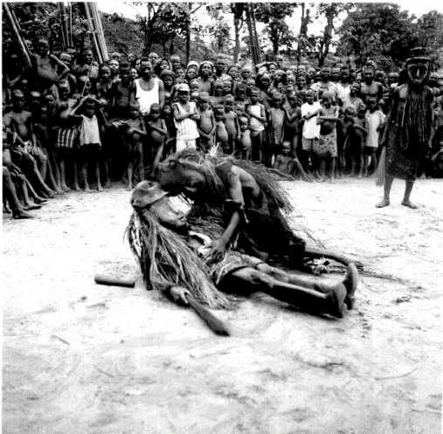
Things Fall Apart chapter 1 (13 minutes)
As you listen, create:
Character list
Record relevant characterization details about each character
Proverb list
Record any proverbs that you find.
What accomplishments have helped to make Okonkwo a great man of the village?
Compare and contrast Okonkwo with his father, Unoka.
Why does Okonkwo hate his father?

Slide 13
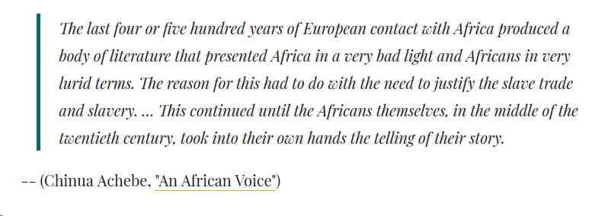

Slide 14
Characters in Things Fall Apart chapters 1-3
What do we know about the following list of characters?
Identify the most important characterization quotes for the following; two quotes from each chapter for Okonkwo and three total for the rest.
Okonkwo
Unoka
The Oracle of the Hills and Caves (chapter 2 + 3)
What does “Agbala” mean in Igbo?
The Priestess?
Ikemefuna

Slide 15
Okonkwo
“His wives, especially the youngest, lived in perpetual fear of his fiery temper, and so did his little children. Perhaps down in his heart Okonkwo was not a cruel man. But his whole life was dominated by fear, the fear of failure and of weakness. It was deeper and more intimate than the fear of evil and capricious gods and of magic, the fear of the forest, and of the forces of nature, malevolent, red in tooth and claw. Okonkwo's fear was greater than these. It was not external but lay deep within himself. It was the fear of himself, lest he should be found to resemble his father.” (13).
“And so Okonkwo was ruled by one passion - to hate everything that his father Unoka had loved. One of those things was gentleness and another was idleness.” (13).
Analyze the nuance and complexity of Okonkwo’s personality. What is the effect of Achebe’s character development?
What is the relationship between stereotypical masculinity and violence? Why?

Slide 16
Ikemefuna
“And that was how he came to look after the doomed lad who was sacrificed to the village of Umuofia by their neighbours to avoid war and bloodshed. The ill fated lad was called Ikemefuna.” (8).
“The lad's name was Ikemefuna, whose sad story is still told in Umuofia unto this day.” (12).
“And so for three years Ikemefuna lived in Okonkwo's household.” (12).
“The elders of the clan had decided that Ikemefuna should be in Okonkwo's care for a while. But no one thought It would be as long as three years. They seemed to forget all about him as soon as they had taken the decision.” (12).
What effect is Achebe creating with Ikemefuna? Why?

Slide 17
Things Fall Apart Chapter 4
How and why did Okonkwo break the “Week of Peace”? How does the tribe handle this faux pas?
Analyze diction: “Okonkwo was provoked to justifiable anger by his youngest wife” (29).
Juxtapose Okonkwo’s relationship with Nwoye and with Ikemefuna.
What is the two boy’s relationship like?
How is Achebe developing Ikemefuna as a character?
Identify ways Igbo society is patriarchal from chapters 1-4.

Slide 18
Group Activity: Explore Okonkwo’s Personality
Fill in the chart below with 4+ details for each side to explore the conflicting sides of Okonkwo’s character from an Igbo perspective.
Okonkwo’s Achievements and Status | Okonkwo’s Negative Personality Traits and Actions
1) 2) 3) 4) | 1) 2) 3) 4)

Slide 19
Read Chapter 5 (36-45)
Try and draw Okonkwo’s family tree.
Who is Okonkwo’s favorite child?
How do the names of the women in Okonkwo’s family demonstrate Igbo Patriarchy?
What thing is Okonkwo really bad at? How does Ekwefi anger Okonkwo?
Predict: What could Achebe be Foreshadowing with Okonkwo’s gun in Chapter 5?

Slide 20
Chapter 5:
How do the names of the women in Okonkwo’s family demonstrate Igbo Patriarchy?

Slide 21
Really Important: Chapter 6
Who is Chielo? What is so interesting about her? How is her role ironic? Who is her friend? Why might this matter? How is Chielo different from her role as priestess of Agbala?
What is “coming to stay” euphemism for?
What is the attitude of Umuofians toward slavery? (46).
Describe the wrestling match. What happens? What does it tell us about Umofians?

Slide 22
Chapter 7: as we read, look for juxtaposition.
What type of oral tradition is the story of the Earth, Sky, and Vulture. What’s the purpose?
Why didn’t Okonkwo heed (listen to) Ogbuefi Ezeudu’s warning not to kill Ikemefuna?
What is the symbolism/significance of the ‘wisest man in the village’ giving Okonkwo advice he doesn’t follow?
What do you think the ramifications (consequences and effects) be for Okonkwo?
Do you think Okonkwo was set up to kill Ikemefuna? By who?
How did Ikemefuna’s death make Nwoye feel? How will Okonkwo feel?

Slide 23
Chapter 9 Discussion
What does Okonkwo’s recovery from sadness over Ikemefuna’s death tell us about him? (Achebe 75).
What does Okonkwo’s mother’s mosquito story explain? What kind of oral tradition is it? (Achebe 75).
What happens to Ezinma? What do we learn about her mother Ekwefi?
What is an obanje? What do Igbo people do about them? Explain in detail.
What do they do for Ezinma? What side of Okonkwo do we see?

Slide 24
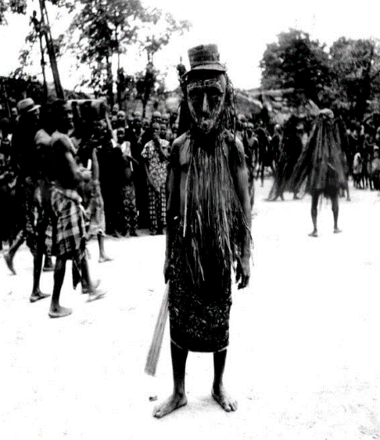
Things Fall Apart chapter 10 (87-94)
What are the Egwugwu like?
What is the name of their leader?
Why does Evil Forest address Uzowulu saying, “Uzowulu’s body, I salute you”? (90).
How do the Igbo people suspend disbelief when the Egwugwu are present?
What things do we learn about Igbo culture from this chapter?
Laws? How does Igbo patriarchy get more complicated as result of the case?
Why will Uzowulu listen to the decision of the Egwugwu?

Slide 25
Things Fall Apart chapter 10 (87-94)
What is ironic about Okonkwo being one of the Egwugwu?
Do we have Egwugwu in America? Similarities? Differences?

Slide 26
Things Fall Apart Chapter 11
Summarize the story in chapter 11 about the tortoise and the birds. Based on what you know about oral tradition, is this a myth or a folktale?
What is the story’s message or moral?
What does it tell us about the beliefs of Umuofians?
What is Ekwefi’s purpose in telling the story?
What do you think Achebe is foreshadowing by using this story in TFA?
What happens to Ezinma? Why?
Okonkwo did what he felt he needed to do, so that he would seem manly and strong the night Ezinma was taken to the shrine. How did Okonkwo really feel?
Use 2 quotes to support your answer.

Slide 27
Things Fall Apart Chapter 12
Okonkwo did what he felt he needed to do, so that he would seem manly and strong the night Ezinma was taken to the shrine. How did Okonkwo really feel? Use 2 quotes to support your answer.
What are Igbo weddings like?
How are they like Western Weddings?
What other ways has Achebe shown us that the Igbo are “like us”?
What is the uri?
What are the 2 similes on page 112?

Slide 28
Things Fall Apart Chapter 13 (120)
What new purpose of the Egwugwu do we see?
How does Igbo culture spread the word when someone dies?
Do the Igbo people throw somber, sad funerals like we do? What are Igbo funerals like?
How does Achebe foreshadow Okonkwo’s killing of the boy?
What does it say about Igbo culture that they have two classifications for murder, male and female? What do they mean? Do we have a similar system in America?
Is Obierika right or wrong? Do you think Okonkwo’s punishment is fair?

Slide 29
Things Fall Apart Chapter 13 (120)
What is the purpose for Obierika’s (chapter 13) and Nwoye’s (chapter 7) critique of Igbo culture?
Why do both these passages contain twins?
What is the significance of the Igbo proverb “if one finger brought oil, it soiled the others”? (125).
Make a prediction, assuming the Igbo proverb is foreshadowing either Nwoye’s or Obierika’s actions in relation to their tribe and the European missionaries.

Slide 30
Things Fall Apart Part 2, chapter 14
What is the mood of Okonkwo’s new life in Mbanta? (131).
What does Okonkwo think about his chi? Does he understand the Igbo principal of chi well? Has Okonkwo really said ‘yea’?
This chapter references Okonkwo's deceased mother. What do readers know about her and about her relationship with her son?
Why do Igbo people say “Mother is Supreme”?
How does this complicate Igbo patriarchy?
What does Okonkwo’s failure to answer some of Uchendu’s questions reveal or reinforce?

Slide 31
Okonkwo’s understanding of himself
Reread pages 66-68.
Analyze:
Does Okonkwo understand his culture well? Other examples? What will his fate (chi) be?

Slide 32
Uchendu’s speech to Okonkwo
What is the purpose of Uchendu’s speech to Okonkwo? What tone does he use? What rhetorical appeals?
Do you think that Unchendu’s words will motivate Okonkwo to act better?

