Slide 1
Rhetoric, Language, Propaganda,
https://www.enotes.com/homework-help/need-examples-denotation-connotation-all-words-128667
http://www.csun.edu/~bashforth/098_PDF/06Sep15Connotation_Denotation.pdf

Slide 2
Next Week: Journal 1-3 culminating points quiz definitions, themes, identify figurative language
Look at your seminar score on Skyward and compare it to your placement on the graph of your group’s “Raw Scores.”
DUE: MLA assignment you did with Bacon in the library

Slide 3
Journal #4: Connotation/Denotation
Learning Targets:
Students will be able to explain denotation and connotation.
Students will be able to analyze word choice and the effect created by word choice.

Slide 4
Meaning of Words…
With your table group rank each of the following lists of words from most positive to most negative:
List 1: Thin, slim, lanky, skinny, gaunt, slender
List 2: Aggressive, assertive, domineering, dynamic, pushy, forceful
List 3: Shrewd, egghead, bright, clever, brilliant, cunning, smart, intelligent, brainy
Turn sheet into Smith when you’re done!

Slide 5
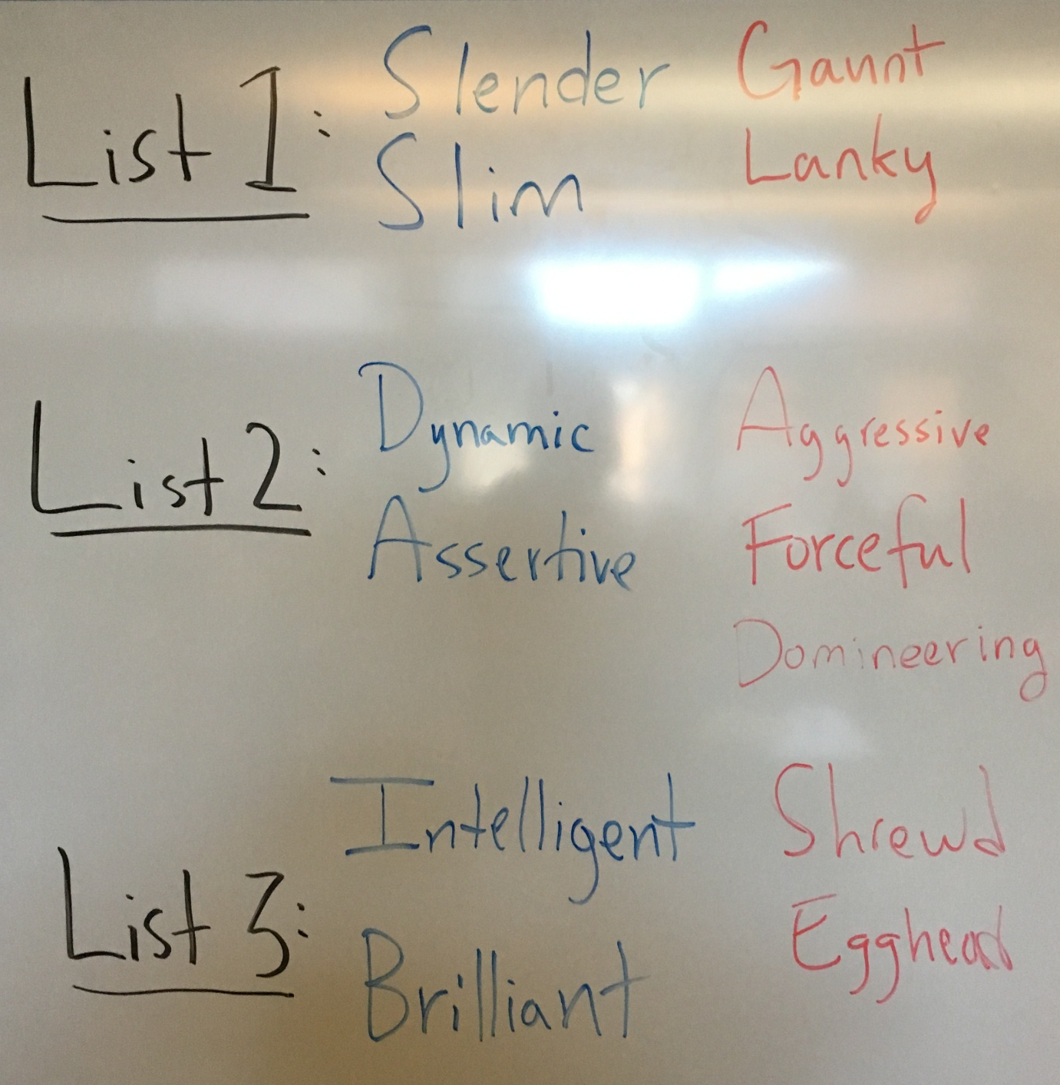
What your kids will come up with:

Slide 6
Thinking Questions:
Was ranking the words easy or hard? Did your table group agree quickly on the most positive words easily in each list?
What is the difference in the meanings of the most positive and most negative words?
What does it mean that our lists where generally the same (or very similar) all over the room??
Why do you think this is?

Slide 7
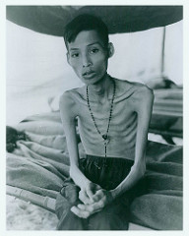
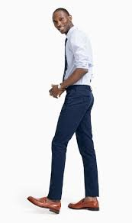
Don’t believe me? Lets look at Google Images for List 1
Thin, slim, lanky, skinny, gaunt, slender

Slide 8
Word Choice: Basic Terms
Diction: word choice that a writer or speaker uses, (don’t write about this)
Denotation: the literal (explicit) meaning of a word
Connotation: the implicit ideas and emotions we associate with a word or phrase. These meanings are socially constructed. Connotative meanings are dynamic over time.
“Implicit”: implied, rather than clearly stated

Slide 9
Example…
Negative: There are over 12,000 vagrants or bums in the city.
Without connotation?: There are over 12,000 people with no fixed-address in the city.
“Positive”: There are over 12,000 homeless in the city.
Denotations are very similar.
Connotations are very different.
A bum is someone who is a public problem and underserving of help. A homeless person is someone who deserves our empathy and help.

Slide 10
Dynamic Connotative Meanings: “Dope”
1851: ‘Dope’ means a fool
1886: ‘Dope Fiend’ means a (foolish) person who is addicted to drugs
1933: ‘Dope’ means narcotics (or hard drugs like heroine) and ‘Dope addict’ becomes official
1981: ‘Dope’ made the leap from a noun to adjective and, more importantly, from negative connotation to positive connotation, coming to mean ‘excellent’ in the lexicon of the emerging hip-hop culture.

Slide 11
With your group come up with a sentence that shows the denotative similarities between “cheap” and “inexpensive” but also the connotative difference in the 2 words. Bonus: come up with a neutral option as well!!

Slide 12
Fill out the worksheet as we watch!
https://www.youtube.com/watch?v=umqvYhb3wf4

Slide 13
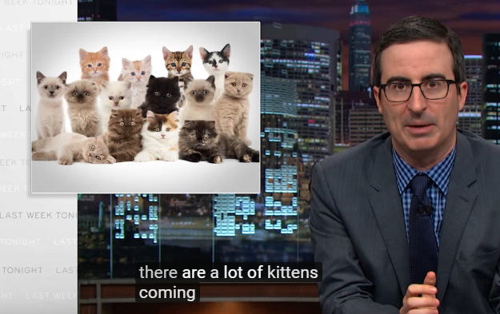
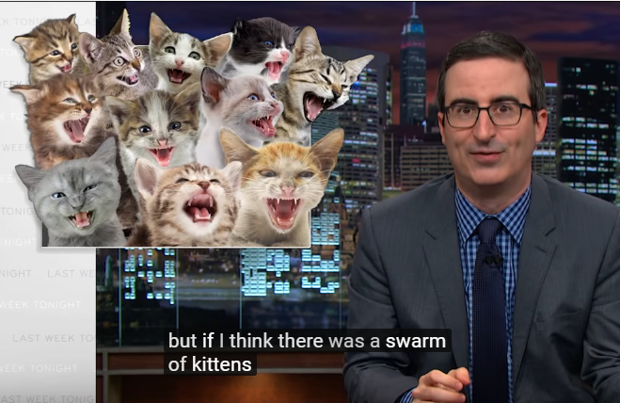
Review yesterday with a friend…

Slide 14
6. Fill in the following chart
Word or Phrase | Denotation | Connotation
Swarm | move somewhere in large numbers
Refugees | A person who has been forced to leave their country in order to escape war, persecution, or natural disaster.
Migrants | A person who moves from their country to another.
Immigrants | a person who comes to live permanently in a foreign country.

Slide 15
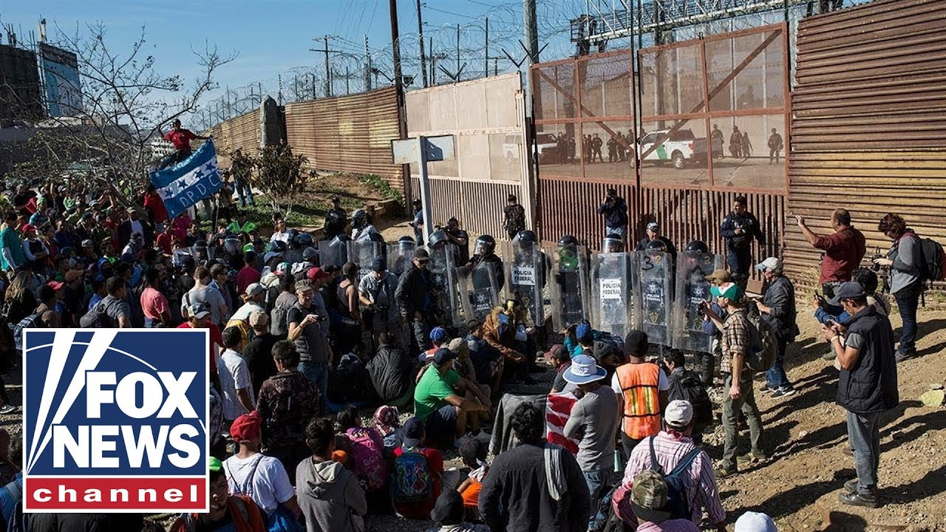
Google Image Results: “Migrant” or “Refugee”? How do you know?

Slide 16
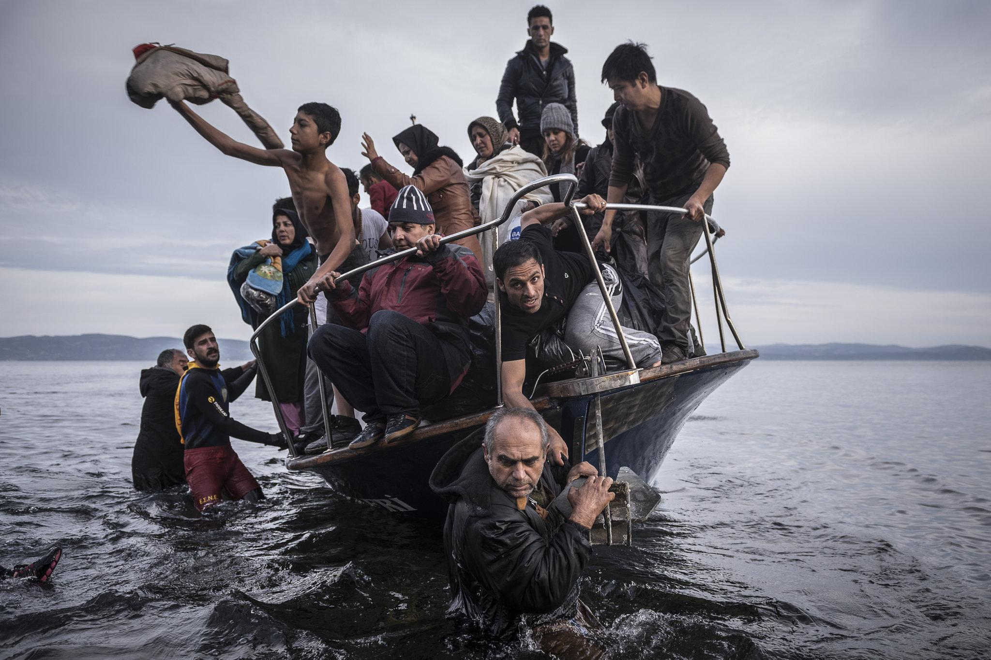
Google Image Results: “Migrant” or “Refugee”? How do you know?

Slide 17
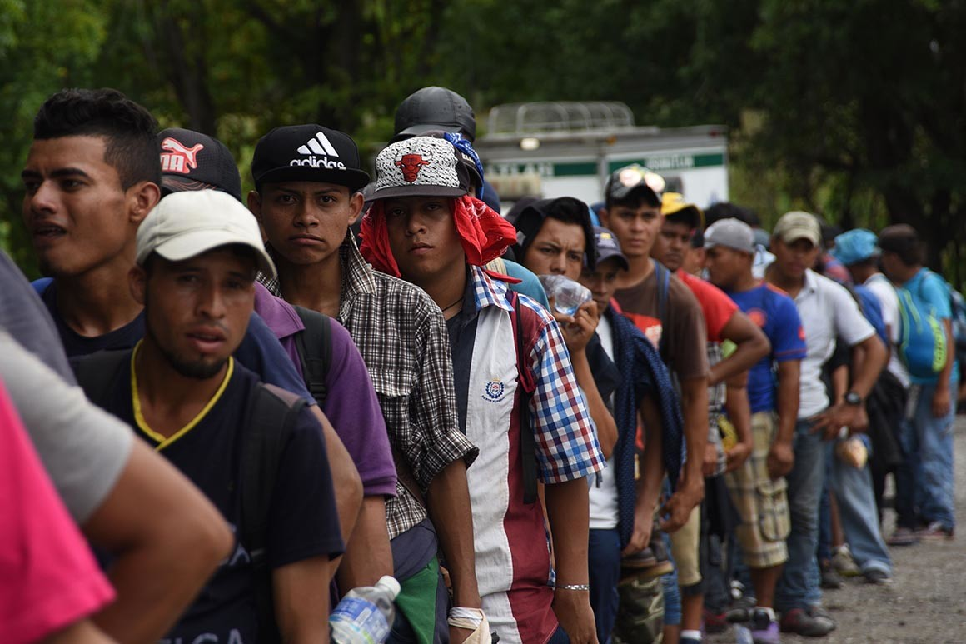
Google Image Results: “Migrant” or “Refugee”? How do you know?

Slide 18
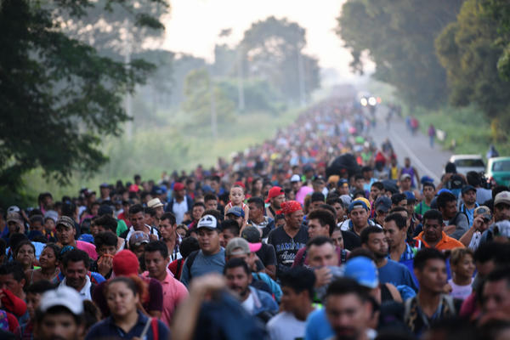
Google Image Results: “Migrant” or “Refugee”? How do you know?

Slide 19
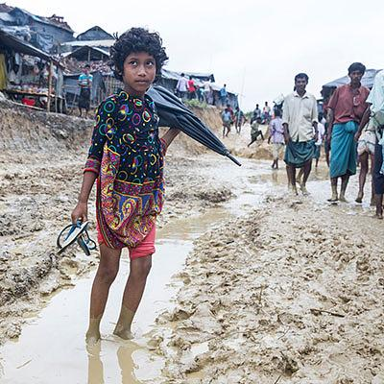
Google Image Results: “Migrant” or “Refugee”? How do you know?

Slide 20
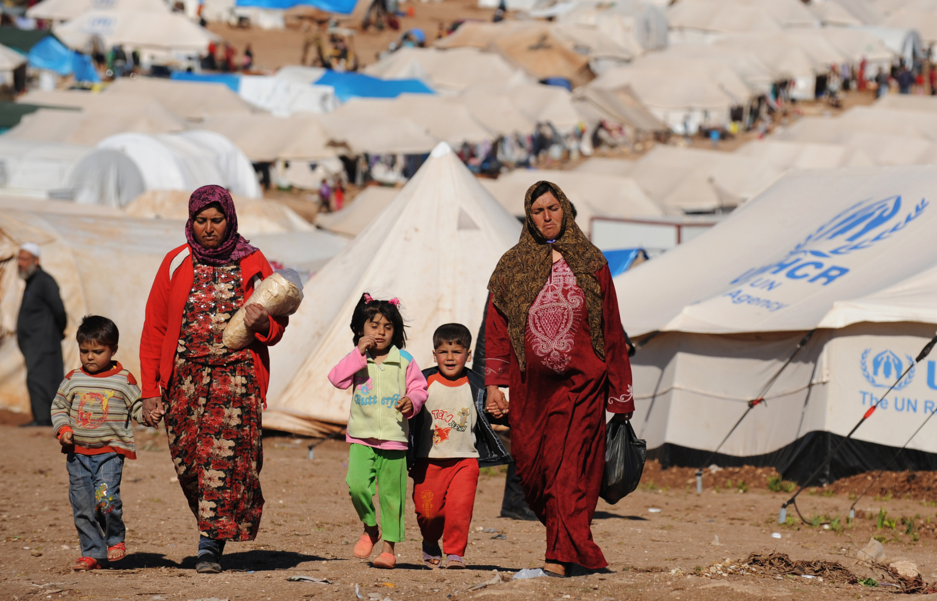
Google Image Results: “Migrant” or “Refugee”? How do you know?

Slide 21
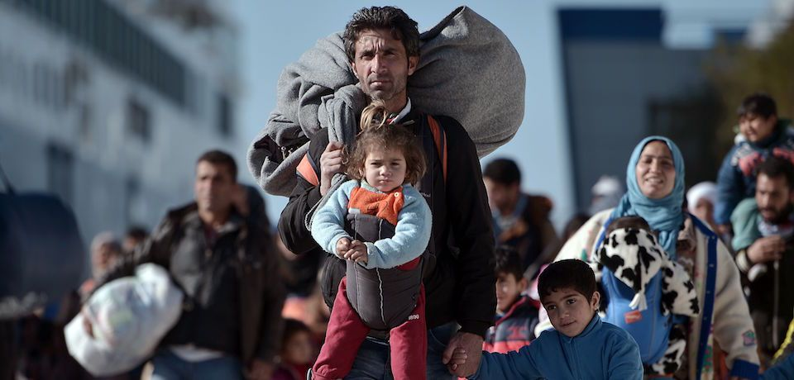
Google Image Results: “Migrant” or “Refugee”? How do you know?

Slide 22
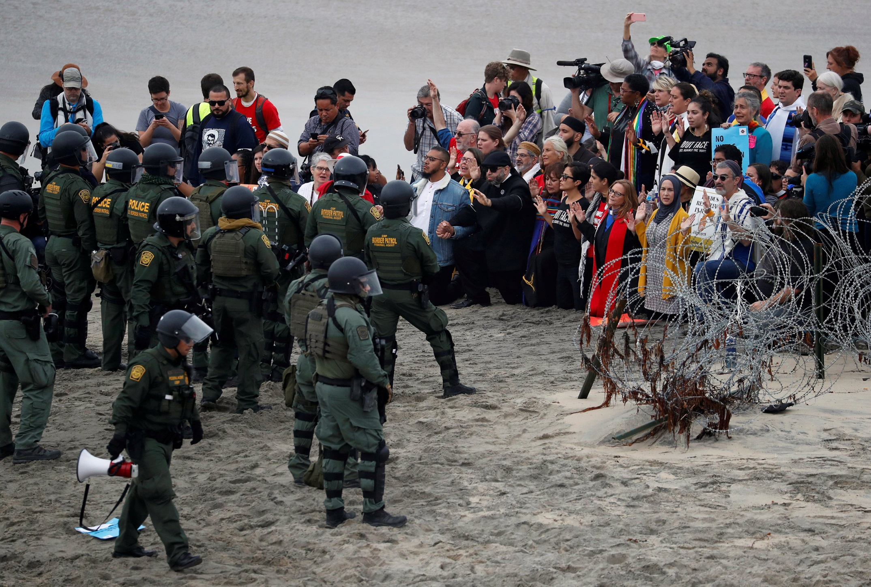
Google Image Results: “Migrant” or “Refugee”? How do you know?

Slide 23
Google Image Results: “Migrant” or “Refugee”? How do you know?
Based on the pictures, what is the difference in meaning American’s (and Google’s algorithm) between “migrant” and “refugee”?
If you were a website editor, what criteria would you use to decide if a photo was of “migrants” or “refugees”?
Create a list for each term to send to your photographers.
Does this matter? Why?
Should speakers choose carefully when using words like “migrants” vs. “refugees”?

Slide 24
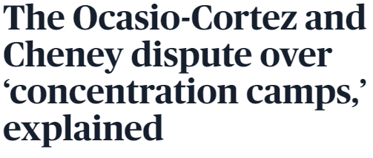
2019’s Debate: Is America running Concentration Camps?
Should we call immigrant detention centers “concentration camps” if they exist inside of America? This is the debate currently raging across the internet, which, in its purest incarnation, pits Rep. Alexandria Ocasio-Cortez against Rep. Liz Cheney. Their original exchange, in which Ocasio-Cortez cited a prominent Holocaust scholar and Cheney accused her of not knowing the basic details of the Holocaust.

Slide 25
2019’s Debate: Is America running Concentration Camps?

Slide 26
2019’s Debate: Is America running Concentration Camps?
Do you remember this debate?
What is the argument really about?
Why were people so angry?

Slide 27
Is America running Concentration Camps?
The choice between these two positions is at the root of the argument between Ocasio-Cortez and the critics of her concentration-camp comment.
It is not an argument just about language. Both sides of the debate agree the term “concentration camp” refers to something so horrible as to be unimaginable. (For this reason, mounting a defense of Ocasio-Cortez’s position by explaining that not all concentration camps were death camps misses the point.) That is to say, “concentration camp” has a horrible connotation.
More than just the connotation of the term “concentration camp,” or the facts, the argument is really about how we perceive history, ourselves, and ourselves in history. This debate became such a big deal because it fundamentally asked if Americans can see themselves as monstrous or if that is so unimaginable it cannot be possible. Thus, for many, the facts of the arguments and the particulars of debate were lost in the emotional response to the meaning of “concentration camp.”

Slide 28
How can we use knowledge of connotation to be better speakers and writers?

