Slide 1
Coronavirus Fake News
Poltifact.com’s Coronavirus Fact Checks:
76% Mostly False or WorseL

Slide 2
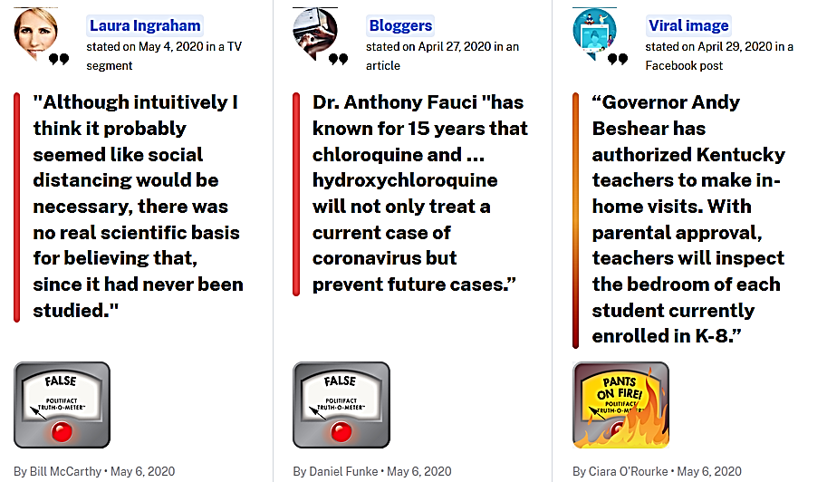
Coronavirus Fake News
Poltifact.com’s Coronavirus Fact Checks:

Slide 3
Coronavirus Fake News

Slide 4
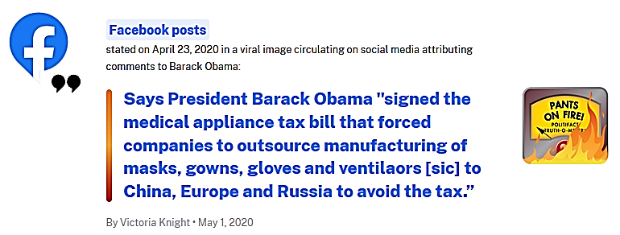
Coronavirus Fake News
The Russian dissident and chess grandmaster Garry Kasparov drew upon long familiarity with that process when he tweeted: “The point of modern propaganda isn’t only to misinform or push an agenda. It is to exhaust your critical thinking, to annihilate truth.”

Slide 5
Manufacturing Dissent + Cognitive Bias + Ideological Supremacy + Dunning Kreuger
Manufacturing Dissent: finding or creating and promoting voices telling going against the factual consensus; no matter how obscure, illegitimate, or untrustworthy.
Other examples: Climate Denialism or this clip from Thank You for Smoking.
Ideological Supremacy: Believing one’s ideas are SO IMPORTANT AND CORRECT AND TRUE, that one is willing to use FALSE OR MISLEADING EVIDENCE to support these ideas where NO GOOD EVIDENCE EXISTS. Leads to the creation of a lot of fake news.
Cognitive Bias: Treating information which goes against one’s own ideas/beliefs/ information with EXTREME DOUBT, SUSPICION, OR CONTEMPT; while meeting information one supports or believes with NONE of the same skepticism. Being really closeminded.
Internet echo-chamber amplifies this problem.
Occurs as a result of holding onto preferences and beliefs REGARDLESS OF CONTRARY INFO.
Dunning–Kruger effect: is a cognitive bias in which people with LOW KNOWLEDGE ABOUT A TASK OVERESTIMATE THEIR KNOWLEDGE AND ABILITY. It results in extreme confidence and stubbornness for a speaker talking about subjects they know very little about; comes from the inability of people to recognize their lack of ability.

Slide 6
Dunning-Kruger
Self-doubt and second-guessing oneself are a sign of intelligence.

Slide 7
Dunning-Kruger

Slide 8
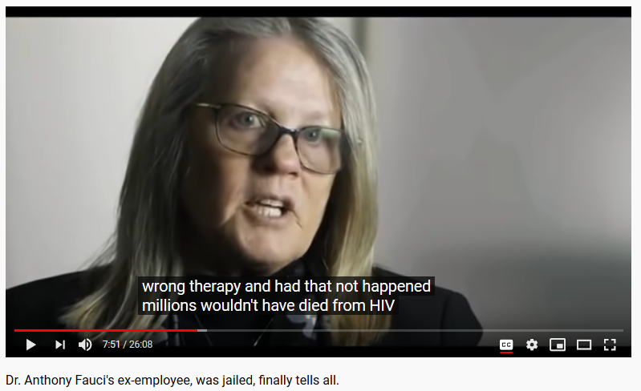
Manufacturing Dissent: Coronavirus
Only ‘tested’ a handful of people in one county, used a mediocre test, only tested people showing symptoms, mathematically multiple their results times the entire population w/o proper statistical mathematics. These men are not virus experts.
1,123,923 views posted May 4, 2020
Just complete garbage, also posted under several other titles daily.
She has never worked on vaccines, she’s never been to jail. However, she is a liar and cheater who has stolen from bosses and faked scientific data numerous times. Since 2011 she has numerously tried to link her story to whatever disease is in the public’s eye.

Slide 9
In Particular
Plandemic:
“Plandemic” was lambasted as the latest manifestation of a toxic internet fever swamp that breeds irrational fantasies and rampant pseudoscience. (LA Times).
Two Paradoxical Claims:
Covid19 isn’t very deadly.
Covid19 was planned by Bill Gates, the US, China, and others (?) to kill millions of people and generate profit.
Forbes:
https://www.forbes.com/sites/tarahaelle/2020/05/08/why-its-important-to-push-back-on-plandemic-and-how-to-do-it/#369b47c75fa3
LA Times:
https://www.latimes.com/entertainment-arts/movies/story/2020-05-13/plandemic-coronavirus-documentary-director-mikki-willis-mikovits

Slide 10
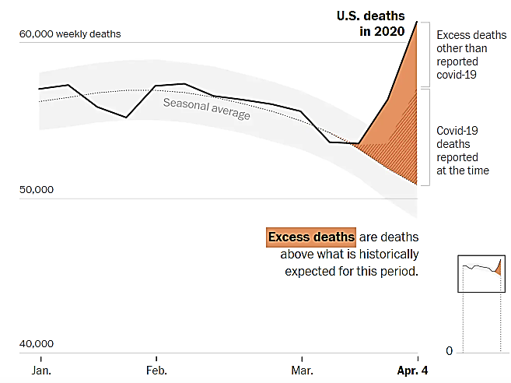
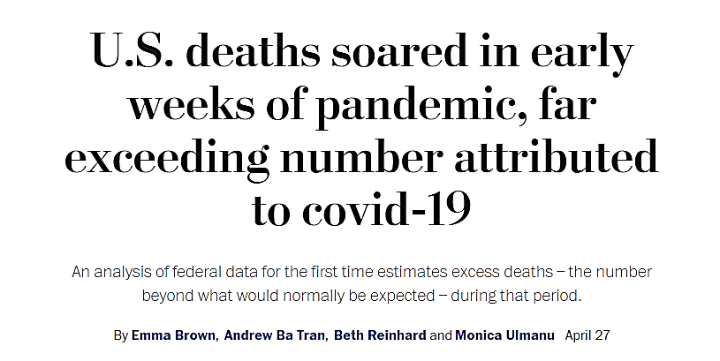
Common Misleading Crap
‘Why have people completely stopped dying from Heart Attacks, Strokes, Cancer, etc.??’
These numbers were never “news” before, they aren’t news now. The implication here is deaths are being misclassified or lied about.
In fact, deaths are likely lower reality
Notes:
https://www.washingtonpost.com/investigations/2020/04/27/covid-19-death-toll-undercounted/?arc404=true

Slide 11
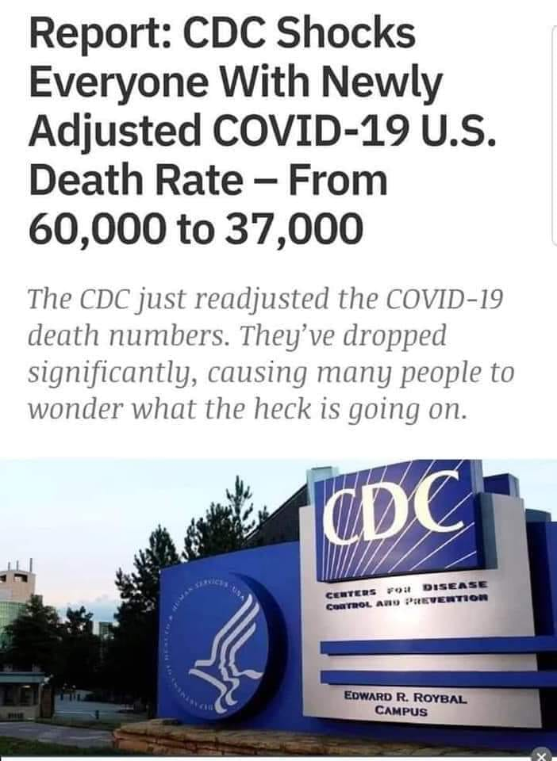
Common Misleading Crap
Easily VERIFIABLE AS FALSE according to everyone, including the CDC.
https://www.snopes.com/fact-check/cdc-death-figures/?fbclid=IwAR30fM-YWtI6FOmXBbrUhGduLoy8rUjjtMr5lHlQpELbsvGoDaGs0ygw13U
However, this claim was NOT TRUE, yet was the result of comparing two separate data sources that report different measurements. The link included points to the CDC’s Provisional Death Counts for Coronavirus Disease (COVID-19) page, which provides provisional death totals by week and state. PROVISIONAL DATA LAGS BEHIND WEEKS, DUE TO THE SLOW PROCESS SPEED OF OFFICIAL DEATH CERTIFICATES.

Slide 12
Common Misleading Crap
‘What about the deaths from starvation, poverty, suicide, homelessness, etc.?!? We’ve got to restart the economy or MORE people will die!!!!!’
Possible, but literally unknowable at the moment. These comments aren’t rooted in any data.
Propaganda Technique: “Whataboutism”
Deflecting difficult subjects or questions by purposefully changing the subject.
Whataboutism refers to the practice of deflecting by pointing to the misdeeds of others or other details. Oxford Dictionaries defines it as “the technique or practice of responding to an accusation or difficult question by making a counter-accusation or raising a different issue.”
Essentially, it’s an appeal to hypocrisy ― a logical fallacy also known as “tu quoque.” Instead of proving that your opponent’s claim is wrong on its face, whataboutism argues that it’s unfair of the opponent to make that claim at all.

Slide 13
Common Misleading Crap
‘First THEY SAID THIS, then THEY SAID THIS, and NOW THEY ARE SAYING THIS! HOW CAN YOU TRUST THAT?!?!?!?!’
Currently this is occurring about:
Wearing face masks?
Social distancing?
How many people have already had the virus?
How similar to the flu is coronavirus?
These posts take advantage of the scientific process (question → hypothesis → test→ theory) to try and delegitimize ALL answers and research.
Good science and analysis evolves over time and is willing to self-correct. Internet B.S. is not.
This means some of what is currently being spread by misinformation (esp. ‘way more people have been infected by Covid19 and are healthy and fine, the death rate is so low’) could be true. However, that doesn’t mean it is correct or wasn’t B.S. when random YouTube videos were saying it without evidence.

Slide 14
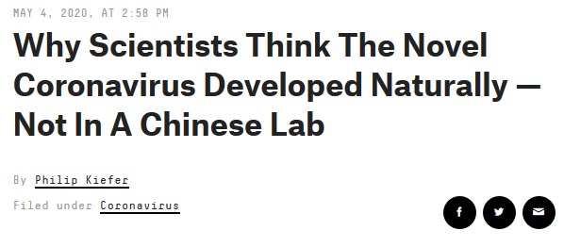
Common Misleading Crap
‘BILL GATES IS TO BLAME!! SECRET WUHAN LABS!! ANTHONY FACCI!! VACCINES KILL MILLIONS!! W.H.O.!!! ’
Anti-Vaxxers get into the game and combine with other random hatred.
Both political parties are going to blame China because of HOW WELL IT CURRENTLY IS POLLING, not because it is ‘TRUE.’
According to a growing body of research, SARS-CoV-2 (the virus that causes COVID-19) is almost certainly a naturally occurring virus that initially circulated in bats then spilled into humans. But that hasn’t stopped some from trying to find a more sinister origin. “It seems like such an extreme event that people are looking for an extraordinary explanation for it,” said Stephen Goldstein, a postdoctoral researcher at the University of Utah who studies coronaviruses. No single piece of evidence has yet confirmed the virus’ origin. But according to scientists, the evidence that does exist paints a consistent picture of a wild virus, not one that sprang from a lab.

Slide 15
Anti-Vaxxers
The anti-vaccine community are much more organized and strategic than many of their critics believe. They are savvy media manipulators, effective communicators and experienced at exploiting the weaknesses of social media platforms.
Example: Shortly after Facebook and YouTube began taking down copies of “Plandemic” for violating their rules, people in anti-vaccine groups editing it in subtle ways to evade the platforms’ automated enforcement software.
The anti-vaxxers have been practicing for this. They will be unusually effective in sowing doubts about a Covid-19 vaccine for several reasons.
A Covid19 vaccine will appear very quickly without years of testing.
Predetermined boogeymen (Gates and the W.H.O.) will be likely involved in the vaccine.
Some airlines, schools, etc. will require the vaccine.
The vast majority of Anti-Vaxxers are willing to fabricate lies to support their stance while completely unwilling to buy into any of the endless support for vaccines.
The researchers found that Facebook pages pushing accurate pro-vaccine information were mostly clustered in an insular group, while the anti-vaccine pages treated vaccine resistance as a kind of political campaign, and used different messages to reach different types of undecided “voters.”
A page promoting holistic health remedies might start seeding doubts about vaccines among liberal yoga moms.
While a page promoting resistance to government-mandated vaccines might appeal to conservatives and libertarians.

Slide 16
Covid19 Misinformation for Political Gains

Slide 18
https://qz.com/1258198/conspiracy-theorists-believe-wild-ideas-because-they-want-to-feel-special/

