Slide 1
Agenda: Today
Today:
Audio Introduction
Actively Learn Article
Join Smith’s class with code ZIPTI
Journal #? Didactic Literature
Optional DJ Khaled story
Later this Week:
Some important writing lessons in a YouTube video

Slide 2
Asian Literature “The usefulness of a pot comes from its emptiness.”
[Far] Eastern Religion and Philosophical Texts
Major Texts:
The Ramayana
The Analects of Confucius
The Tao Te Ching
The Art of War
The Rig Veda Creation Myth
Wild Swans
Major Terms/Learning:
Didactic Literature
Parable
Maxim
Epic Poetry
Wu-Wei
Yin and Yang
Filial Piety
Paradox
Pantheism
Vedic Sanskrit

Slide 3
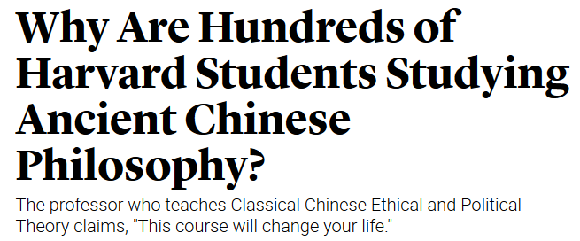
Activity One: Why are Hundreds of Harvard students Studying Ancient Chinese philosophy?
Using the ActivelyLearn.com software read the article from The Atlantic and answer the 5 questions.
https://read.activelylearn.com/#student/reader/1818223/notes

Slide 4
Journal ??: Didactic Literature
Learning Targets:
Students will be able to define and list the types of Didactic Literature.
Students will be able to define maxim, parable, and anecdote as they relate to Didactic Literature.
Students will be able to identify and explain Didactic Literature in Ancient Chinese texts.

Slide 5
Background Knowledge: Think
What does “moral” mean? What is the value in having morals? What does “ethics” mean? What is an ethical dilemma?
Is it worse to have too strict or too loose personal ethics and morals?
Who makes the morals in our society? Do individuals have their own morals?
How would you share an important message about right and wrong with your classmates?

Slide 6
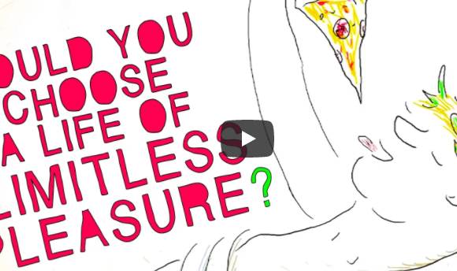
Background Knowledge: Jot down your thoughts:
How do we know what is right/wrong?
Is something right if it causes pleasure?
How do we know if something is good?
Why do we choose to do wrong when we know it is wrong?
How do you approach difficult moral decisions?]
Watch this: https://ed.ted.com/lessons/would-you-opt-for-a-life-with-no-pain-hayley-levitt-and-bethany-rickwald#watch
Notes:
https://ed.ted.com/lessons/would-you-opt-for-a-life-with-no-pain-hayley-levitt-and-bethany-rickwald#watch

Slide 7
Morals and Ethics
Morals: a person's standards of behavior or beliefs concerning what is and is not acceptable for them to do
Ethics: moral principles that govern a person's behavior or the conducting of an activity.
Who do you share moral or ethical standards with?

Slide 8
Didactic Literature
Didactic Literature: texts meant to teach moral lessons or pass on rules for behavior.
Didactic Literature texts are often created using allegory and theme to create the idea in reader’s minds that they should behave a certain way. Critics say didactic literature can be boring. Didactic literature tries to teach what is right and wrong.
What does this remind you of?
What groups of people might have created didactic literature?
Can you think of any examples of stories that might be didactic in nature?
Why would critics say that didactic literature is boring?
Notes:
#3 the little boy who cried wolf

Slide 9
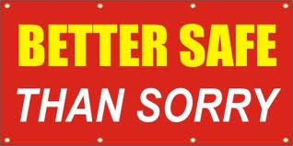
There are 3+ different types of didactic literature!
1. Maxim: a simple and memorable line, quote or rule that a reader supposedly can do or follow for a good life. Can be a lit device.
Example: Better safe than sorry
Come up with another example!

Slide 10
Oral Tradition
Literary Tradition: Didactic Literature
Proverb
Maxim

Slide 11
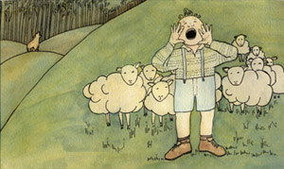
There are 3+ different types of didactic literature!
2. Parable: a succinct story with a moral lesson at the end. Parables are often short and simple stories that use symbolism, theme, and allegory to create the lesson a reader should learn.
Example: The Boy Who Cried Wolf
What term does parable remind you of?
Succinct = short and simple, straight to the point

Slide 12
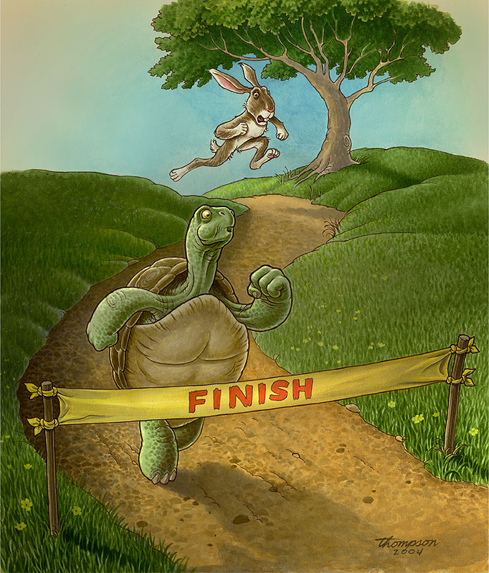

Slide 13
Oral Tradition
Literary Tradition
Myth
Parable

Slide 14
There are 3+ different types of didactic literature!
3. Anecdote: a brief TRUE story that focuses on a single (often funny) interesting event in order to prove a point or to reveal a general truth or rule. Anecdotes are stories about real events or people. When talking about evidence, anecdotes are not great evidence usually…

Slide 16
What important didactic texts do we have in our life today?
Do we still have a place in our lives for didactic literature?

Slide 17
Modern Didactic Lit.
Optional (funny?): Listen to a short NPR story about DJ Khaled’s didactic lit.* (*we would have read the chapter about pillows if we were still in school, but Smith forgot his copy of The Keys at Skyline)
https://www.npr.org/2017/01/06/506305611/dj-khaled-throws-us-the-keys
https://www.npr.org/2017/01/17/510230324/rest-your-greatness-6-key-moments-with-dj-khaled

Slide 18
Strategies for reading Didactic Literature
Is it a maxim, parable, or anecdote?
What is the writer’s message? Is it explicit or implicit?
Look for patterns in language use.
Ask questions, make predications, focus on the main idea, visualize who could use the moral advice.

