Slide 1
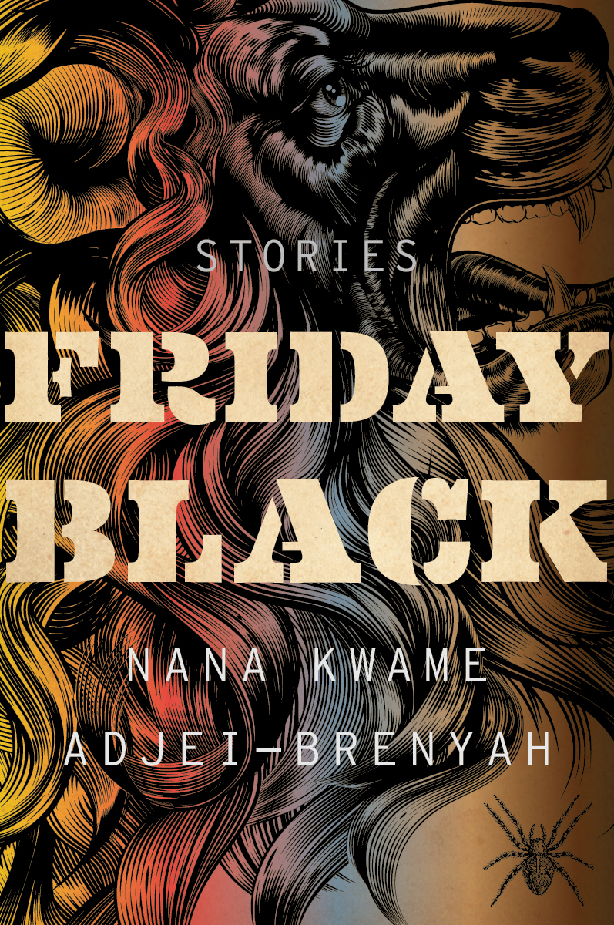
Friday Black by Nana Kwame Adjei-Brenyah
Nana Kwame Adjei-Brenyah worked in a clothing store during the holiday season, which peaks on Black Friday. This experience informs the dystopian short story collection he calls Friday Black.
Adjei-Brenyah's book makes its points by exaggerating race and class divisions, and consumer culture to create dark satire.
Number 11 on the New York Times “Most Notable Books of 2018” list.
“Friday Black,” a short-story collection that veers from absurd humor to extreme violence, is earning early raves.
Notes:
https://www.npr.org/2018/10/22/659416452/nana-kwame-adjei-brenyahs-new-book-friday-black

Slide 2
Read the short story “Friday Black”
What do we know about our narrator?
How are the customers characterized? What imagery?
What is “Friday Black”?
How is real Black Friday dystopian?
How does Adjei-Brenyah try and make it dystopian?
Who is more dehumanized the customers or sales-people? Why?
Enjoyable? Funny? What are your Black Friday experiences?

Slide 3
Black Friday Deaths
https://www.ranker.com/list/13-most-brutal-black-friday-injuries-and-deaths/john-barryman
http://blackfridaydeathcount.com/

Slide 4
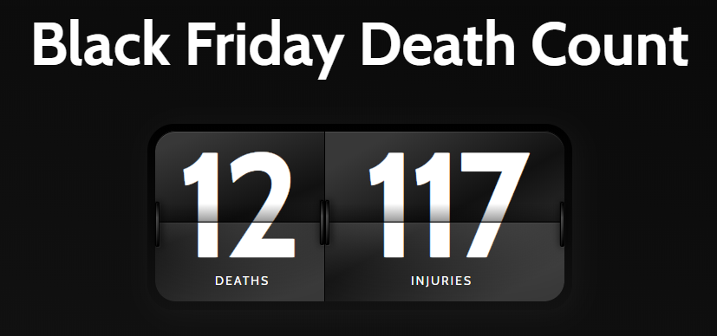

Slide 5
“Friday Black”
What do you think Adjei-Brenyah’s purpose for writing the story was?
How are the themes of poverty, consumerism, and/or materialism developed?
How does the story utilize and build dark humor?

Slide 6
Timed-Write

Slide 7
Adjei-Brenyah on his story “Friday Black”:
“To talk about the humor, for me it's important to try to laugh when you can because I think it's healthy. But also I think for me it's a way to help me say exactly what I want to say because if I don't add some levity, some humor, I probably won't get through, on some level, for the reader. I think it's like the sugar to help the medicine go down. Sometimes you kind of get through a story where there's, like, sort of this vein of humor. And sometimes I think the punchline is, like, it actually wasn't a joke after all. But with that story, "Friday Black," I did work in retail. I really have seen, like, a woman step on another woman's, like, calf or jeans.
We all know for a fact that pretty much annually, someone gets killed because people in Wal-Mart are trying to get TVs. In my mind, the first time that happened, everyone - the country, the world should have been like, whoa, whoa, whoa, whoa. You know, maybe we've taken this thing too far. But it's - that's a scary thing for me to think about. And what's scary is I think how - how we can know that happens so regularly and still sort of casually participate.”

