Slide 1
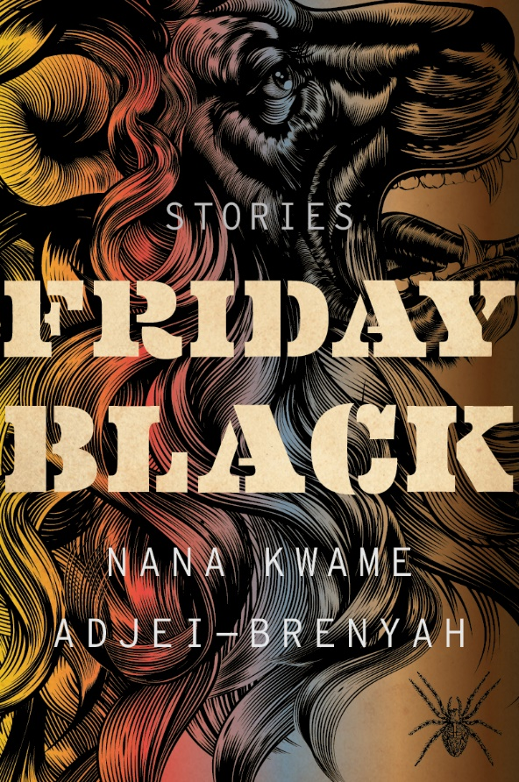
Friday Black
Nana Kwame Adjei-Brenyah makes his points by exaggerating race and class divisions, and consumer culture to create dark satire.
No. 11 on The New York Times’ “Most Notable Books of 2018” list.
“Friday Black,” is a short-story collection that veers from absurd humor to extreme violence.
“To talk about the humor, for me it's important to try to laugh when you can because I think it's healthy. But also I think for me it's a way to help me say exactly what I want to say because if I don't add some levity, some humor, I probably won't get through, on some level, for the reader. I think it's like the sugar to help the medicine go down. Sometimes you kind of get through a story where there's, like, sort of this vein of humor. And sometimes I think the punchline is, like, it actually wasn't a joke after all.”
One story is a dystopian satire of black Friday shopping where bodies litter the floor of malls.
“But with that story, "Friday Black," I did work in retail. I really have seen, like, a woman step on another woman's, like, calf or jeans. We all know for a fact that pretty much annually, someone gets killed because people in Wal-Mart are trying to get TVs. In my mind, the first time that happened, everyone - the country, the world should have been like, whoa, whoa, whoa, whoa. You know, maybe we've taken this thing too far. But it's - that's a scary thing for me to think about. And what's scary is I think how - how we can know that happens so regularly and still sort of casually participate.”

Slide 2
Friday Black: “Era”
Look for the “Good.” What does it do? How does it effect Ben?
What does our narrator mean when he says he is a “clear-born”? Social Hierarchy?
What does the language they use reveal about their society?
“HowItWas Class”?
Blunt communication?
“excited/electric”? (41).
Is the ending satisfying? What happens to Ben? Is Ben a tragic hero? Is “Era” a tragedy? How is the story really sad? Funny?

Slide 3
Friday Black: “Era”
Would the Good have changed Ben’s fate?
To what extent is the New Federation deliberately cruel?
Compared to Oceania? America 2019? Brave New World?
Are the McStowe’s really “Antis”? Or capitalists exploiting the dehumanization of their world?
Does it matter?
How successful are OptiLife™’s gene editing practices? Benefits? Risks?
What is the definition of pride and truth in this society? Why encourage those and suppress emotion?

Slide 4
Creative Task: Choose one or choose the literary analysis one page essay on the next page to try and raise your MT3 grade
Create a pharmaceutical ad for “the Good”
Use textual evidence to list the effects, side effects, and other details.
Match the style of speech in the world of “Era” and pharmaceutical ads in general. (important for grade)
Create an ad for OptiLife™
Use textual evidence (quotes) to list the benefits, options, risks, and other details.
Match the style of speech in the New Federation of “Era” and healthcare ads in general. (important for grade)
Can be any medium you want [even with a partner over video?]

Slide 5
Literary Analysis One-Pager Options →choose this option if you are planning on trying to significantly raise your grade from MT3
How does Adjei-Brenyah develop the character of Ben into a Shoelooker? What is a Shoelooker? What is the purpose?
Hint: motif of the ground/floor/shoes etc.
How does Adjei-Brenyah use language to develop his dystopia? What role does the language and speaking style of the New Federation play into dehumanization?
How does Adjei-Brenyah create his fear of social hierarchies? What is his dystopian warning?
How does Adjei-Brenyah create humor in “Era”?

