Slide 1
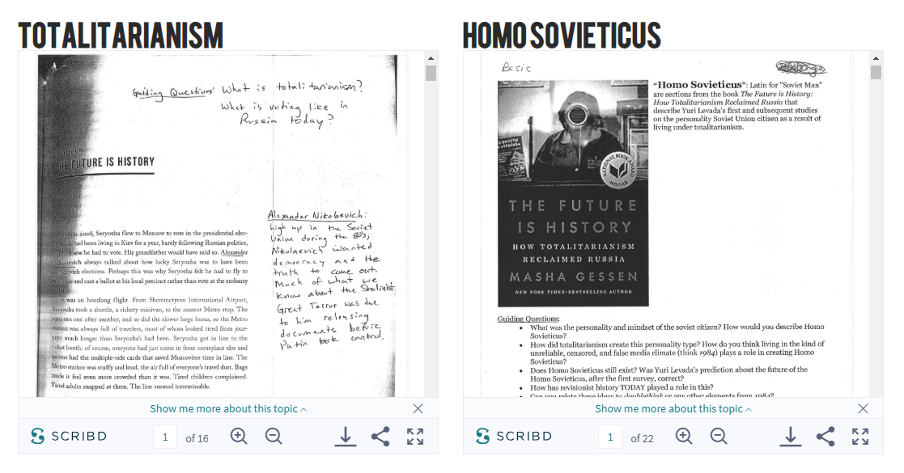
HW: Read the 2 passages from The Future is History: How Totalitarianism Reclaimed Russia
“Totalitarianism”
Pages 286-299
Assignment: infographic (see next slide)
Example on slide 3
“Homo Sovieticus”
This is a compilation of sections from the whole book.
Assignment: User profile, see slide 4
Example on slide 5

Slide 2
HW: Read the passage from The Future is History: How Totalitarianism Reclaimed Russia
Create an infographic, Totalitarian village of 100 people, sway, or other creative piece to demonstrate what Totalitarianism is based off the reading.
Think about how WELL Orwell establishes Oceania as a totalitarian society
Questions from the reading will appear on a reading quiz, Socratic Seminar, the final, and at other times.

Slide 3
Examples:

Slide 4
HW: Read the passages about “Homo Sovieticus” and demonstrate your knowledge of how/what they think by:
Doing a Instagram, Twitter, dating profile, or FB page for Homo Sovieticus
OR
??
Creating a drawing of Mr. Parsons (part ONE of 1984) and labeling +explaining how he exemplifies Homo Sovieticus
You might need to fill in the blanks some places

Slide 5
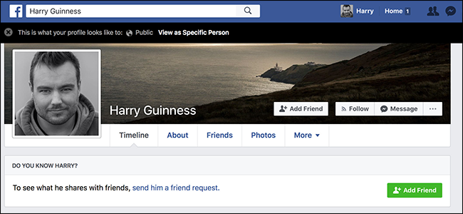
Examples:
Homo Sovieticus, 32
Homo Sovieticus
Here’s where you write things that Homo Sovieticus post to prove you understand the personality and reading.
Here’s where you write things that Homo Sovieticus would write on a dating profile to prove you understand the personality and reading.

