Slide 1
Preview Thinking Questions
Do meritocracies exist in the real world? Can they? Should they?
How much is American society shaped around these ideas?
How does society measure “potential”? Do people have equal opportunity to achieve their potential?
Have your teachers and parents accurately measured YOUR potential? Why?
Who generally gets labeled as ‘high-potential’? ‘Low-potential’?
How have BNW and “Era” dealt with organizing society around ability?

Slide 2
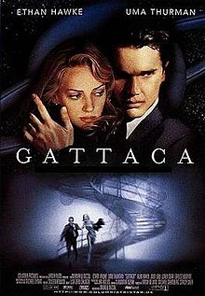
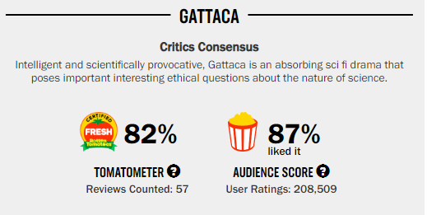
Gattaca
In 2011, NASA named it as “the most scientifically plausible science fiction film of all time.”
Directed and written by Andrew Niccol.
Concerned with eugenics, social hierarchy, and dehumanization through science, Social Darwinism, and biology.
Eugenics: a set of beliefs and practices that aims at improving the genetic quality of a human population.
Meritocracy: class structure where power is supposedly held by people on the basis of their ability.

Slide 3
Viewing Options
If none of these options work let Smith know.
Free trials require credit cards.
Your next quiz will have Gattaca questions.

Slide 4
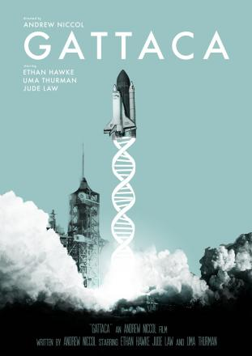
Gattaca (1997)
How does the genetic editing in Gattaca dehumanize people and relationships?
How does the genetic editing in Gattaca create a social hierarchy? How does that hierarchy dehumanize people at both the top and bottom?
How do the characters develop? What is important about the real Jerome?
Is there such a thing as ‘genetic destiny’? Should human DNA be edited ethically? How private should a person’s DNA and genetics be?
How do we determine someone’s “potential”? What does this mean?
What is the symbolism of swimming and playing chicken?
What do you think about the film’s ending?
“For someone who was never meant for this world, I must confess I'm suddenly having a hard time leaving it. Of course, they say every atom in our bodies was once part of a star. Maybe I'm not leaving... Maybe I'm going home.” Cheesy or nah?

Slide 5
Gattaca (1997)
Ultimately, how dystopian is Gattaca? Why?
Do meritocracies exist in the real world? Can they? Should they?
How does society measure “potential”? Do people have equal opportunity to achieve their potential?
Did you like the film?
Is the narration effective?
Is the pace and narrative sci-fi detective-trope effective?
In 2011, NASA named it as “the most scientifically plausible science fiction film of all time.” Thoughts? What warnings does the film have for our society?

