Slide 1
Overview of Task
Research shows Fake News and misinformation breeds and spreads online ‘faster’ and ‘deeper’ that truth. Often in the forms of memes, fake tweets, misleading claims, etc.
Relating to the reading "What is Post-Truth," find a piece of Coronavirus/ Covid19 fake news/misinformation and analyze it from a political/"ideological supremacy" lens.
Due to Turnitin.com:
The piece of fake news/misinformation
Brief explanation of the falsehood. Why is it fake? How do you know?
Analyze/speculate about the ideological supremacy or politics which lead to the author creating the lie.
For a challenge pick one from both ends of the US political spectrum.

Slide 2
Key Terms
Fake News: information that is clearly and demonstrably fabricated and that has been packaged and distributed to appear as legitimate news.
This specific definition seeks to separate fake news from other types of misleading information by clarifying that it is explicitly false and was created and presented in a way meant to fool viewers into thinking it is real.
Fake News refers to a specific piece of information; it does not refer to any particular type of news outlet, individual, or other actor.
Ideological Supremacy: When a person knowingly uses false evidence in support of a strongly held political or ideological belief, because they ‘know’ and ‘feel’ they’re ‘correct’ even though they cannot prove it.

Slide 3
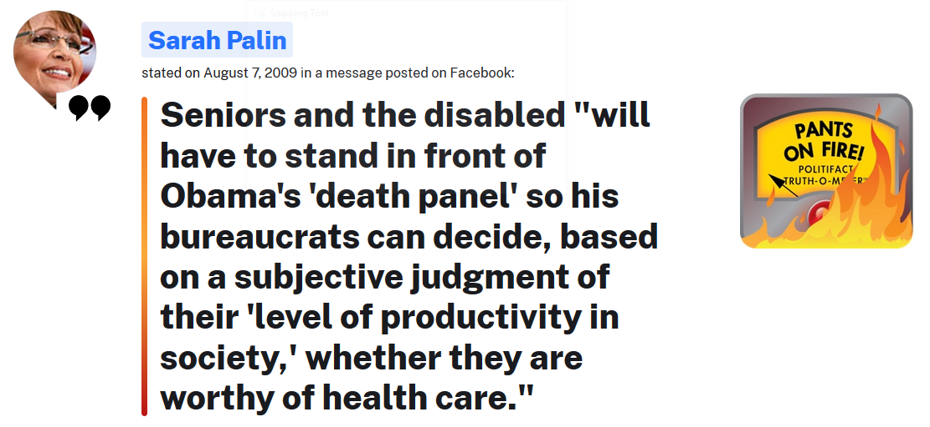
Ideological Supremacy Example: “Obamacare Death Panels” (2009)
Smith’s example analysis:
Sarah Palin, and many other commentators believed in a few pretty clear political philosophies which lead to the creation of some outrageous Affordable Care Act (colloquially named “Obamacare”) lies. The most famous was the claim that Obamacare would set up death camps to kill seniors who were too expensive to provide healthcare for. The ideological supremacy at the root of this claim was the conservative beliefs/opinions:
Small Government is good
Universal Healthcare is Socialism
Socialism is Bad, thus Obamacare is bad
While any and all of these beliefs may or may not be true, the ‘death panel’ claim is a complete lie (Politifact’s 2009 lie of the year). So Palin used the ‘death panel’ claim to support anti-ACA sentiments brought on by the belief in small government and free market solutions to healthcare.
https://www.politifact.com/article/2009/dec/18/politifact-lie-year-death-panels/
https://www.politifact.com/factchecks/2009/aug/10/sarah-palin/sarah-palin-barack-obama-death-panel/

Slide 4
More Practice
Here are some pieces of fake news about Covid19 from before we left school. Think about the ideological supremacy involved.
Trump Coronavirus claim about the Insurance Industry:
Joy Behar on The View:

Slide 5
Resources
Where can I find fake news about Covid19 or Coronavirus?
Fact Checking Websites:
Politifact.com
Snopes.com
https://www.iste.org/explore/Digital-and-media-literacy/Top-10-sites-to-help-students-check-their-facts
What have you seen on social media? Lots of it is probably questionably true at best.

Slide 6
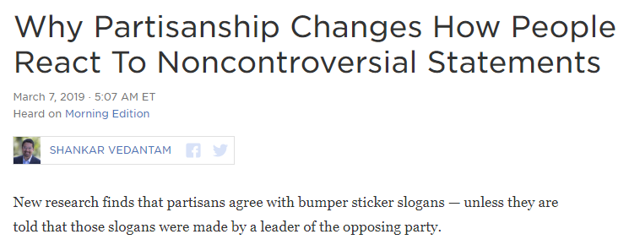
Interested? Bored? Have some links…
https://www.npr.org/2019/03/07/700625538/why-partisanship-changes-how-people-react-to-noncontroversial-statements
https://www.vox.com/2014/12/22/7433899/debunk-how-to
https://thenib.com/covid-19-myths-debunked/
https://qz.com/1258198/conspiracy-theorists-believe-wild-ideas-because-they-want-to-feel-special/

