Slide 1
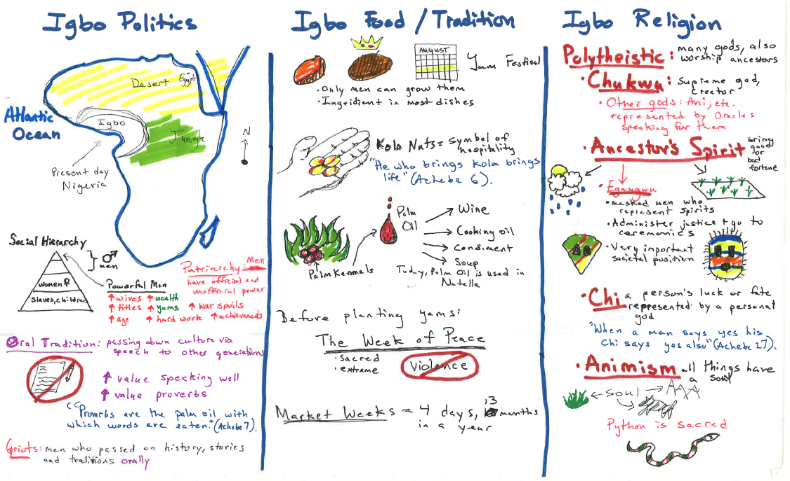
Journal #19: Igbo Culture Pictoral Input Chart
Learning Targets:
Students will be able to articulate important characteristics of Igbo culture.
Students will appreciate Igbo culture and avoid ethnocentric thoughts.

