Slide 1
Improving Analysis
What is analysis?
What is good analysis?
What isn’t analysis?
Analyze the following passage from a fictional text:
“Obedience is not enough. Unless [mankind] is suffering, how can you be sure that he is obeying your will and not his own? Power is in inflicting pain and humiliation. Power is in tearing human minds to pieces and putting them together again in new shapes of your own choosing.” (266).

Slide 2
Improving Analysis
Analyze the following passage from a song:
When she leave me she said, "Why does love lead to hurtin'?"
I said, one thing's for certain, I ain't preaching no sermon
But if it aches in your heart
That means that something is working
Don't think for once it ain't worth it
Don't think for once there's no purpose

Slide 3
Improving Analysis
Coast Modern: “Run it Up” (2:30 on)

Slide 4
Students say good analysis is…
Your own thinking and interpretation that is unique and abstract.
Not only connecting evidence to your claim, but also explaining HOW and WHY.
WHY this quote is what you claim it is.
“Quote” is an example of juxtaposition or characterization or symbolism, because…
HOW it impacted the text.
Identifying and explaining literary devices & techniques, as well as the effects and purpose.
Choices the author made and their significance/impact.
Synthesis of multiple ideas and places from the text.
Detailed and very specific.
Shows your deeper understanding clearly.
Focused on your thesis statements’ “SO WHAT” and themes.

Slide 5
Smith says good analysis is…
Elaboration
Interpret evidence’s deeper meaning
From literal/narrative to figurative or analytical meanings
Explain your citation’s relation to the claim
How is your evidence an example of your arguable claim?
Justify its value and relevance to your point
Explain:
Connections
Conclusions
cause and effect
Importance
literary terms
Explain the connection of evidence to thesis’ “so what”
Explains development of ideas, etc.
ANALYSIS IS FROM YOUR BRAIN– not things explicitly said in the text.

Slide 6
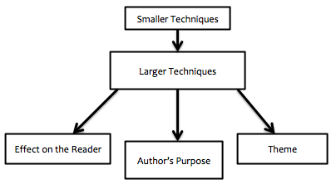
Smith says good analysis is…
Evidence →
Analysis →

Slide 7
Teaching Analysis feels like…

Slide 8
Improving Analysis
Look at the Writing Focus: Analysis sheet
What analysis exists in the example extract?
What analysis improvements have been made in the revision?
What types of analysis does the revision include? How does it avoid summary?

Slide 9
STUDENT THESIS: In the novel Bless Me, Ultima, Anaya characterizes Antonio through thoughts, words, and actions to emphasize Antonio’s growth throughout the story to convey that innocence is lost through the acquiring of knowledge.

Slide 10
Improving Analysis
Look at the Writing Focus: Analysis sheet
Improve the back!
Note: Analysis can improve by getting smaller, as well. Being more specific and focused can result in a reduction of word count that improves analysis.

Slide 11
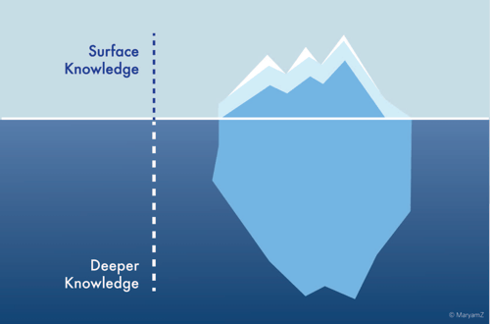
Iceberg Metaphor
The iceberg metaphor states that any work of literature has two different levels of complexity and meaning.
The first level is the Surface Knowledge.
The second level is Deeper Knowledge.
Why might an iceberg be a good metaphor for literature?

Slide 12
Iceberg Metaphor
Let’s look at Bless Me, Ultima:
The top of the iceberg contains the plot of BMU.
A boy’s magical friend comes as he grows up. He becomes confused about religion and experiences many gods. There are witches and a bad guy. Ultima dies.
According to the Iceberg Theory this only makes up about 10% of the novel.

Slide 13
Iceberg Metaphor
Let’s look at Bless Me, Ultima:
What sort of things would the bottom; or hidden deeper knowledge of the novel contain?

Slide 14
Iceberg Metaphor
What relationship might the Iceberg Theory have to writing Body Paragraphs?
In body paragraphs we can think that our EVIDENCE is surface level information from the text, i.e. a quotation.
Our ANALYSIS is explaining how that evidence works to prove our thesis’ claim on a deeper level. We are essentially explaining the deeper contents of the literary work.

