Slide 1
Integrated Africa Outline: Some Problems
Organization.
Minutiae focus on specific propaganda techniques instead of the big picture.
Use of Things Fall Apart.
Lack of importance/significance.
Vague or broad so what.
Analysis.
Note: without a teacher explaining this to you, you’re going to have to READ & THINK about the content of these slides to improve your own writing.

Slide 2
1. Illogical Organization: Example

Slide 3
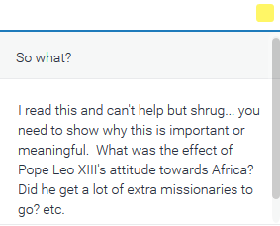
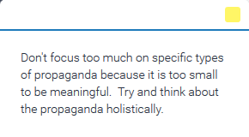
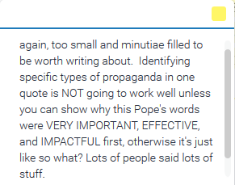
2. Propaganda Focus: Example 1
Note: You can mention propaganda, but remember propaganda is about PERSUASION, so you need to be able to show these words matter because others DID (or thought?) SOMETHING based off their persuasive rhetoric (propaganda).

Slide 4
2. Propaganda Focus: Example 2

Slide 5
3. Use of Things Fall Apart
I added the BTS to help clarify
1)Use Things Fall Apart to support a claim you make based on a primary or secondary source:
{BTS} Christianity intentionally used access to European markets and greed to convert many people, a fact missionaries were well aware of.
According to Reverend Ross Taylor’s journal entries Africans who benefited from trade were much more likely to convert to Christianity: “How can you work commerce and the Gospel together? Just as [Saint] Paul worked at tentmaking in the cities” (Taylor).
Similarly, Chinua Achebe wrote “The white man had indeed brought a lunatic religion, but he had also built a trading store and for the first time palm-oil and kernel became things of great price, and much money flowed into Umuofia. And even in the matter of religion there was a growing feeling that there might be something in it after all,” (Achebe 178).
{Write Analysis}
{Write Analysis}
{Write Analysis}
In outline format
These work together as ‘one’ evidence to support each other.

Slide 6
3. Use of Things Fall Apart
Actually look at this document

Slide 7
4. Lack of Importance: Example 1

Slide 8
4. Lack of Importance: Example 2

Slide 9
4. Lack of Importance: Example 3

Slide 10
5. Vague or Broad So What

Slide 11
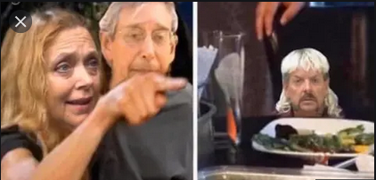
6. Analysis: you can use quoted material to support your analysis and clarify the importance of your primary source evidence
Edits Highlighted to Show Improved Analysis and use of secondary source in Analysis
Original example of evidence and analysis
C. “The scramble for territorial spheres of influence among the different Christian missions produced, as one Roman Catholic priest aptly put it, 'an atmosphere of war” (Ekechi 7).
Although the two groups disagreeing in this instance are of the same religion, it still shows that there is fighting caused by the new religions.
The scholar Carole Baskins noted “while Christians were harsh on African tribes who were hesitant to convert, they were much more violent with rival factions of missionaries.” (Big Cat Rescue 1).
This fighting was described as “...an atmosphere of war”, which is very extreme considering Christians are called to love their neighbors as themselves, showed how hypocritical some missionaries were.
Smith made this up completely, but is showing you how you can support your analysis

