Slide 1
Add the following notes to Journal #24 and read the passage

Slide 2
Some Sacred (religiously important) Texts of Hinduism
The four Vedas:
The Rigveda, which includes the Creation Hymn we read.
The Yajurveda
The Samaveda
The Atharvaveda
The Mahabharata, Sanskrit epic poetry.
Part of which is the Bhagavad Gita, (“Song of the Lord”), a conversation between prince Arjuna and the god Krishna.
Arjuna is counselled by Lord Krishna to "fulfill his Kshatriya (warrior) duty as a warrior and establish Dharma.”
The Ramayana, Sanskrit epic poetry.

Slide 3
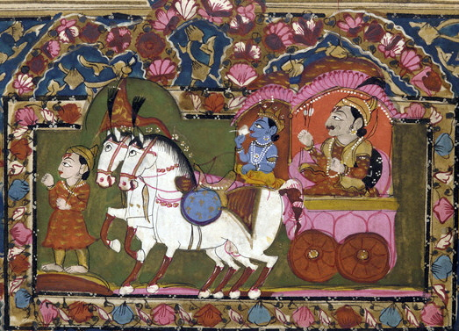
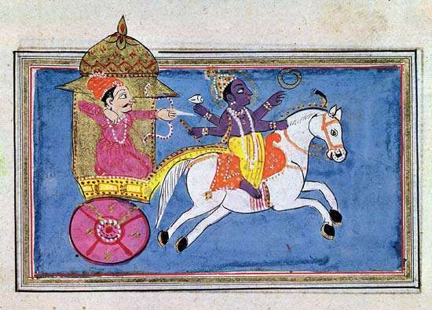
THE MAHABHARATA
Mahabharata translates to mean “great epic of the Bharata dynasty” and details the conflict between the two branches of the Bharata family (descendants of Pandu vs. descendants of Kuru)
Is the world’s longest Epic Poem
100,000 couplets (rhyming 2 lines) fill 18 books!!
Discusses history, legend, religion, morality, and philosophy.
Add 3-5 important details about the Mahabharata to your notes from online research.
So what? Why should I care?
Historians use literary works from the past to learn about the social and political values and norms of the people who created them.
The Mahabharata gives a glimpse of the nature of ancient (Hindu) Indian society.

Slide 4
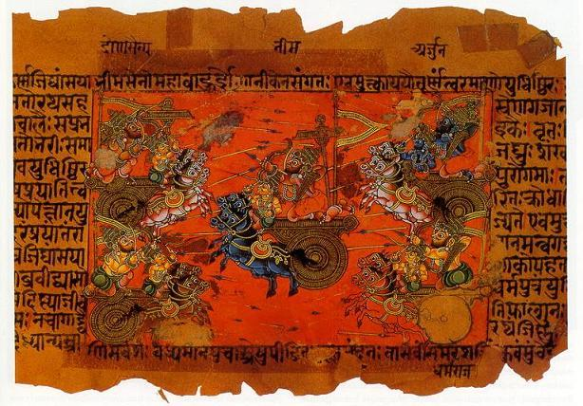
THE MAHABHARATA

Slide 5
THE MAHABHARATA
Didactic Text: meant to pass on some of Hinduism’s most important beliefs and concepts, such as the four "goals of life.”
Dharma
Karma
Moksha
Artha
This is an epic that reflects the struggles that took place in India as the Aryans moved south. A legendary story of the Kurukṣetra War. There is evidence of cultural blending: Aryan gods mixed with local gods.

Slide 6
THE MAHABHARATA
Read attached segment of the Mahabharata
Answer the following question in your journal:
How do Arjuna’s valuable qualities + skills standout when he is juxtaposed with other characters? What are they?
How does he fit as an Epic Hero?
What are Arjuna’s titles? Look for epithets. Epithet = a descriptive word or phrase that accompanies (or occurs in the place of) a name.
Drona = Arjuna’s teacher

Slide 7
THE MAHABHARATA
Read attached segment of the Mahabharata
Answer the following question in your journal:
How do Arjuna’s valuable qualities + skills standout when he is juxtaposed with other characters? What are they?
What are Arjuna’s titles? Look for epithets. Epithet = a descriptive word or phrase that accompanies (or occurs in the place of) a name.
What lessons does this segment of The Mahabharata contain? Why is it valuable for passing on Hindu culture?
Drona = Arjuna’s teacher

Slide 8
Epic Hero: Arjuna
Honest, admitted the truth about the bird.
“But Arjuna was the best on every weapon.”
Quick to act, killed the crocodile before others could act.
Really strong, “bull among men”
Focused and Patient,

Slide 9
THE MAHABHARATA: The Bhagavad-Gita
Read The Bhagavad-Gita segment.
Answer the following question in your journal:
What is the Bhagavad-Gita? What larger text is it a part of?
What “story” does the Bhagavad-Gita tell? What is its purpose?
Explain the difference between Dharma and Karma.
What is Moksha? How does someone achieve this?

Slide 10
The Bhagavad-Gita
Translates as “Song of the Lord,” The Bhagavad-Gita (Bha·ga·vad Gi·ta) is a conversation between prince (and Epic Hero) Arjuna and the god Krishna.
Arjuna is counselled by Lord Krishna to "fulfill his Kshatriya (warrior) duty as a warrior and establish Dharma.” Arjuna doesn’t want to have to fight and kill the great kings and men who are his enemies.
Krishna tells Arjuna: “And even considering your personal dharma as well, it is not right for you to hesitate. There is nothing better for a warrior than a fight based on dharma.” (Bg. 2.31)

Slide 11
THE MAHABHARATA: The Bhagavad-Gita
http://www.krishna.com/dharma-bhagavad-gita

Slide 12
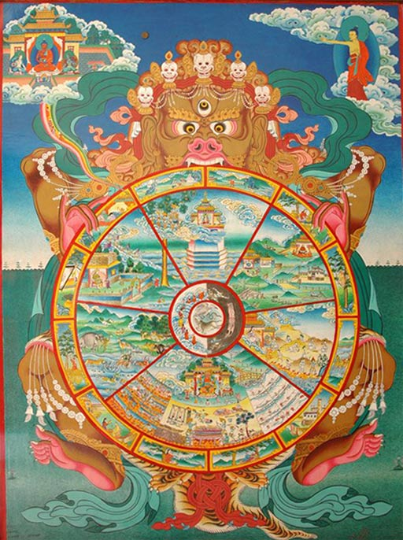
Key Religious Terms: Hinduism
Dharma: A person’s “sacred duty” of a person based off their place in the Caste System (Social Hierarchy)
It’s better to do your job poorly than do someone else’s well
Karma: the sum (quality) of a person's actions in this and previous states of existence, viewed as deciding their fate in future existences
Moksha: Union with God by escaping the Samsara cycle through continually achieving better Karma and Dharma.
Artha: translates as "meaning, sense, goal, purpose or essence"
Samsara: the cycle of death → rebirth

Slide 13
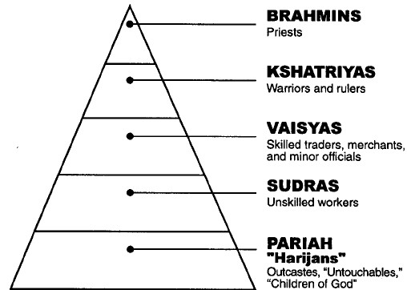
Hindu Caste System
Dharma: A person’s “sacred duty” of a person based off their place in the Caste System.

Slide 14
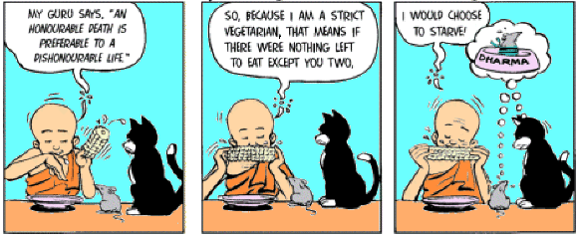
Quick write: How could the concept of DHARMA apply to your life? Based on your “role”—as a student, son/daughter/etc.—what do see as the parts of your duty?
What about the idea that it is better to do your job poorly rather than someone else’s well?

