Slide 1
Journal #1: Figurative Language & Literary Analysis
Learning Targets:
Students will be able to define figurative language.
Students will be able to articulate details about why we do literary analysis and what literary analysis is.
Students will be able to identify which literary devices rely on figurative language to understand.
Students will be able to identify personification, imagery, simile, repetition, ambiguity, foreshadowing, and metaphor in text.

Slide 2
Why do we read fiction? Discussion:
Why do people around the world tell fictional stories?
What stories are important to you? Your family?
How can stories, fiction, and works of art relate to reality? Can lies be used to tell the truth?
Are there any ‘universal truths’?

Slide 3
Why do we read fiction? Discussion:
Why do we talk about what we read?
How do we create meaning from what we read?
How can we tell when words mean something other than what they exactly say?
What counts as a ‘text’? What can we ‘read’?
Can we read Mr. Smith’s TwentyOne Pilots poster?

Slide 4
Can we read Mr. Smith’s TwentyOne Pilots poster?

Slide 5
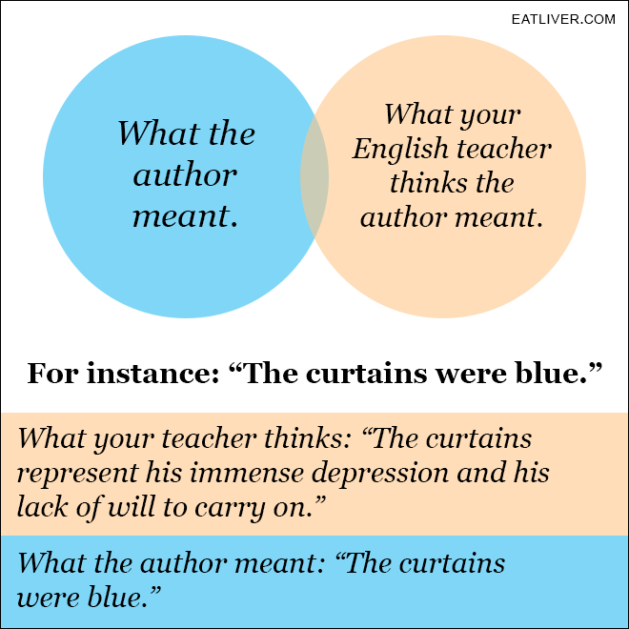
Ever feel this way?

Slide 6
What is Literary Analysis?
Is there any truth to this?
How does this thinking intellectually limit you?
What is the benefit to search for deeper meaning in literature?

Slide 7
What is Literary Analysis?
Let’s read: “The Reader As Artist”
What is Toni Morrison’s argument (thesis)?
What is your reaction?

Slide 8
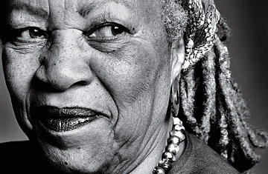
“The Reader As Artist”
“That Alice-in-Wonderland combination of willing acceptance coupled with intense inquiry is still the way I read literature: slowly, digging for the hidden, questioning or relishing the choices the author made, eager to envision what is there, noticing what is not. In listening and in reading, it is when I surrender to the language, enter it, that I see clearly. Yet only if I remain attentive to its choices can I understand deeply.”
We have to assume that everything in a novel is an intentional choice the author made– there are no accidents.

Slide 9
What is Literary Analysis?
The consumption of art (literature) is between the viewer and the art… so it would be fine to defend a claim that the blue curtains represent ‘immense depression.’
This is one way services like Sparknotes limit us!

Slide 10
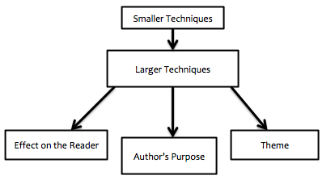
Using The Reader as Artist, use paragraph 4 to define Literary Analysis.
Additionally, include:
We assume that ‘authors made choices intentionally to create an effect.’

Slide 12
Important Term for Literary Analysis: Figurative Language
words or phrases that writers use to create different and/or deeper meanings than what is explicit. The primary purpose of figurative language is to force readers to understand or see what a writer wants and be more effective, persuasive, or impactful.
Figurative language is not meant to convey literal meanings, and often it compares one concept with another in order to describe something difficult to fully encompass literally.
Figurative language is a useful way of explaining difficult ideas that readers cannot completely understand, due to its complex and/or abstract nature– such as emotions or descriptions.

Slide 13
Important Term for Literary Analysis: Figurative Language
Figurative language can appear in multiple forms with the use of different literary devices. Figurative language has five different forms:
Understatement or Emphasis
Relationship or Resemblance
Figures of Sound
Errors
Verbal Games
We’re going to focus our early Literary Analysis on Figurative Language and some basic literary devices.

Slide 14
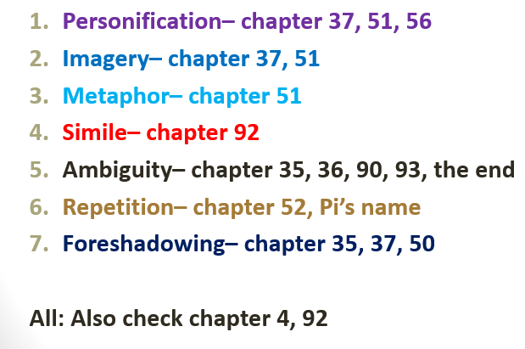
TASK
With a partner look up the figurative language you are assigned and:
Look up a definition from literarydevices.net and one other website to create your own (NEW) definition for the literary device and put it on your poster.
How do authors use this technique to create or enhance meaning?
Is your term a literary device? Is it figurative language? If yes include those in your definition.
Read Life of Pi to find 2-3 examples to put on your poster.
Use the suggestions Smith made, then start at p. 97 and read on.
What meaning is Yann Martel creating through the examples you found?

Slide 15
Literary Devices and other Figurative Language
Personification– chapter 37, 51, 56
Imagery– chapter 37, 51
Metaphor– chapter 51
Simile– chapter 92
Ambiguity– chapter 35, 36, 90, 93, the end
Repetition– chapter 52, Pi’s name
Foreshadowing– chapter 35, 37, 50
All: Also check chapter 4, 92

Slide 16
Gallery Walk
There is no repetition
There is no repetition
There is no repetition
There is no repetition
There is no repetition
There is no repetition
Because life of pi doesn’t use a ton of repetition or use it well

