Slide 1
Journal 24: India
Learning Targets:
Students will be able to define epic poetry and identify the 5 characteristics of an epic poem in a text.
Students will be able to explain Sanskrit, Dharma, Karma, Moksha, the Rigveda, epic heroes, and Valmiki.

Slide 2
Didactic Literature
Didactic Literature: texts meant to teach moral lessons or pass on rules for behavior.
Didactic Literature texts are often created using allegory and theme to create the idea in reader’s minds that they should behave a certain way. Critics say Didactic Literature can be boring. Didactic Literature tries to teach what is right and wrong.
What does this remind you of?
What groups of people might have created Didactic Literature?
Can you think of any examples of stories that might be Didactic in nature?
Why would critics say that Didactic Literature is boring?

Slide 3
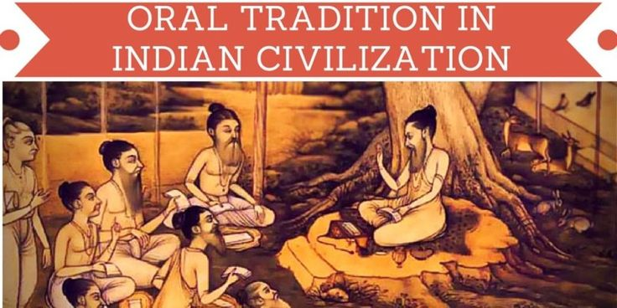
Oral Tradition: Review
What is oral tradition?
What is a myth? What is a folktale?
Why are these things important to a culture?

Slide 4
Oral Tradition: Review
Oral Tradition: cultural material and tradition passed on to other members of the culture in SPOKEN words passed from one generation to the other.
Myth: traditional or legendary story explaining some practice, rite, or natural phenomenon (such as the creating of the earth).
Folktales: a story without a known author that has been preserved through spoken words from one generation to the other.

Slide 5
Oral Tradition → Literary Tradition
Epic Poetry: long story in the form of a poem concerning a serious subject containing details of an Epic Hero’s deeds and events significant to a culture or nation. These often serve a Didactic purpose.
Ancient Epic Poetry was passed down through oral tradition until someone wrote it down, thus transitioning it into literary tradition.

Slide 6
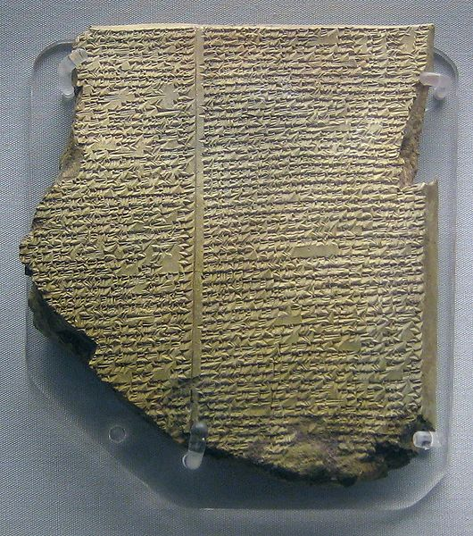
Epic Poetry Examples
Epic of Gilgamesh– from Mesopotamia
Mahābhārata– India
Ramayana– India
Iliad– Greek mythology (Homer)
Odyssey– Greek mythology (Homer)
Beowulf– Old English

Slide 7
EPIC POETRY & EPIC HEROES
An EPIC is a long, narrative poem that describes the actions of an EPIC HERO. The setting is vast (really big), and usually includes supernatural elements.
Epic poems convey universal themes—such as “good vs. evil” and are written in a serious tone.
Ancient Epic Poetry was passed down through oral tradition until someone smart wrote it down.
The EPIC HERO displays the following characteristics:
High-status & usually male
He’s a reflection of the culture's “ideals”; his actions reflect the value of the culture
→ serve a didactic purpose
Sometimes the epic hero is part god; epic heroes display recognizable human qualities and traits.
→Research 3-5 NEW things to add to your notes about Epic Poetry and/or Epic Heroes

Slide 8
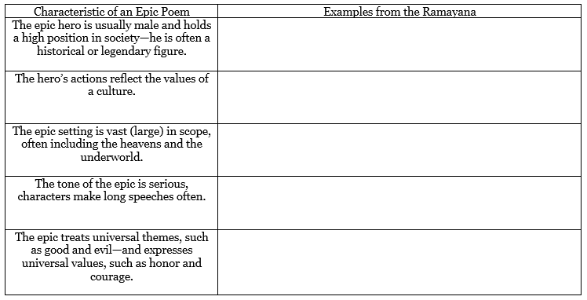
EPIC POETRY & EPIC HEROES
An EPIC is a long, narrative poem that describes the actions of an EPIC HERO. The setting is vast, and usually includes supernatural elements. Also these characteristics and charts you’ll need later:

Slide 9
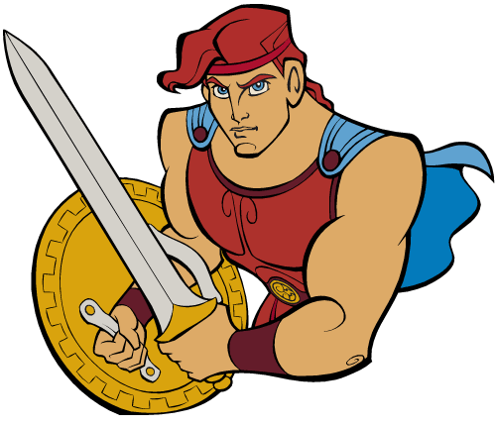
HW: CREATE AN “EPIC HERO” (turn in to Smith’s Tii by May 8th)
List 10 of the qualities you believe the “perfect” man, then woman, has (within today’s world/culture/society from your perspective).
Sketch an EPIC HERO (you can take a pic and paste into your document)
Use 3+ colors
Annotate your sketch to include 5-7 specific traits and/or features.

Slide 10
Example: CREATE AN “EPIC HERO”
Russel Wilson
Star Athlete: Wilson plays in the NFL (America’s favorite sport) and is one of the most successful quarterbacks.
Kind: Wilson spends countless hours of his free-time visiting children with cancer.
Rich: financially successful with a four-year contract worth $87.6 million. Wilson has become one of the NFL's most marketable players, scoring deals with Microsoft and Nike.
Stylish: launched his own clothing line, Good Man Brand, at Nordstrom in 2016.

