Slide 2
Journal #12: Juxtaposition
Students will be able to construct a definition of juxtaposition from examples.
Students will be able to identify juxtaposition in a text, and explain the effects.
Students will be able to apply their knowledge of juxtaposition to graphic novels and comics.

Slide 3
What is Juxtaposition?
You probably don’t know! That’s okay. However, we’ve encountered it in out literature so far. Additionally, it will be essential to analyzing graphic novels.
We’re applying a special technique related to the theory of learning.
Constructivist theory of learning believes:
People learn best when experiences and real world situations lead to development of knowledge on their own, i.e. without being explicitly told.
Constructivism is a learning theory found in psychology which explains how people might acquire knowledge and learn. It therefore has direct application to education. The theory suggests that humans construct knowledge and meaning from their experiences.
In this journal there will be many different examples of juxtaposition (print, video, text, etc.) that will hopefully lead to the construction of a definition of juxtaposition for you.
What times can you remember learning in a constructivist way?
What challenges might exist in learning this way?
How many of you already think you know what juxtaposition mean?

Slide 4
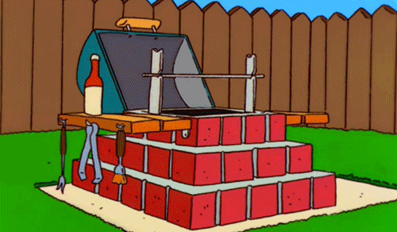
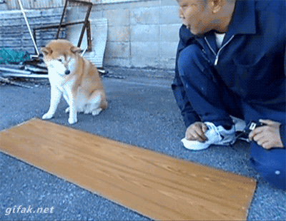
Constructivist Theory
In constructivist theory, the teacher’s role is assist students and provide them with opportunities to build the knowledge.
Teacher
You

Slide 5
Before we begin…
It is important that each of you construct their own knowledge, therefore please do not verbally share what knowledge you are constructing until it is time to share!
For each example write a heading like “Romeo and Juliet” and then write quick notes on what you see or hear.

Slide 6
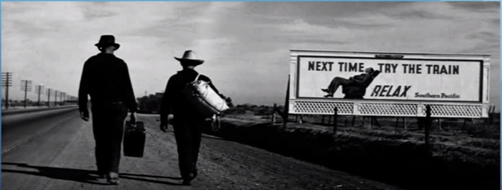
Photograph: Of Mice and men (film)

Slide 7
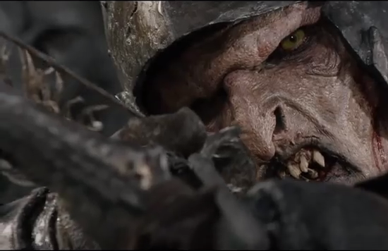
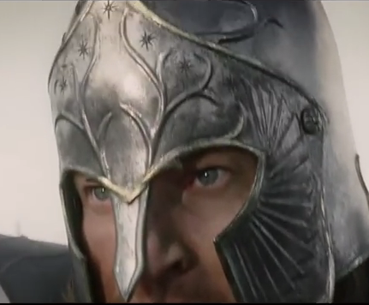
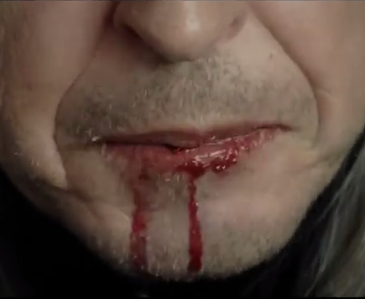
Movie: Lord of the Rings: The return of the king
https://youtu.be/N3qrhhMCJlI?t=41
4:41

Slide 8
Checkpoint one: Write something even if you don’t know for sure.
Based on the two examples, I think juxtaposition means…

Slide 9
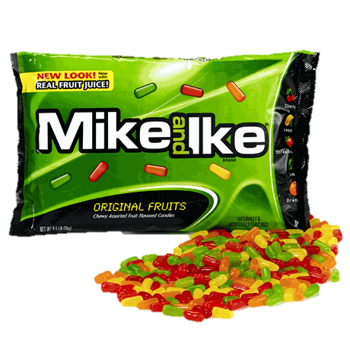
Meme: Drake

Slide 10
Play: Romeo and Juliet Act I, Scene V
Romeo:
“O, she doth teach the torches to burn bright! It seems she hangs upon the cheek of night Like a rich jewel in an Ethiope’s ear;”

Slide 11
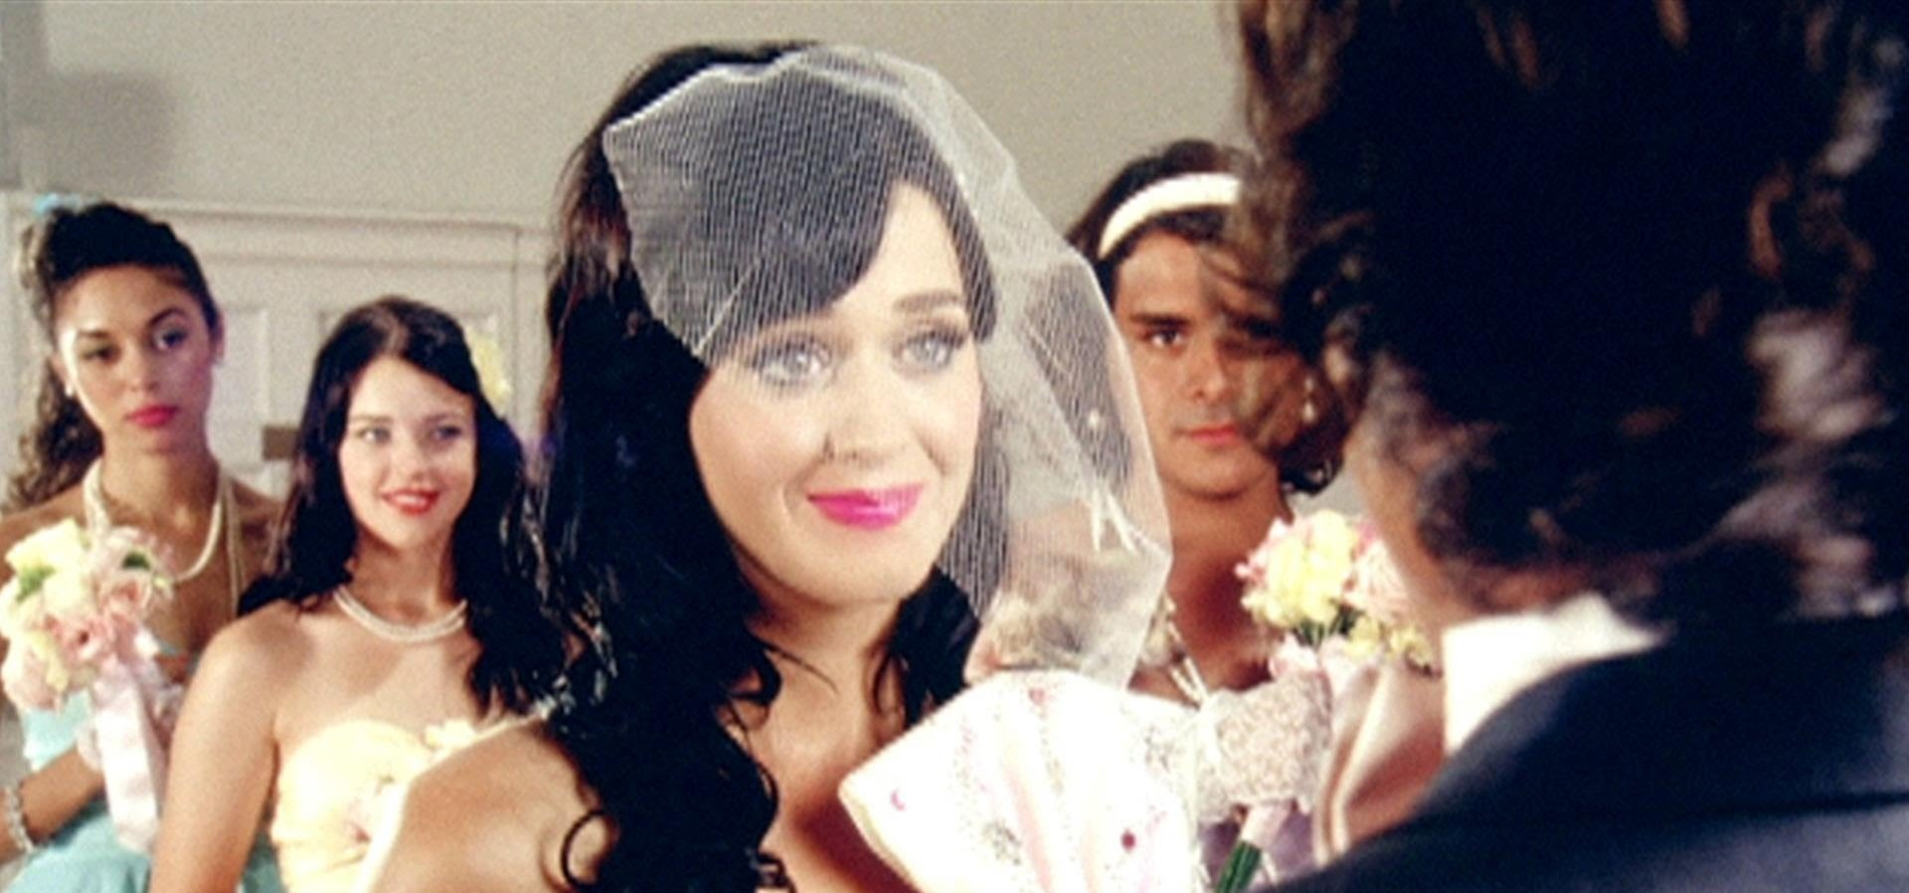
Music: “Hot and Cold”– Katy Perry
https://www.youtube.com/watch?v=kTHNpusq654

Slide 12
Checkpoint two: Write something even if you don’t know for sure.
Based on the examples, I think juxtaposition means…
Since Checkpoint One I think I learned…
Since Checkpoint One I was confused by…

Slide 13
Poetry: “Do not Go Gentle into that Good Night” by Dylan Thomas
“Grave men, near death, who see with blinding sight Blind eyes could blaze like meteors and be gay, Rage, rage against the dying of the light. And you, my father, there on the sad height, Curse, bless, me now with your fierce tears, I pray. Do not go gentle into that good night. Rage, rage against the dying of the light.”

Slide 14
Photo: Advertising placement

Slide 15
Poetry: “Let America Be America Again” by Langston Hughes (1938)
Let America be America again.
Let it be the dream it used to be.
Let it be the pioneer on the plain
Seeking a home where he himself is free.
(America never was America to me.)
Let America be the dream the dreamers dreamed--
Let it be that great strong land of love
Where never kings connive nor tyrants scheme
That any man be crushed by one above.
(It never was America to me.)
O, let my land be a land where Liberty
Is crowned with no false patriotic wreath,
But opportunity is real, and life is free,
Equality is in the air we breathe.
(There's never been equality for me,
Nor freedom in this "homeland of the free.")
Say, who are you that mumbles in the dark?
And who are you that draws your veil across the stars?
I am the poor white, fooled and pushed apart,
I am the Negro bearing slavery's scars.
I am the red man driven from the land,
I am the immigrant clutching the hope I seek--
And finding only the same old stupid plan
Of dog eat dog, of mighty crush the weak.
I am the young man, full of strength and hope,
Tangled in that ancient endless chain
Of profit, power, gain, of grab the land!
Of grab the gold! Of grab the ways of satisfying need!
Of work the men! Of take the pay!
Of owning everything for one's own greed!
I am the farmer, bondsman to the soil.
I am the worker sold to the machine.
I am the Negro, servant to you all.
I am the people, humble, hungry, mean--
Hungry yet today despite the dream.
Beaten yet today--O, Pioneers!
I am the man who never got ahead,
The poorest worker bartered through the years.
Yet I'm the one who dreamt our basic dream
In the Old World while still a serf of kings,
Who dreamt a dream so strong, so brave, so true,
That even yet its mighty daring sings
In every brick and stone, in every furrow turned
That's made America the land it has become.
O, I'm the man who sailed those early seas
In search of what I meant to be my home--
For I'm the one who left dark Ireland's shore,
And Poland's plain, and England's grassy lea,
And torn from Black Africa's strand I came
To build a "homeland of the free."
The free?
Who said the free? Not me?
Surely not me? The millions on relief today?
The millions shot down when we strike?
The millions who have nothing for our pay?
For all the dreams we've dreamed
And all the songs we've sung
And all the hopes we've held
And all the flags we've hung,
The millions who have nothing for our pay--
Except the dream that's almost dead today.
O, let America be America again--
The land that never has been yet--
And yet must be--the land where every man is free.
The land that's mine--the poor man's, Indian's, Negro's,
ME--
Who made America,
Whose sweat and blood, whose faith and pain,
Whose hand at the foundry, whose plow in the rain,
Must bring back our mighty dream again.
Sure, call me any ugly name you choose--
The steel of freedom does not stain.
From those who live like leeches on the people's lives,
We must take back our land again,
America!
O, yes,
I say it plain,
America never was America to me,
And yet I swear this oath--
America will be!
Out of the rack and ruin of our gangster death,
The rape and rot of graft, and stealth, and lies,
We, the people, must redeem
The land, the mines, the plants, the rivers.
The mountains and the endless plain--
All, all the stretch of these great green states--
And make America again!
https://www.youtube.com/watch?v=b6Im4b3kdfc

Slide 16
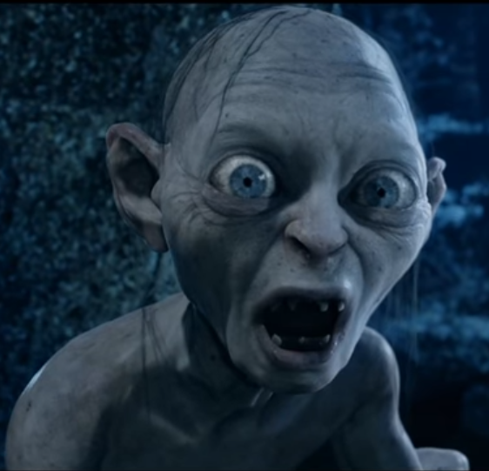
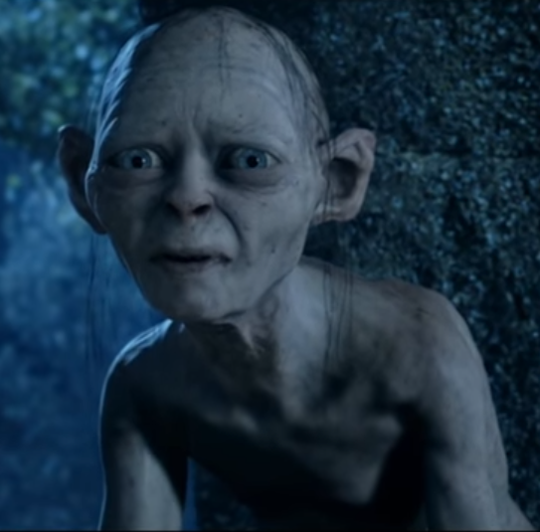
Movie: Lord of the Rings: The two Towers
https://www.youtube.com/watch?v=NB2CNr692RE
2:31

Slide 17
Novel: A Tale of Two Cities by Charles Dickens
“It was the best of times, it was the worst of times, it was the age of wisdom, it was the age of foolishness, it was the epoch of belief, it was the epoch of incredulity, it was the season of Light, it was the season of Darkness, it was the spring of hope, it was the winter of despair, we had everything before us, we had nothing before us, we were all going direct to Heaven, we were all going direct the other way…”

Slide 18
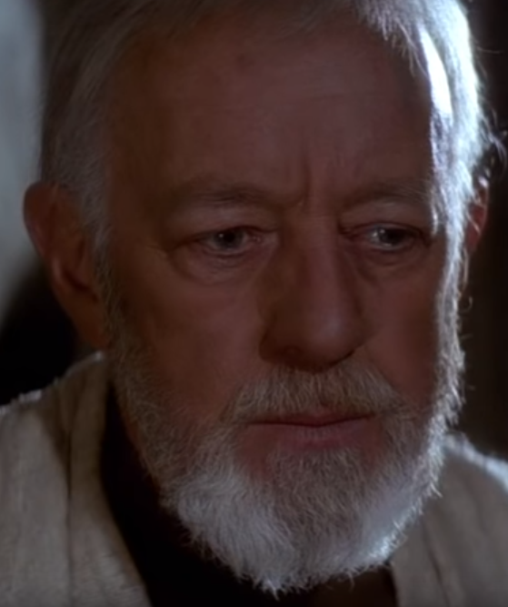
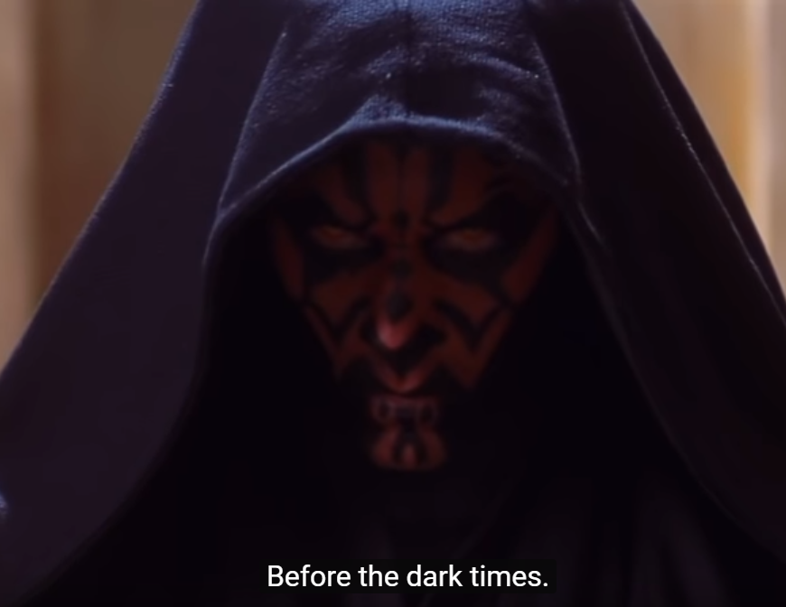
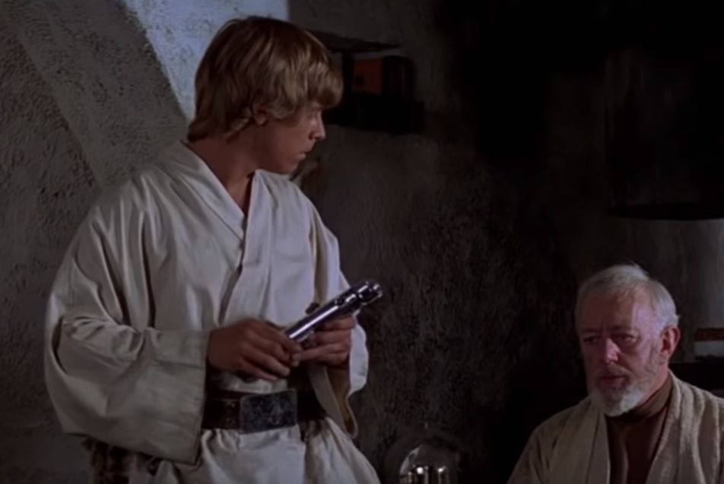
Fan edits Movie: Star wars: a new Hope + prequel content
https://www.youtube.com/watch?v=T9j7kLG7VK8
5:05

Slide 19
Checkpoint three: Write something even if you don’t know for sure.
Based on the examples, I think juxtaposition means…
Since Checkpoint Two I think I learned…
Since Checkpoint Two I was confused by…
Now talk to the people around you and come up with (construct) a definition together. Based on the examples, we think juxtaposition means…

Slide 20
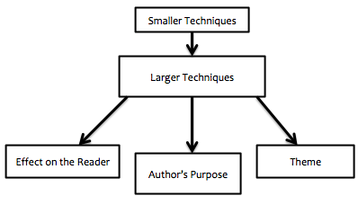
Juxtaposition definition:
Two (or more) items side-by-side (or near each other) to emphasize and contrast the differences between the two to create an effect (often more knowledge about one of the things). This can be done with:
Characters;
Events or Scenes;
Words/phrases;
Ideas;
Symbols;
Settings;
Etc.

Slide 21
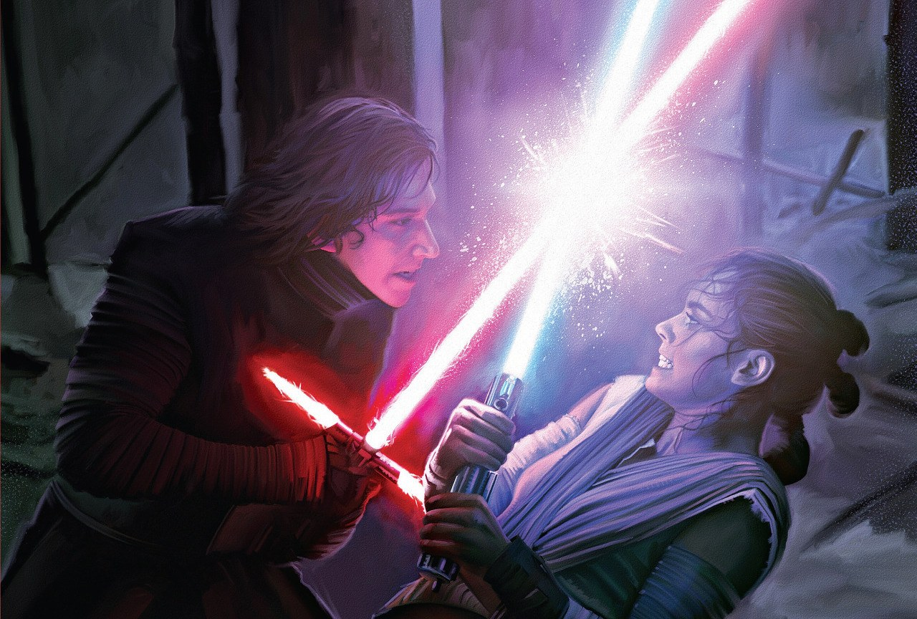
Reflection:
Did you figure out what juxtaposition was? Did your group?
How helpful was the constructivist approach?
What example was the most helpful towards figuring it out?
What example was the least helpful?
What do you think the purpose of juxtaposition is? Who creates juxtaposition?

Slide 22
Juxtaposition + Graphic Novels
Graphic novels pair sequential visual art with minimal text to tell a story.
Taken individually, the pictures in a cartoon are merely that– pictures.
However when pictures are part of a sequence, the ‘art of the picture’ is transformed into the art of comics and narrative can develop.
Definition of comics: juxtaposed pictorial and other images in deliberate sequence, intended to convey information and/or produce aesthetic response in the viewer.

Slide 23
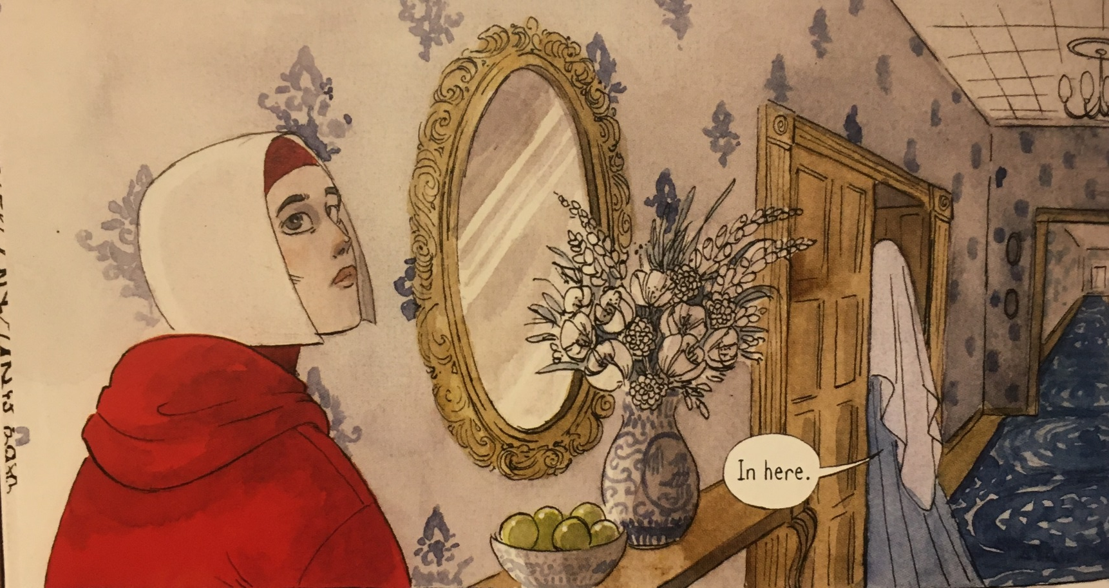
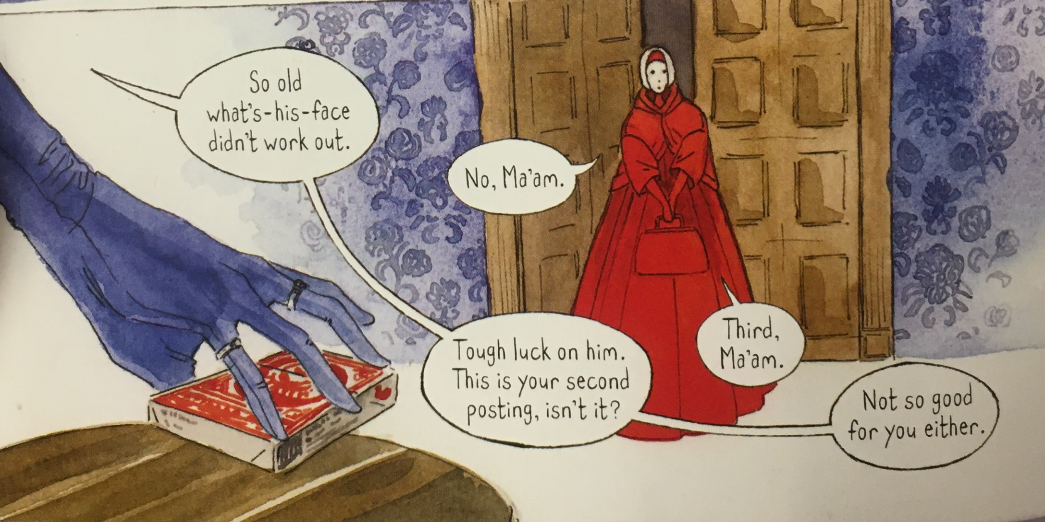
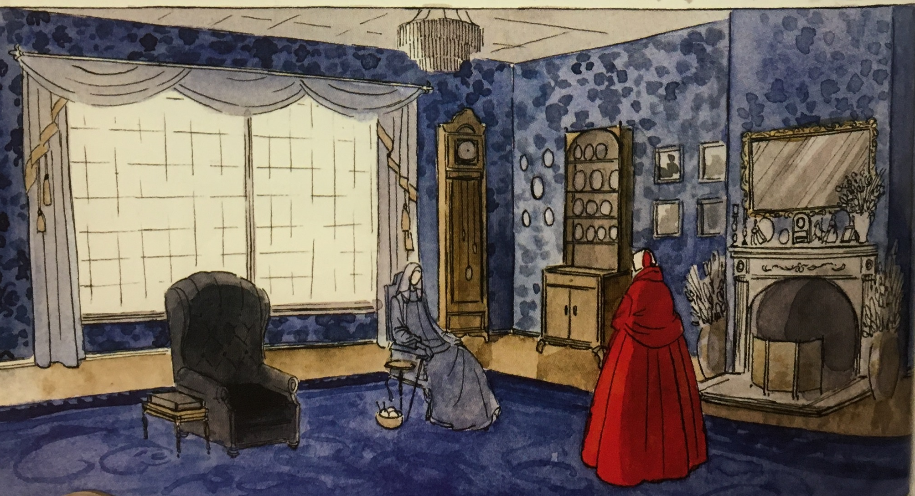
Juxtaposition + Graphic Novels
Notice how the panel to the left is just art, but once the next three panels are added in sequential order they can be juxtaposed and meaning can interpreted.

Slide 24
Answer the prompt:
One example of juxtaposition in Bless Me, Ultima I can think of is….

Slide 25
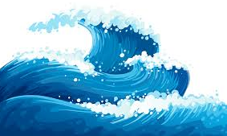
Some Juxtaposition in Bless Me, Ultima (so far)….
The Luna and Márez families
Antonio’s parents
God vs. the Virgin of Guadalupe
Page 44
Antonio’s dreams
Labeling juxtaposition is a claim you make, so as long as you can defend it (by saying it creates an effect, emphasizes a point, serves an author’s purpose, or develops a theme) and the two elements are near each other, go for it. Look for further examples as you read.
Pick one of the above examples and try explaining how Anaya uses it to creates an effect, emphasizes a point, serves Anaya’s purpose, or develops a theme.

Slide 26
Juxtaposition in BMU
The Luna and Marez families
Antonio’s dreams
Especially page 119-121
Antonio’s parents
God vs. the golden carp
The Black Bass vs. the golden carp
Ultima’s Magic vs Catholicism
The llano vs. the river valley
God vs. the Virgin of Guadalupe
Page 44
Ultima vs. Tenorio and his daughters
“’But I was not to interfere with the destiny of any man. Those who wallow in evil and brujeria cannot understand this. They create a disharmony that in the end reaches out and destroys life–’” (Anaya, 260).

Slide 27
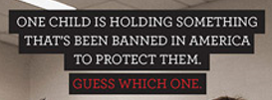
entrance ticket:
What is juxtaposition?
Write a thesis statement about the image.

Slide 29
Ultima’s Magic vs Catholicism
“’The church would not allow your grandfather to let me use my powers. The church was afraid that-’ She did not finish, but I knew what she would have said. The priest at El Puerto did not want the people to place much faith in the powers of la curandera. He wanted the mercy and faith of the church to be the villagers' only guiding light. Would the magic of Ultima be stronger than all the powers of the saints and the Holy Mother Church? I wondered.” (Anaya 97)
“The power of the doctors and the power of the church had failed to cure my uncle. Now everyone depended on Ultima's magic. Was it possible that there was more power in Ultima's magic than in the priest?” (Anaya 99)
What effect does this juxtaposition, and the rest of diez create for readers?

Slide 30
Antonio’s dream (119-121)
That night in my dreams I walked by the shore of a great lake. A bewitching melody filled the air. It was the song of the mer-woman! I looked into the dark depths of the lake and saw the golden carp, and all around him were the people he had saved. On the bleached shores of the lake the carcasses of sinners rotted.
Then a huge golden moon came down from the heavens and settled on the surface of the calm waters. I looked towards the enchanting light, expecting to see the Virgin of Guadalupe, but in her place I saw my mother!
Mother, I cried, you are saved! We are all saved!
Yes, my Antonio, she smiled, we who were baptized in the water of the moon which was made holy by our Holy Mother the Church are saved.

Slide 31
Lies! my father shouted, Antonio was not baptized in the holy water of the moon, but in the salt water of the sea!
I turned and saw him standing on the corpse-strewn shore. I felt a searing pain spread through my body.
Oh please tell me which is the water that runs through my veins, I moaned; oh please tell me which is the water that washes my burning eyes!
It is the sweet water of the moon, my mother crooned softly, it is the water the Church chooses to make holy and place in its font. It is the water of your baptism.
Lies, lies, my father laughed, through your body runs the salt water of the oceans. It is that water which makes you Marez and not Luna. It is the water that binds you to the pagan god of Cico, the golden carp!

Slide 32
Oh, I cried, please tell me. The agony of pain was more than I could bear. The excruciating pain broke and I sweated blood.
There was a howling wind as the moon rose and its powers pulled at the still waters of the lake. Thunder split the air and the lightning bursts illuminated the churning, frothy tempest. The ghosts stood and walked upon the shore.
The lake seemed to respond with rage and fury. It cracked with the laughter of madness as it inflicted death upon the people. I thought the end had come to everything. The cosmic struggle of the two forces would destroy everything!
The doom which Cico had predicted was upon us! I clasped my hands and knelt to pray. The terrifying end was near. Then I heard a voice speak above the sound of the storm. I looked up and saw Ultima. Cease! she cried to the raging powers, and the power from the heavens and the power from the earth obeyed her. The storm abated.

Slide 33
Stand, Antonio, she commanded, and I stood. You both know, she spoke to my father and my mother, that the sweet water of the moon which falls as rain is the same water that gathers into rivers and flows to fill the seas. Without the waters of the moon to replenish the oceans there would be no oceans. And the same salt waters of the oceans are drawn by the sun to the heavens, and in turn become again the waters of the moon. Without the sun there would be no waters formed to slake the dark earth's thirst.
The waters are one, Antonio. I looked into her bright, clear eyes and understood her truth.
You have been seeing only parts, she finished, and not looking beyond into the great cycle that binds us all.
What effect does this juxtaposition, and the rest of diez create for readers?

