Slide 1
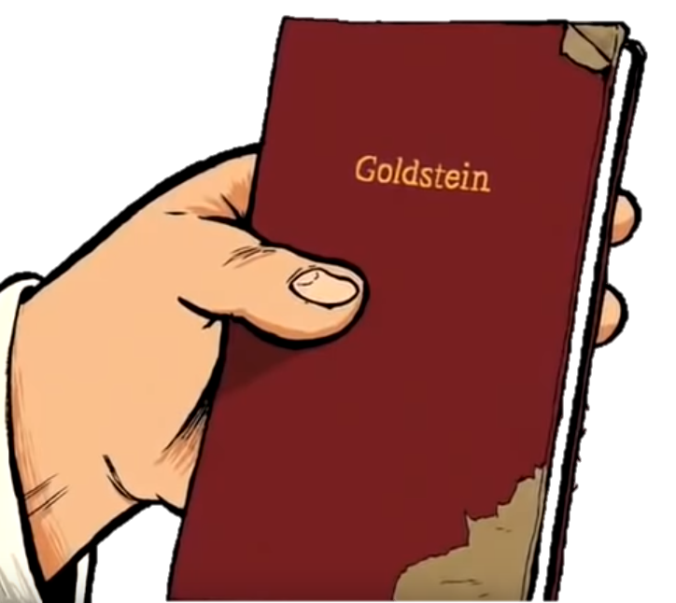
“Oligarchical Collectivism”
Task: Create a “lesson” to teach another group about your chapter of Goldstein’s book. A successful lesson will:
Be detailed, informative and thought provoking
Detail information your audience should know about your section.
Create a task for your audience: note blanks, questions, etc.
Critical thinking is better.
Include LTs?
Include pictures or some sort of visuals
Not just summary; include original thoughtful analysis
Take between 8 and 10 minutes

Slide 2
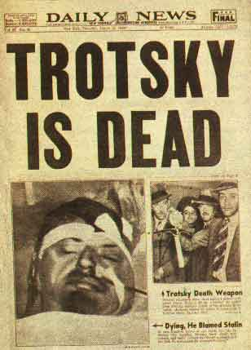
The Theory and Practice of Oligarchical Collectivism by Emmanuel Goldstein
Explains why and how the USSR is and predicts what would happen
Explains why and how the Party is through the three slogans

Slide 3
The Revolution Betrayed: What is the Soviet Union and where is it going? By Leon Trotsky
Published in 1936 (Trotsky was run out of Russia in 1928).
Came out right before the Terror started, during the ‘Moscow Trials’ of Trotsky and Communist loyalists.
Trotsky added a P.S. : “This book was completed … before the ‘terrorist’ conspiracy trial … was announced. … Its indication of the historic logic of this ‘terrorist’ trial, and its advance exposure of the fact that its mystery is deliberate mystification, is so much the more significant.”
First two years of the Purges (during 1937 and 1938) the NKVD detained 1,548,366 persons, of whom 681,692 were shot – an average of 1,000 executions a day
Trotsky’s view of the Soviet Union is an example of Marxist Historical Criticism.
He analyzes the triumph of Stalin, the separation of the party from Bolshevism, and the rising bureaucracy. The importance of this chapter lies in Trotsky's observation that the ruling class in the USSR are neither capitalists nor workers, but rather a section of the working class alienated from its class roots, influenced by bureaucracy.

Slide 4
The Revolution Betrayed: What is the Soviet Union and where is it going? By Leon Trotsky
One of the key predictions made by Trotsky is that the USSR would come before a disjuncture: either the toppling of the ruling bureaucracy by means of a political revolution, OR capitalist restoration led by the bureaucracy.
This prediction was made at a time when most commentators, capitalist and Stalinist, predicted the continued rise of Soviet power.
Historically speaking, Trotsky was right: Reform during the 1980’s was followed by the full embrace of capitalism a decade later without any apparent ideological discomfort amongst former party members, who became the new economic oligarchs in post-Soviet Russia while living standards of the Soviet proletariat fell precipitously in the 1990s.
Part of the problem was Russia rose from the ashes of the Soviet Union mostly on the back of the same men who corrupted in during the 1980’s.

Slide 5
The Revolution Betrayed: What is the Soviet Union and where is it going? By Leon Trotsky
After Smith read/skimmed The Revolution Betrayed, he realized that perhaps one of the most important of Trotsky’s thesis’ was that oligarchy and bureaucracy is bad and should be feared.
This seems to be a key idea in The Theory and Practice of Oligarchical Collectivism.

Slide 6
Key Definitions:
Oligarchy: a small group of people who have formal and informal power based on (1) wealth; (2) connections; and (3) [class] privilege; despite the appearance of democracy the will of the people is subverted by the powerful oligarchs who shape laws and policy.
Bureaucracy: the group of professional government employees (state officials) who make many important decisions, rather than the elected representatives.

Slide 7
“Oligarchical Collectivism”
Task: Create a “lesson” to teach another group about your chapter of Goldstein’s book. A successful lesson will:
Be detailed, informative and thought provoking
Detail information your audience should know about your section.
Create a task for your audience: note blanks, questions, etc.
Critical thinking is better.
Include LTs?
Include pictures or some sort of visuals
Not just summary; include original thoughtful analysis
Take between 8 and 10 minutes

