Slide 1
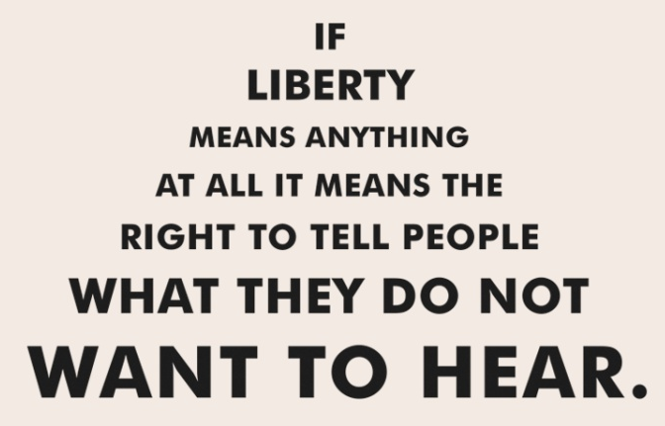
In writing, analyze one of the Orwell quotes and turn in.
“Political language – and with variations this is true of all political parties, from Conservatives to Anarchists – is designed to make lies sound truthful and murder respectable, and to give an appearance of solidity to pure wind.”

