Slide 1
What Smith saw in your outlines…
Your evidence SHOULD be of literary techniques
  Authors do more to develop their specific concerns/purpose about dehumanization than just including plot
Very few of you had works cited or proper MLA formatting
  IF you are writing about a movie or show, cite the FILM and the SCRIPT– you’ll draw evidence from both. Script Example: “Everyone waits in silence. They all avoid making eye contact. David grabs a coffee table book from the coffee table next to him. He flicks through the pages quickly, looking at the pictures without any real interest.” (Lanthimos).
Most of your analysis was not comparative in nature.
  50-70% of your analysis should be comparative to hit the A/B range in analysis
The most successful papers (usually*) have BTS about both texts to help you focus
Don’t speculate or summarize, they’re NOT analysis

Slide 2
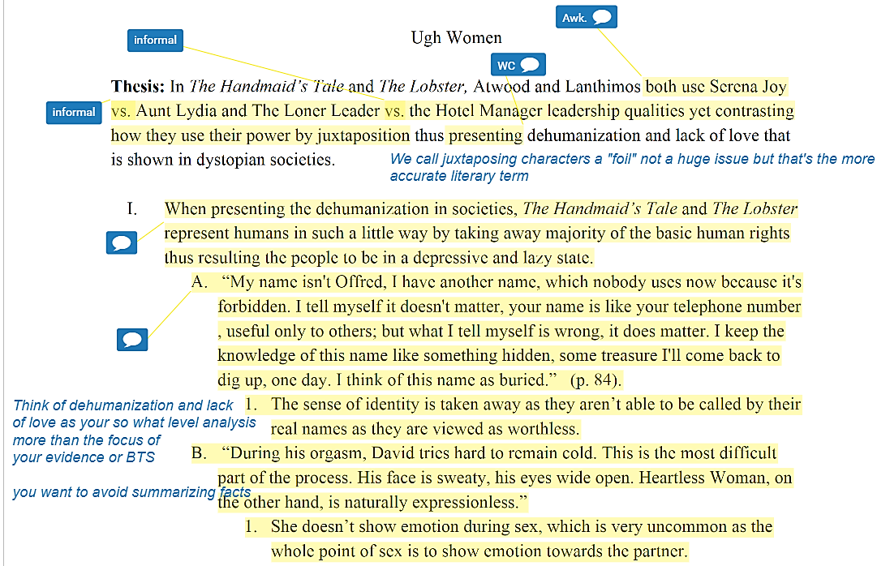
‘Typical Example’#1/#5:
Evidence should be of how author uses/ develops X literary device to create a specific thematic concern which leads to dehumanization

Slide 3
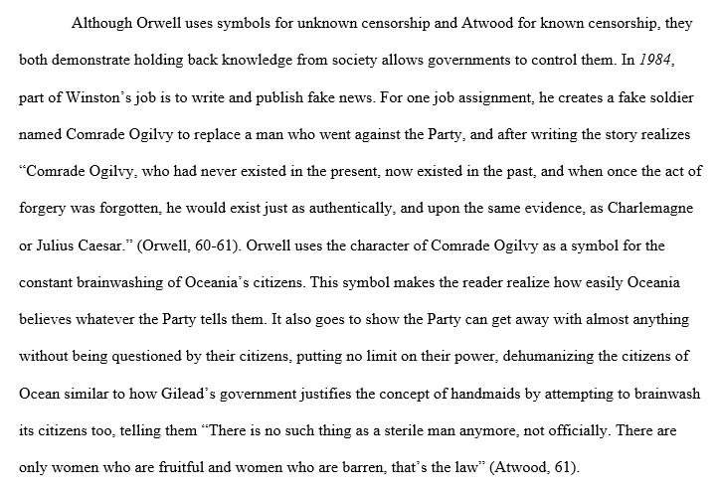
‘Correct Example’
#1/#4:

Slide 4
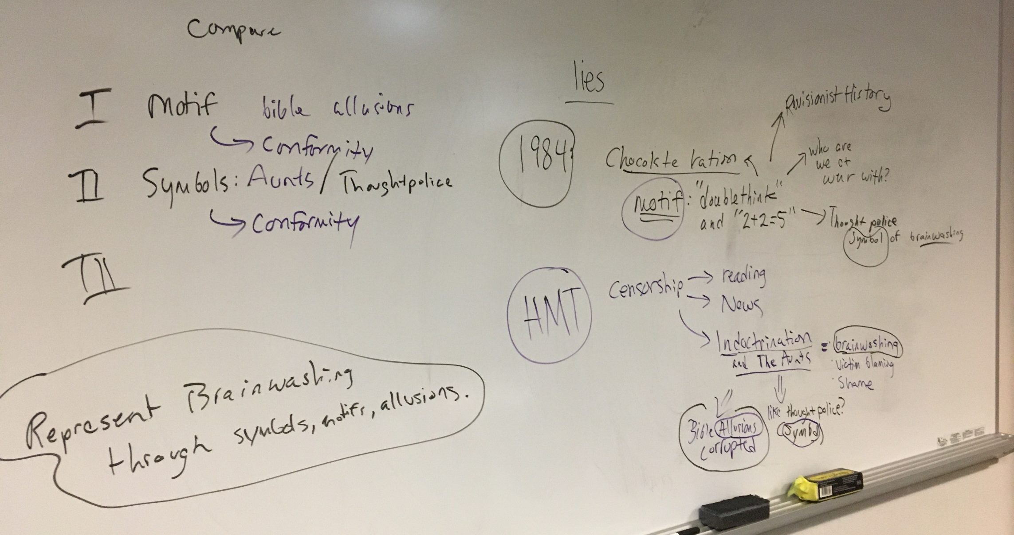
Struggling with the literature? Break it down

Slide 5
Outlines → Rough Drafts
More than just deleting the layers (something many of you catastrophically screwed up anyways).
Reorganize to focus on comparative analysis ☺
Improve evidence and INTEGRATE it into sentences.
Improve analysis/ construct nuanced comparative arguments
Construct transitions
Polish: improve grammar and syntax.

Slide 6
Integrating Evidence
Integrating evidence means incorporating cited quotes (evidence) from the text into sentences of your own writing. This is an essential requirement of writing in all fields.
Example:
Narciso, who lost his innocence, asks Antonio to confess him: “’Then pray for me,’ he said weakly and closed his eyes, ‘you are pure of heart-‘” (Anaya 170).
What do you see?

Slide 7
Integrating Evidence
Here are three ways to integrate evidence:
1. Leading Sentence followed by a quote (to set up plot or context of quote)
• Napoleon finds the puppies and instantly seeks to gain an advantage over Snowball when he “took the puppies away from their mothers, saying that he would make himself responsible for their education.” (Orwell, 31).
2. Claim or Statement of your own with quoted material worked in
• Boxer truly believes that “Napoleon is always right” and his motto mirrors the proletariats’ opinion of Stalin, created by Russia’s Cult of Personality. (Orwell, 76).
3. Claim or Statement of your own followed with a colon
• The narrator leads readers to believe the animals are stupid with irony: “They saw now that the Commandment had not been violated; for clearly there was good reason for killing the traitors who had leagued themselves with Snowball.” (Orwell, 112).
• Even before Snowball was chased off the farm things had begun to deteriorate: “The animals were not badly off throughout that summer, in spite of the hardness of their work. If they had no more food than they had had in Jones’s day, at least they did not have less.” (Orwell, 71).

Slide 8
Way over the word count? Feeling repetitive?
Trim Evidence to what you actually need:
  Achebe foreshadows Okonkwo’s lack of self-control with the symbolism of Okonkwo’s gun: “He pressed the trigger and there was a loud report accompanied by the wail of his wives and children. He threw down the gun and jumped into the barn and there lay the woman, very much shaken and frightened but quite unhurt. He heaved a heavy sigh and went away with the gun.” (Achebe 16). 68 words.
  Achebe foreshadows Okonkwo’s lack of self-control with the symbolism of his gun: “Okonkwo … ran madly into his room for the loaded gun,” and “heaved a heavy sigh and went away with the gun” when he realized he had missed killing Ekwefi (Achebe 16). 38 words.
  Achebe foreshadows Okonkwo’s lack of self-control with the symbolism of his gun by associating chaotic words like “madly,” “wail,” “loud,” and “shaken and frightened” when Okonkwo unthinkingly nearly murders Ekwefi (Achebe 16). 30 words.
Paraphrase evidence:
  Achebe foreshadows Okonkwo’s lack of self-control with the symbolism of guns when Okonkwo unthinkingly nearly murders Ekwefi (Achebe 16). 18 words.

Slide 9
Integrating Evidence
You might have heard teachers say TLQ: Transition-Lead in-Quote.
Next, Narciso, who already lost his innocence, asks Antonio to confess him: “’Then pray for me,’ he said weakly and closed his eyes, ‘you are pure of heart-‘” (Anaya 170).
At least use integration of evidence to get all the plot and context out of the way…

Slide 10
Quoting Dialogue: MLA Formatting
Integrate multiple character dialogue by using line breaks to signify change in speakers (similar to how it appears in the actual novel). For example:
You should only do this when it is ABSOLUTELY necessary.
Otherwise, utilize breaks in quotations to include dialogue. For example:
Okonkwo “demanded to know ‘who killed this banana tree?’” and Ekwefi is the only woman with the courage to speak: “nobody killed it.” (Achebe, 16).
Body thesis statement, blah blah. Early in F. Scott Fitzgerald’s The Great Gastby, Miss Baker tells the narrator, Nick Carraway, that she knows someone from his town:
“You live in West Egg,” she remarked contemptuously. “I know somebody there.”
“I don’t know a single–”
“You must know Gatsby.”
“Gatsby?” demanded Daisy. “What Gatsby?” (Fitzgerald 11).
This is the first time that Fitzgerald develops the possibility of Gatsby being someone other than who he claims. Blah, blah analysis, blah.

Slide 11
Clarifying your Evidence: MLA Formatting
If you add a word or words in a quotation, you should put brackets around the words to indicate that they are not part of the original text. For example:
If you omit a word or words from a quotation, you should indicate the deleted word or words by using ellipsis marks, which are three periods ( . . . ) preceded and followed by a space. For example:
DO NOT start or end citations with ellipsis. It is unnecessary.
Jan Harold Brunvand, in an essay on urban legends, states, "some individuals [who retell urban legends] make a point of learning every rumor or tale" (Brunvand 78).
In an essay on urban legends, Jan Harold Brunvand notes "some individuals make a point of learning every recent rumor or tale . . . and in a short time a lively exchange of details occurs" (Brunvand 78). Blah blah analysis.

