Slide 1
POP Quiz: For the following ad:
How are the ads utilizing ethos, logos, or pathos?
How effective are they at persuading?
Who is their target audience?

Slide 2
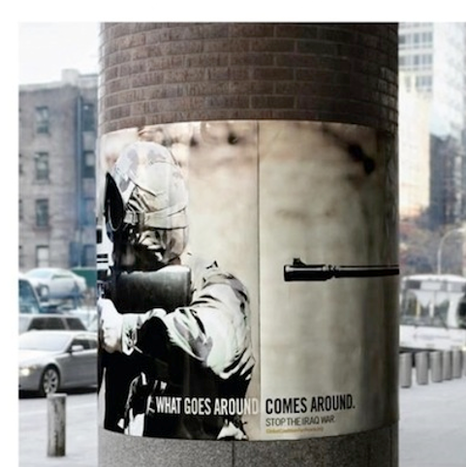

Slide 3
Quiz: For the following ad:
How are the ads utilizing ethos, logos, or pathos?
How effective are they at persuading?
Who is their target audience?

Slide 4
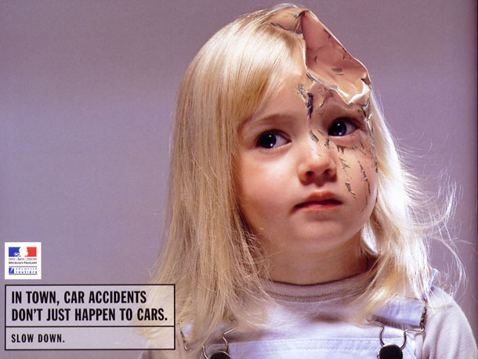

Slide 5
Discuss
How can you tell the difference between what is real (trustworthy) and what is not? How can we evaluate the truthfulness of what we read or watch?
Do you think most people can tell the difference between what is reliable and trustworthy and what is not? Why or why not?
What do you think our focus on media and reality television says about our society as a whole? Why?
What is fake news? Who creates it? Why? Do you think you have read a fake news story?

Slide 6
So what?
The media/corporations/politicians/everyone else is constantly trying to persuade you. The words, images, and sounds they choose work together to make you believe what they want you to believe.
→They’re really good at this!

Slide 7
Journal #6: Propaganda
Learning Targets:
Students will be able to synthesize definitions of propaganda to create their own definition.
Students will be able to identify and evaluate various propaganda techniques.
Students will be able to connect rhetoric and propaganda.

Slide 8
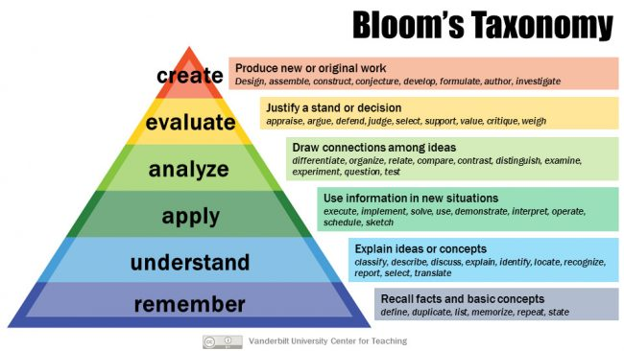
What is Synthesis?
Synthesis is where students put the parts they’ve learned together into a whole to create a new meaning or structure.

Slide 9
Why is propaganda hard to define?
All this will indicate that there is a lot of difficulty in working out any formal definition of propaganda. Most experts of the subject agree that propaganda has to do with any ideas and beliefs that are intentionally spread. They agree also that it attempts to reach a goal by making use of words and word substitutes (pictures, drawings, graphs, exhibits, parades, songs, and similar devices). Moreover, although it is used in controversial situations, most experts agree that it is also used to promote noncontroversial, or generally acceptable, ideas. Types of propaganda range from the selfish, deceitful, and subversive to the honest and aboveboard promotional effort. It can be concealed or open, emotional or containing appeals to reason, or a combination of emotional and logical appeals.

Slide 10
How will we use synthesis to learn about propaganda?
We will look at propaganda techniques!
We will look at specific examples of propaganda!
We will look at different definitions of propaganda!

Slide 11
Checkpoint 1: Based on What you know or have heard:
What does propaganda mean? Don’t look it up but list whatever you know about it or think you know. Feel free to list words you think are similar or any connotations you have with the word!

Slide 12
Propaganda Technique #1: “BANDwagon”
an appeal to (persuade) the subject to follow the crowd, to join in because others are doing so as well. Bandwagon propaganda is, essentially, trying to convince the viewer that one side is the preferable or better option, because more people have joined it.

Slide 13
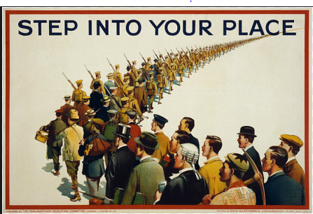
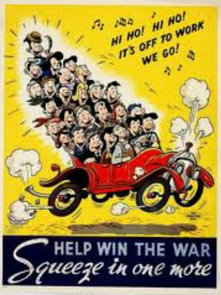
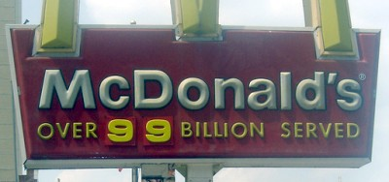

Slide 14
Propaganda Technique #1: “BANDwagon”

Slide 15
Propaganda Technique #2: “Assertion”
An appeal to persuade the viewer using an enthusiastic or energetic statement presented as a fact, although it is not necessarily true. Often implies that the statement requires no explanation or evidence, but that it should merely be accepted without question.

Slide 16
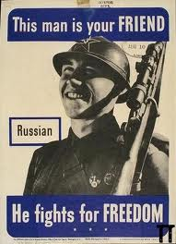

Slide 17
Propaganda Technique #3: “False Equivalence”
False Equivalency is comparing or equating things that are not appropriately similar in terms of magnitude, importance, severity, or blame. The purpose of a false equivalency can be to deflect attention from one side or part of an issue to diminish victims, raise up perpetrators, appeal to hypocrisy, convolute the narrative, or obfuscate the truth. Oftentimes false equivalency most easily noticed in entertainment and/or news media.
In some cases false equivalency can also be called “Bothsiderism” and results from an attempt to provide overly ‘balanced coverage,’ even when the truth is discernable. The purpose of “Bothsiderism” is to make the truth appear to be a (1) matter of opinion, (2) unknowable, or (3) ‘somewhere in the middle.’ However, it is a logical fallacy to always assume the truth lies somewhere in the middle of two competing versions.

Slide 18
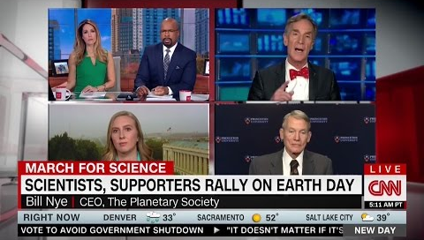
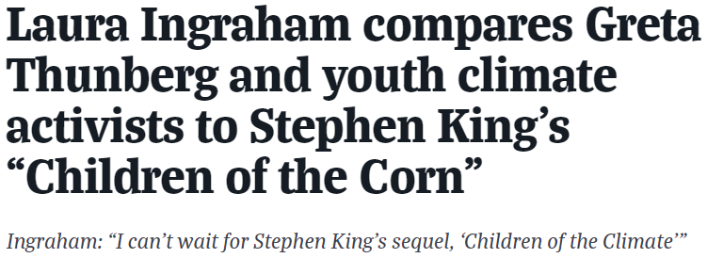
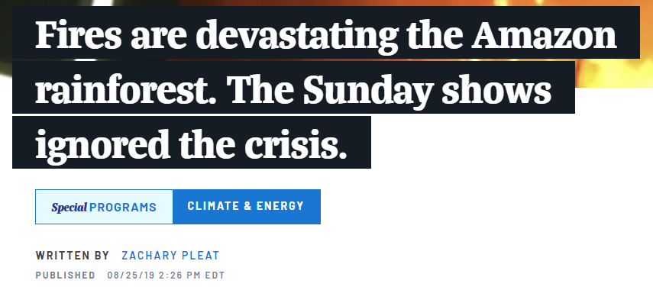
Propaganda Technique #3: “False Equivalence”
Notes:
https://fair.org/home/in-month-after-charlottesville-papers-spent-as-much-time-condemning-anti-nazis-as-nazis/

Slide 19
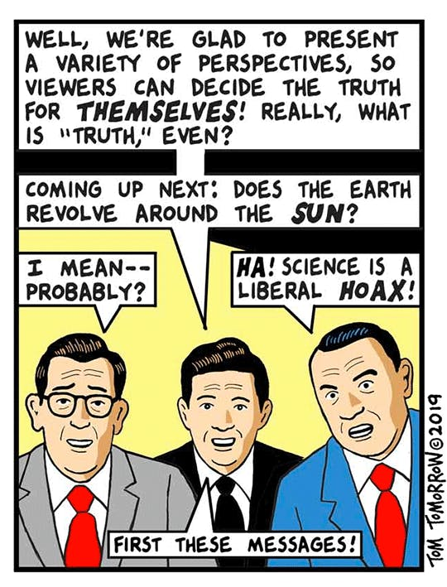
Propaganda Technique #3: “False Equivalence”
“Bothsiderism” can involve promoting conspiracy theories on one hand in response to more legitimate views.
SILLY
Notes:
https://fair.org/home/in-month-after-charlottesville-papers-spent-as-much-time-condemning-anti-nazis-as-nazis/

Slide 20
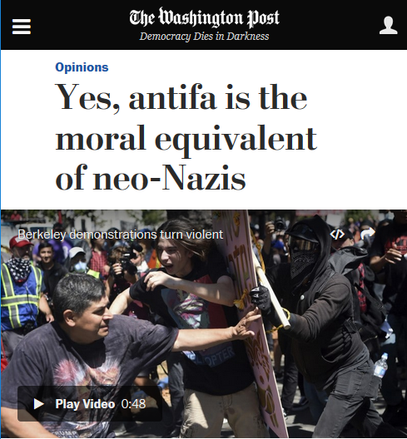
Propaganda Technique #3: “False Equivalence”
Since the Charlottesville attack a month ago, a review of commentary in the six top broadsheet newspapers—the Wall Street Journal, NYT, USA Today, LA Times, San Jose Mercury News and Washington Post—found virtually equal amounts of condemnation of fascists and anti-fascist protesters.
Between August 12 and September 12, these papers ran 28 op-eds or editorials condemning the anti-fascist movement known as Antifa, or calling on politicians to do so, and 27 condemning neo-Nazis and white supremacists, creating a false equivalency.
In Charlottesville no person supporting Antifa killed anyone, while one of the many moments of Neo-Nazi violence killed Heather Heyer and injured 28 others.
Notes:
https://fair.org/home/in-month-after-charlottesville-papers-spent-as-much-time-condemning-anti-nazis-as-nazis/

Slide 21
Propaganda Technique #3: “False Equivalence”
Consider this brief period of history last week: A neo-Nazi murdered 11 Jewish people in a Pittsburgh synagogue; another white supremacist in Kentucky shot dead two black people after attempting to attack a black church; and another sent out 14 mail bombs. Faced with the task of reflecting on a historic week of racist or anti-Semitic violence, however, liberal and centrist media outlets have continued with, at best, fangless and, at worst, equivocal responses to the rise of fascism.
The response from the New York Times editorial board last weekend offers a case study in false equivalencies and platitudes under the veneer of anti-racism. The board went as far as noting that “hate appears to be on the rise,” in an op-ed which cited statistics showing that anti-Semitic and racist hate not only appears to be but, in fact, is on the rise. The board’s main solution was to call for “more good speech, from more good people.” It was a riff on a quote, also used in the editorial, from none other than Facebook honcho Mark Zuckerberg, who invoked the need for “good speech” as a response to his website’s failure to police Holocaust denial. The idea that “good speech” is a sufficient weapon against rising fascism — and the desires and collectivities that fuel it — is a misplaced fantasy.
Notes:
https://fair.org/home/in-month-after-charlottesville-papers-spent-as-much-time-condemning-anti-nazis-as-nazis/

Slide 22
Propaganda Technique #3: “False Equivalence”
Notes:
https://fair.org/home/in-month-after-charlottesville-papers-spent-as-much-time-condemning-anti-nazis-as-nazis/

Slide 23
Propaganda Technique #4: “Name Calling”
An appeal to persuade the viewer against something using derogatory language or words that carry a negative connotation when describing an opponent, alternate idea, or enemy. The propaganda attempts to arouse prejudice among the public by labeling the target as something that the public dislikes. Commonly used in politics.

Slide 24
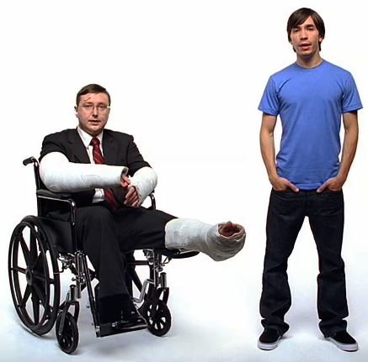
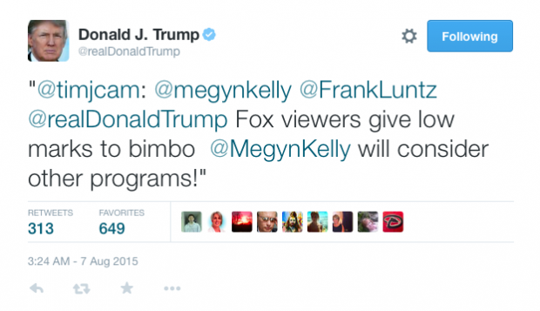
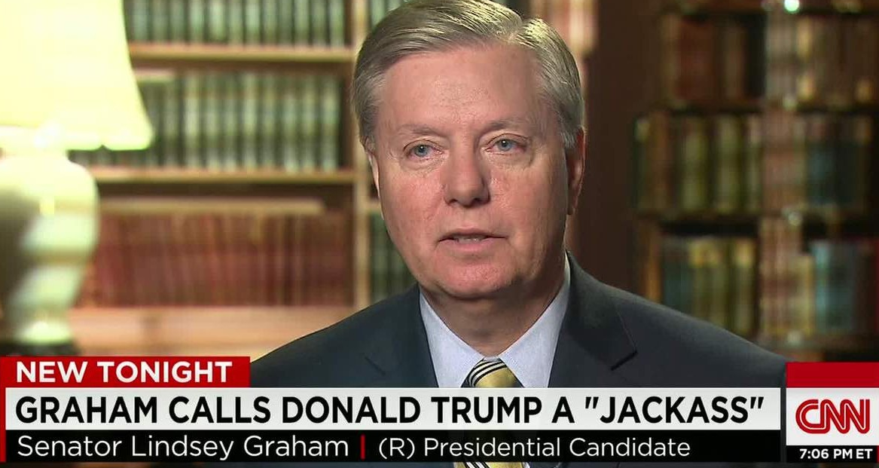

Slide 25
Checkpoint #2
Based off the four propaganda techniques, and what you already knew, what is propaganda?
What do you notice about the examples so far? How does ethos, logos, pathos play into them? What about connotation?

Slide 26
Propaganda Technique #5: “Plain folks”
An appeal to persuade the viewer that their position or arguments reflect those of the average person and that they are also working for the benefit of the common person. Also that the speaker is a normal person.
the propagandist, especially during speeches, may attempt to increase the illusion through imperfect pronunciation, stuttering, and a more limited vocabulary. Errors such as these help add to the impression of sincerity and spontaneity.

Slide 27
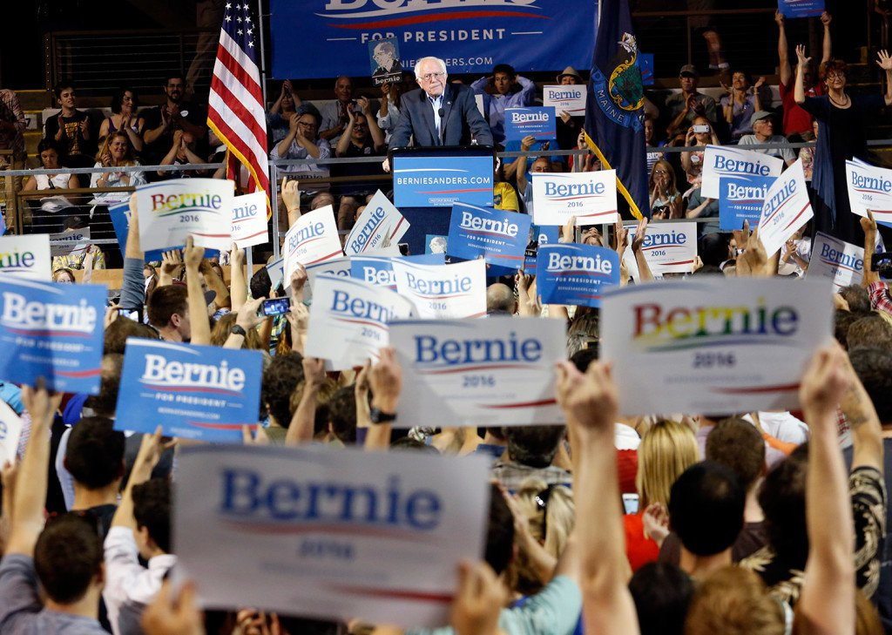
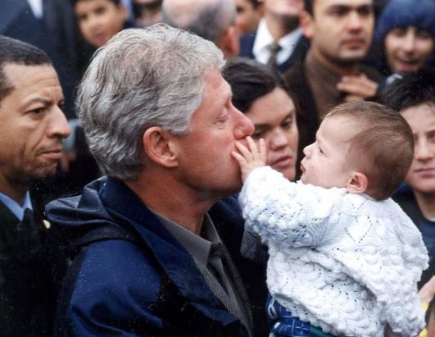
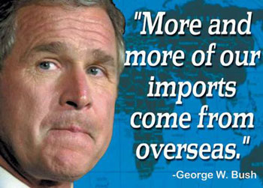

Slide 28
Propaganda Technique #6: “Glittering Generalities”
Glittering generalities are words (or short phrases) that have widespread positive meaning for individual people– even if the words mean different things from person to person. Glittering generalities are linked to a culture’s highly valued concepts and ideas.
When these words are used, they demand approval without thinking, simply because such an important concept is involved.
What words do you think would be highly valued by Americans? List 8.

Slide 30
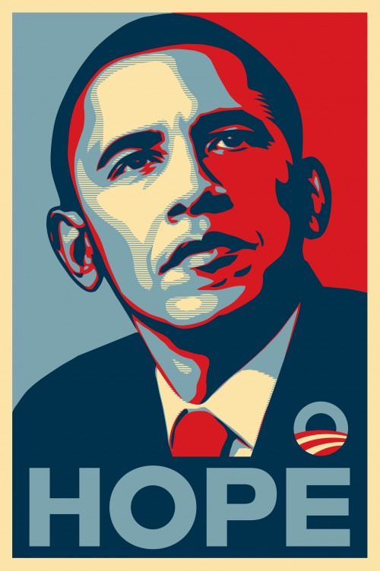
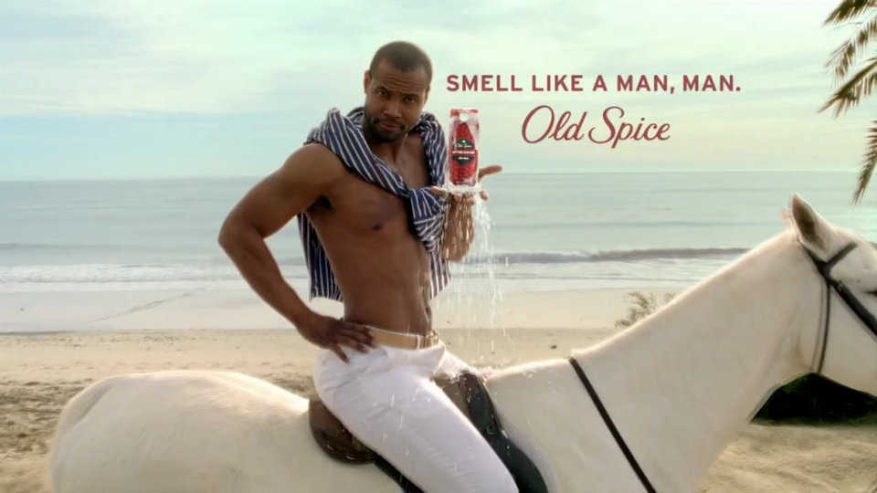

Slide 31
Techniques #2 & #6: “Assertion” + “Glittering Generalities”

Slide 32
Propaganda Technique #7: “Lesser of two evils”
tries to convince viewers to support an idea or proposal by presenting it as the least bad option, among many bad choices.
This technique is often implemented during wartime to convince people of the need for sacrifices or to justify difficult decisions. This technique is often accompanied by adding blame on an enemy country or political group. One idea or proposal is often depicted as one of the only options or paths.

Slide 33
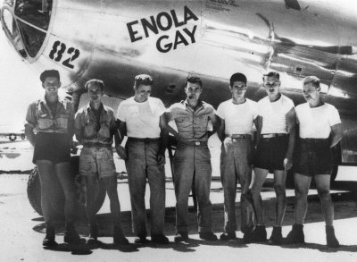
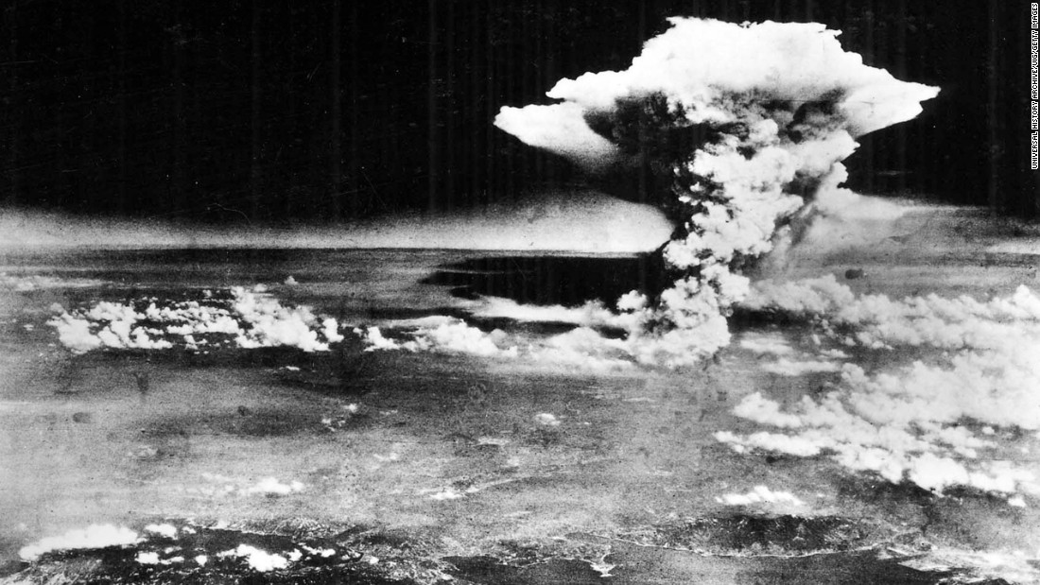
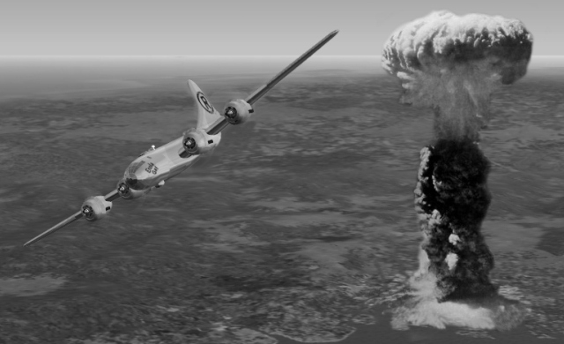
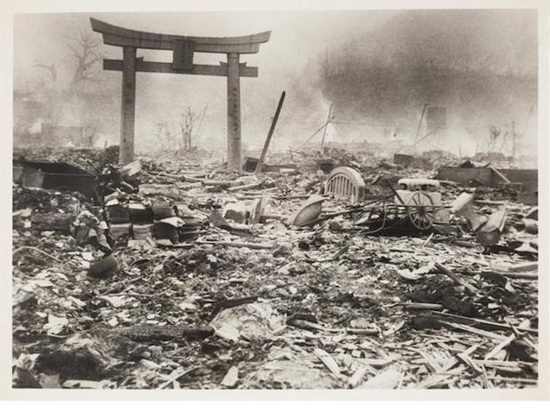

Slide 34
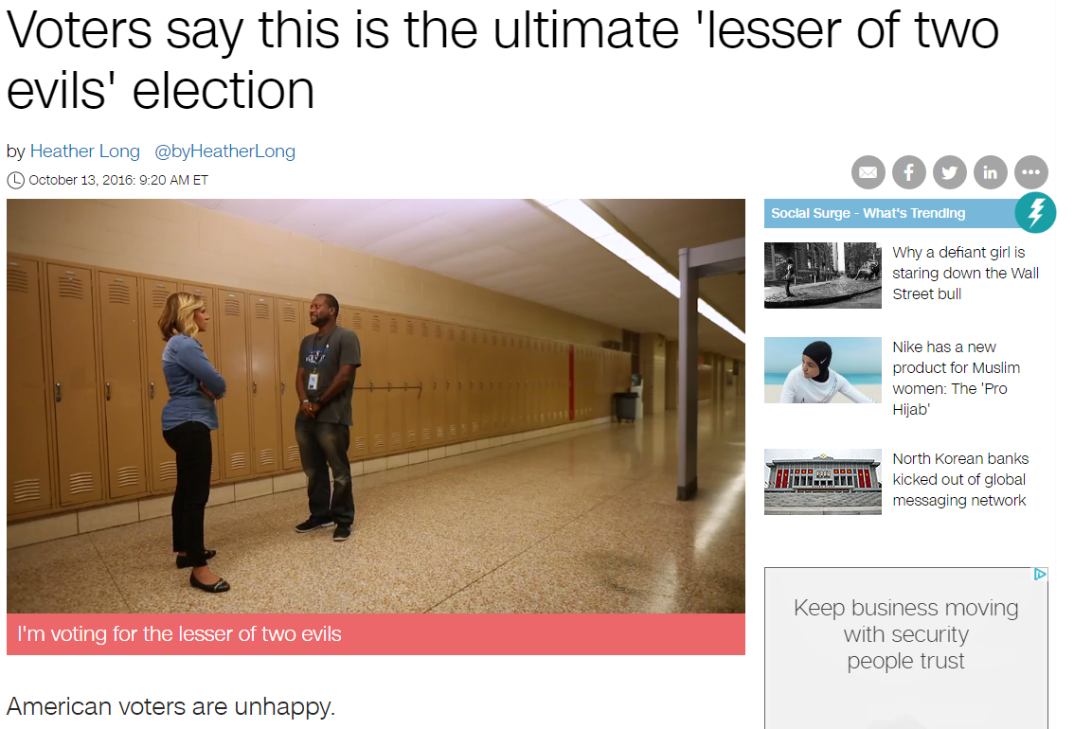

Slide 35
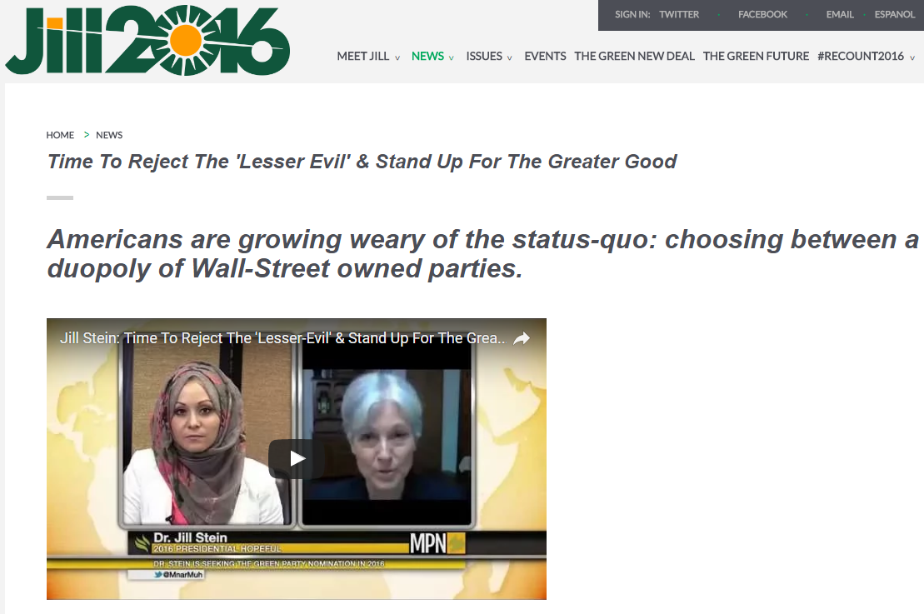

Slide 36
Checkpoint #3
Based off the propaganda techniques, and what you already knew, what is propaganda?

Slide 37
Review! Journal 18 so far
What are our learning targets?
What type of learning/thinking activity are we engaged in?
What types of propaganda have we examined so far?
What is the difference between your first definition of propaganda and check point one?
What have you noticed about the examples so far?

Slide 38
Propaganda Technique #8a: “Card Stacking”
only presenting information that is positive to an idea or proposal and omitting information contrary to it. Card stacking is used in almost all forms of propaganda, and is extremely effective in convincing the public.
Although the majority of information presented by the card stacking approach is true, it is dangerous because it leaves out important information.
Also: Only presenting the pros and not the cons.

Slide 39
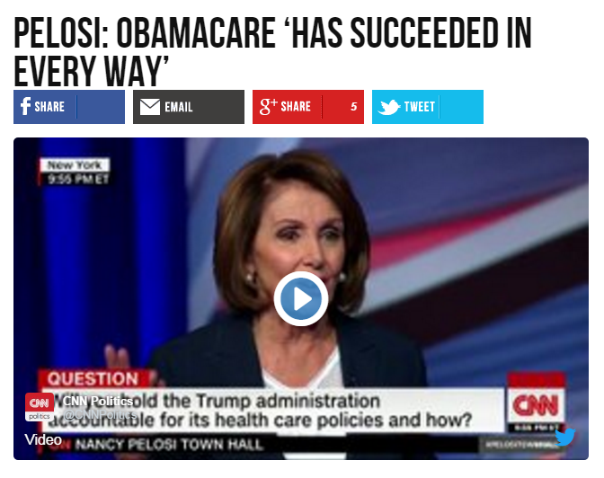
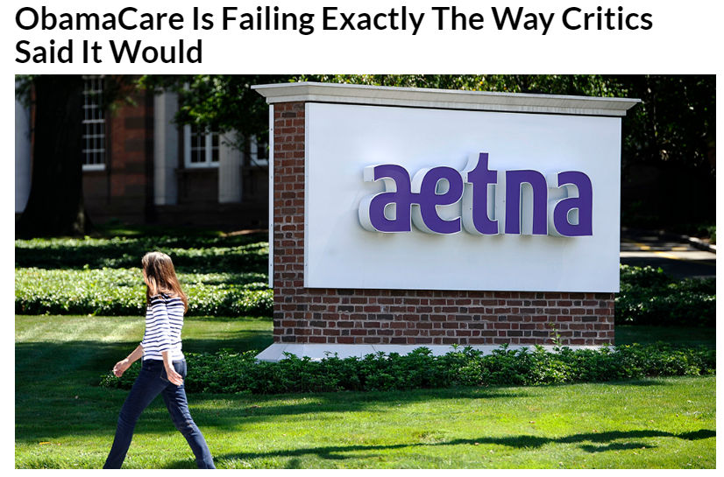

Slide 41
Propaganda Technique #8b: “Misleading numbers”
involves the propagandist using numbers or statistics that aren't always valid or are manipulated in various ways. The numbers presented aren't pure lies, however, sometimes they are shown in certain ways which cause them to be interpreted differently than they should be or context is missing.

Slide 43
Propaganda technique #9: “whataboutism”
Deflecting difficult subjects or questions by purposefully changing the subject.
Whataboutism refers to the practice of deflecting criticism by pointing to the misdeeds of others. Oxford Dictionaries defines it as “the technique or practice of responding to an accusation or difficult question by making a counter-accusation or raising a different issue.”
Essentially, it’s an appeal to hypocrisy ― a logical fallacy also known as “tu quoque.” Instead of proving that your opponent’s claim is wrong on its face, whataboutism argues that it’s unfair of the opponent to make that claim at all.

Slide 44
Propaganda technique #10: “Fear mongering”
Using frightening and exaggerated rumors of impending danger to persuade viewers to act in a certain way, or the habit or tactic of purposely and needlessly arousing public fear about an issue.
One type of Fear Mongering is “Us Vs. Them”: ‘THEY are stealing from US’; ‘THEY are ruining OUR country’; ‘THEY are corrupting OUR values.’

Slide 45
“Bolshevism without its Mask”
This remarkable German postcard depicts the Earth, marked with a Star of David and a Communist Star on fire. A soldier with a skull for a face sits atop the burning planet. The implication is that he is a Soviet soldier secretly ruled by the Jews. These cards were quite popular during the Great Anti-Bolshevik Exhibition. The exposition was held in Berlin Nov 1937 to Jan 1938, Hamburg March to April 1938, and Vienna Dec 1938 to Feb 1939.

Slide 46
Propaganda outside of these techniques…
The propagandist tries to stimulate others to accept their claims without challenging the ideas, or to act as they want them to do. The idea of using suggestion or stimulation as propaganda is that it will lead a public to accept a proposition even though there are not logical grounds to do so.
How does the propagandist use this tool? By making broad and positive statements. By presenting statements in simple and familiar language. By refusing to admit, or even suggest, that there is another side to the question. Hitler’s brutal and direct suggestion that the Jews sold out the German people in World War I—the “stab in the back,” the Nazi propagandists called it—is an example of this kind of propaganda.

Slide 47
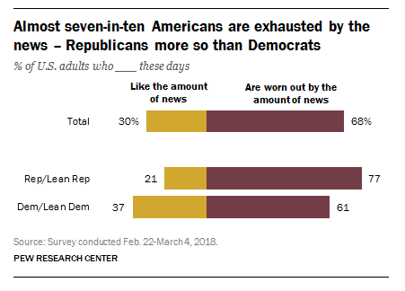
Propaganda outside of these techniques…
The Russian dissident and chess grandmaster Garry Kasparov drew upon long familiarity with propaganda when he tweeted: “The point of modern propaganda isn’t only to misinform or push an agenda. It is to exhaust your critical thinking, to annihilate truth.” Mr. Kasparov grasps that the real threat is not merely that a large number of Americans have become accustomed to rejecting factual information, or even that they have become habituated to believing hoaxes. The real danger is that, inundated with “alternative facts,” many voters will simply shrug, asking, “What is truth?” — and not wait for an answer.

Slide 48
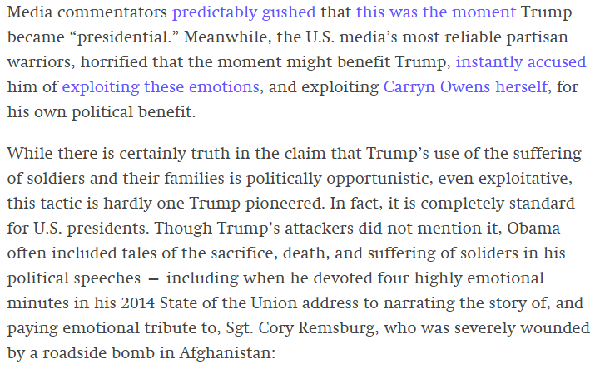
Propaganda outside of these techniques…
https://www.youtube.com/watch?v=z_3FR6FrTEk
https://theintercept.com/2017/03/01/trumps-use-of-navy-seals-wife-highlights-all-the-key-ingredients-of-u-s-war-propaganda/

Slide 49
For reference
https://www.historians.org/about-aha-and-membership/aha-history-and-archives/gi-roundtable-series/pamphlets/what-is-propaganda/what-are-the-tools-of-propaganda
https://www-tc.pbs.org/weta/reportingamericaatwar/teachers/pdf/propaganda.pdf

Slide 50
What Type of rhetoric does propaganda rely on?
For each of the rhetoric terms listed, pick 2 types of propaganda that rely on inaccurate or misleading uses of it to work.
Ethos
____________ because ____________.
____________ because ____________.
Logos
____________ because ____________.
____________ because ____________.
Pathos
____________ because ____________.
____________ because ____________.
What did you realize while doing this? Was it hard? Easy? Which rhetorical appeal was most commonly used?

Slide 51
Several different definitions of propaganda
Most students of the subject agree that propaganda has to do with any ideas and beliefs that are intentionally spread. They agree also that it attempts to reach a goal by making use of words and word substitutes (pictures, drawings, graphs, exhibits, parades, songs, and similar devices). Moreover, although it is used in controversial situations, most experts agree that it is also used to promote noncontroversial, or generally acceptable, ideas. Reasons for propaganda range from the selfish, deceitful, and subversive to the honest and aboveboard promotional effort.

Slide 52
Several different definitions of propaganda
information, especially of a biased or misleading nature, used to promote a political cause or point of view.
ideas, facts, or allegations spread deliberately to further one's cause or to damage an opposing cause.
the use of a variety of communication techniques that create an emotional appeal to accept a particular belief or opinion, to adopt a certain behavior or to perform a particular action. There is some disagreement about whether all persuasive communication is propagandistic or whether the propaganda label can only be applied to dishonest messages.
NOW SYNTHESIZE YOUR OWN DEFINITION OF PROPAGANDA

Slide 53
Is Propaganda always bad?
Or only used by ‘bad’ people or people who are wrong?
Are all one sided arguments propaganda?
Who is most likely to use propaganda?
Is all advertising propaganda?

Slide 54
How can we Fight Political misinformation and propaganda?
Use Fact Checks!
Be skeptical! Be wary of ‘common sense.’
Avoid hyper-partisan websites and media.
Read reviews of products and services.
Check the ‘fine print.’
Who pays for the information?
Who benefits from the information?
Is the ‘other side’ presented?

Slide 55
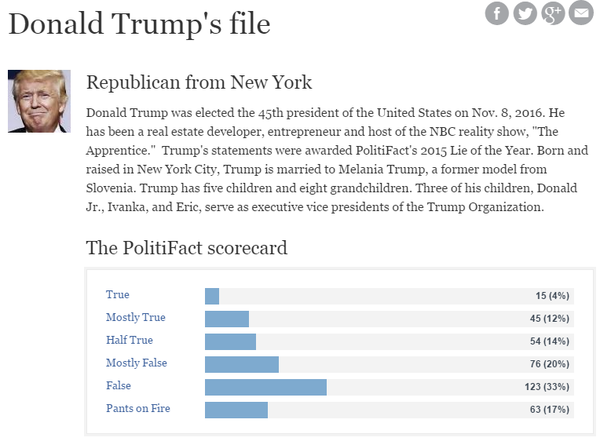
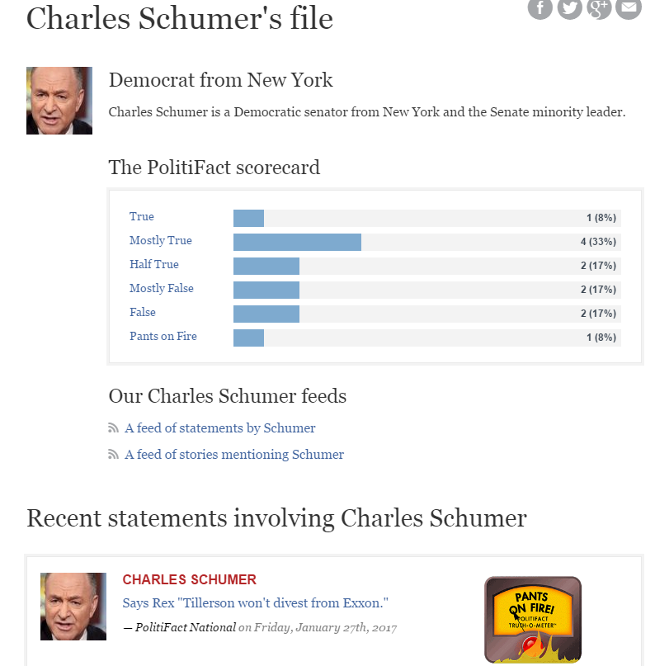
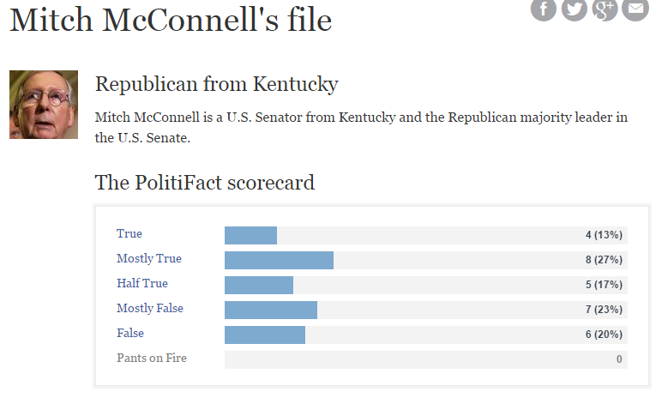
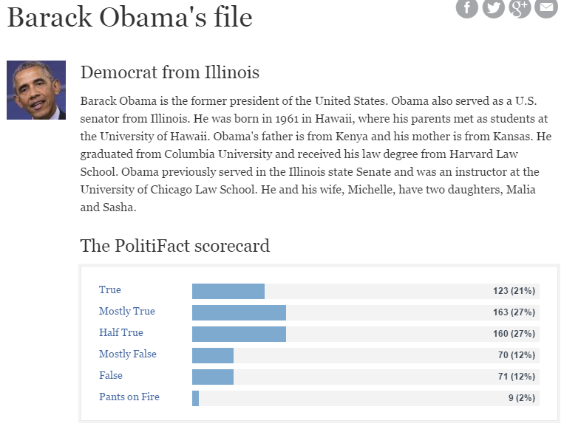
How can we Fight Political misinformation and propaganda?

Slide 56
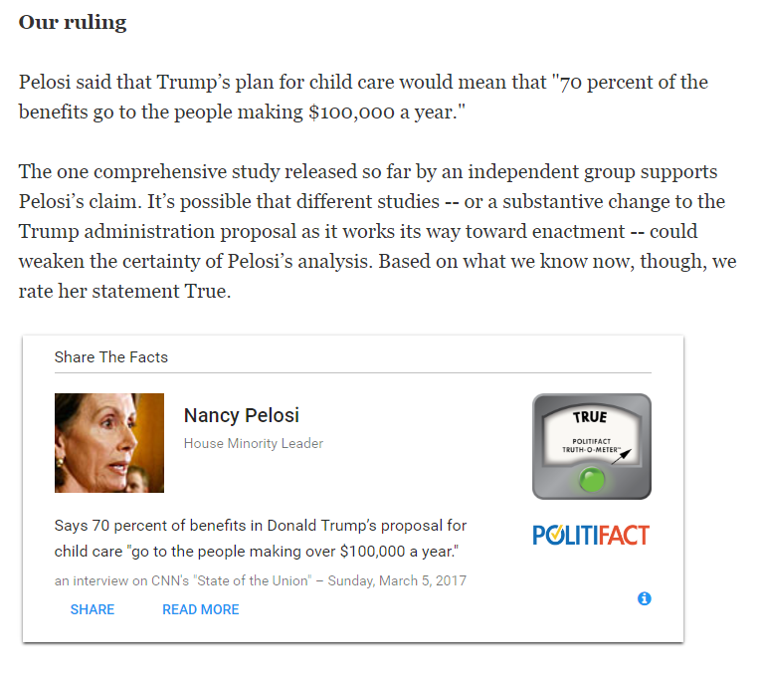
PolitifacT

Slide 57
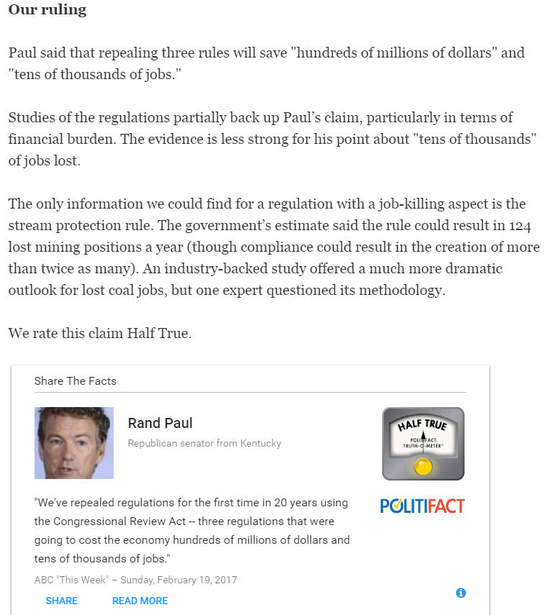
PolitifacT

Slide 58
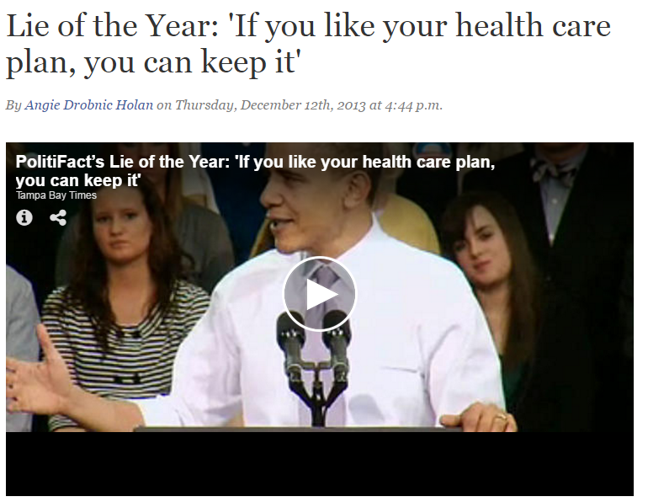
PolitifacT

Slide 59
Propaganda
In your journal, create propaganda to persuade Smith to stop giving you HW.

