Slide 1
Discuss
How can you tell the difference between what is real (trustworthy) and what is not? Do your teachers allow you to do this? How can we evaluate the truthfulness of what we read or watch?
Do you think most people can tell the difference between what is reliable and trustworthy and what is not? Why or why not?
What do you think our focus on media and reality television says about our society as a whole? Why?
How is the media influencing you today, as a freshman in 2017?
What is the relationship between media and culture?
What is fake news? Who creates it? Why? Do you think you have read a fake news story?
What is propaganda? Who creates it? Why?

Slide 2
So, what?
The media/corporations/politicians/everyone else is constantly trying to persuade you. The words, images, and sounds they choose work together to make you believe what they want you to believe.
They’re really good at this!
We’ll learn to analyze the rhetorical devices, propaganda, and hopefully figure out fake news.
Always question everything you see, hear, and read.
Who benefits from the information you’re seeing?

Slide 3
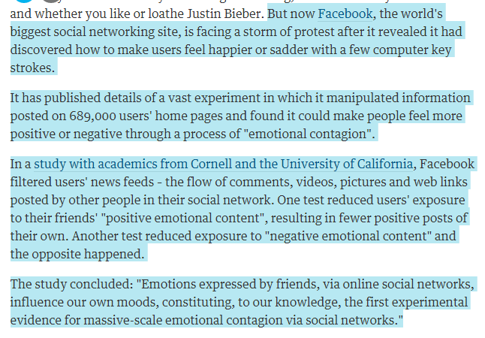

Slide 4
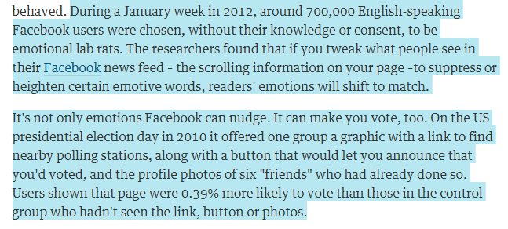

Slide 5
What do you think about this? Does it matter?

Slide 6
Silently, over the next 10 minutes on a separate piece of paper:
Write a letter or speech to persuade your parents to let you have a puppy or kitten– write this assuming they really do not want to let you have one (or another) and you really want one.
Use a variety of persuasive strategies/reasons
Be convincing
Keep it!

Slide 7
“Other Men’s Flowers”
Critically read the article. Smith will check tomorrow that you have marked the text and answered these questions.
What does Rhetoric mean?
What is the best advice for being persuasive?
Find the words ethos/logos/pathos. What do they mean?
What is repetition? Why is it important?
What is the author’s thesis? Write a thesis statement. [clear and specific, arguable claim, so what]

Slide 8
Journal #5: Intro to Rhetoric
Learning Targets:
Students will be able to define, identify, and analyze ethos, logos, and pathos in media and texts.
Students will be able to define and analyze rhetoric in media or text.

Slide 9
Review: Connotation and Denotation
What do these terms mean?
Can you give an example of a two words with similar denotations and very different Connotations?

Slide 10
Word Choice
Diction: word choice that a writer or speaker uses
Denotation: the literal (explicit) meaning of a word
Connotation: the implicit ideas and emotions we associate with a word or phrase. These meanings are socially constructed. Connotative meanings are dynamic over time.

Slide 11
Pull out your worksheet for the John Oliver video we watched before break

Slide 12
With your group copy the chart from the back of your worksheet into your journal!

Slide 13
Connotation: the implicit ideas and emotions we associate with a word or phrase. These meanings are socially constructed.
“a lot of kittens coming”
“a swarm of kittens coming”

Slide 14
Rhetoric:
Rhetoric is the art of effective or persuasive communication (speaking or writing).
When we analyze a speaker/writer/or group’s use of language, style, or messaging we’re studying their rhetoric.
Note: a “rhetorical question” is a question asked in order to create a dramatic effect or to make a point rather than to get an answer.
Aristotle (Greek, 384–322 BC) taught his students that a speaker's ability to persuade is based on how well the speaker appeals to their audience in 3 different areas: ethos, pathos, and logos.

Slide 15
Ethos
Ethos refers to the speaker’s "ethical appeal," or how well the speaker presents themselves. To be persuasive or convincing a speaker must seem like they know what they are talking about. Ethos is the Greek word for “character.”
Do they seem:
Knowledgeable and reasonable? Experienced?
An ‘expert’ or very experienced on the topic?
Trustworthy? Honest? Unbiased?
Ethos can be stated explicitly, implicitly, be visually presented, or rely on reputation.
Visually might be a trusted logo or an expensive suit
Implicitly might include choosing language that is appropriate for the audience and topic

Slide 16
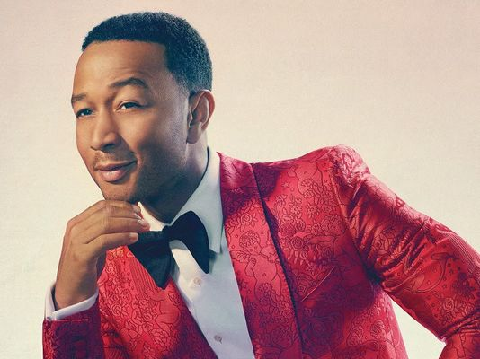
Ethos
Identify how the speaker develops John Legend’s ethos in the clip: https://www.youtube.com/watch?v=Li-G3pyyKtI
Why is John Legend, a pop-musician, a good speaker for a M.L.K. Day Education event?
Is it effective?

Slide 17
Ethos?

Slide 18
Ethos
Compare how 2 different candidates present their ethos on their website?
How effective are they?

Slide 19
Ethos
Kerri Walsh is a multiple Olympic Gold Medalist in Beach Volleyball.
If you eat Corn Flakes, you will become an Olympic Gold Medalist, too!
If she’s eating them, they must be good for you, because she is an Olympic Gold Medalist and they are healthy!

Slide 20
Ethos

Slide 21
Logos
Logos corresponds with the argument's logical appeals; or how well the speaker uses evidence in their argument.
Effective arguments will probably include facts and other supporting details to back up the speaker’s claims.
They may contain testimony from authorities (using their ethos) and will demonstrate the speaker’s carefulness in choosing and considering evidence.
“Common sense” counts, but generally isn’t considered a rhetorically strong logos appeal.
Anecdotes (small, personal stories) count as well, but aren’t considered strong either.
Visually this might be a graph or data.

Slide 22
Logos!

Slide 23
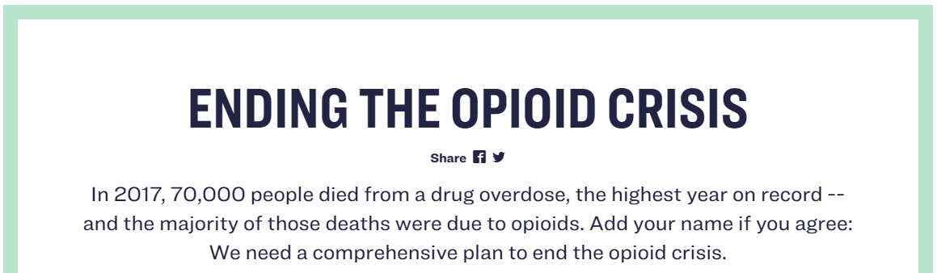
Logos?

Slide 24
Pathos
Pathos refers to the argument's emotional appeals, that is, how well the speaker taps into the audience’s emotions to persuade or convince. Does the argument, language, and content appeal to your emotions:
Sadness
Pride
Fear
being young
Anger
Patriotism
Love
Justice
Negative emotions are psychologically more motivating than positive ones.
Coast Modern’s “Run It Up”:
But if it aches in your heart That means that something must be working

Slide 25
Pathos
Identify how pathos is used in the clip: https://www.youtube.com/watch?v=Pr1BjIJ78Pc

Slide 26
Pathos

Slide 27
Pathos
“Smoking isn’t just suicide. It’s murder.”

Slide 28
Ethos, Logos, and Pathos
Note: Ethos refers to the SPEAKER, though you can use the actual language, structure, content, arguments, evidence, etc. used in your writing or speaking to build it.
However, Logos and Pathos refer to the actual language, structure, content, arguments, evidence, etc. used in your writing or speaking.

Slide 29
Logos and Pathos and Ethos
NOTE: this is an ANTI-VAXXER meme

Slide 30
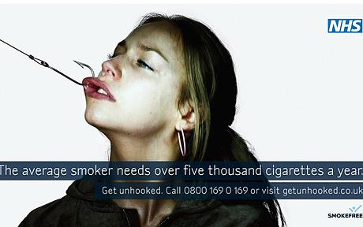
Logos and Pathos and Ethos
How does this ad use all three appeals?

Slide 31
Logos and Pathos and Ethos
How does the first section of the ‘about’ tab on Trump’s website use the three appeals?

Slide 32
Create a metaphor that represents the rhetorical appeals (Ethos, Logos, and Pathos) – draw and explain in your journal!
You should eat me!
DECORATIONS = ETHOS “It looks tasty, I want to eat it.”
TASTE = PATHOS
“Mmm it tastes so good, I want to eat another”
INGREDIENTS = LOGOS “Zero calories?! It would be dumb not to eat it.”

Slide 33
Classify: What and how many types of arguments did you use?
Read your letter and mark it for how you tried to convince your parents to get a pet.
Identify where you used:
Logos?
Ethos?
Pathos?
Lies? (“I’ll walk the dog every day…” No you won’t)
Others?

Slide 34
HOMEWORK DUE Monday
Use the Proquest database to find an editorial on a topic that you find interesting and relates to high school or high school students. Read the editorial and the answer the following questions. Passwords for Proquest can be found on msbacon.com by clicking on the black star. Feel free to type your answers to this assignment.
Include the editorial and annotate the ethos, logos, and pathos.
What is the citation for the editorial?
What would you say the thesis of the editorial is?
What are the 5 most persuasive parts of the editorial’s argument? For each persuasive part identify explicitly what is persuasive: ethos, logos, and pathos.
Overall, how effective is the persuasive argument?

Slide 35
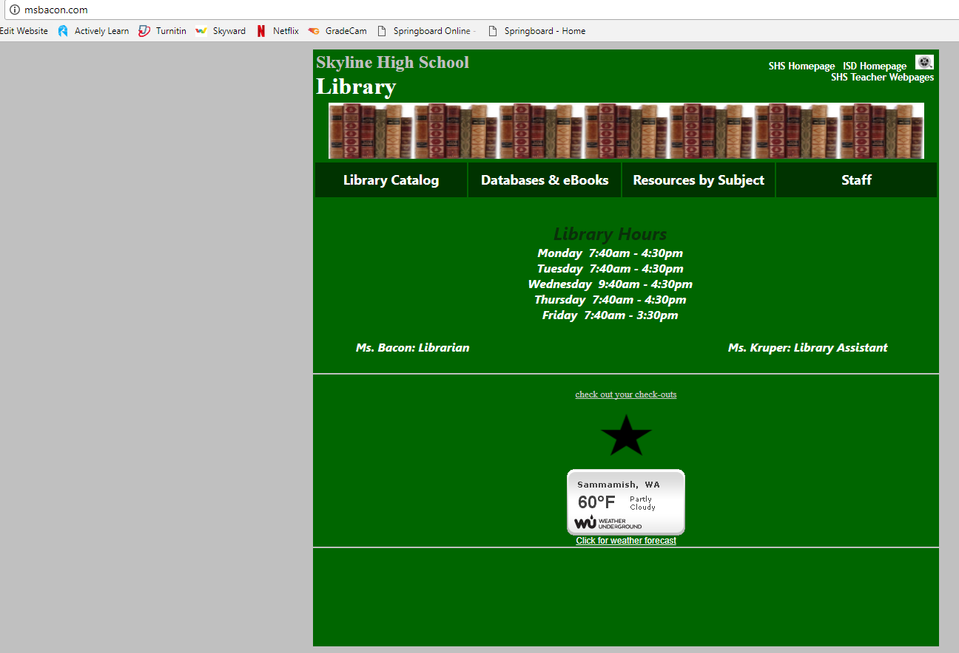

Slide 36
Password?

Slide 37
PROQUEST?

Slide 38
Quiz: For the following ads:
How are the ads utilizing ethos, logos, or pathos?
How effective are they at persuading?
Who is their target audience?

Slide 40
Quiz: For the following ads:
How are the ads utilizing ethos, logos, or pathos?
How effective are they at persuading?
Who is their target audience?

Slide 42
Quiz: For the following ads:
How are the ads utilizing ethos, logos, or pathos?
How effective are they at persuading?
Who is their target audience?

Slide 44
Making rhetoric relevant
RHETORIC in everyday TEXT…
Political discourse
Speeches
Advertising
Social Network
Editorials (opinion articles)
Essays

Slide 45
Making rhetoric relevant
APPLYING RHETORIC…
Resume
Social Media
E-mail
Persuasive Essay
Speech

Slide 46
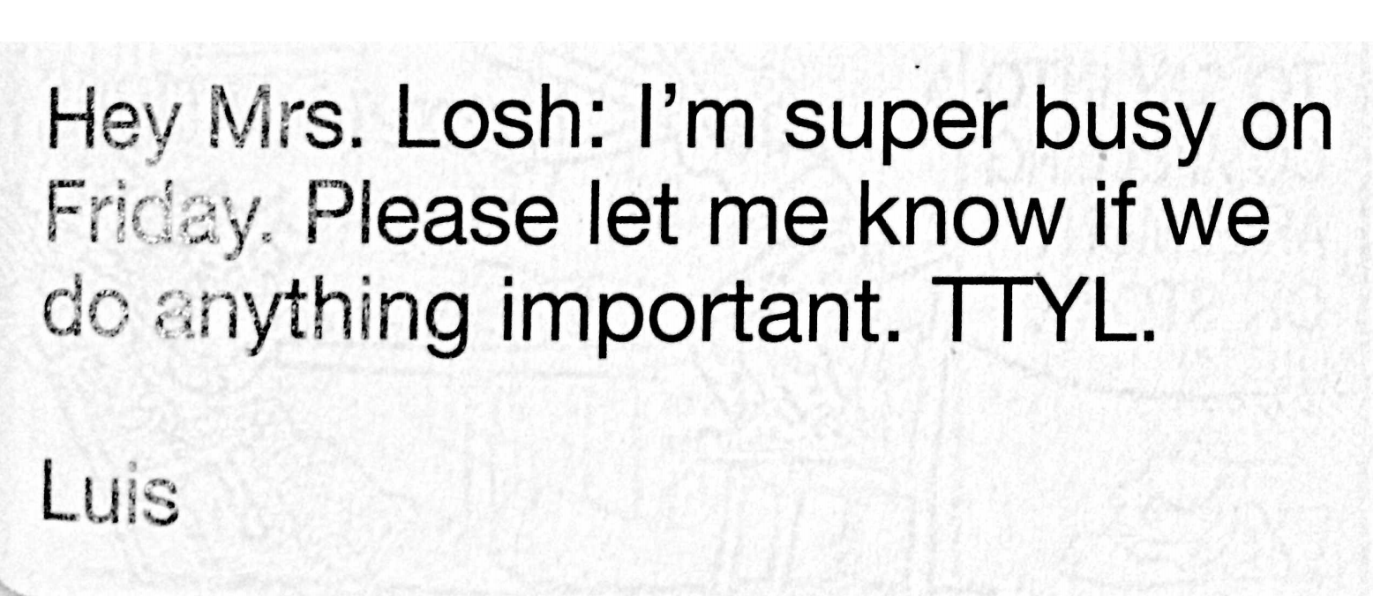
An example ☹

Slide 47
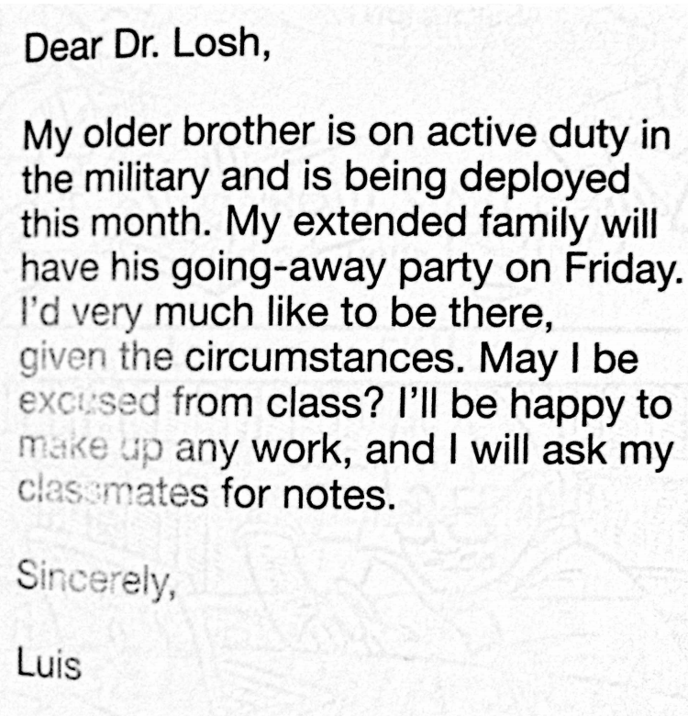
A (revised) example ☺

