Slide 1
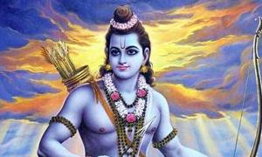
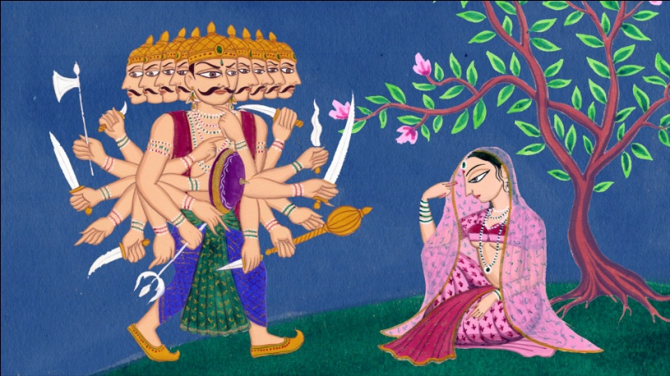
THE RA-MAYA-NA
Read 130-131 and The Ramayana. With your group fill in the Characteristics of an Epic Hero Chart for your journal.
Characters: (of our chunk)
Rama (राम): the epic hero.
Rama is the “Seventh Avatar (reincarnation on earth) of Vishnu” (one of the supreme Hindu god). He isn’t entirely a god though.
He’s blue, brave, good at archery, and honorable.
Shows up in Buddhism as well as Hinduism.
Ravana: Demon, antagonist with 10 heads.

Slide 2
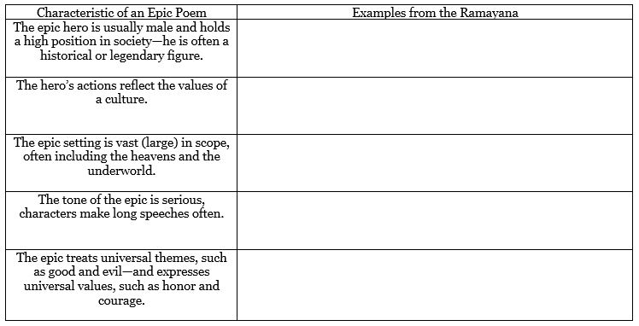
THE RA-MAYA-NA

Slide 3
Discussion Questions
What is the plot of the battle?
What does Ravana mean when he says “Either that woman Sita, or my wife Mandodari, will soon have cause to cry… one of them will be a widow”? (134).
What are the differences between Rama and Ravana?
How does the Ramayana serve as oral tradition? What cultural material is it passing along? How does Rama achieve dharma?

Slide 4
Text Analysis (Epic Poem Chart #2)
What passages reflect “the values of Indian culture” through Rama’s characterization? Use and explain quotes.
“He felt that this might be one way of saving Ravana. With his armies gone, it was possible that Ravana might have a change of heart.” (135).
“But Rama put away his bow and said, ‘It is not fair warfare to attack a man who is in a faint. I will wait. Let him recover,’ and waited.” (138-9).
“He looked concerned at this supposed lapse on his part that Vibishana, Ravana’s brother, came forward to explain. ‘What you have achieved is unique. I say so although it meant the death of my brother.’” (140).

