Slide 1
Science Fiction: Genre
Our texts for this unit are Science Fiction dystopias. Science Fiction:
Genre of fiction often set in the future, in space, on a different world, or in a different universe or dimension. Stories focus on science and technology of the future interacting with people.
Has to have a relationship with the *true* principles of science
Stories involve partially true, partially fictitious laws or theories of science.
Science and technology has to be key to the narrative.
Authors imagine what the future could be like if the science of their time keeps progressing without moral or ethical guidelines.
Science fiction texts also must include a human element: explaining what effect new discoveries, happenings and scientific developments will have on people in the future, often bad.

Slide 2
Science Fiction: Genre
This line, from Jurassic Park (1993), perfectly connects to the purpose of the science fiction genre. How?

Slide 3
Science Fiction: Purpose
Science fiction has often criticized developing and future technologies, especially by religiously-minded writers who see certain developments as ‘man playing God.’
What technologies of our time are worth criticizing?
However, science fiction has also initiated innovation and new technology into the world. Here are two totally optional links about how without the original Star Trek the inventors of many technologies may have never had their ideas:
“Here are all the Technologies Star Trek Accurately Predicted”: https://qz.com/766831/star-trek-real-life-technology/
“The Top 10 real-life Star Trek Inventions”: https://www.pcworld.idg.com.au/slideshow/198968/top-10-real-life-star-trek-inventions/

Slide 4
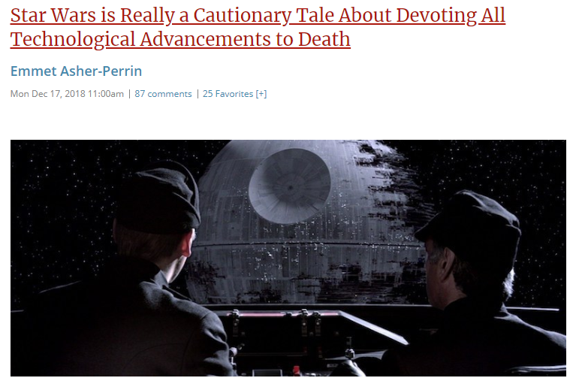
Science Fiction: Purpose
Optional: https://www.tor.com/2018/12/17/star-wars-is-really-a-cautionary-tale-about-devoting-all-technological-advancements-to-death/

Slide 5
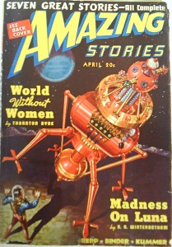
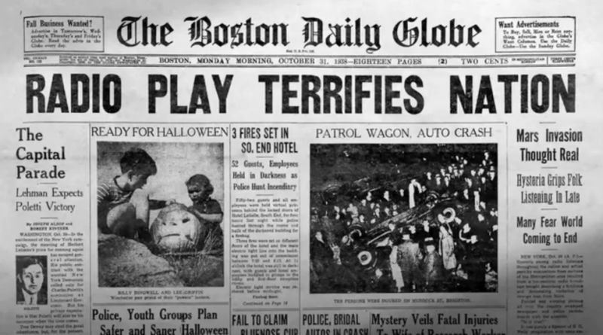
Science Fiction: Origins
Began as far back as the epic of Gilgamesh (2000 BC), but was popularized by Pulp Magazines in the 20th century
Originally targeted towards scientific education
Followed the format of popular adventure stories, but grew increasingly less educational.
Golden age of science fiction: 1930s- 1950s
Brave New World is from the 1930’s.
Escapism of the 1930s

Slide 6
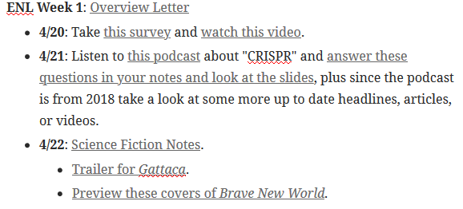
Science Fiction: Task
Imagine you are writing a piece of science fiction about CRISPR. What would you warn the future about? Write a few sentences down somewhere about an idea you have to warn the future about CRISPR technology. There is an optional Tii discussion board for this and/or the Brave New World cover artwork.

