Slide 1
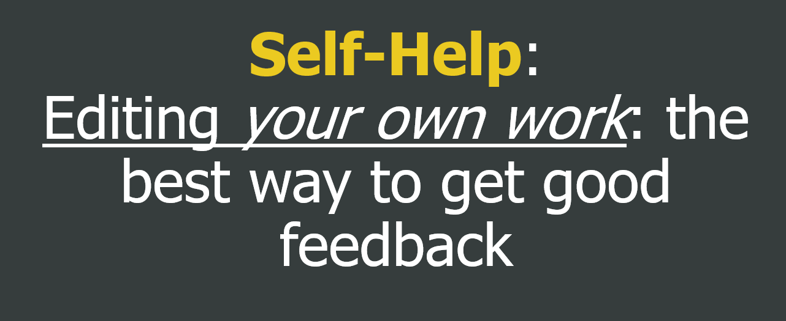
Monday: BRING A PRINTED DRAFT TO CLASS
If you want me to read something in your RD you need to ask!

Slide 2
Self-Help: Editing your own work: the best way to get good feedback

Slide 3
Advice generated from undergraduate writing centers at:

Slide 4
Self-Help: Editing your own work: the best way to good feedback
Read your work out loud. Seriously.
What sounds weird? What sentences are way too long? Where do you need more punctuation? What was difficult to read?
Focus on using the correct pauses when you read your work aloud: be dramatic about the pauses with commas and periods.
Actually listening to your written syntax is one of the best ways you can catch areas with awkward phrasing. Read your work out loud and mark anything that doesn’t make sense or that you stumble over, oftentimes you can figure out better writing.
Reading paragraphs backwards can help a lot as well.

Slide 5
Self-Help: Editing your own work: the best way to good feedback
Choose better words:
Avoid being too repetitive in your use of words: Shoot for variety. Better yet, shoot for greater precision and specificity
Don’t be vague: Seek clarity, accuracy and efficiency of prose above all. Mean what you say, and say exactly what you mean, as clearly and as compactly as possible. Areas where writers are often vague:
Pronoun use (who is “he”?).
A pronoun (it/they/you/he/she/we) should have only ONE possible antecedent (the noun that comes before the pronoun – the noun the pronoun refers to). When there is more than one possible noun in the preceding sentence that the pronoun could refer to, readers may become confused.
Don’t tell readers what something “seemed” like. Tell them what it IS.
Complete thoughts with specific details and state conclusions explicitly.

Slide 6
Self-Help: Editing your own work: the best way to good feedback
Choose better words:
Eliminate words: Editors agree that at least 10% of words should be eliminated during the editing and revising process. Why? Because writers overuse words. We’re all guilty of falling in love with our writing. Don’t.
Take it from Dr. Seuss: “So the writer who breeds more words than he needs, is making a chore for the reader who reads.”
Can you get rid of “This shows” in your analysis and mean the same thing?
YES!
Avoid using the word ‘that’: In about 5 percent of your sentences “that” makes your idea easier to understand. In the other 95 percent, get rid of it! “I decided that teaching was a good career for me” reads worse than “I decided teaching was a good career for me.”
Also avoid: clearly, very, some, thing, just, and “one of.”
To be verbs (more later)

Slide 7
Self-Help: Editing your own work: the best way to good feedback
Make sure all of your words are doing important work in making your argument. Are all of your words and phrases necessary? Or are they just taking up space? Are your sentences tight and sharp, or are they loose and dull? Don't say in three sentences what you can say in one, and don't use 14 words where five will do. You want every word in your sentence to add as much meaning and inflection as possible. When you see phrases like "My own personal opinion," ask yourself what "own personal" adds. Isn't that what "my" means?
Even small, apparently unimportant words like "says" are worth your attention. Instead of "says," could you use a word like argues, acknowledges, contends, believes, reveals, suggests, or claims? Words like these are analytical, and not only make your sentences more lively and interesting; they provide useful information: if you tell your readers that someone "acknowledges" something, that deepens their understanding of how or why he or she said that thing; "said" merely reports.
When writing about literature “develops” is a great term to use.

Slide 8
Self-Help: Editing your own work: the best way to good feedback
Example of being too indirect (analytical stuff highlighted):
Okonkwo had some flaws like the time where he almost killed his wife and this goes to show as one of the tragic hero traits. Okonkwo has some problems/flaws like his anger which can go too far. Okonkwo showed a lack of self-control though the near miss of killing his wife with a gun but foreshadows that he will eventually kill someone. [62 words].
Also notice how superfluous ‘some’ and ‘that’ are here.
Edits to make Direct (important stuff highlighted):
Okonkwo had flaws, like the time where he almost killed his wife, developing the tragic hero trait of lacking self-control. Nearly killing his wife foreshadows how Okonkwo will eventually kill someone with his gun. [34 words].
Putting ‘lack of self control’ by the ‘tragic hero trait’ removes vagueness
Cleaned up unnecessary words and phrases shortens total word count
Removing “Okonkwo has some problems/flaws like his anger which can go too far.” strengthens argument by removing uncertainty and half-hearted expression.

Slide 9
Self-Help: Editing your own work: the best way to good feedback
Examples of being too indirect:
Achebe uses irony to show that women have a higher place in Igbo society and are more important than they seem in the beginning. [24 words]/[20 words].
Achebe’s irony demonstrates women have a higher and more important standing in Igbo society than culturally understood. [17 words].
Winston had rebellious thoughts against the government and commits these illegal against the government as a sign of rebellion. [19 words].
If a citizen is even suspected of going against the Party, they will be turned into the Thought Police by anyone who witnesses it and evaporated from existence. [28 words].
Okonkwo tries to fight against them, but has to face many challenges as the Europeans try to erase and diminish Igbo culture and their people. [24 words].
Okonkwo tries to fight them, but has many challenges as the Europeans erase and diminish Igbo culture. [17 words].

Slide 10
Self-Help: Editing your own work: the best way to good feedback
Integrate your quotations (citations) into sentences that introduce the quote.
Put the title of the novel into italics.
Black Mirror: “Nosedive” (subtitles or episode titles go in quotes)
1984
The Handmaid’s Tale
The Lobster

Slide 11
Self-Help: Editing your own work: the best way to good feedback
Be tough on your most dazzling sentences: As you revise, you may find that sentences you needed in earlier drafts no longer belong—and these may be the sentences you're most fond of. We're all guilty of trying to sneak in our favorite sentences where they don't belong, because we can't bear to cut them. But great writers are ruthless and will throw out brilliant lines if they're no longer relevant or necessary. They know that readers will be less struck by the brilliance than by the inappropriateness of those sentences and they let them go.
Prune long sentences and paragraphs: Whether you’ve exceeded your word count or not, long sentences and paragraphs should be edited because they can be trickier to read, and risk being boring or hard to follow.
Or break long paragraphs into two– you don’t need a new BTS, just make it obvious you’re continuing on the same topic

Slide 12
For Formal Academic Voice: Avoid Past Tense Verbs
Always write about books in the present tense
Examples:
“Okonkwo mourned for his village …”
Okonkwo mourns for his village …
The culture of Umofia defined him completely.
The culture of Umofia defines him completely …
Okonkwo was a strong, proud man.
Okonkwo is a strong, proud man.

Slide 13
Self-Help: Editing your own work: the best way to good feedback
Nix Adverbs and Adjectives as Often as Possible*: mark through every adjective and adverb you see, and then add back the ones that you think are absolutely necessary. When in doubt, find a verb that says it better.
Adverb: a word or phrase that modifies or qualifies an adjective, verb, or other adverb or a word group, expressing a relation of place, time, circumstance, manner, cause, degree, etc. (e.g., gently, quite, then, there ).
Adjective: a word or phrase naming an attribute, added to or grammatically related to a noun to modify or describe it.
*some adjectives and adverbs ARE analytical and impactful, while most are hollow and pointless.
→ More often, Adverbs are useless than Adjectives.

Slide 14
Self-Help: Editing your own work: the best way to good feedback
USELESS adverbs and adjective examples:
Achebe specifically uses this to enforce the idea that his Okonkwo’s fear will become reality, to show how Okonkwo is losing part of his values.
USEFUL adverbs and adjective examples:
Compared to the relatively docile attitude many other Igbo women have, this harsh action is shocking.

Slide 15
Self-Help: Editing your own work: the best way to good feedback
Further thoughts:
Read backwards: Disrupting narrative flow can help you find mistakes you would otherwise miss. Try reading your work backwards, starting with the last paragraph and ending with the first. This approach forces you to pay careful attention to details and makes it easy for your brain to correct mistakes.
Be ahead of schedule, so you can take a break: Wait awhile after you’ve finished a draft before looking at it again. The Roman poet Horace thought one should wait nine years, but that’s a bit much. A day—a few hours even—will work. When you do return to the draft, be honest and don’t be lazy.
Think honestly about your thesis: Do you still agree with it? Should it be modified in light of something you discovered as you wrote the paper? Does it make a sophisticated, provocative point, or does it just say what anyone could say if given the same topic?
Think honestly about your evidence: Just because a piece of evidence made it into your rough draft doesn’t mean it was good evidence or still is good evidence.

Slide 16
Self-Help: Editing your own work: the best way to good feedback
Writing Focus: Revising
I want everyone to find their weakest piece of evidence in the Rough Draft and replace it with something better before the Final Draft.

Slide 17
Editing Work: Trimming Evidence
Trim Evidence to what you actually need:
Achebe foreshadows Okonkwo’s lack of self-control with the symbolism of Okonkwo’s gun: “He pressed the trigger and there was a loud report accompanied by the wail of his wives and children. He threw down the gun and jumped into the barn and there lay the woman, very much shaken and frightened but quite unhurt. He heaved a heavy sigh and went away with the gun.” (Achebe 16). 68 words.
Achebe foreshadows Okonkwo’s lack of self-control with the symbolism of his gun: “Okonkwo … ran madly into his room for the loaded gun,” and “heaved a heavy sigh and went away with the gun” when he realized he had missed killing Ekwefi (Achebe 16). 38 words.
Achebe foreshadows Okonkwo’s lack of self-control with the symbolism of his gun by associating chaotic words like “madly,” “wail,” “loud,” and “shaken and frightened” when Okonkwo unthinkingly nearly murders Ekwefi (Achebe 16). 30 words.
Paraphrase evidence:
Achebe foreshadows Okonkwo’s lack of self-control with the symbolism of guns when Okonkwo unthinkingly nearly murders Ekwefi (Achebe 16). 18 words.

Slide 18
Self-Help: Editing your own work: the best way to good feedback
Compare: ”Sally recommended that the student attend the workshop.” with “The student was recommended by Sally to attend the workshop.”
The sentence written in passive voice is wordy, vague, and ineffective.
Passive voice: a improper grammatical voice that involves confusing the order of subjects (nouns) and actions (verbs). In passive voice the subject is acted upon:
The food was eaten by the cat.
The student was recommended by Sally to attend the workshop.
The door was closed by Misty.
Eliminate passive voice by making the subject do the action. You can shift the focus of the sentence from the direct or indirect object to the actor. For example, you can transform the following sentence from passive to active voice.
Passive: The tree was cut down by the man.
Active: The man cut down the tree.
However, sometimes passive voice is preferable. When the person or the object being acted upon is more important than the doer, you should use passive voice. Example: President Kennedy was shot today.

Slide 19
Self-Help: Editing your own work: the best way to good feedback
“To be” is the most frequently used verb in the English language. Its conjugations include:
am
are
is
was
were
being
been
Because “To Be” verbs are so common, we easily overuse them, especially with progressive verbs, verbs that end in -ing.
Example: “Spot was running through the woods.”
Instead: “Spot ran through the woods.”
“Spot was running” is a good example of a verb weakened by “to be.”
“Spot ran” on the other hand, is a much stronger example, and less words.

Slide 20
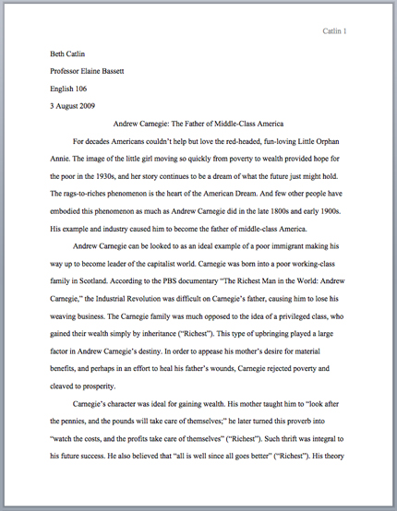
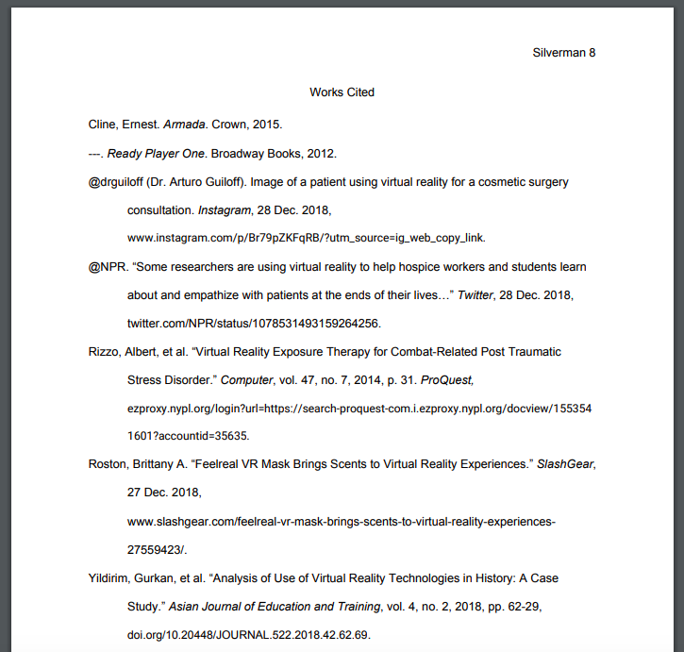
Does your paper look like a paper?

