Slide 1
Reread pages 57-61 and try and identify an example of juxtaposition and the effect.
Start with “The next day…” (57) and end with “…thought weak” (61).
What does juxtaposition mean?
What types of effects does juxtaposition create? What did you come up with?

Slide 2
Juxtaposition in chapter 7 (58-9)
Group of men taking Ikemefuna to be sacrificed
Man Taking a new title in a nearby village
“Party”
“A deathly silence descended… Even the very little children seemed to know… Nwoye sat in his mother's hut and tears stood in his eyes.”
“But as they drew near to the outskirts of Umuofia silence fell upon them”
“The men trod dry leaves on the sand.”
“from the distance came the faint beating of the ekwe. It rose and faded with the wind--a peaceful dance from a distant clan.”
“the elusive dance rose and fell with the wind. Somewhere a man was taking one of the titles of his clan, with music and dancing and a great feast.”
Q: What supports the claim Smith is making that these things are juxtaposed? What does the juxtaposition of these two “parties” highlight to readers? What evidence/aspects about them are juxtaposed?

Slide 3
Journal #20: Motifs
Learning Targets:
Students will be able to explain the difference between symbols and motifs and analyze them.

Slide 4
Symbol and Motif: What’s the difference?
Symbol
Motif
A reoccurring object in literature that figuratively represents another idea or thing and is almost always related to the theme.
A reoccurring object in literature that figuratively represents another idea or thing and is almost always related to the theme.

Slide 5
Some of the things we’ve called symbols, in past novels, would be more accurately called motifs!!
Symbol
Motif
Shoes:
Esperanza’s shoes/feet
Women sitting by the window:
Esperanza’s grandmother
Mamacita dreaming of home
Esperanza and 4 Skinny Trees
Rafeala drinking papaya juice
Minerva sitting by a broken window

Slide 6
Definitions
Symbol
Motif
A specific and static reoccurring object in literature that figuratively represents another idea or thing and is almost always related to the theme.
A reoccurring object, literary devices**, or plot structure** in literature that figuratively represents another idea or, always related to the theme or the author’s purpose.
Motifs appear in different contexts (i.e. water appearing in different ways) or be dynamic
Motifs can be reoccurring literary devices

Slide 7
3 “types” of Motif:
A (1) literary device**, (2) reoccurring object, or (3) plot structure** in literature that figuratively represents another idea or thing, always related to the theme or the author’s purpose.
Motifs appear in different contexts or be dynamic
Motifs can be reoccurring literary devices
Three different types of Motifs:
Reoccurring language or Literary Devices
Reoccurring Dynamic Objects (AKA symbolic-motifs)
Reoccurring Plot Structures

Slide 8
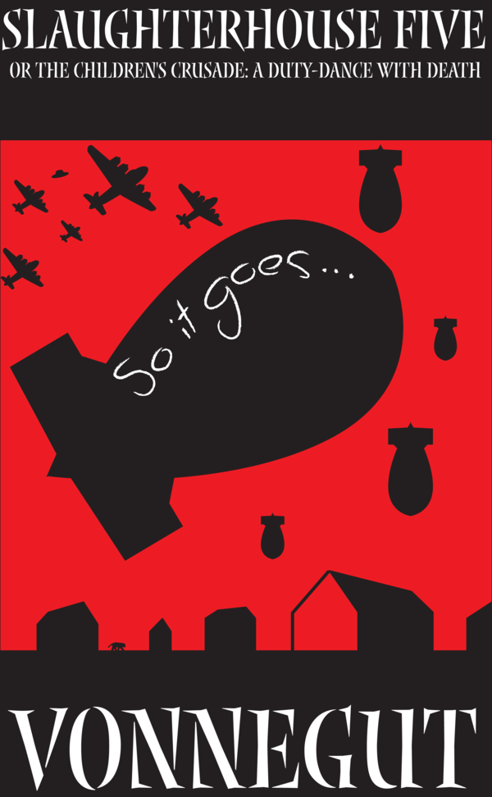
1. Repetition of Literary/Language Devices
Slaughterhouse Five is a satirical anti-war novel about a man who is ‘stuck in time’ and keeps ending up at the bombing of Dresden during WWII.
The phrase “So it goes.” appears 99 times over the 105 page novel.
Look at your page with random pieces of Slaughterhouse Five: How does Kurt Vonnegut use the motif of “So it goes.” to build his anti-war message?
Let’s write a group thesis!

Slide 9
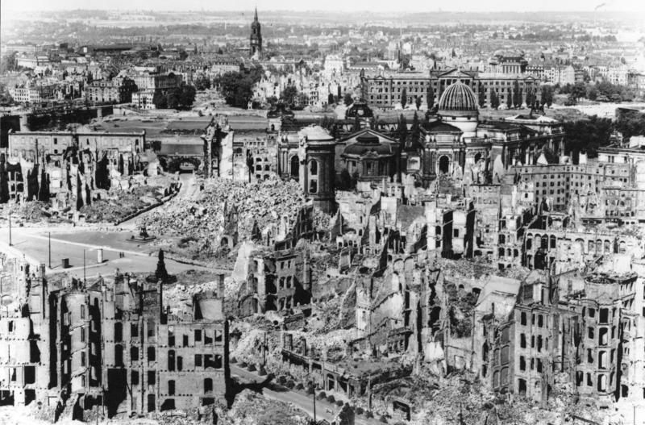
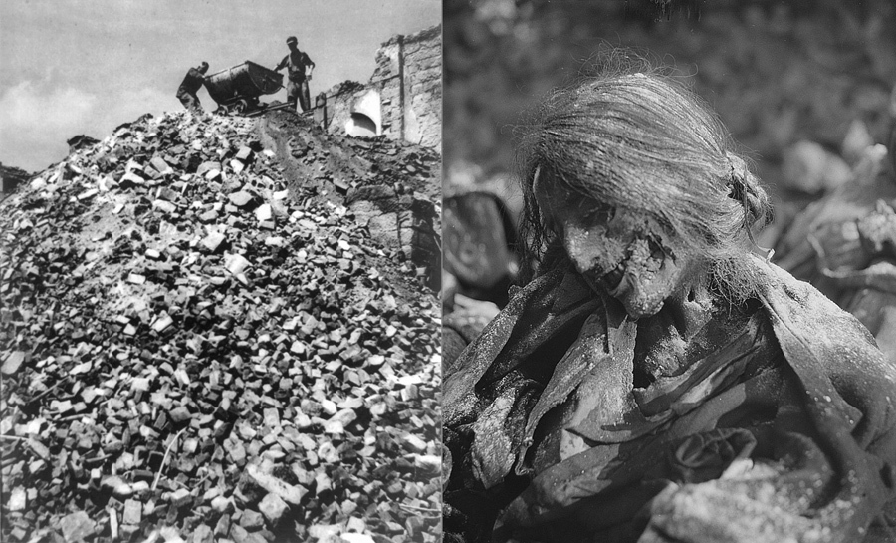

Slide 10
1. Repetition of Literary/Language Devices Example: Figurative language about the character nicknamed ‘Horse’
“’Bullshit!’ Horse cried out. They called him Horse because his face looked like the face of a horse, and he was always stomping at the ground.” (Anaya 36).
“Horse neighed loudly. ‘Hey, Florence, top this one!’ Again he cleared his throat and spit.” (Anaya 37).
“His dark, wild eyes held me hypnotically, and I could hear the deep sounds a horse makes inside his chest when he is ready to buck.” (Anaya 39).
“That year a pissing contest was held behind the school house, and Horse won,” (Anaya 76).

Slide 11
1. Repetition of Literary/Language Devices Example: Characterization of Horse
“Horse's … I thought he would bolt. His big horse-eyes looked up at me nervously.” (Anaya 155).
“Horse smiled into my face. … His horse-eyes were wild with excitement and his big, yellow teeth chomped on something that smelled like spoiled eggs.” (Anaya 202).
“Horse whinnied and reared up and Bones was on him” (Anaya 195).
“Horse, sensing something he could not understand, began to get nervous.” (Anaya 209).

Slide 12
2. Symbolic Motifs
Women sitting by windows?
Twins in Things Fall Apart
Or people thinking about twins

Slide 13
Motif of walking on dry leaves p207, chapter 7 and 24 in TFA

Slide 14
3. Repetition of Plot Structures
Silence vs. Noise in Things Fall Apart
Death or dreams are the most common situational motifs

Slide 15
What would you need to notice to call something a “motif”?
Can you connect their effects or meaning?
Does it reoccur?
Is it dynamic?
(changes in context, type, or situation)
Is it connected to something important?
(Purpose? Theme?)

Slide 16
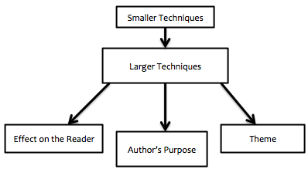
Fill in the chart for Things Fall Apart
Plot motif of questioning Igbo Traditions after unjust deaths
Associated with the motif of Twins
→what do Twins represent?
____?
____?
_____?

