Slide 1
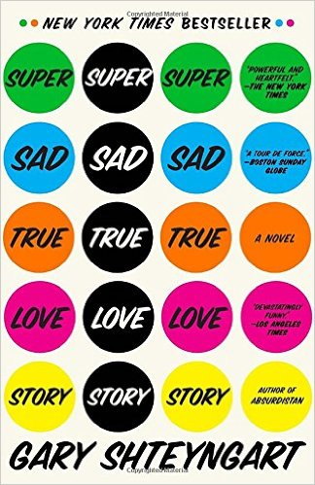
Super Sad True Love Story by Gary Shteyngart
You’ll be reading a chapter near the middle of the book Super Sad True Love Story.
Included here are some terms and characters to know, reviews of the novel, and other relevant info.

Slide 2
Super Sad True Love Story by Gary Shteyngart
Characters:
Lenny Abramov = main character, you’re reading his diary; he loves Eunice
Eunice, or Euny = Lenny fell in love with her in Italy
The Abramovs= Lenny’s parents
Noah Weinberg= Lenny’s friend
Vishnu Cohen-Clark= Lenny’s friend
Joshie = Lenny’s immortal* boss and firend

Slide 3
Super Sad True Love Story by Gary Shteyngart
Terms to know:
äppärät = iPhone type device
"my äppärät buzzing with contacts, data, pictures, projections, maps, incomes, sound, fury“
"I’m learning to worship my new äppärät’s screen, the colorful pulsating mosaic of it, the fact that it knows every last stinking detail about the world, whereas my books only know the minds of their authors.“
"he wasn’t there. He didn’t have an äppärät, or it wasn’t set on “social” mode, or maybe he had paid some young Russian kid to have the outbound transmission blocked.“
"my äppärät picked up on some scan-able faces, an old-time porno star and a slick guy from Mumbai just starting out on his first worldwide Retail empire.“
"But even he seemed unimpressed, glancing impatiently at his äppärät, which was alive with at least seven degrees of information, numbers and letters and Images stacked on the screen, flowing and eddying against one another as the waters of the Tiber once did."
Global Teens = some combination of ALL social media
"I put the name of my oldest Media pal, Noah Weinberg, into my äppärät and learned that he would be airing our reunion live on his GlobalTeens stream, “The Noah Weinberg Show!,” which made me nervous at first, but, then, this is exactly the kind of thing I have to get used to if I’m going to make it in this world"
SUK DIK = a clothing brand
Yuan= Chinese money
Solvency= having more money than debt

Slide 4
Super Sad True Love Story by Gary Shteyngart
“Gary Shteyngart might be too funny for his own good. His novel, Super Sad True Love Story, is a spectacularly clever near-future dystopian satire… At first, the book seems like Shteyngart business-as-usual as we delve into the diary of one Lenny Abramov, a pure exemplar of this writer's favorite species of comic protagonist: a self-deprecating Russian-American Jewish male, self-conscious about his appearance, uselessly well-educated, wry, passionate, neither old nor young, and helplessly prone to error.”
-- Slate

Slide 5
Super Sad True Love Story by Gary Shteyngart
“Consumerism; youth-worship; subliteracy; and developed societies' obsessions with money, class, health, and entertainment—the most prestigious occupations in this society are Media and Credit, followed at a discreet distance by Retail—are easy sport for a wit as gifted as Gary Shteyngart. He takes aim and the targets go down, unerringly. For the first half of Super Sad True Love Story, quick, bitter little jokes pop on every page, one after the other, like rifle fire on opening day of hunting season. Like every good satirist, he's observant and annoyed, nursing innumerable beefs, both major and minor, with the state of the world.
And, more to the point, how do you live in a culture like that? The beauty of this novel is that its hero and its heroine, in their hugely different ways, really do attempt to negotiate this trashed and trashy world with some tiny measure of dignity. Lenny, the romantic schlemiel, keeps reading—Chekhov, Tolstoy, Kundera—and keeps believing, against the best evidence, in love. Eunice, confused and scattered though she is, keeps trying to give her inchoate life some recognizable form, and to fix, or at least come to terms with, her terrible family. They're fighting a losing battle, one whose outcome is as inevitable as the war on mortality, but their persistence is genuinely touching.”
-- Slate

Slide 6
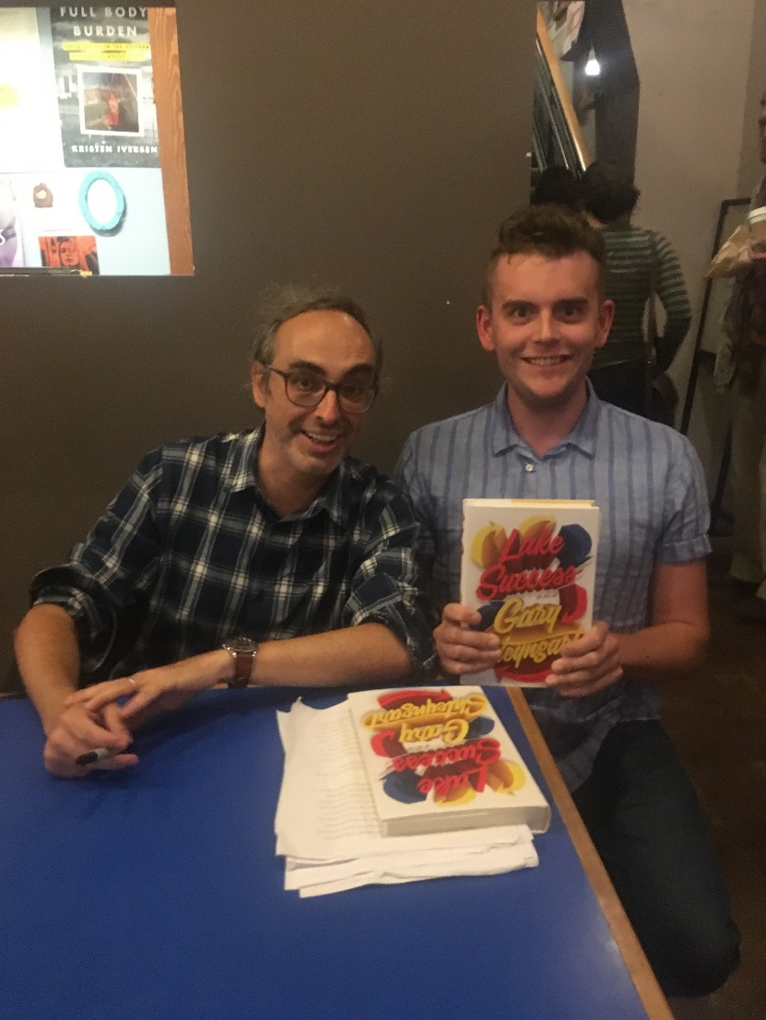
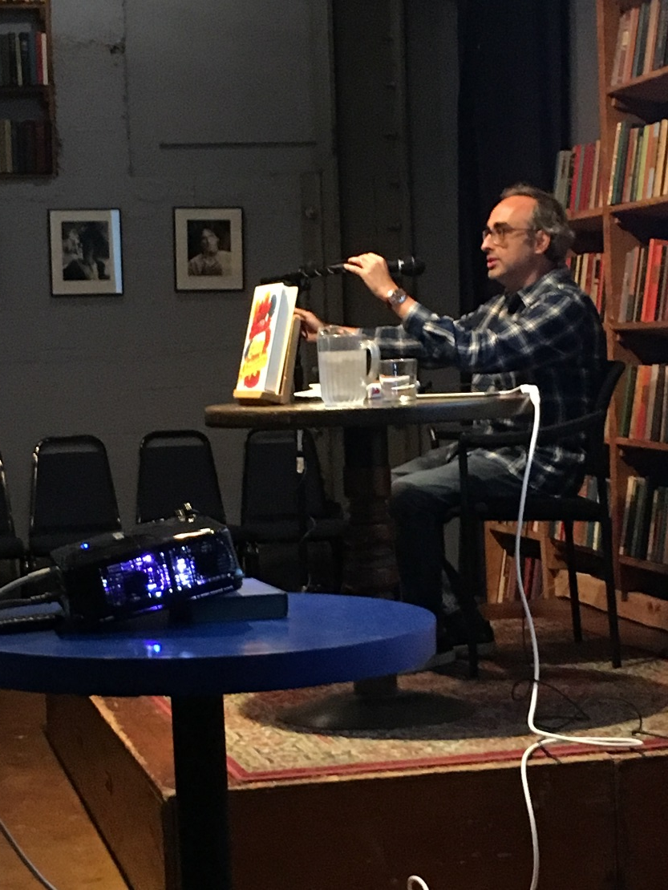
Super Sad True Love Story by Gary Shteyngart

Slide 7
Super Sad True Love Story by Gary Shteyngart
“It doesn’t let America go, either. The “prematurely old country” of the novel is run as a kind of war zone by the “Bipartisan” secretary of state, Rubenstein, who has installed the youthful Jimmy Cortez as a puppet president. The state of emergency is permanent, tanks are all over the place, and in a particularly brilliant invention, people are required to deny the existence of all the weaponry they see and to consent formally to the act of denial they have just performed. The only thing that keeps people really happy is their credit rating, if they have one that’s high enough. Scores are publicly available on screens posted on every street and can always be checked on the devices everyone carries, instruments that work like iPhones designed for Orwell, providing instant background checks on anyone you might like to know, along with helpful ratings like that of your perceived desirability for sex or anything else as compared to other members of the group you’re in. The area that used to house the Security Council is now the U.N.R.C. (United Nations Retail Corridor), a mammoth cross between a mall and a North African bazaar. A euro costs you nearly $9, and by the end of the novel this America, with all its “loud, dying wealth” and its quiet and ubiquitous poverty, has been taken over by a combination of Chinese and Norwegian business interests.”
--NYTimes

Slide 8
Super Sad True Love Story by Gary Shteyngart
How is the social media climate/ranking in Super Sad similar to “Nosedive”?
What is the äppärät like?
What ranking categories are people judged by?
How are the people dehumanized?
What is the slang like in America? How is Shteyngart being satirical?
What are Lenny’s friends like? Lenny?
Funny?

