Slide 1
Things Fall Apart Part 2: chapter 14
What is the mood of Okonkwo’s new life in Mbanta? (131).
What does Okonkwo think about his chi? Does he understand the Igbo principal of chi well? Has Okonkwo really said ‘yea’?
This chapter references Okonkwo's deceased mother. What do readers now know about her and about her relationship with her son?
Why do Igbo people say “Mother is Supreme”?
How does this complicate Igbo patriarchy?
What does Okonkwo’s failure to answer some of Uchendu’s questions reveal or reinforce?

Slide 2
Okonkwo’s understanding of himself
Reread pages 66-68.
Analyze:
Does Okonkwo understand his culture well? Other examples? What will his fate (chi) be?

Slide 3
Uchendu’s speech to Okonkwo
What is the purpose of Uchendu’s speech to Okonkwo? What tone does he use? What rhetorical appeals?
Do you think that Unchendu’s words will motivate Okonkwo to act better?

Slide 4
Read: “The Western Erasure of African Tragedy”
“When the first Africans arrived in Virginia in 1619, there were no ‘white’ people there; nor, according to colonial records, would there be [white people] there for another 60 years.”
–Theodore W. Allen
What is the author’s thesis?
How does it connect thematically to our study of Africa so far?
“The Danger of a Single Story”?
The creation of blackness?
Things Fall Apart?
Social Studies?
This video: https://www.youtube.com/watch?v=eLqC3FNNOaI
Additional Homework: find a current (2018-19) news story that erases Africa/Africans/African-Americans from the narrative to focus on white people. Write a few sentences analyzing how and why the article does that.

Slide 5
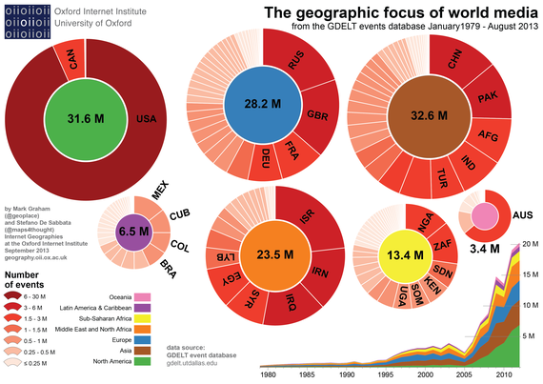
Geographic Focus on World Media

Slide 6
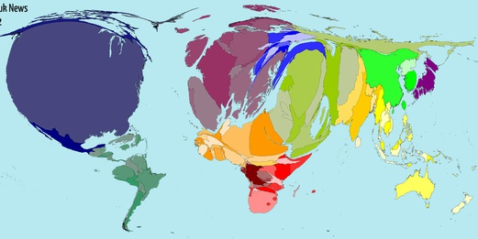
Geographic Focus on World Media

Slide 7
Journal #29: European Power and Control
Learning Targets:
Students will be able to identify the various techniques Europeans used to gain control of Africa from Things Fall Apart.
Students will be able to analyze themes of control, cultural conflict, and European imperialism from Things Fall Apart.
Students will analyze imperialist control and power and it’s legacy.

Slide 8
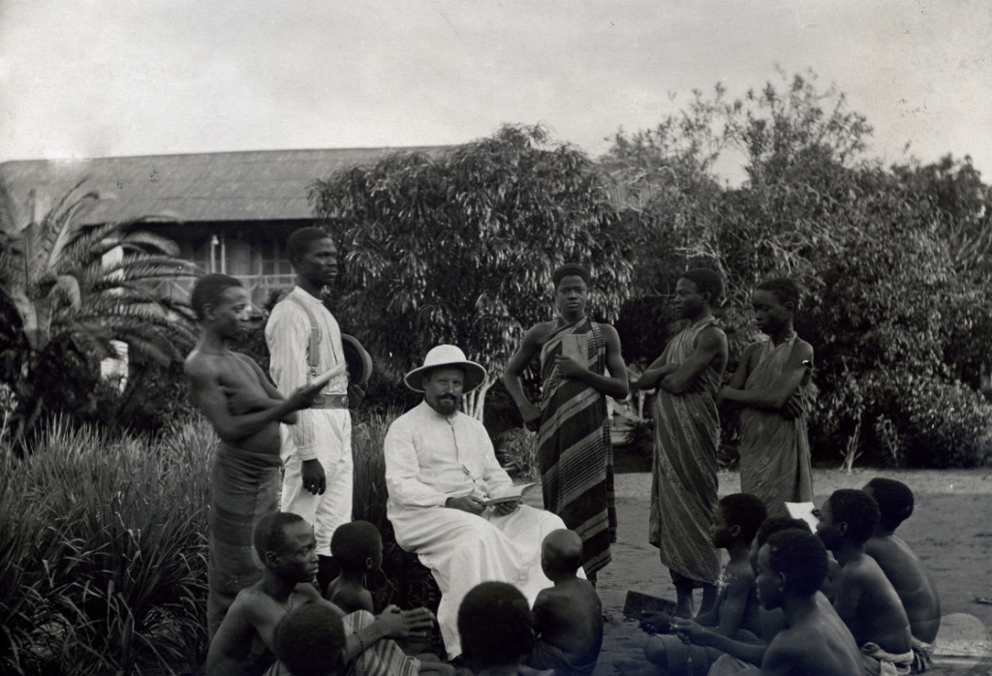
POWER
How did Europeans control and maintain power over Africa?
What does power and control look like?
Analyze the image to the right →

Slide 9
Analyze the following quotes about Imperialist POWER

Slide 10
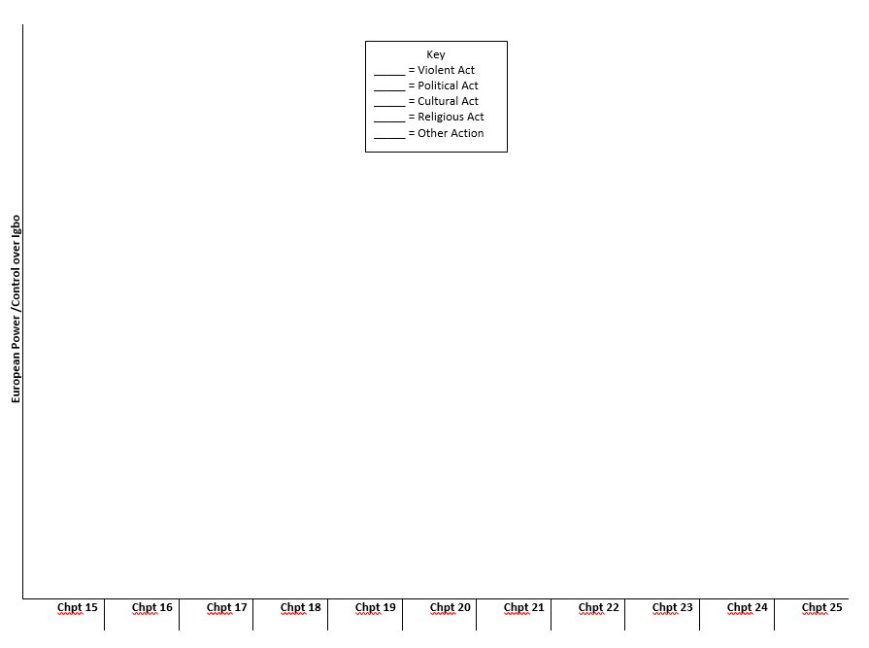
On Going Task: Chart
As you study chapters 15 to 25 of Things Fall Apart track and chart the ‘amount’ of power and control Europeans have over the Igbo people, and how they gain power.
Use quotes from the text.

Slide 11
Key: Igbo Chart
Violence
Politics
Economics
Law/Justice
Cultural
Shattering cultural norms
Destroying Oral Tradition
Misunderstanding or refusing to understand Igbo practices
Technology or Science causing Igbo doubt
Education/Literacy/Etc.
Religion
Conversions
Spiritual Coincidences
God
Miscellaneous
Dehumanizing language?
Whatever else you need?

Slide 12
Analyze the following quotes about Imperialist POWER

Slide 13
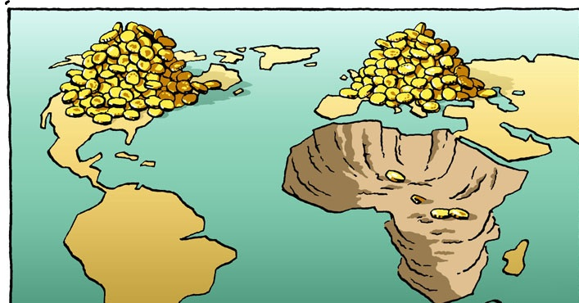
Imperialism
When a country extends its power over a group of people by taking their territory. Often times material wealth (natural resources, slaves, etc.), racism, or international power are the primary motivations.
It may also include the violent control or exploitation of these territories, an action that is linked to colonialism.
Do we still have imperialism today? Examples?

Slide 14
Imperialism
https://www.theguardian.com/news/2019/feb/15/the-us-hidden-empire-overseas-territories-united-states-guam-puerto-rico-american-samoa

Slide 15
Analyze the following quotes about Imperialism
“Gentlemen, we must speak more loudly and more honestly! We must say openly that indeed the higher races have a right over the lower races ....
I repeat, that the superior races have a right because they have a duty. They have the duty to civilize the inferior races .... In the history of earlier centuries these duties, gentlemen, have often been misunderstood; and certainly when the Spanish soldiers and explorers introduced slavery into Central America, they did not fulfill their duty as men of a higher race .... But, in our time, I maintain that European nations acquit themselves with generosity, with grandeur, and with sincerity of this superior civilizing duty.”
--Jules Ferry, Prime Minister of France (1883-1885)

Slide 16
Analyze the following quotes about Imperialism
“One word as regards missionaries themselves. The essential point in dealing with Africans is to establish a respect for the European. Upon this---the prestige of the white man---depends his influence, often his very existence, in Africa. If he shows by his surroundings, by his assumption of superiority, that he is far above the native, he will be respected, and his influence will be proportionate to the superiority he assumes and bears out by his higher accomplishments and mode of life. In my opinion---at any rate with reference to Africa---it is the greatest possible mistake to suppose that a European can acquire a greater influence by adopting the mode of life of the natives. In effect, it is to lower himself to their plane, instead of elevating them to his. The sacrifice involved is wholly unappreciated, and the motive would be held by the savage to be poverty and lack of social status in his own country…To maintain it a missionary must, above all things, be a gentleman; for no one is more quick to recognize a real gentleman than the African savage. He must at all times assert himself, and repel an insolent familiarity, which is a thing entirely apart from friendship born of respect and affection. His dwelling house should be as superior to those of the natives as he is himself superior to them.?
--Captain F. D. Lugard, British writer (1893)

