Slide 1
TFA 15 to 19
Part 2

Slide 2
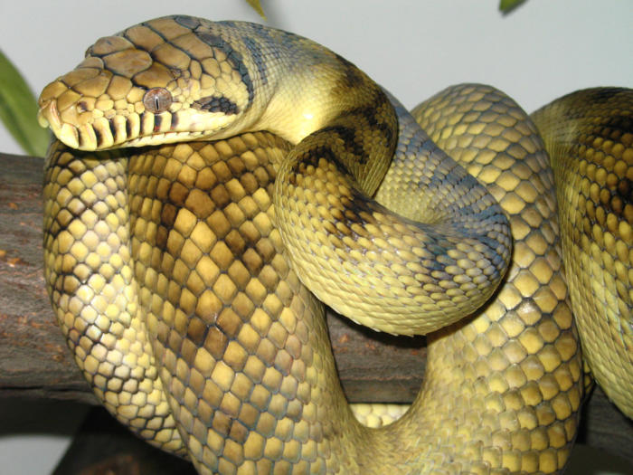
Chapter 18 Discussion Questions
Explain the relationship of the outcasts with the new church.
How does the incident with the python confirm for the people of Mbanta that their gods still have power?
Why is this potentially a really bad thing?
How does Okonkwo want to handle the Christians? What do the people of Mbanta decide to do?
How is the python in Igbo tradition similar to the Cow for Hindus?

Slide 3
Royal Python drama
It was in fact one of them who in his zeal brought the church into serious conflict with the clan a year later by killing the sacred python, the emanation of the god of water. The royal python was the most revered animal in Mbanta and all the surrounding clans. It was addressed as "Our Father," and was allowed to go wherever it chose, even into people's beds. It ate rats in the house and sometimes swallowed hens' eggs. If a clansman killed a royal python accidentally, he made sacrifices of atonement and performed an expensive burial ceremony such as was done for a great man. ...
But, all the same, the rulers and elders of Mbanta assembled to decide on their action. … The spirit of wars was upon them. Okonkwo, who had begun to play a part in the affairs of his motherland, said that until the abominable gang was chased out of the village with whips there would be no peace.
But there were many others who saw the situation differently, and it was their counsel that prevailed in the end.
"It is not our custom to fight for our gods," said one of them. "Let us not presume to do so now. If a man kills the sacred python in the secrecy of his hut, the matter lies between him and the god. We did not see it. If we put ourselves between the god and his victim we may receive blows intended for the offender. When a man blasphemes, what do we do? Do we go and stop his mouth? No. We put our fingers into our ears to stop us hearing. That is a wise action.” (157-8).
“Okoli was not there to answer. He had fallen ill on the previous night. Before the day was over he was dead. His death showed that the gods were still able to fight their own battles. The clan saw no reason then for molesting the Christians.” (161).

Slide 4
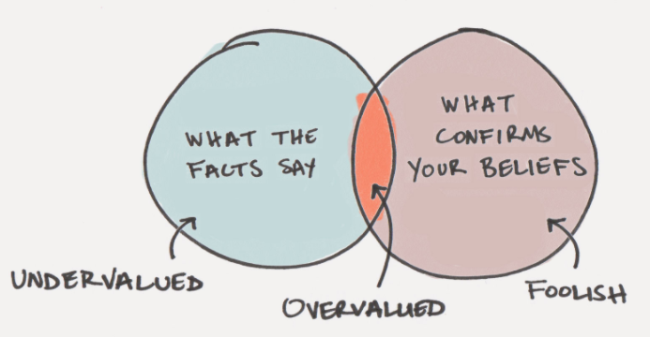
Confirmation bias: the tendency to interpret new evidence as Proof of one's existing beliefs or theories, even if they are not proof.
How are the Igbo falling victim to confirmation bias when dealing with the Europeans and Christians?
How is confirmation bias keeping the Igbo from doing anything to stop the Europeans and Christians?
What events allow the Igbo to believe their religious beliefs in the face of other ideas?

Slide 6
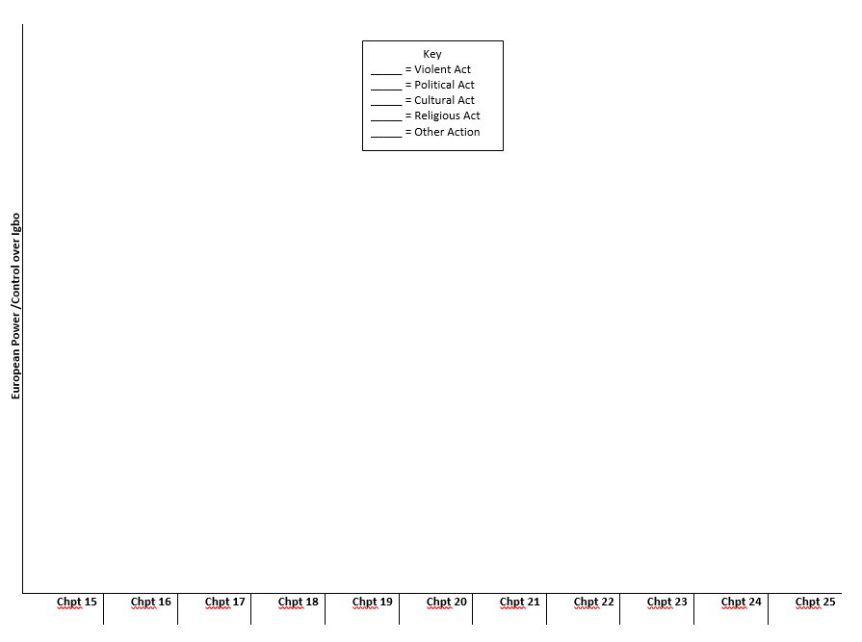
Pull out your journal #29 Chart
How did the Christian missionaries gain power over the Igbo people in chapters 15-17?
Violence?
Politics?
Culture?
Religious?
Other?
WHY and HOW were these actions effective in gaining power over the Igbo?

Slide 7
Back to Journal #29: Analyze the following quote about Imperialist POWER

Slide 8
Discussion questions: 15-17
Chapter 15:
Why does Obierika visit Okonkwo?
What did the Oracle call Europeans? (Symbolism)
Chapter 16:
Analyze: “My buttocks”?
Who does Obierika see with the Christian missionaries?
What are ‘efulefu’? (143).
Analyze the last paragraph of chapter 16. (147).
Chapter 17:
Describe what happens when Okonkwo confronts Nwoye. (152).
Why is it so important that Europeans are establishing a school?
Describe Okonkwo in the last 2 paragraphs of the chapter. What does he blame for Nwoye?

Slide 9
Chapters 15-17 important pages
Chapter 15
138-141
Chapter 16
146
147
Chapter 17
148-9
150-1
152-3

Slide 10
Hamlet Allusion and Okonkwo
Okonkwo's characterization:
“LIVING FIRE … IMPOTENT ASH” (152).
Hamlet:
Not that I think you did not love your father; But that I know love is begun by time; And that I see, in passages of proof, Time qualifies the spark and fire of it. There lives within the very flame of love A kind of wick or snuff that will abate it; And nothing is at a like goodness still;

Slide 11
chapter 19
What do the names of the Okonkwo's children who have been born in exile show about his experiences in Mbanta?
Describe the feast Okonkwo throws for his kinsmen at the end of his exile.
What was the gist of the speech that Okonkwo's elderly relative gives at the meeting?
If the point of Part I was to characterize Umofia and the Igbo Culture, what was the point of part II of the novel?

Slide 12
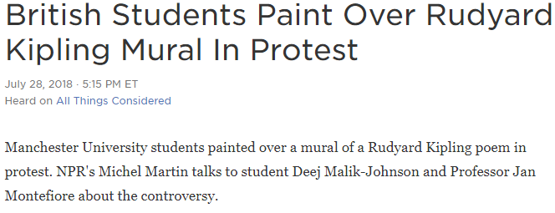
Listen to the story… https://www.npr.org/2018/07/28/633461864/british-students-paint-over-rudyard-kipling-mural-in-protest
Reactions?

Slide 13
Read: “The Western Erasure of African Tragedy”
What is the author’s thesis?
How does it connect thematically to our study of Africa so far?
“The Danger of a Single Story”?
The creation of blackness?
Things Fall Apart?
Social Studies?
This video: https://www.youtube.com/watch?v=eLqC3FNNOaI
Additional Homework: find a current (2018-19) news story that erases Africa/Africans/African-Americans from the narrative to focus on white people. Write a few sentences analyzing how the article does that. Due Friday.
“When the first Africans arrived in Virginia in 1619, there were no ‘white’ people there; nor, according to colonial records, would there be [white people] there for another 60 years.”
–Theodore W. Allen

Slide 14
J#29: “The Western Erasure of African Tragedy”
“When the first Africans arrived in Virginia in 1619, there were no ‘white’ people there; nor, according to colonial records, would there be [white people] there for another 60 years.”
–Theodore W. Allen
What is the author’s thesis?
How does it connect thematically to our study of Africa so far?
“The Danger of a Single Story”?
The creation of blackness?
Things Fall Apart?
Social Studies?
This video: https://www.youtube.com/watch?v=eLqC3FNNOaI
Additional Homework: find a current (2018-19) news story that erases Africa/Africans/African-Americans from the narrative to focus on white people. Write a few sentences analyzing how and why the article does that.

