Slide 1
Journal 22: Tragic Heroes & Classical Tragedy
Learning Targets:
Students will be able to identify what makes a character a tragic hero .
Students will be able to identify a character as a tragic hero and identify their Tragic Flaw.
Students will be aware of, and able to define, Classical Tragedy, catharsis, and Hubris.
Students will be able to connect these terms to Things Fall Apart.

Slide 2
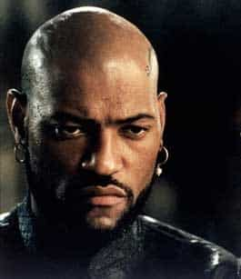
Classical Tragedy
Classical Tragedy: is a genre of drama based terrible events and human suffering (of the hero) that causes catharsis for the audience. This tradition comes from the Ancient Greeks.
The hero in a Classical Tragedy is plagued by a tragic flaw that keeps him or her from solving their problem– or leads them to creating the problem in the first place.
The hero will have many opportunities to overcome their flaw but never be able to.
Involves dramatic irony.
Modern examples of tragedy often change the rules somewhat.

Slide 3
Catharsis (a feeling)
Catharsis is when the audience feels intense pity or sadness about the contents or characters of literature and plays that results in the audience feeling happier or refreshed afterword.
Aristotle argued that tragedy cleansed the heart through pity and terror, purging us of our petty concerns and worries by making us aware that there can be nobility in suffering.
In your own words: describe what Catharsis emotionally feels like. Have you felt this?

Slide 4
Tragic Hero Traits: think of this as a checklist
A character whose fate matters, figuratively (symbolism) or literally, to a nation or people.
A character who challenges fate; struggles against supernatural forces or doom.
A character who has a tragic flaw
A character who fails in the end; they make choices that bring about their destruction and/or fate prevent success.
A character who develops deeper self-knowledge through suffering.

Slide 5
Tragic Hero Traits
6.The character who usually goes on a quest.
7. The character has both good and bad in his personality.
8. Can be protagonists or antagonists (“good guy” or “bad guy”)

Slide 6
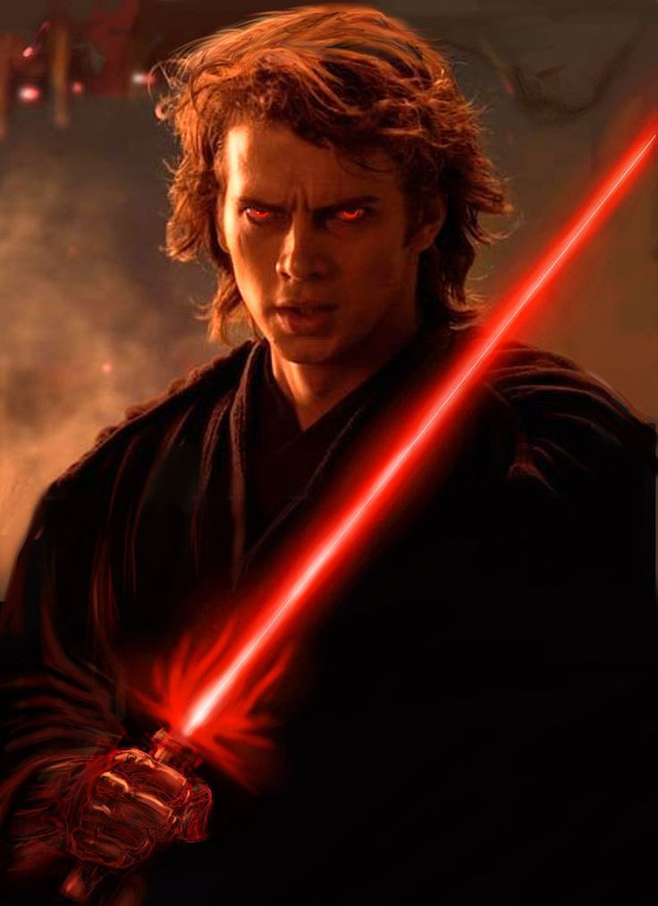
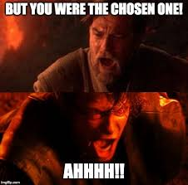
Tragic Hero Traits (Example)
2. Challenges Fate: yes, wants to save his wife who is supposed to die in child birth
1. Fate Matters: yes, supposedly the chosen one to defeat the Dark Side
5. Deeper Self Knowledge through Suffering:
4. Fails in the End:
3. Tragic Flaw: lacks self-control, is ambitious, and suffers from Hubris
6. Quest: Sure.
7. Good and Bad: Yes.
Anikan Skywalker, Star Wars Prequels
8. Pro/Antagonist: Definetly.

Slide 7
Common Tragic Flaws (personality flaws)
Hubris: excessive pride or confidence or (for the Greeks going against the gods)
Ambition: the desire to achieve greatness or status
Indecisiveness: failing to make a choice quick enough for fear of being wrong
Misplaced-Trust: the hero trusts the wrong people despite evidence they should not
Lack of Self-control: the character is unable to control their emotions, behavior, reactions, and desires

Slide 8
Okonkwo, Tragic Hero? Put this chart in your journal
Tragic Hero Trait | Okonkwo
A character whose fate matters, figuratively, to a nation or people.
A character who challenges fate; struggles against supernatural forces or doom.
A character who has a tragic flaw
A character who fails in the end; they make choices that bring about their destruction and/or fate prevent success.
A character who develops deeper self-knowledge through suffering
The character who usually goes on a quest.
The character has both good and bad in his personality.

