Slide 1
How are you ranked?
Consider both qualitatively and quantitatively.

Slide 2
Which ranking systems do we have control over, in terms of participation?
How do product ranking systems empower consumers? Is there a parallel with ranking people?
How do ranking systems benefit you?
What does it mean for society if rankings only benefit you if your scores are good? Where do good scores come from?
How can they hurt you?
Who controls the majority of these systems?

Slide 3
Final (culminating points) question:
Based on Black Mirror, the Tom Scott TedX video, Sesame Credit, and Super Sad True Love Story; what aspects– related to social media or ranking systems– are dystopian authors warning us about in contemporary society? How valid are these fears, in your opinion, based on the current social media/ranking landscape in the world?

Slide 4
How does social media relate to our rankings?
What scores do you have? “Friends”? Likes? Etc.
Battery percentage over last 10 days?
What conclusions can you draw from your own social media usage and status?

Slide 5
What conclusions can you draw from your own social media usage and status?
Is it authentically “you”?
Can you think of a time you weren’t in control of your social media or online presence? E-bullying, gossip, screen -shots, etc.
Is your social media ever used against you? How? When?
Can your social media be used to control your behaviors? How?
Can the government punish you for your social media posts?

Slide 6
Social Media Dystopia - Tom Scott - TEDxSheffield 2010
Tom Scott pops the utopian bubble surrounding social media in a way that is uniquely believable, insightful and dramatic.
https://www.youtube.com/watch?v=JE3azAS2e9k

Slide 7
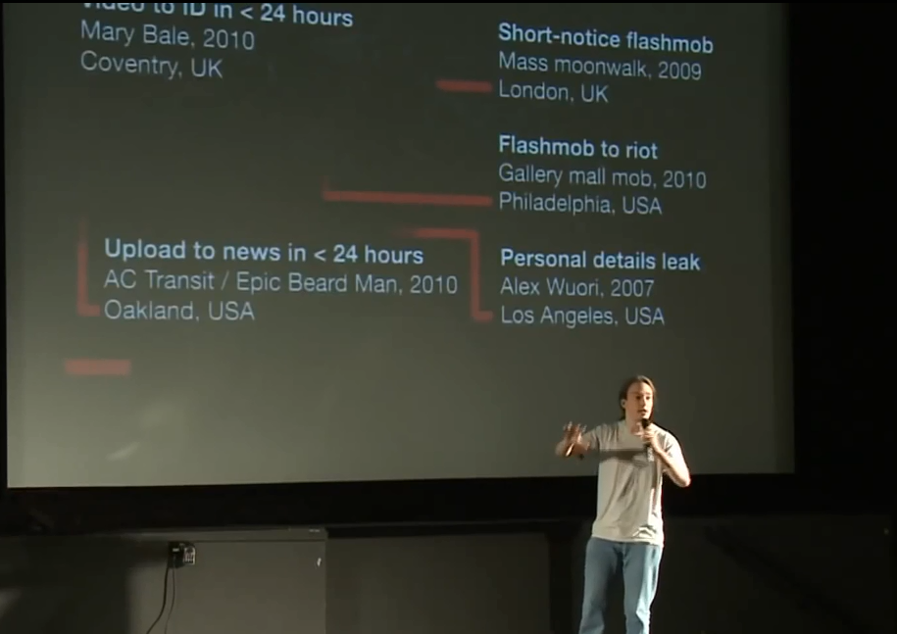
Why does Tom Scott include the quote “The whole world turns upside down in ten years, but you turn upside down with it” in his TEDx presentation about the dystopian potential of social media?

Slide 8
Black Mirror: “Nosedive”
Netflix
Season 3, episode 1
https://www.netflix.com/watch/80104627?trackId=13752289&tctx=0%2C0%2C0429cfc3-8510-412f-974e-1e33d4e18f6f-398814761

Slide 9
Non-Fiction social media topics
Sesame Credit
Social Media and the border
Social Media and behavior
Social Media and democracy
Social Media and privacy

Slide 10
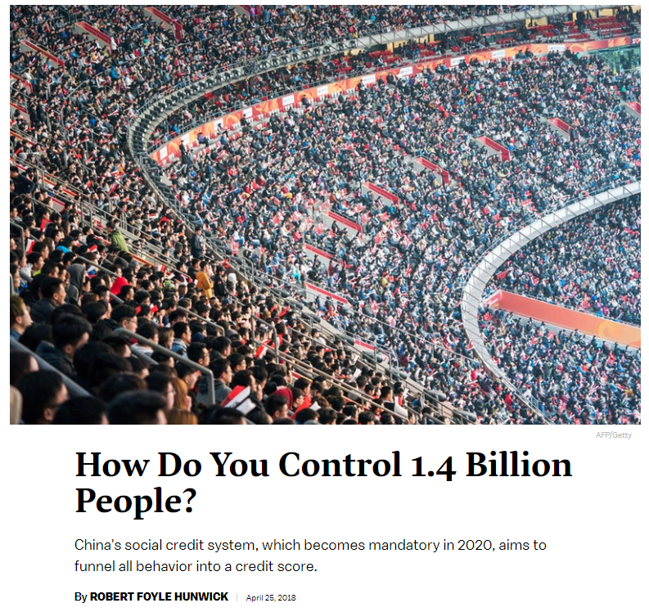
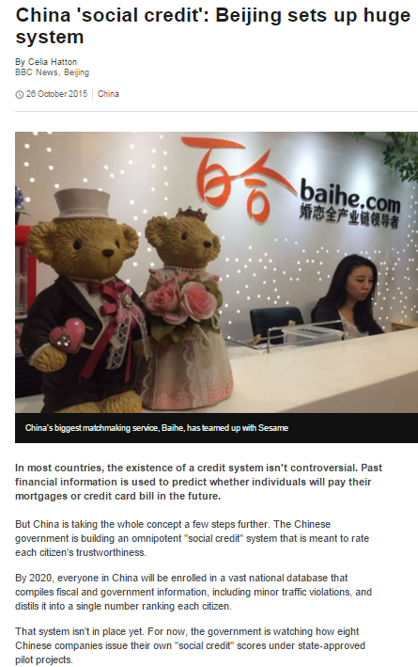
https://www.youtube.com/watch?v=lHcTKWiZ8sI
Notes:
http://www.bbc.com/news/world-asia-china-34592186

Slide 11
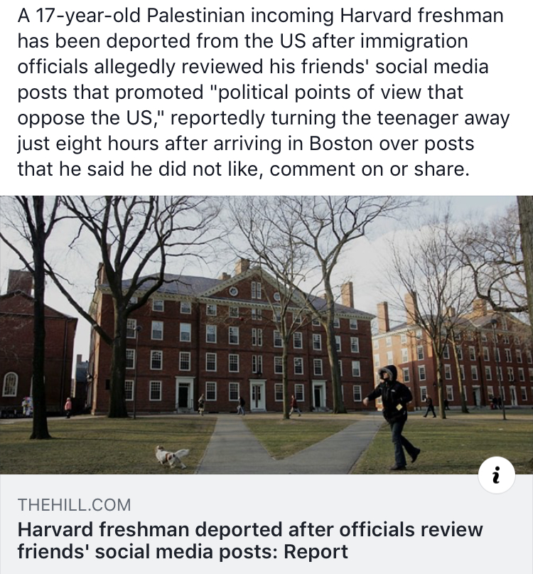
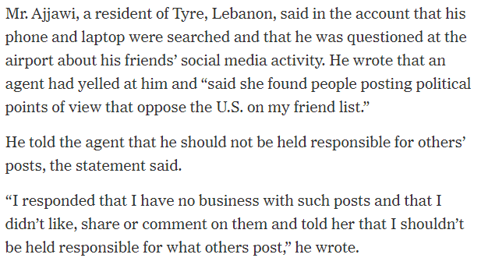
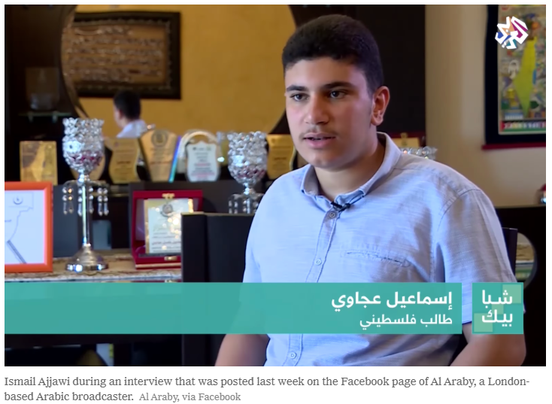

Slide 12
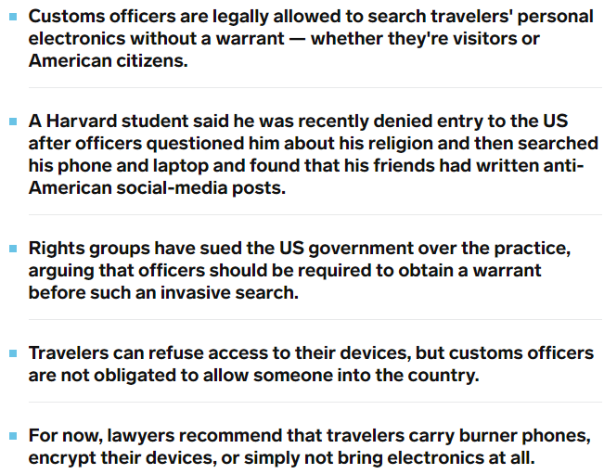

Slide 13
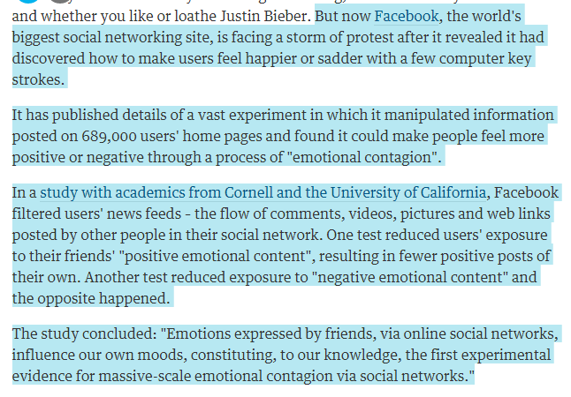
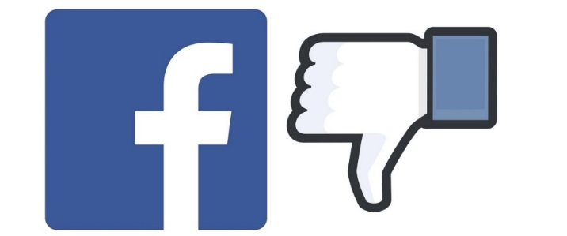

Slide 14
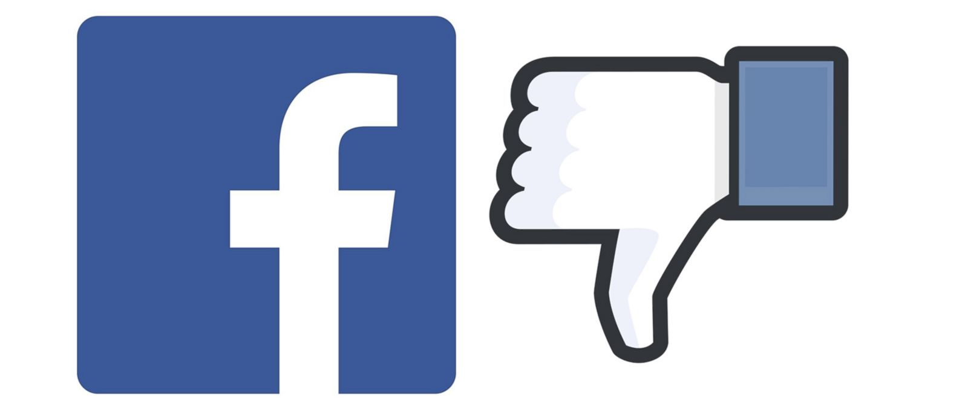
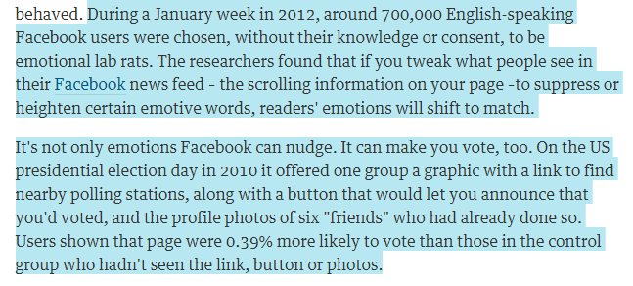

Slide 15
What do you think about this? Does it matter?

Slide 16
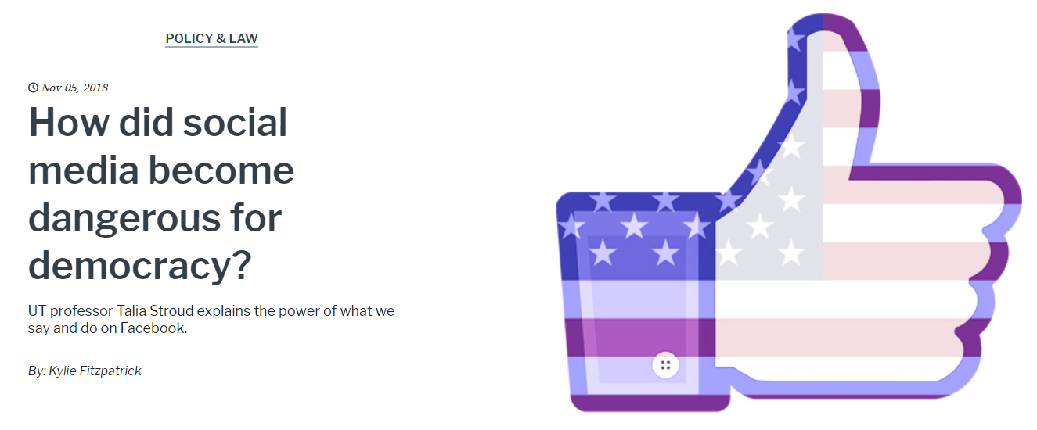
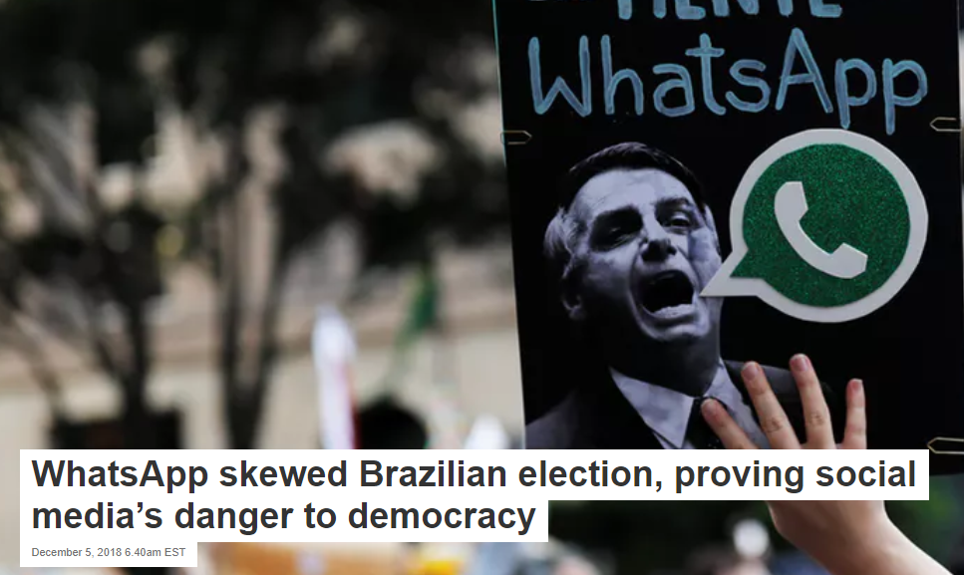
Social media and democracy

Slide 17
Social media and democracy
“44% of the total US adult population gets their news from social media.” (McIntrye).
“the rise of the Internet and social media is making the ideological foundation of liberal democracy—which has had a tight hold over our imagination for the better part of two centuries—look increasingly brittle.” (Mounk).
“Misinformation and fake news spread faster and deeper on social media than real stories.” (McIntrye).
Snippets from an interview with Talia Stroud, director of the Center for Media Engagement at the Moody College of Communication. Stroud is the North American Chair of Social Science One.
“Right now, I would say that the research is clear: social media can influence democratically important outcomes like polarization and participation.”

Slide 18
A confidential Facebook document reviewed by The Intercept shows that the social network courts carriers, along with phone makers — some 100 different companies in 50 countries — by offering the use of even more surveillance data, pulled straight from your smartphone by Facebook itself.
Offered to select Facebook partners, the data includes not just technical information about Facebook members’ devices and use of Wi-Fi and cellular networks, but also their past locations, interests, and even their social groups. This data is sourced not just from the company’s main iOS and Android apps, but from Instagram and Messenger as well. The data has been used by Facebook partners to assess their standing against competitors, including customers lost to and won from them, but also for more controversial uses like racially targeted ads.
Some experts are particularly alarmed that Facebook has marketed the use of the information — and appears to have helped directly facilitate its use, along with other Facebook data — for the purpose of screening customers on the basis of likely creditworthiness. Such use could potentially run afoul of federal law, which tightly governs credit assessments.
Facebook’s cellphone partnerships are particularly worrisome because of the extensive surveillance powers already enjoyed by carriers like AT&T and T-Mobile: Just as your internet service provider is capable of watching the data that bounces between your home and the wider world, telecommunications companies have a privileged vantage point from which they can glean a great deal of information about how, when, and where you’re using your phone. AT&T, for example, states plainly in its privacy policy that it collects and stores information “about the websites you visit and the mobile applications you use on our networks.” Paired with carriers’ calling and texting oversight, that accounts for just about everything you’d do on your smartphone.
Notes:
https://theintercept.com/2019/05/20/facebook-data-phone-carriers-ads-credit-score/?fbclid=IwAR0o4RAP0KFv2taOasL5_7LVWnIHonQZt-50K7t1nlspT7MMSc03hMfxW_4

Slide 19
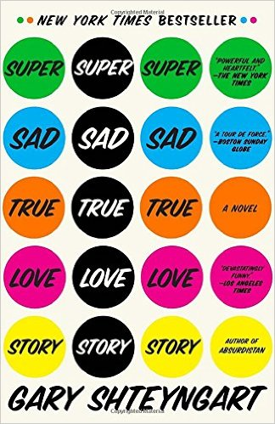
Super Sad True Love Story by Gary Shteyngart
What is the quality of American culture as Shteyngart imagines it in Super Sad True Love Story?
How is the social media climate/ranking in Super Sad similar to “Nosedive”?
What is the äppärät like?
What ranking categories are people judged by? (p 89).
How are the people dehumanized?
What is the slang like in America? How is Shteyngart being satirical?
What are Lenny’s friends like? Lenny?
Funny?

Slide 20
Lacie Pound: “Maybe you’re just too old to get it– you have to play the numbers game, it’s the way the fucking world works.”
Is Lacie Pound right about OUR world?

