Slide 1

Wrapping up Confucianism
Tuesday and Wednesday: Write Confucian maxims and turn into Tii
Thursday and Friday: Dear Abby Confucius Letters

Slide 2
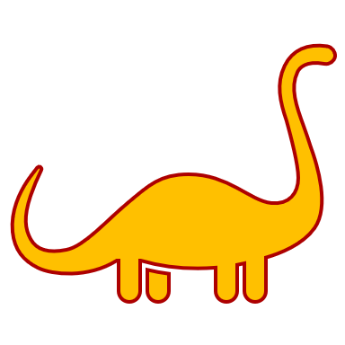
Write Confucian Maxims to demonstrate learning
Write 5 maxims (in the style of Confucius).
Each maxim MUST focus on at least one key tenet of Confucian thought: Ren, Li, Junzi, or Filiality/Relationships.
1-2 of your maxims MUST be specific advice for characters from novels we’ve read (Okonkwo, Esperanza, Nwoye, etc.)
1-2 of your maxims should be about being a good student
Your last maxim can be advice to Mr. Smith (be funny not rude A.F.).
Annotate your Maxims to explain how they connect to the Confucian principles.
→Due Wednesday night to Tii

Slide 3
Confucianism Bonus:
Are you trying to prove to Smith you deserve a grade HIGHER than what you had at MT3?*
Use the discussion tab of Tii to answer this question in your own work:
Does Confucianism have a fundamentally optimistic or pessimistic view of human nature?
*This isn’t a promise of a grade bump, just an opportunity to show Smith you want it.

Slide 4
Dear Abby Confucius Letters
Dear Abby is an American advice column founded in 1956 by Pauline Phillips under the pen name "Abigail Van Buren" and carried on today by her daughter, Jeanne Phillips. Dear Abby has been appearing across numerous American newspapers for 64 years.
Task: Go to the Dear Abby Archive (https://www.uexpress.com/dearabby/topics) and find an interesting question from either the Work & School, Teen, or Friends & Neighbors category and answer it with advice Confucius would give. Mimic the style of Dear Abby. Must be PG-15.
Include the reader question. You could make your own, but it better not be lame.
Then answer this question at the bottom: To what extent is Confucian thought a good framework for existing in 2020? Why?
→Due Friday night to Tii

