Slide 1
BMU Introduction Paragraph
HOOK: Interesting quote related to your topic that is INTEGRATED.
Briefly explain Bless Me, Ultima plot/novel.
ETHOS: Explain your literary term or context about it.
Thesis Statement.
Ethos: means the credibility, trustworthiness, or knowledge of the speaker or writer. Prove to your readers you understand the literary, cultural or other techniques you’re writing about by explaining them in your own words.
Think of your introduction paragraph as a funnel, it should gradually get more focused and specific as it funnels from you engaging HOOK to YOUR THESIS.

Slide 2
BMU Introduction Paragraph
HOOK: Interesting quote related to your topic that is INTEGRATED. “There is power here, power that can fill a man with satisfaction,” in Bless Me, Ultima Antonio is surrounded by a world with competing powers that call into question his beliefs and identity (Anaya 229).
Briefly explain Bless Me, Ultima plot/novel.
ETHOS: Explain your literary term or context about it. Rudolfo Anaya, the father of Chicano Literature, creates the dilemma about religion and the powers of the universe for Antonio by using the literary technique juxtaposition. Juxtaposition is when an author puts two different things near each other in a text to show the reader their differences.
Thesis Statement. Anaya’s use of juxtaposition shows conflict between the Luna and Marez families and the various religious powers in Antonio’s life; eventually leading readers, and Antonio to some extent, to realize growing up is choosing one’s own path.

Slide 3
Introductions and conclusions: A Visual
HOOK: Interesting quote related to your topic that is INTEGRATED.
Briefly explain Bless Me, Ultima plot/novel.
ETHOS: Explain your literary term or context about it.
Thesis Statement.
Restated, in different words, your argument or thesis.
Summarize the evidence you used (body paragraphs) to prove your thesis
A citation from a piece of research:
Final explanation of the “so what”
Concluding Final Thought:
NOTE: C. and D. can be flipped, if it makes more sense for your conclusion.

Slide 4
BMU Conclusion Paragraph
Restated, in different words, your argument or thesis.
Summarize the evidence you used (body paragraphs) to prove your thesis
A citation from a piece of research: use the school’s database to cite something relevant, probably ACADEMIC research or AUTHOR’s QUOTE
Final explanation of the “so what”
Concluding Final Thought: broad, universal final thought that feels like a conclusion.
Think of your conclusion paragraph as the opposite of your introduction funnel, it should gradually get more universal and culminating as it funnels from your specific YOUR THESIS to a satisfying, FINAL THOUGHT.

Slide 5
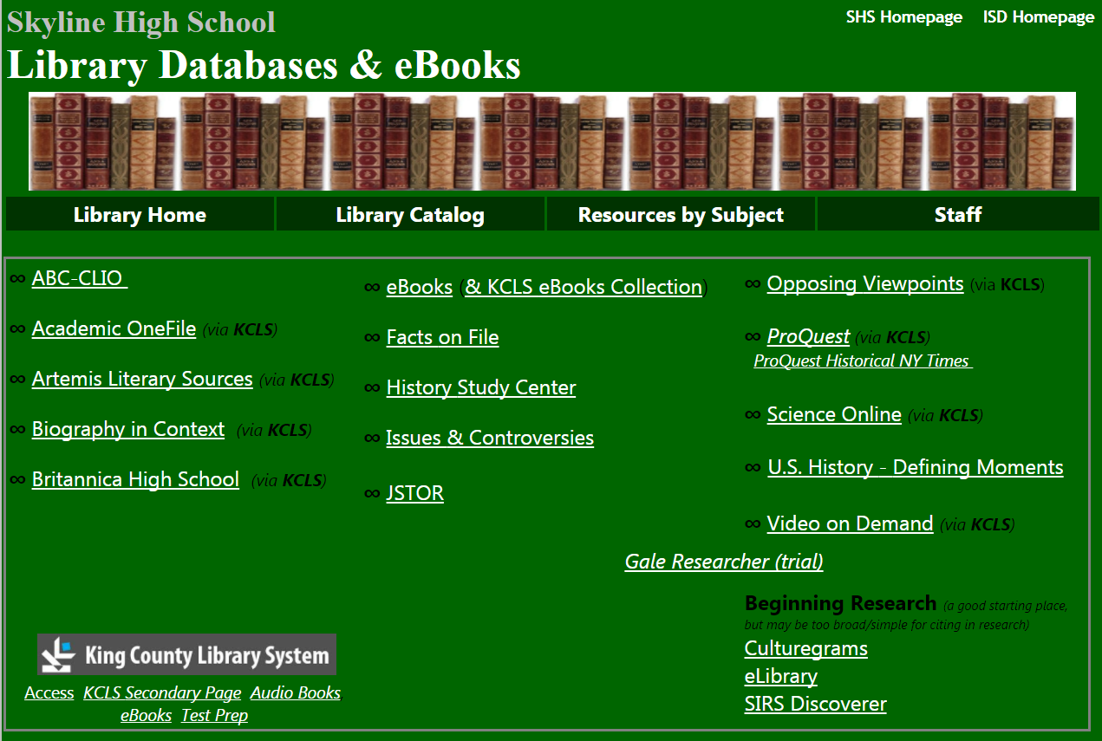
Start with this one!

Slide 6
BMU Conclusion Paragraph Example (NOTE: not aligned with earlier example of INTRO)
Restated, in different words, your argument or thesis: Anaya’s novel Bless Me, Ultima was able to create a meaningful example of juxtaposition between Ultima’s cures and Catholicism, which showed Antonio the advantages from incorporating syncretism into life; teaching Antonio to grow by accepting his own truths.
Summarize the evidence you used (body paragraphs) to prove your thesis: Anaya proved god was not the only way to resolve problems, a mixture of religion and culture is necessary for growth, and that judgment is part of syncretism.
A citation from a piece of research: The juxtaposition found in Bless Me, Ultima is an enlightening creation, able to bring harmony between two distinct cultures without war: “wisdom and experience allow one to look beyond difference to behold unity,” (Kanoza 1999).
Final explanation of the “so what”: Anaya’s purpose of promoting syncretism was exceptionally described through Ultima’s cures juxtaposed with Catholicism in his novel.
Concluding Final Thought: For this reason, Anaya’s novel disseminated a whole new genre among American readers: Chicano Literature.

Slide 7
BMU Conclusion Paragraph Example (NOTE: not aligned with earlier example of INTRO)
Anaya’s novel Bless Me, Ultima was able to create a meaningful example of juxtaposition between Ultima’s cures and Catholicism, which showed Antonio the advantages from incorporating syncretism into life; teaching Antonio to grow by accepting his own truths. Anaya proved god was not the only way to resolve problems, a mixture of religion and culture is necessary for growth, and that judgment is part of syncretism. The juxtaposition found in Bless Me, Ultima is an enlightening creation, able to bring harmony between two distinct cultures without war: “wisdom and experience allow one to look beyond difference to behold unity,” (Kanoza 1999). Anaya’s purpose of promoting syncretism was exceptionally described through Ultima’s cures juxtaposed with Catholicism in his novel. For this reason, Anaya’s novel disseminated a whole new genre among American readers: Chicano Literature.

