Slide 1
BrAve New World
chapter 2

Slide 2
Smith’s favorite cover of Brave New World
From 1971, you should be able to figure out why after reading chapter 2. There might be a quiz question about this in the future, just to make sure you’re opening PPTs.

Slide 3
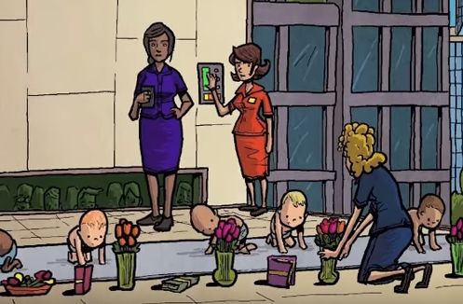
Chapter 2 Content Questions
What happens to the Delta babies? What social class are deltas? How are they made?
What is the attitude people have about family in Brave New World? Why does this benefit World State?
What is the attitude about sex in chapter 2?
What is the attitude about social class in Brave New World? What is genius about this for the purpose of achieving “Stability”?
What details from the Hypnopæda stand out?
What type of economy exists in 632 A.F.? How do the people in charge of World State (they’re called “World Controllers,” FYI) manipulate this using biology and psychology? Why choose this type of economy? Henry Ford?

Slide 4
Chapter 2 Essential New Learning
What psychological/learning principal is being applied to the Delta babies?
What do you know about classical conditioning and Ivan Pavlov’s dogs?
https://www.youtube.com/watch?v=hhqumfpxuzI (if this video sucks, or you don’t get it, find your own until you understand the idea)
Conditioning as featured on The Office: https://www.youtube.com/watch?v=11zRl9bWY_A
Pavlov’s discoveries straight up shook science fiction authors. Why? What fears would’ve emerged when this knowledge was still in its infancy? (Luckily people cannot be conditioned for very long).
“Books and loud noises, flowers and electric shocks-already in the infant mind these couples were compromisingly linked; and after two hundred repetitions of the same or a similar lesson would be wedded indissolubly. What man has joined, nature is powerless to put asunder. ‘They’ll grow up with what the psychologists used to call an ’instinctive’ hatred of books and flowers. Reflexes unalterably conditioned. They’ll be safe from books and botany all their lives.’” (Huxley).

Slide 5
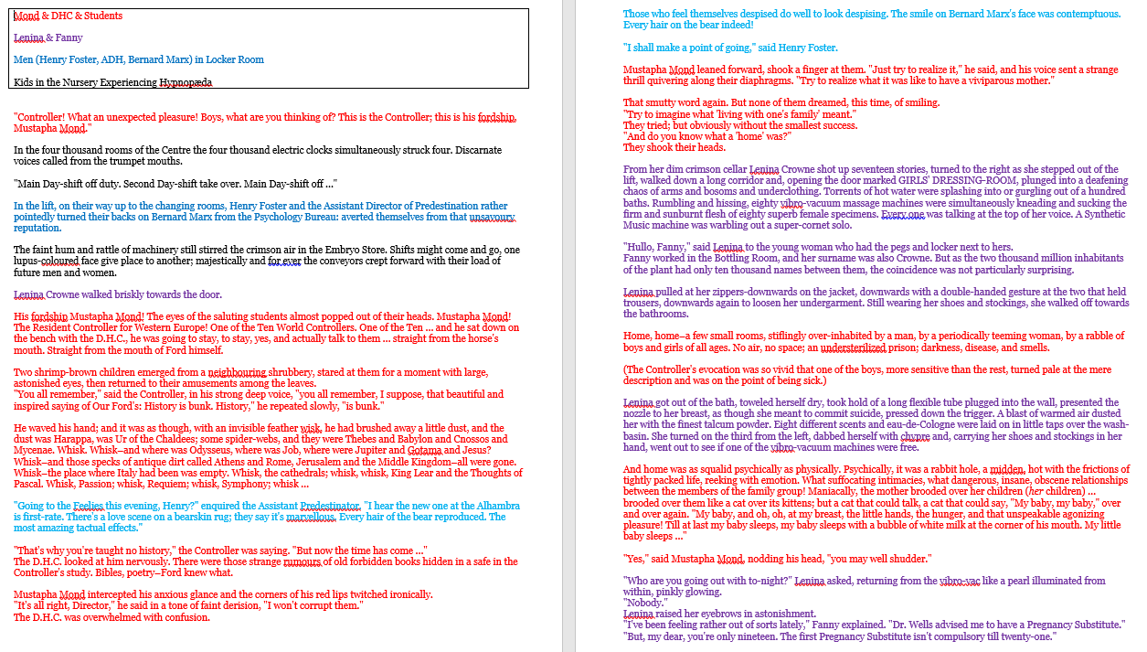
Chapter 3 Preview
Read the PDF containing the first bit of chapter 3. Notice how at the very end it seamlessly jumps between 3 different scenes, from that point on the entirety of chapter 3 is four different scenes jumbled together in increasingly small and randomized chunks. Color coded it would look like the screenshot to the right. Luckily Smith has the four scenes broken down into separate documents so that is how you’ll read them Wednesday
You will read them all.
You (and potentially a partner from your small ENL groups) will have a choice of tasks to complete.
Everyone should also keep a character web, which you can use on your upcoming quiz. <3 Smith

Slide 6
Chapter 2 Literary Analysis (optional)
Mood is what the reader feels while reading a scene or story. It’s not the reader’s emotions, but the atmosphere (the vibe) of a scene or story.
Mood is created by (1) setting (physical environment and time period), (2) theme, (3) diction[word choice], (4) imagery and (5) tone.

Slide 7
Between the rose bowls the books were duly set out-a row of nursery quartos opened invitingly each at some gaily coloured image of beast or fish or bird….
The babies … began to crawl towards those clusters of sleek colours, those shapes so gay and brilliant on the white pages. As they approached, the sun came out of a momentary eclipse behind a cloud. The roses flamed up as though with a sudden passion from within; a new and profound signficance seemed to suffuse the shining pages of the books. From the ranks of the crawling babies came little squeals of excitement, gurgles and twitterings of pleasure.
The Director rubbed his hands. “Excellent!” he said. “It might almost have been done on purpose.”
The swiftest crawlers were already at their goal. Small hands reached out uncertainly, touched, grasped, unpetaling the transfigured roses, crumpling the illuminated pages of the books. The Director waited until all were happily busy. Then, “Watch carefully,” he said. And, lifting his hand, he gave the signal.
What is the mood of this passage?

Slide 8
Between the rose bowls the books were duly set out-a row of nursery quartos opened invitingly each at some gaily coloured image of beast or fish or bird….
The babies … began to crawl towards those clusters of sleek colours, those shapes so gay and brilliant on the white pages. As they approached, the sun came out of a momentary eclipse behind a cloud. The roses flamed up as though with a sudden passion from within; a new and profound significance seemed to suffuse the shining pages of the books. From the ranks of the crawling babies came little squeals of excitement, gurgles and twitterings of pleasure.
The Director rubbed his hands. “Excellent!” he said. “It might almost have been done on purpose.”
The swiftest crawlers were already at their goal. Small hands reached out uncertainly, touched, grasped, unpetaling the transfigured roses, crumpling the illuminated pages of the books. The Director waited until all were happily busy. Then, “Watch carefully,” he said. And, lifting his hand, he gave the signal.
Mood through word choice + imagery

Slide 9
The Head Nurse, who was standing by a switchboard at the other end of the room, pressed down a little lever.
There was a violent explosion. Shriller and ever shriller, a siren shrieked. Alarm bells maddeningly sounded.
The children started, screamed; their faces were distorted with terror.
“And now,” the Director shouted (for the noise was deafening), “now we proceed to rub in the lesson with a mild electric shock.”
He waved his hand again, and the Head Nurse pressed a second lever. The screaming of the babies suddenly changed its tone. There was something desperate, almost insane, about the sharp spasmodic yelps to which they now gave utterance. Their little bodies twitched and stiffened; their limbs moved jerkily as if to the tug of unseen wires.
What is the mood of this passage?

Slide 10
The Head Nurse, who was standing by a switchboard at the other end of the room, pressed down a little lever.
There was a violent explosion. Shriller and ever shriller, a siren shrieked. Alarm bells maddeningly sounded.
The children started, screamed; their faces were distorted with terror.
“And now,” the Director shouted (for the noise was deafening), “now we proceed to rub in the lesson with a mild electric shock.”
He waved his hand again, and the Head Nurse pressed a second lever. The screaming of the babies suddenly changed its tone. There was something desperate, almost insane, about the sharp spasmodic yelps to which they now gave utterance. Their little bodies twitched and stiffened; their limbs moved jerkily as if to the tug of unseen wires.
Mood through word choice + imagery

Slide 11
Write a thesis: What effect does Huxley create by dramatically shifting the mood at the beginning of chapter 2?
Why do the poor little Delta babies have to get electrocuted?
“They’ll grow up with what the psychologists used to call an ’instinctive’ hatred of books and flowers. Reflexes unalterably conditioned. They’ll be safe from books and botany all their lives.”
Why does this benefit World State?

