Slide 1
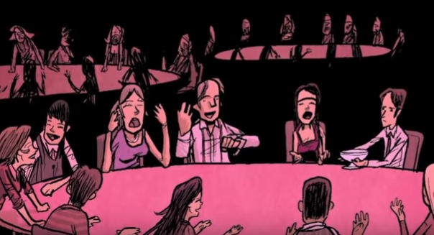

Slide 2
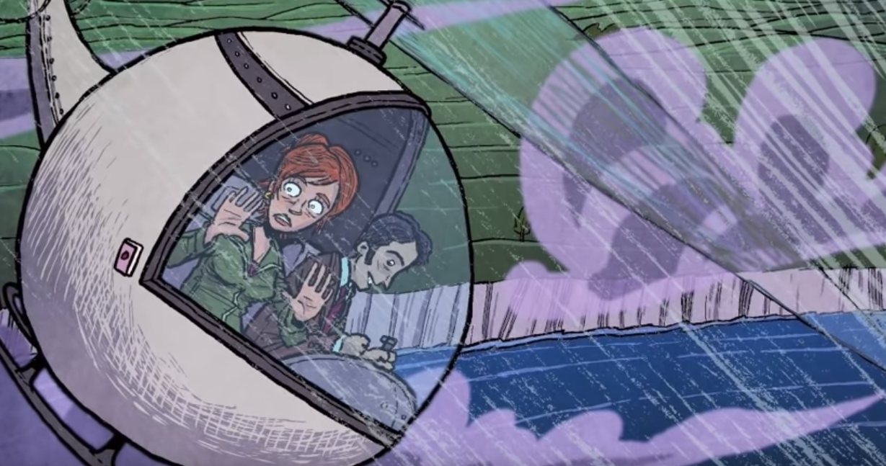
BNW chapter 5
What do Lenina and Henry talk about on their way home? What happens at the crematorium?
Is being “socially useful” in all aspects of life and death important? Should we strive to make people “socially useful” at all times?
Why are stars “depressing”?
What are the solidarity services like? What role does soma play?
How strong is soma?
What is “orgy-porgy”?
Orgy-porgy is a chant that is repeated as part of a solidarity circle after the soma, but before group sex.

Slide 3
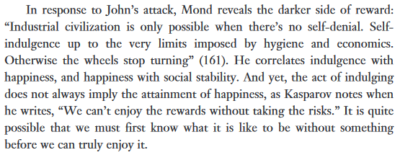
Optional Essay on BNW in the Digital Age: “Facebook the Orgy-Porgy”
https://cas.nyu.edu/content/dam/nyu-as/casEWP/documents/erslyfacebook10.pdf
There some spoilers.

