Slide 1
Chapter 5 and 6.1 discussion!
Why is someone “socially useful” after they die? Is being “socially useful” in all aspects of life and death important? Should we strive to make people “socially useful” at all times?
Is everyone truly happy now? Is artificial happiness the same as true happiness? Does it matter? Would you want to be Soma happy?
Is Brave New World more utopian or dystopian?
“orgy-porgy”?
What is Bernard and Lenina’s date like?
What does Bernard say about Freedom?

Slide 2
What is happiness?

Slide 3
Chapter 6.2 and 6.3!
TOMORROW: 5 and 6 quiz
Why is chapter 6 part 3 hilarious??

Slide 4
3/28/2017
5-6 quiz
Discussion
In class write
HW: Read Chapter 7
Look for the strange religious and cultural practices of the “Savages.” List 4-5!

Slide 5
Chapter 6.2 and 6.3!
Part 2
How does the Director feel about Bernard? What does he tell him?
What is the Director’s story?
What does it tell us about the Director?
How does Bernard react to all of this?
What could this be foreshadowing?
Part 3
What is the scene with the Warden and Lenina/Bernard like?
What facts are shared about the reservation?
What does Helmholtz tell Bernard? How does Bernard feel about being an individual now?

Slide 6
QUICKWRITE TIMED IN CLASS WRITE [1 page?]
In a thesis driven response:
How does Aldous Huxley create humor in the scene between the Warden and Lenina and Bernard at the Reservation?
Be sure to include quotes from the text and an articulate response focused on literary conventions.
You can start reading chapter 7 when you’re done ☺

Slide 7
Knock Knock…
Turn to the person next to you. Tell them your best joke.
What makes that joke funny? Or, what makes it not funny?

Slide 8
Analyzing Humor
E. B. White said, “Analyzing humor is like dissecting a frog. Few people are interested and the frog dies of it.”
Although definitions of humor differ somewhat, depending on whether one approaches it from a psychological, anthropological, or literary perspective, most scholars agree that it is rooted in expectation and surprise.
One of the fundamental aspects of humor is that it disrupts expectations. It violates our logical perceptions of the normal.

Slide 9
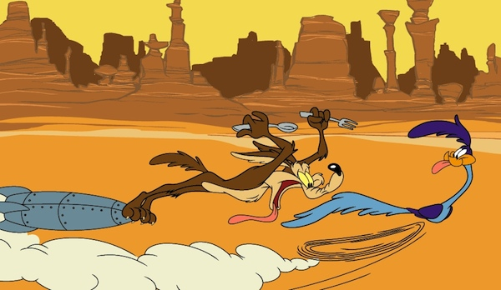
Classic Comedy
We are going to watch an example of classic comedy. As you watch, please jot down a few answers to the following question:
What makes this funny?
Notes:
https://www.youtube.com/watch?v=_W_wz7qQVN0

Slide 10
Humor & Power
Another aspect of humor: it can be hostile. Whether playfully self-deprecating or virulently abusive, most humor has a target. Someone or something is the butt of the joke.
That being said, humor also…
Helps builds community
Allows us to discuss topics that are difficult & uncomfortable by easing that discomfort
Whatever is funny is subversive.
—George Orwell

Slide 11
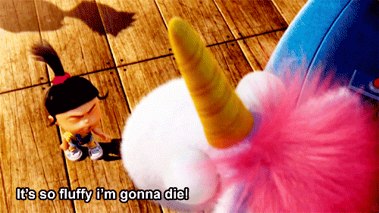
Satire as Social Commentary
Satire is a specific type of social commentary that uses humor to create the author’s commentary (opinion, analysis, judgment, and explanation) about the target. Often involves use of:
Sarcasm
narration
Allegory
Juxtaposition: two different things next to each other to show their differences
Tone/mood
Hyperbole: intense exaggeration: “It’s so fluffy I’m gonna die!”
Irony
Parody
Criticism
Silliness

Slide 12
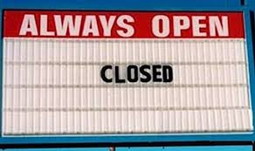
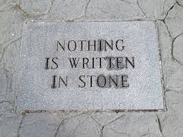
Humor Techniques: irony
i·ro·ny¹
ˈīrənē/
noun
the expression of one's meaning by using language that normally signifies the opposite, typically for humorous or emphatic effect.
Or:
Irony is figurative language where/when words are used in such a way that their intended meaning is different from their actual meaning in a incongruent way.

Slide 13
QUICKWRITE TIMED IN CLASS WRITE [1 page?]
In a thesis driven response:
How does Aldous Huxley create humor in the scene between the Warden and Lenina and Bernard at the Reservation?
Be sure to include quotes from the text and an articulate response focused on literary conventions.
You can start reading chapter 7 when you’re done ☺

Slide 14
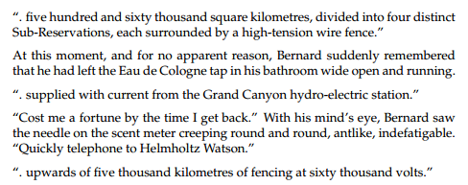
Chapter 6 [87-106]
Part 3

Slide 15
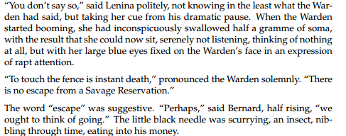
Chapter 6 [87-106]
Part 3

Slide 16
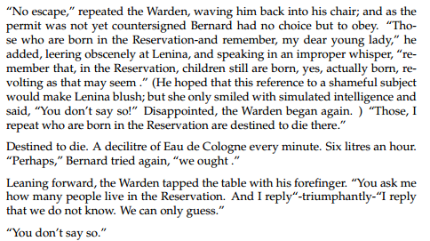
Chapter 6 [87-106]
Part 3

Slide 17
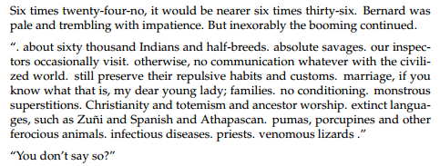
Chapter 6 [87-106]
Part 3
Comment on Huxley’s style here

Slide 18
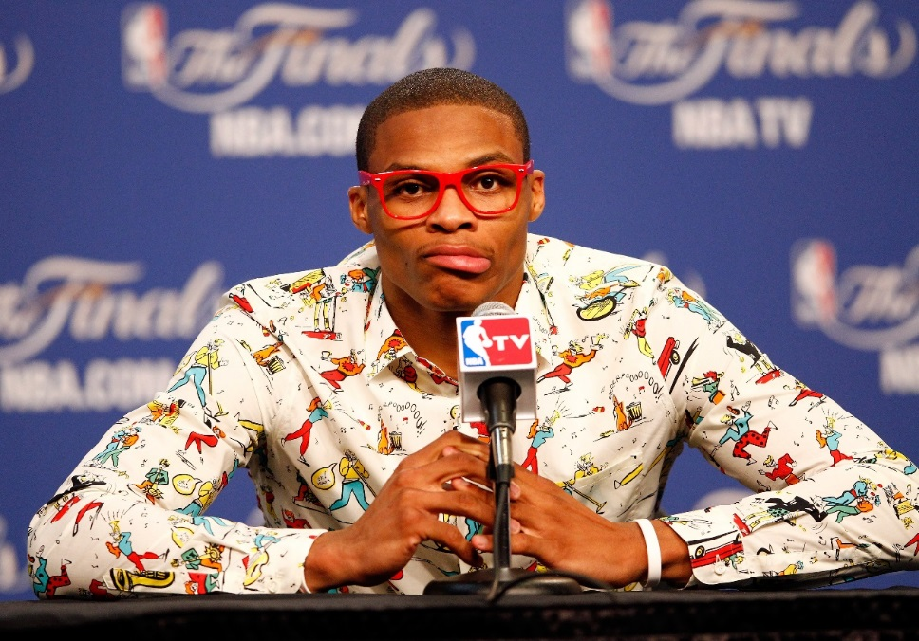
Style
is the literary term that describes the ways that an author uses words — including the author's (1) word choice, (2) sentence structure, (3) use of figurative language, and (4) sentence arrangement all work together to create:
mood,
tone,
imagery,
a unique voice
the quality of their work,
and meaning in the text.

