Slide 1
Goal: design a cover for Things Fall Apart that illustrates your understanding of …
The danger of a single story
The FLAWED representations of indigenous peoples in Imperialist Literature
Achebe’s purpose for writing Things Fall Apart
Okonkwo’s story as valuable and worthy of a whole novel
A theme from the novel

Slide 2
Ted Talk https://www.youtube.com/watch?v=0nI65jgHG9o
Balance “clarity and mystery”
Remember previous learning:
Amplification through Simplification
Symbolism
Graphic Weight
Not all clarity is good, not all mystery is good
“unuseful clarity” vs. “useful clarity”
“unuseful mystery” vs. “useful mystery”

Slide 3
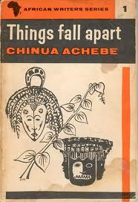
Compare and contrast these older covers of Things Fall Apart. Remember the proverb, “You can tell a ripe corn by its look” and consider what is revealed in these images.
Which one is balances “clarity and mystery” better? Which is better for OUR assignment?

Slide 4
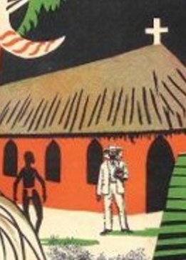
How is this book cover subtly a promotion of the kinds of ideas Achebe was fighting against? (it’s ironic that…)

Slide 5
How is this book cover much better?

Slide 6
Which one is balances “clarity and mystery” better? Which is better for OUR assignment? Which employs amplification through simplification and graphic weight the best?

Slide 7
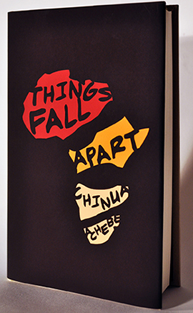
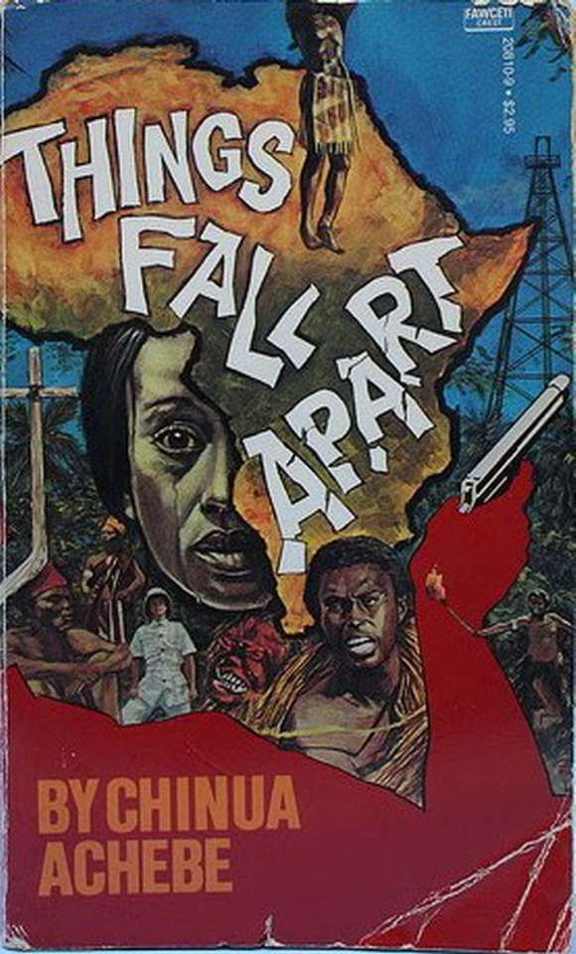
Which one is balances “clarity and mystery” better? Which is better for OUR assignment? Which employs amplification through simplification and graphic weight the best?

Slide 9
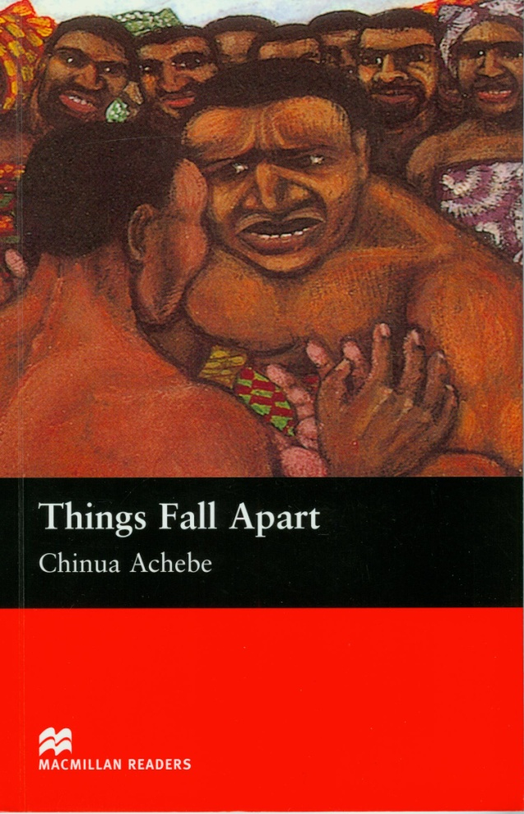
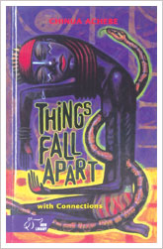
Which one is balances “clarity and mystery” better? Which is better for OUR assignment? Which employs amplification through simplification and graphic weight the best?

Slide 10
Goal: design a cover for Things Fall Apart that illustrates your understanding of …
An awesome (A+) product will:
Represent ¾ of these ideas.
In addition to possibly another key aspect of the story and/or Igbo culture
Balance “clarity and mystery.”
Possibly utilize:
Amplification through Simplification.
Symbolism.
Graphic Weight.
Not be racist.
Be creative and original.
Include, on the back in writing, an explanation of HOW your cover achieves these things and WHY you did what you did.
The danger of a single story
The FLAWED representations of indigenous peoples in Imperialist Literature
Achebe’s purpose for writing Things Fall Apart
Okonkwo’s story as valuable and worthy of a whole novel

Slide 11
Goal: design a cover for Things Fall Apart that illustrates your understanding of …
The danger of a single story
The FLAWED representations of indigenous peoples in Imperialist Literature
Achebe’s purpose for writing Things Fall Apart
Okonkwo’s story as valuable and worthy of a whole novel
A good (B) product will:
Represent 2/4 of these ideas.
Balance “clarity and mystery.”
Possibly utilize:
Amplification through Simplification.
Symbolism.
Graphic Weight.
Not be racist.
Be creative and original.
Include, on the back in writing, an explanation of HOW your cover achieves these things.

Slide 12
Rubric

