Slide 1
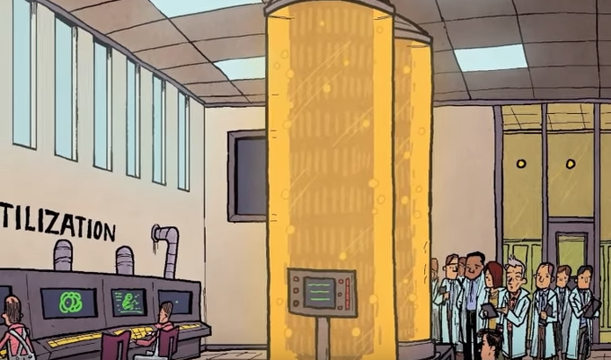
Brave New World chapter 1
“The principle of mass production at last applied to biology.” (Huxley).

Slide 2
Brave New World chapter 1
How is the world used by Huxley completely different than that of Orwell in 1984? Look at the first 2 paragraphs of each.
What is the purpose of the factory in chapter 1?
Notice the sarcastic (?) narration.

Slide 3
1984 opening
It was a bright cold day in April, and the clocks were striking thirteen. Winston Smith, his chin nuzzled into his breast in an effort to escape the vile wind, slipped quickly through the glass doors of Victory Mansions, though not quickly enough to prevent a swirl of gritty dust from entering along with him.
The hallway smelt of boiled cabbage and old rag mats. At one end of it a coloured poster, too large for indoor display, had been tacked to the wall. It depicted simply an enormous face, more than a metre wide: the face of a man of about forty-five, with a heavy black moustache and ruggedly handsome features. Winston made for the stairs. It was no use trying the lift. Even at the best of times it was seldom working, and at present the electric current was cut off during daylight hours. It was part of the economy drive in preparation for Hate Week. The flat was seven flights up, and Winston, who was thirty-nine and had a varicose ulcer above his right ankle, went slowly, resting several times on the way. On each landing, opposite the lift-shaft, the poster with the enormous face gazed from the wall. It was one of those pictures which are so contrived that the eyes follow you about when you move. BIG BROTHER IS WATCHING YOU, the caption beneath it ran.

Slide 4
Brave New World chapter 1
Visually represent the World State’s ‘Decanting Process’ in your notes with annotations of:
Decanting System
Bokanovsky’s Process
Podsnap’s Technique
The delineation of the social hierarchy
Other key details
Quotes from the text

Slide 5
Brave New World chapter 1
It would take ALL the men of New York City, working 24/7, three months to fill an Olympic sized pool with semen– enough for the sperm baths in BNW.
Olympic sized pool: 36,900 ft³
At least 4 million men in NYC

Slide 6
Brave New World chapter 1
Describe the benefits and drawbacks of the decanting system, including Bokanovsky's Process and Podsnap's Technique.
How are they instruments of “social stability”?
In your opinion, are these methods of reproduction moral? (2 points for and 2 against)
What different conditions do the fetuses of different castes undergo to make them acceptable?
How does Huxley utilize humor in chapter 1? How does he write about the students and the director?
What is the meaning of the World State’s motto “COMMUNITY, IDENTITY, STABILITY?”
What are the social norms of World State?
Why don’t Epsilons “need human intelligence”?

Slide 7
Science + BNW
BNW is a science fiction dystopia.
What does that tell you about the fears that created it?
“Bokanovsky’s Process” enables a single egg to spawn up to 96 children and one ovary to produce thousands of children.
To further increase the birthrate of Gammas, Deltas and Epsilons, “Podsnap’s Technique” causes all the eggs in the ovary to mature simultaneously, allowing the hatchery to get full use of the ovary in two years' time.

Slide 8
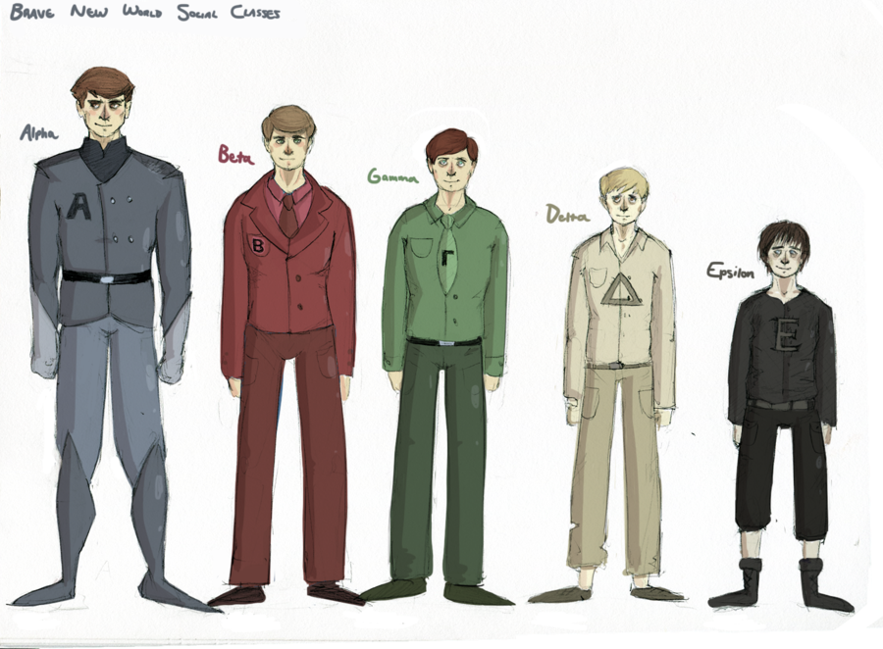
Brave New World Social Hierarchy

Slide 9
Designer Babies and Genetic Editing
https://www.youtube.com/watch?v=2ixEDLa3Jlc
What do you think about the process for baby making in Brave New World?
What about in the real world?

Slide 10
ANALYZE THIS PASSAGE FROM CH 1 FOR MOOD, TONE, AND RACIAL ETHNOCENTRISM pg. 8/9
“Sixteen thousand and twelve in this Centre," Mr. Foster replied without hesitation. He spoke very quickly, had a vivacious blue eye, and took an evident pleasure in quoting figures. "Sixteen thousand and twelve; in one hundred and eighty-nine batches of identicals. But of course they've done much better," he rattled on, "in some of the tropical Centres. Singapore has often produced over sixteen thousand five hundred; and Mombasa has actually touched the seventeen thousand mark. But then they have unfair advantages. You should see the way a negro ovary responds to pituitary! It's quite astonishing, when you're used to working with European material. Still," he added, with a laugh (but the light of combat was in his eyes and the lift of his chin was challenging), "still, we mean to beat them if we can. I'm working on a wonderful Delta-Minus ovary at this moment. Only just eighteen months old. Over twelve thousand seven hundred children already, either decanted or in embryo. And still going strong. We'll beat them yet.”

Slide 11
Homework: Read chapter 2
LOOK FOR:
Sex
Gender Interactions
Capitalism
Electricity
Expect a quiz on chapters 1-?

