Slide 1
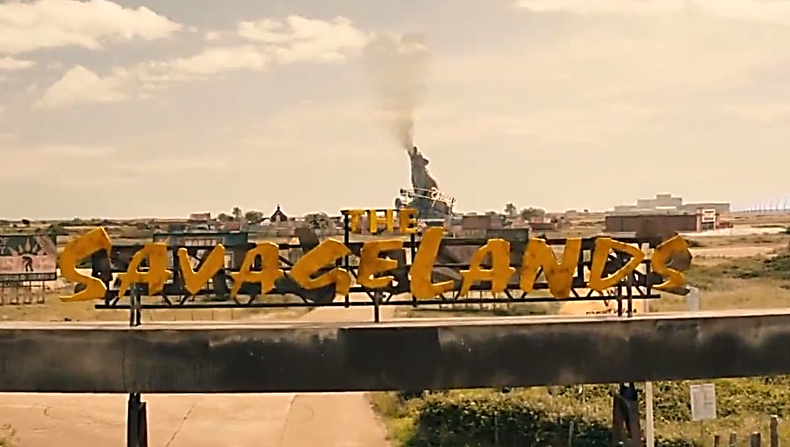
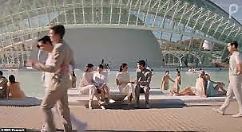
Apparently there is a NEW Brave New World Netflix show coming out this July
Trailer: https://www.youtube.com/watch?v=wC04ypdLOa4
What do you think?
Will you be watching?
What changes do you notice?

Slide 2
Brave New World chapter 11
How does World State treat Linda’s arrival back to civilization? How does she respond to civilization?
Look at the characterization web you made about Bernard Marx after chapter 3:
How and why has he changed? Is this a positive development?
What does his character development reveal about his true personality?
Is it surprising? How does it develop the theme of social control of Huxley’s dystopia?
What does John mean when he says “civilized infantility too easy or… ‘not expensive enough’”? [Included in Bernard’s letter to Mustapha Mond]
How does Huxley use numbers as a motif to develop the creepiness of the labor relations of the caste system in Brave New World?
Why do they pay low-class workers in soma?
What is the school like in chapter 11? What do the students of different castes learn? Why do young children learn about death?

Slide 3
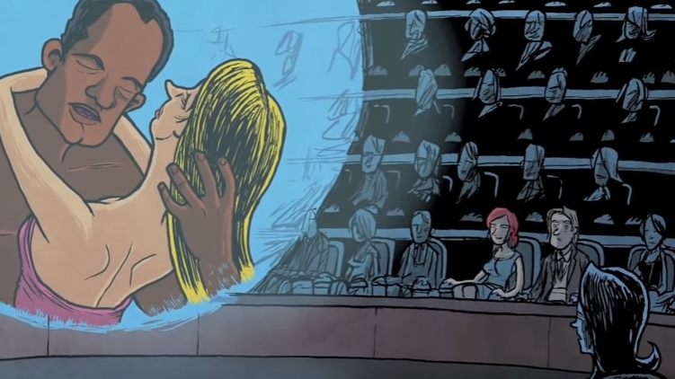
Brave New World chapter 11: The Feelies
How is Lenina handling John and Bernard’s stardom?
How is John and Lenina’s relationship developing?
What are “the feelies”? How racist is the story in the feelie?

Slide 4
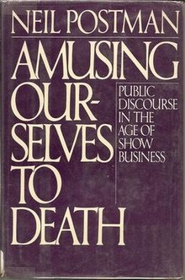
Amusing Ourselves to Death by Neil Postman
Amusing Ourselves to Death: Public Discourse in the Age of Show Business (1985) is a book by educator Neil Postman.
Postman was participating in a panel on Orwell's Nineteen Eighty-Four and the contemporary world. In the introduction to his book, Postman wrote that the contemporary world is better reflected by Aldous Huxley's Brave New World, whose public was oppressed by their addiction to amusement, than by Orwell's work, where they were oppressed by state control.
The simplest example of this process at work Smith can provide you with is the fact that airlines (only recently) have started providing even cheap seats with FREE access to tv shows and movies on the headrest.
Thinking about your cell phone, social media, etc. How much of American life is controlled by an addiction to amusement?
How do these things control us?

