Slide 1
Doce (122-135)

Slide 2
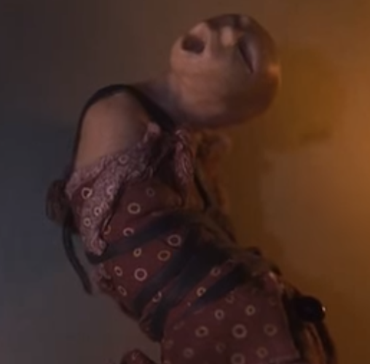
The Dolls?

Slide 3
Scapular?
The Christian scapular typically consists of two small (usually rectangular) pieces of cloth, wood or laminated paper, a few inches in size, which may bear religious images or text and are worn on a necklace.
What is different about Ultimas’?

Slide 4
Doce (122-125)
What 2 friends did Maria make on the llano?

Slide 5
Doce (126-135)
What does Antonio show his family to prove that Ultima is innocent of killing Tenorio’s daughter?
Who is heroic in chapter 12? Why?
How does the attempted lynching (kill-the-witching) of Ultima end?

Slide 6
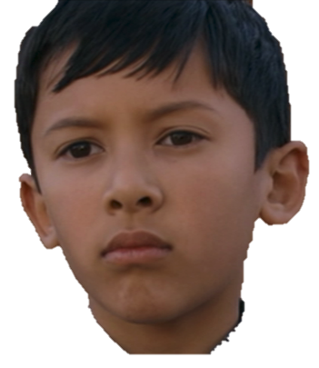
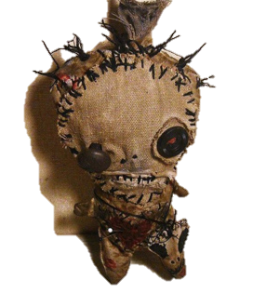
If Young Ultima Don’t Trust Ya (Brujas)
She gonna clay doll ya

Slide 7
Doce in film: (49:00 – 55:15)
https://youtu.be/mbi5lzH0HGY?t=49m

Slide 8
Doce (122-135)
Is Ultima a bruja?!
Is the magic Ultima does evil? Is it like the Trementina sisters’ magic?

Slide 9
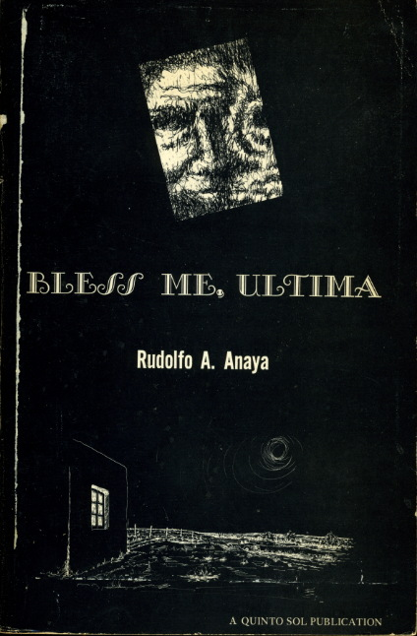
Journal #14: Curanderas vs. Brujas
Learning Targets:
Students will be able to differentiate between Curanderas and Brujas in Bless Me, Ultima and Hispanic culture.
Students will decide if Ultima is a witch or not.
Students will be able to examine the juxtaposition of religious powers and Ultima’s as it relates to the themes of BMU.
Students will be able to define syncretism.

Slide 10
How does the attempted lynching (kill-the-witching) of Ultima end?
What is suspicious about this?

Slide 11
Monsters and the practice of labeling or creating people ‘monsters,’ according to sociological theory, come from our fears of things that are different than our social norms.
What societal differences do you think lead people to labeling women around them witches?

Slide 12
Monsters and the practice of labeling or creating people ‘monsters,’ according to sociological theory, come from our fears of things that are different than our social norms.

Slide 13
Additionally Sociologists Say…
Witchcraft provides a culturally validated explanation for: chronic illness that defies treatment; death without known cause; and successive misfortunes assumed to be beyond the control of the individual. A diagnosis of bewitchment may enable the victim to undertake a treatment which assures him of thesupport of family and community.
Witchcraft belief provides an outlet for the release of hatred and resentment.
It offers the individual a means of temporarily reducing anxiety and tension arising from cognitive dissonance.
Witchcraft provides social control of deviance from approved patterns of behavior.

Slide 14
Brief History of Witches
In Europe beginning in the 700s CE witchcraft was associated with heresy
Heresy: Belief or opinion contrary to orthodox religious doctrine
The Christian church began a long crusade to stamp out heresy
Especially in the 1500s people were brought before secular courts and accused of human sacrifice and worshiping with the Devil
Many of the accused were midwives or nurses
The stereotype about women in the 1600 and 1700s was that women were in need of male guidance, in order to protect them from natural inclination to sin (kind of like Eve)

Slide 15
The Church’s Take
During the late Middle Ages, the church took up the position that witches were in fact real. This began with the shift in perceptions of Satan, and with the testimony of Thomas Aquinas.
Witches were essentially vessels or puppets that demons worked through to do Satan’s dirty work.
Another common belief was that witches knowingly engaged in a deal with Satan in exchange for these powers.
Of course they didn’t really possess the powers, the demons did.

Slide 16
Important thought…
The church acknowledged there were demons throughout the world, and that it was the churches job to seek out and destroy these demons.
However: if you identify a witch or a person possessed, you can physically see/fight them.
The belief and attack on witches gave the Church something real to point at, and served as a way of reinforcing their power. Not only were people afraid to speak against the church for fear of persecution, but those who were accused of withcraft, acted as visible symbols that demons were real and among us!

Slide 17
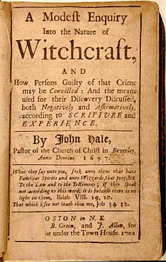
Salem Witches
Colonial Massachusetts, 1692-1693
Incredibly Puritan village, devoutly religious and conservative in values
Resulted in the execution of 20 people, most women
1 man, Giles Corey, was pressed to death by stones

Slide 18
Witches in Mexico
Dates back to AFTER the Spaniards took over South and Central America.
Spaniards labeled people as witches to set an example for the “mass of newly converted Indians,” or at least to not contaminate Christianity with indigenous “misconstrued beliefs and superstitions.”
What the Spaniards eventually confronted, “was an interaction of peoples and beliefs, an interaction that proved a fertile ground for the [development] of a popular magical and religious culture beyond their control.”
Spaniards labeled the practices that existed before Christianity as heresy and the practice of such acts as witches.

Slide 19
Sociologists Say about Witches in Hispanic/Latin Cultures
Fears of witches and witchcraft (brujas and brujaeria) may be especially strong due to the pressures that come from syncretism of Anglo-Catholic Traditions and from Polythiest-Folk Societies.
Syncretism: the merging of cultures and religions
As deviation away from Mexican-American customs toward Anglo behavior norms increases in urban centers, the fear of bewitchment grows and frequently forces the deviant to revert to strict Catholic behaviors or to abandon the communality.

Slide 20
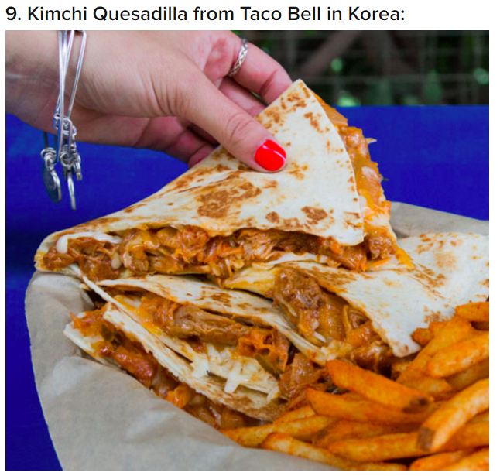
Syncretism

Slide 21
Rudolfo Anaya:
“I hope my books present some of my New Mexican culture which includes Hispanic [Catholic] and Native American [polytheist] traditions and ceremonies.…”
Syncretism: the merging of cultures and religions.

Slide 22
Doce (122-135)
Is Ultima a bruja?!
Is the magic Ultima does evil? Is it like the Trementina sisters’ magic? What would the Church think of her magic? Does any of this matter?

Slide 23
Two Theories
Theory #1
Theory #2 (Conspiracy)
Ultima IS NOT a bruja and wields curandera powers
Ultima IS a bruja and wields brujeria powers

Slide 24
Two Theories
Theory #1
Theory #2
Record 3-4 pieces of evidence from chapters 1-12 to support theory 1
Record 3-4 pieces of evidence from chapters 1-12 to support the conspiracy theory

Slide 25
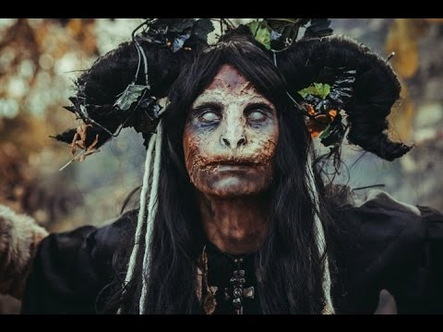
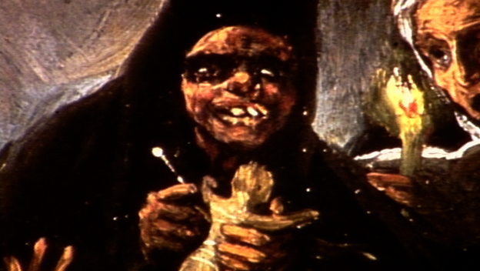
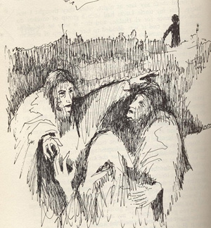
Brujas– No bueno

Slide 26
Brujas– No bueno
Early Brujería can be traced back as far as the 1500s when the archbishop of Santo Domingo and fifth bishop of Puerto Rico, Nicolás Ramos, recorded his recollections of “black brujos who engaged with the devil in the shape of a goat and, every night in front of this goat, cursed God, Santa María, and the sacraments of the Holy Church.’’ Ramos wrote, ‘‘Asserting that they did not have nor believe in a god other than that devil…they performed these rituals in some fields …not in dreams since there were some people who saw them.’’ These people, Ramos continues, ‘‘tried to make them refrain from their doings through chanting and holy gifts, and with all this information they came to me.’”
This perpetual demonization of elements of African worship set up the forefront to the centuries of demonization of Brujería practices.

Slide 27
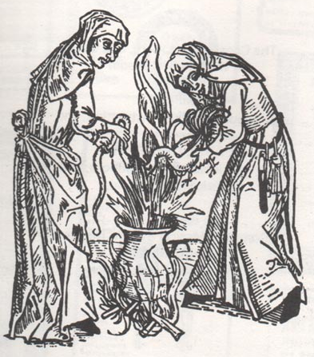
Brujas– No bueno
Witchcraft was also an important part of the social and cultural history of late-Colonial Mexico, during the Mexican Inquisition. Spanish Inquisitors viewed witchcraft as a problem that could be cured simply through confession. Yet, as anthropologist Ruth Behar writes, witchcraft, not only in Mexico but in Latin America in general, was a "conjecture of sexuality, witchcraft, and religion, in which Spanish, indigenous, and African cultures converged.”
Furthermore, witchcraft in Mexico generally required an interethnic and interclass network of witches. Yet, according to anthropology professor Laura Lewis, witchcraft in colonial Mexico ultimately represented an "affirmation of hegemony" for women, Indians, and especially Indian women over their white male counterparts as a result of the caste system

Slide 28
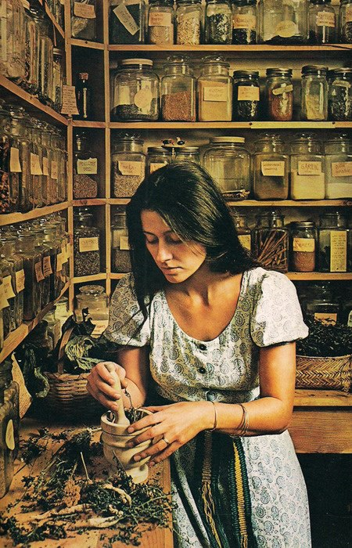
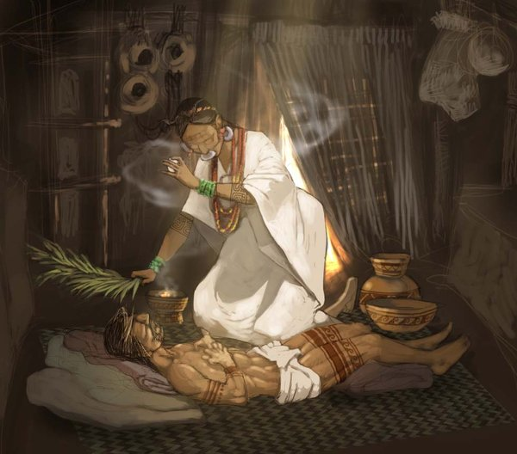
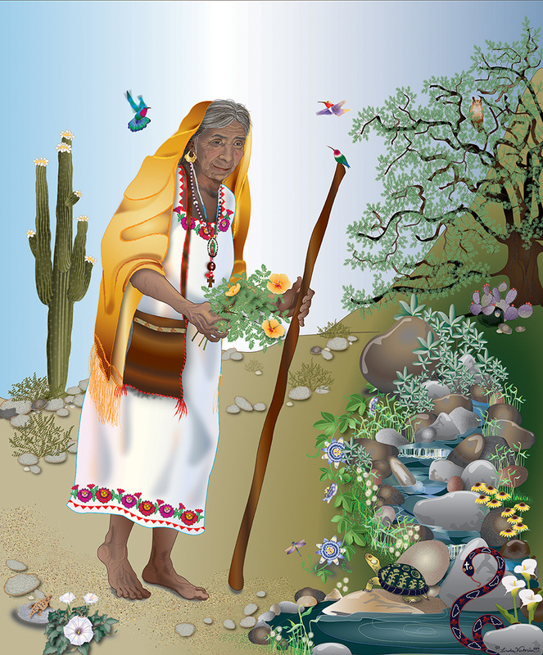
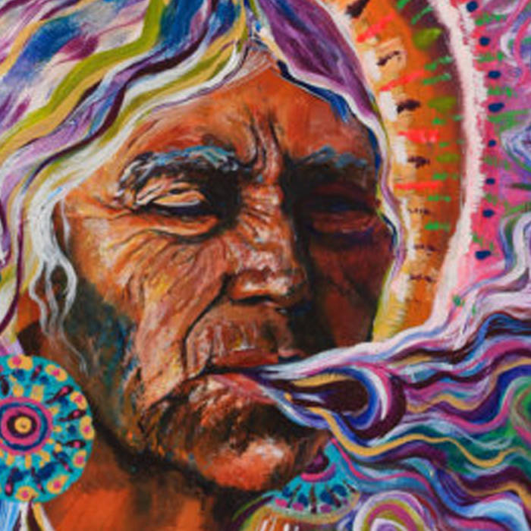
Curanderas– bueno

Slide 29
Curanderas– bueno
The term curanderos can be traced all the way back to the Spanish colonization of Latin America. Curanderos are the result of the mixture of traditional indigenous medicinal practices and Catholic rituals.
There was also an influence from African rituals brought to Latin America by slaves.
The term stems from the Spanish word for "to heal“: curar. Curanderos go beyond Western medicine, by linking illness with evil spirits. This extends a curandero's duties to cover not only physical ailments but also psychological issues and even things like a failing marriage.
In Colonial Latin America, female folk healers, or curanderas, were often conflated with brujas, which refers to those who cast spells; although curanderas were persecuted during such times, it is likely because they were females in positions of authority, not because of their healing methods.
Today many women and men continue the curandero tradition in Mexico and the southwestern United States.
Curanderismo is not only a form of folk healing, it also includes the practice white magic, ritual, cleansings, energy work, spirit contact, divination, and a vast amount of prayer just to name a few.

Slide 30
Curanderas and the Church
An excerpt from:
“The pope and La Curandera, the Healer”
by Dr. Clarissa Pinkola Estés on Aug. 09, 2010
National Catholic Reporter
Latino healing practices called curanderismo are often taught under the guidance and protection of the older women. Curanderismo is the spiritual practice, most often devoted to intercession through Jesús y Maria, toward the healing of spirit, soul, mind and body.
This spiritual discipline is specific and varied in each locality. It can be said that in parts of Mexico, it is a combination of the ancient Nahua people’s (the original tribal name which Spaniards overlaid with their word, Aztec) spiritual understandings, blended with very old Sephardic traditions that had entered the Catholicism of the 16th century Conquistadores, and sometimes merging further with spiritual practices from 15th century Africa, via slave women and men forced to the east coast of Mexico and Central America.
In curanderismo, the old people teach there is to be no shyness or false modesty about artfulness, for every person’s bloodline is sacred. The healer is thus considered from day one, an artesaño of the soul. The invisible world is acknowledged easily, and without undue eeriness or superstition. What is sometimes called ‘la primera,’ first reality, is fully acknowledged directly along with consensual reality.
No curandera worth her herbias will take on students who are hyperfascinated, egotistic, or thrill seekers. As in the priesthood, in the convents across the world, selection tries to avoid the passive-dependent personality as well as the one seeking deference from others without having earned it in spades.
Curanderismo’s practices are steeped in holiness and in sacred prayer, in hands-on healing touch, and platicas, talking as spiritual companions... the very same attributes prized by monks, priests, nuns, brothers and other consecrated persons, whether avowed, or not.

Slide 31
As we read, fill in details from the text about what makes a bruja and what makes a curandera. Include page numbers.
Curanderas | Brujas
Know “the herbs and remedies of the ancients, a miracle-worker who could heal the sick. And … could lift the curses laid by brujas,” (Anaya 4). “And because a curandera had this power she was misunderstood and often suspected of practicing witchcraft” (Anaya 4). Must accept payment for cures? (Anaya 91). “The priest at El Puerto did not want the people to place much faith in the powers of Ia curandera.” (Anaya 97). | Do evil (Anaya 4). “the owl was one of the disguises a bruja took” (Anaya 13). Witches serve the devil by performing the black mass in exchange for their powers (Anaya 87). “known to make clay dolls and prick them with needles. … made many people of the valley sick, some died from her curses.” (Anaya 89). “They knew that the sign of the cross would work against any bruja, but it had not worked against Ultima. Either she was not a bruja, or to their way of thinking, she had powers that belonged to the Devil himself.” (Anaya 93).

Slide 32
Could there be a third theory?!
Theory #3
Ultima IS a curandra and wields magic powers that are the same as brujeria because the powers of good and evil are the same

Slide 33
Links
Youtube: https://www.youtube.com/watch?v=TvzGxClJdEI
https://newworldwitchery.com/2011/08/24/blog-post-134-%E2%80%93-brujeria-and-curanderismo-a-very-brief-overview/
http://pages.mtu.edu/~smbosche/courses/read/Curanderismo.htm

