Slide 1
Journal #25: Confucius
Learning Targets:
Students will be able to synthesize definitions of 4 major Confucian ideas.
Students will be able to identify Confucian ideas from other examples of Chinese philosophy.
Students will be able to contextualize Confucian philosophy within China and Chinese history.

Slide 2
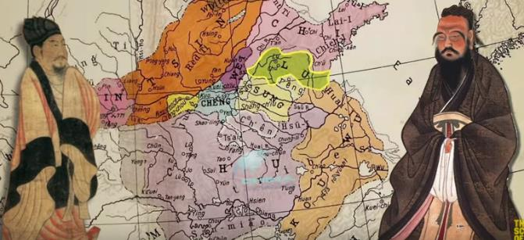
Confucius lived between ~551 BC and ~479 BC
Take notes on the following two videos.
Watch this overview of Chinese history (Santos will go into more detail later): https://www.youtube.com/watch?v=ylWORyToTo4
Watch this short video about Confucius: https://www.youtube.com/watch?v=tUhGRh4vdb8
What important ideas did Confucius have?
What is one word you would use to characterize Confucius?

Slide 3
Research the period of Chinese History called “The Warring States Period”
How could this time period have contributed to the basic Confucian ideas you learned about yesterday? (I.E. a focus on strict social hierarchies and conservative values)

Slide 4
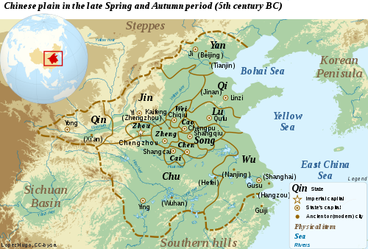
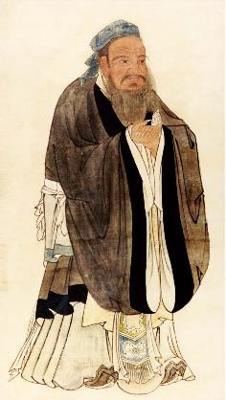
Confucianism
儒教
Called "Rú jiào" - Ruism
Rú: scholar
jiào: doctrine/religion
Founder: Kongzi (Master Kong) → Confucius (Latinized)
551 BCE – 479 BCE
Lived during Spring and Autumn Period / Warring Period in China
Lots of chaos, violence, different kingdoms/states fighting each other
From an aristocratic family in the state of Lu (N. China)
Believed he discovered the solution for social harmony

Slide 5
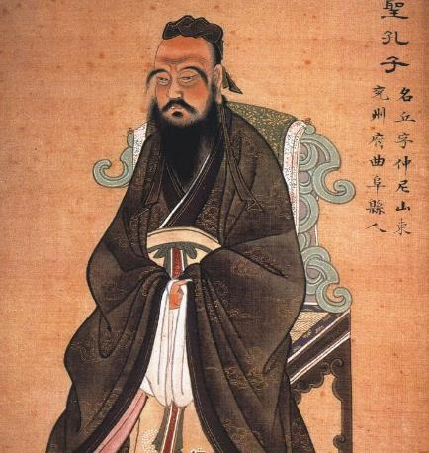
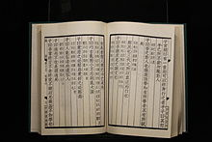
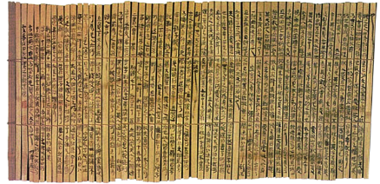
Confucianism
Spent most of his adult life wandering around China
Looking for a leader who would adopt his philosophy
No one was interested...
After his death – his students wrote down his teachings in a book called the Analects
Idea becomes more popular – Chinese rulers began to adopt his philosophy into practice
Would become the basis for Chinese society for 2,000 years
Spreads throughout China & neighboring countries (Korea, Japan, and Vietnam)
儒教

Slide 6
Confucianism
儒教
Focused on human behaviors in everyday life not beliefs about any deity (god)
Philosophy for life, not a religion
Social harmony could be attained by moral examples by superiors
Looking up to elders
Looking back to the past for these examples

Slide 7
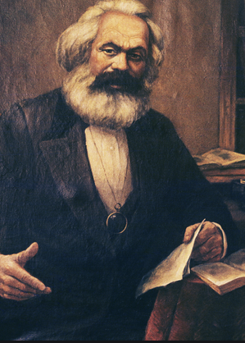
Philosopher Showdown: What’s the best way to achieve Social Harmony? Social Harmony: peace and prosperity between people in a stable society
?
?

Slide 8
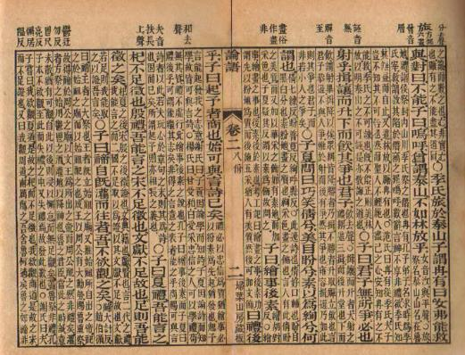
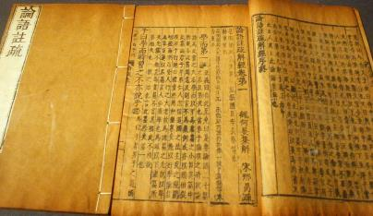
Text: The Analects of Confucius
Analects = collection of short literary or philosophical extracts.
In The Analects Confucius is referred to as “Master”
Didactic Literature!
A collection of sayings and ideas attributed to Confucius and his students and followers.
It is believed to have been written during the Warring States period (475–221 BC), and it achieved its final form during the mid-Han dynasty (206 BC–220 AD).
Divided in Books and Chapters (for example 1.6 would be Book 1, chapter 6).

Slide 9
The Analects (Maxims)
“To study without thinking is futile.”
“Don’t worry if people don’t recognize your merits; worry that you may not recognize theirs.”
“Set your heart upon the Way; rely upon moral power; follow goodness; enjoy the arts”
“A youth is to be regarded with respect. How do we know that his future will not be equal to our present?”

Slide 10
Make one of these to keep your notes in!

Slide 11
Simple Definition of Important Ideas and Terms
Important Term or Idea
Quote 5 analects and analyze the message + the 2 Smith picked
After learning, place for ADVANCED definition

Slide 12
Term: | Ren | Li | Junzi | Filiality
Basic Definition: | The moral code a person should follow. | Following important laws, traditions, and rituals. | A respectable leader. | Interpersonal Relationships.
Analects: | 4.14: Do not be concerned that you have no position, be concerned that you have what it takes to merit a position. Do not be concerned that no one recognizes you, seek that which is worthy of recognition. 4.4: If one sets one’s heart on ren, there will be none he hates. __: __: | 7.20: I was not born with knowledge. I love what is old and am assiduous* in pursuing it. 1.12: ‘In the practice of li/ Harmony is the key.’ In all affairs, great and small, follow this. __: __: | 4.10: The Master said, The junzi’s stance towards the world is this: there is nothing he insists on, nothing he refuses, he simply aligns himself beside [what is] right. 2.19: The Lord asked, “What should I do so that the people will obey?” Confucius replied, “Raise up the straight and set them above the crooked and the people will obey. Raise up the crooked and set them above the straight and the people will not obey.” __: __: | 2.7: Ziyou asked about filial piety. The Master said, “What is meant by filial piety today is nothing but being able to feed and take care of your parents. But even hounds and horses require food and care. Without respect, what is the difference?” 4.19: The Master said, When one’s parents are alive, make no distant journeys; when you travel, have a set destination. __: __:
Larger ‘Synthesis’ Definition:

Slide 13
Directions: Constructivist learning of the Analects important terms and ideas
Read your selection from the Analects of Confucius. Front and back.
Attempt to figure out (explain) the didactic advice/message of 6-8 maxims.
Then categorize each maxim: does it go with
Ren,
Li,
Junzi, or
Filiality/Relationships.
Fill them into your chart

Slide 14
Strategies for reading Didactic Literature
Is it a maxim, parable, or anecdote?
What is the writer’s message or message? Is it explicit or implicit?
Look for patterns in language use.
Ask questions, make predications, focus on the main idea, visualize who could use the moral advice.

Slide 15
Using your chart: Write a new and improved definition of each concept at the bottom based on what you’ve learned.

Slide 16
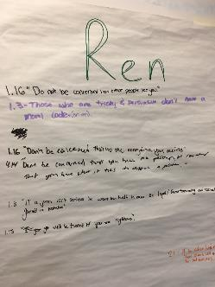
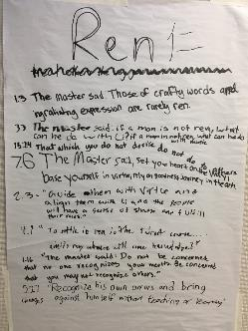
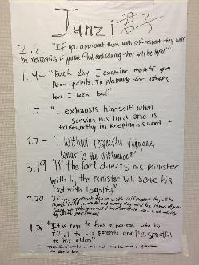
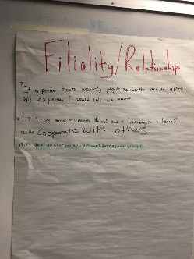
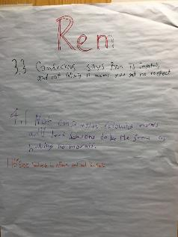
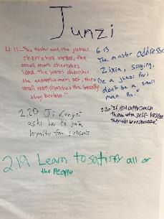
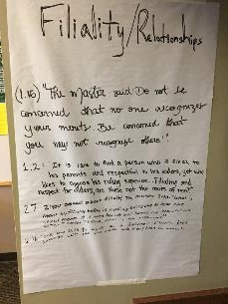
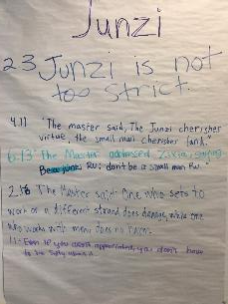

Slide 17
Add these Following Slides as Notes.
Check your work on your chart! How accurate were you? What questions do you have?

Slide 18
Ren: the moral code a person should follow.
Confucianism believes:
Humans are all born with ren, and are intrinsically good
negative leaning and experiences suppress the good nature
Essential ingredient of a peaceful society
13.19: Fan Chi asked about ren.
The Master said, “Let your bearing be reverent when you are at leisure, be respectfully attentive in managing affairs, and be loyal towards others. Though you be among barbarians, these may never be cast aside.”
Ren 仁

Slide 19
Li: following important laws, traditions, and customs.
The ritual practices of the Zhou, of which Confucius was master; the range of behavior ranges from:
political protocol,
court ceremony,
religious rite,
village festival,
daily etiquette,
personal behavior when alone.
Following historical traditions and customs allows people to learn from the wisdom of the past and honor their ancestors.
8.2: The Master said, If one is reverent but without li one is burdened; if one is vigilant but without li one is fearful; if one is valorous but without li one causes chaos; if one is straightforward but without li one causes affronts. When the junzi is devoted to his parents, the people rise up as ren; when he does not discard his old comrades, the people are not dishonest.
Li 禮

Slide 20
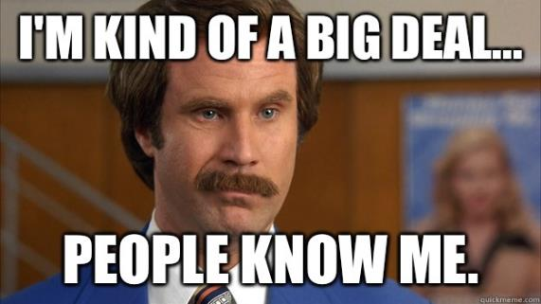
Junzi: A respectable leader.
Needs to be moral and ethical (Ren)
Also well educated
Everyone should know who the leader is and was
2.3: The Master said: Guide them with policies and align them with punishments and
the people will evade them and have no shame. Guide them with virtue and align
them with li and the people will have a sense of shame and fulfill their roles.
Junzi 君子

Slide 21
Filial Piety (xiào): the way people should behave in relationships
Five (unequal) relationships lead to social order:
Ruler and Subject
Parent and child
Husband and wife
Older sibling and younger sibling
Friend to friend
Virtue of respect for one’s parents, elders, and ancestors
Obeying your parents in life, taking care of them in old age, and honoring them in death (Li)
Ultimate duty in life
Patriarchy: men OVER women. (So younger sons over older daughters)
The universe/cosmos is hierarchical and gendered
Heaven → male
Earth → female
Educate girls so they could better serve their husbands
Educate boys so they could be better contributors to society
Subjects MUST obey their Rulers.
2.5: Meng Yizi asked about filiality.
The Master said, “Never disobey.” Fan Chi was driving the Master’s chariot, and the Master told him, “Meng Yizi asked me about filiality and I replied, ‘Never disobey.’”
Fan Chi said, “What did you mean?”
The Master said, “While they are alive, serve them according to li. When they are dead, bury them according to li; sacrifice to them according to li.”
Filial Piety 孝

Slide 22
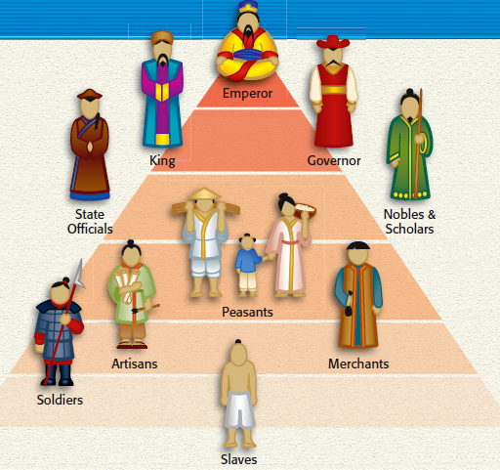
Everybody has a role to play.
China had a strict social hierarchy that Confucius believed people needed to follow for a stable society.
Filial Piety helped make these relationships concrete.
There is a Moral Order (The Mandate of Heaven)
Behavior is based on relationships
Filial Piety: Respect for father and family roles
Citizens respect the ruler
Ruler must act as a father to his citizens

Slide 23
Confucianism
儒教
If the Superior party behaves with sincerity, benevolence, and genuine concern for others
Inferior party will respond with deference and obedience
Harmony

Slide 24
Confucianism
“The relationship between superiors and inferiors is like that between the wind and the grass. The grass must bend when the wind blows across it”

Slide 25
Write Confucian Maxims to demonstrate learning
Write 5 maxims (in the style of Confucius).
Each maxim MUST focus on at least one key tenet of Confucian thought: Ren, Li, Junzi, or Filiality/Relationships.
1-2 of your maxims MUST be specific advice for characters from novels we’ve read (Okonkwo, Tenorio, Antonio, Esperanza, Nwoye, etc.)
1-2 of your maxims should be about being a good student
Your last maxim can be advice to Mr. Smith (be funny not rude A.F.).
Leave space in between your maxims for annotating.

Slide 26
Application Question:
In what ways do your family’s values reflect, or not reflect, Confucian values?

Slide 27
Confucianism
Does Confucianism have a fundamentally optimistic or pessimistic view of human nature?
孝

