Slide 1
Journal ??: India
Learning Targets:
Students will be able to define epic poetry and identify the 5 characteristics of an epic poem in a text.
Students will be able to explain Sanskrit, Dharma, Karma, Moksha, the Rigveda, epic heroes, and Valmiki.
Students will be able to define paradox and identify it in various texts.
Students will be able to act out the Ramayana.

Slide 2
Paradox
a statement that is, or appears to be, self-contradictory but may include a hidden truth.
Generally, people find paradoxes to be really interesting…
Example: “What a pity that youth must be wasted on the young.” – George Bernard Shaw
“Contradiction”: a combination of statements, ideas, or features of a situation that are opposed to one another.

Slide 4
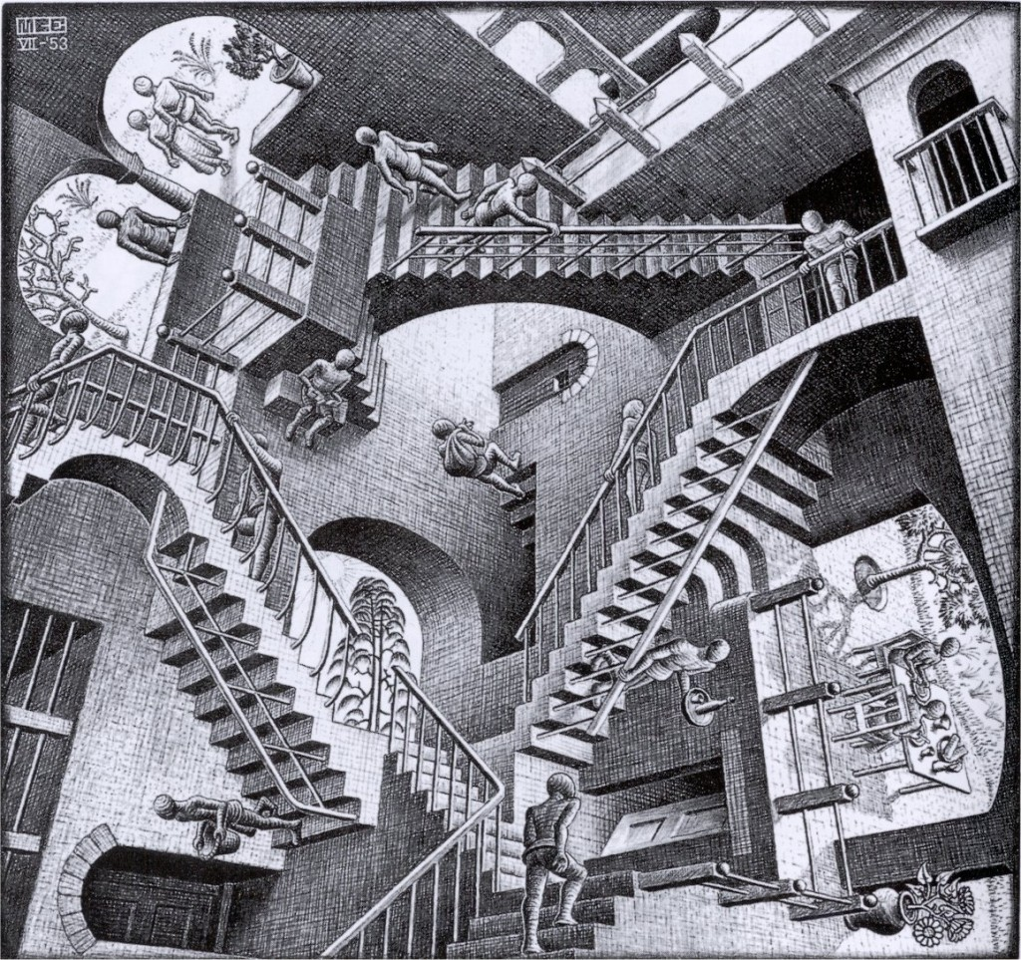

Slide 5
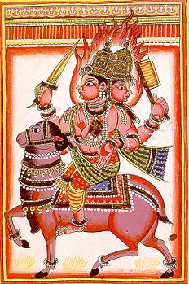
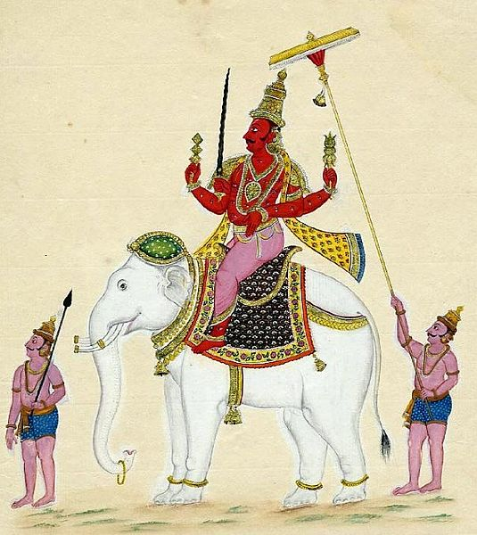
The Creation Hymn from the Rig Veda
The Rigveda is an ancient Indian collection of Vedic Sanskrit hymns. It is one of the four sacred texts of Hinduism known as the Vedas.
The text is a collection of 1,028 hymns and 10,600 verses, organized into ten books. The hymns are dedicated to Rigvedic deities.
Indra, Visnu, etc.
In the 8 books that were composed the earliest, the hymns predominantly discuss cosmology and praise the deities.
Books 1 and 10, which were added last, deal with philosophical or speculative questions about the origin of the universe and the nature of god, the virtue of charity in society, and other metaphysical issues.
One of the oldest texts in any Indo-European language.
Agni
Indra

Slide 6
Read the Hindu Creation Hymn
What might be the benefits of leaving the creation a mystery?
Compared to the whole ‘7 days and 7 nights’ thing…?
Does the mystery make Hinduism stronger or weaker?
Your final writing assignment for this unit will be to “argue for the excellence of a particular piece” from the unit... What would you say is excellent about the Creation Hymn?

Slide 7
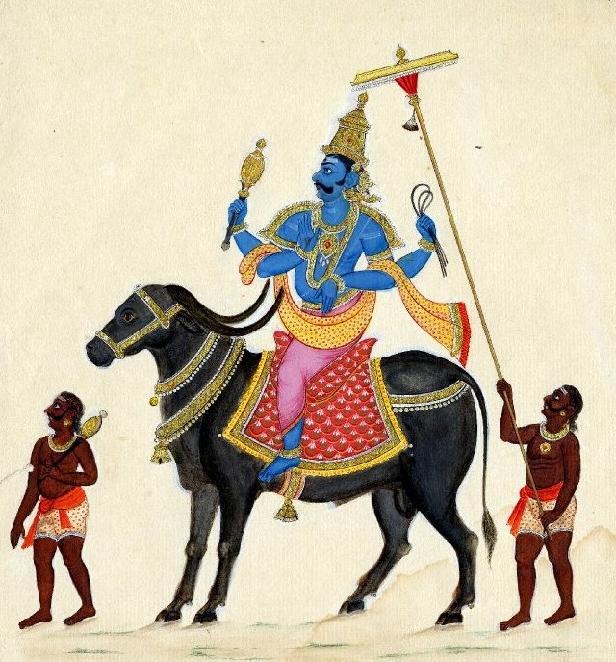
What inferences can you draw about the values and/or beliefs of Ancient Indians based on the “Creation Hymn” from Rigveda?
Talk turns sharing a specific idea. Please reference an example from the text.
“The paradoxical statement stating neither death nor immortality existed in the beginning suggests...”

