Slide 1
Remember, Smith is using the gold dinosaurs to guide your for thinking, notes, etc. you should do.

Slide 2
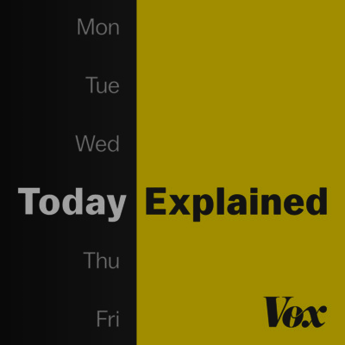
Vox’s Today Explained: “Humans 2.0”
From 11/30/2018
You’ll be expected to do a *little* search afterword's to figure out what’s new on the CRISPR front. Choose your own adventure. There are some other links in this PPT which relate.
You’ll talk about this in your group’s first video chat.
They mention the movie we’ll watch, Gattaca
24:18 minutes
easy to follow at 1.5x speed.
Its on the podcast app on your phone or spotify if you want enhanced play speed settings.
Ultimately, what dystopian fears could emerge from the use of this technology?
Notes:
https://art19.com/shows/today-explained/episodes/70001cb1-935c-4671-b0d3-b7526ffc0ec8

Slide 3
Vox’s Today Explained: “Humans 2.0”
Review Questions for your Notes:
What is CRISPR?
Who is He Jiankui and what breakthrough has he claimed to have made?
From the podcast: “I guess what seems scariest about this is that there’s just some random scientist in a lab deciding that he wants to alter how humans are made.” Now that it’s been done “maybe another 500 scientists will be like ‘meh maybe I’ll give that a shot too.’ Isn’t that, like, scary?”
What scenario was outlined about how CRISPR could do some good?
Connections to dystopian fiction? Ultimately, what dystopian fears could emerge from the use of this technology?
What questions do you have? How was listening to the podcast?
Notes:
https://art19.com/shows/today-explained/episodes/70001cb1-935c-4671-b0d3-b7526ffc0ec8

Slide 4
CRISPR
https://www.broadinstitute.org/what-broad/areas-focus/project-spotlight/questions-and-answers-about-crispr
“CRISPR” (pronounced “crisper”) stands for Clustered Regularly Interspaced Short Palindromic Repeats, which are the hallmark of a bacterial defense system that forms the basis for CRISPR-Cas9 genome editing technology. In the field of genome engineering, the term “CRISPR” or “CRISPR-Cas9” is often used loosely to refer to the various CRISPR-Cas9 and -CPF1, (and other) systems that can be programmed to target specific stretches of genetic code and to edit DNA at precise locations, as well as for other purposes, such as for new diagnostic tools. With these systems, researchers can permanently modify genes in living cells and organisms and, in the future, may make it possible to correct mutations at precise locations in the human genome in order to treat genetic causes of disease. Other systems are now available, such as CRISPR-Cas13’s, that target RNA provide alternate avenues for use, and with unique characteristics that have been leveraged for sensitive diagnostic tools, such as SHERLOCK.

Slide 5
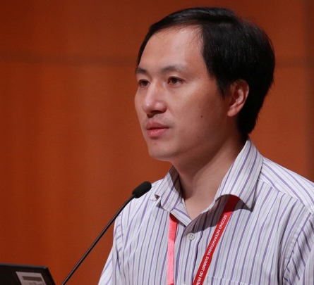
He Jiankui attends the International Summit on Human Genome Editing at the University of Hong Kong.
It is still unclear if He did what he claims to have done. Nonetheless, the reaction was swift and negative. The CRISPR pioneer Jennifer Doudna says she was “horrified,” NIH Director Francis Collins said the experiment was “profoundly disturbing,” and even Julian Savulescu, an ethicist who has described gene-editing research as “a moral necessity,” described He’s work as “monstrous.”
Such a strong reaction is understandable, given the many puzzling and worrying details about the experiment. Even without any speculation about designer babies and Gattaca-like futures that may or may not come to pass, the details about what has already transpired are galling enough. If you wanted to create the worst possible scenario for introducing the first gene-edited babies into the world, it is difficult to imagine how you could improve on this 15-part farce.
Notes:
https://www.theatlantic.com/science/archive/2018/12/15-worrying-things-about-crispr-babies-scandal/577234/?utm_campaign=the-atlantic&utm_content=5c09c9973ed3f0000178227a_ta&utm_medium=social&utm_source=facebook

Slide 6
He didn’t address an unmet medical need: “Deactivating CCR5 doesn’t confer complete immunity to HIV, either, since some strains of the virus can enter cells via a different protein.”
The actual editing wasn’t executed well: “Ryder says: ‘He made new mutations, and there’s no reason to think that they’d be protective—or even that they’d be safe.’”
It’s not clear what those new mutations will do.
There were problems with informed consent.
He operated under a cloak of secrecy.
A few people knew about He’s intentions but failed to stop him.
He acted in contravention of global consensus.
He acted in contravention of his own stated ethical views.
He sought ethical advice and ignored it.
A leading geneticist came to He’s defense.
This could easily happen again: “regardless of the risks or merits of the experiment, it reveals a vulnerability at the heart of modern science. That is: Small groups of researchers can make virtually unilateral decisions about experiments that have potentially global consequences, and that everyone else only learns about after the fact.”
Notes:
https://www.theatlantic.com/science/archive/2018/12/15-worrying-things-about-crispr-babies-scandal/577234/?utm_campaign=the-atlantic&utm_content=5c09c9973ed3f0000178227a_ta&utm_medium=social&utm_source=facebook

Slide 7
Key Definitions:
Cloning: is the process of producing genetically identical individuals of an organism either naturally or artificially.
Genome: our entire genetic blueprint. Three billion pairs of As, Ts, Cs, and Gs that each of us carries in most of our cells.
Germline Cells: a series of germ cells each descended or developed from earlier cells in the series, regarded as continuing through successive generations of an organism. The germline in a multicellular organism is the population of its bodily cells that are so differentiated or segregated that in the usual processes of reproduction they may pass on their genetic material to the progeny.

Slide 8
Extent of Modern (Human) Gene Editing
It is just in the last 65 years– a single lifetime– we figured out how DNA works, built machines that could read it, and then tools that could rewrite it.
From the podcast: “We have a long trend towards using genetics more and more in human reproduction. This is a big step towards that direction, but we’ve been doing it for a really long time. I mean in the United States you can walk into a fertility clinic... Say ‘I want a baby, I don’t want a girl, and I want my baby boy to have blue eyes.’ … You can do that. There are non-CRISPR questions that have to do with the way we’re using genetics to choose what kind of humans we bring into the world.”
If you do some supplemental research, look into what has happened on the CRISPR front recently.

Slide 9
Preimplantation genetic diagnosis (PGD):
Preimplantation genetic diagnosis (PGD): is a procedure used prior to implantation to help identify genetic defects within embryos. This serves to prevent certain genetic diseases or disorders from being passed on to the child. The embryos used in PGD are usually created during the process of in vitro fertilization (IVF). The PGD allows studying the DNA of eggs or embryos to select those that carry certain mutations for genetic diseases.
PGD has raised ethical issues, although this approach could reduce reliance on fetal deselection during pregnancy. The technique can be used for prenatal sex discernment of the embryo, and thus potentially can be used to select embryos of one sex in preference of the other in the context of "family balancing". It may be possible to make other "social selection" choices in the future that introduce socio-economic concerns. Only unaffected embryos are implanted in a woman’s uterus; those that are affected are either discarded or donated to science.
PGD has the potential to screen for genetic issues unrelated to medical necessity, such as intelligence and beauty, and against negative traits such as disabilities. The medical community has regarded this as a counterintuitive and controversial suggestion. The prospect of a "designer baby" is closely related to the PGD technique, creating a fear that increasing frequency of genetic screening will move toward a modern eugenics movement. On the other hand, a principle of procreative beneficence is proposed, which is a putative moral obligation of parents in a position to select their children to favor those expected to have the best life. An argument in favor of this principle is that traits (such as empathy, memory, etc.) are "all-purpose means" in the sense of being of instrumental value in realizing whatever life plans the child may come to have.
Designer Baby Video: https://www.youtube.com/watch?v=2ixEDLa3Jlc

Slide 10
SOME SUPPLIMENTAL LINKS, YO
Barbra Streisand Reveals She Cloned Her Dog, 'Variety' Reports
https://www.npr.org/2018/02/28/589415467/barbra-sreisand-reveals-she-cloned-her-dog-variety-reports
“Explained” on Netflix discussion of Designer DNA, CRISPR, etc. [17 minutes]
https://www.netflix.com/watch/80243752?trackId=13752289&tctx=0%2C18%2Ca4912706-55e5-4683-b5a2-f776c6bc940f-649535794%2C%2C
The Risk of Using CRISPR [3 minutes]
https://www.youtube.com/watch?v=0kf5S2HQSjY
Ethical Issues Related to CRISPR [5 minutes]
https://www.youtube.com/watch?v=oIzO8qPUOno

Slide 11
Think: Cloning + Gene Editing in other Science Fiction Texts
What other science fiction texts involve gene editing?
How does it work out? What problems arise? What uses does society have for these practices?
Jurassic Park: “Yeah, but your scientists were so preoccupied with whether or not they could, they didn’t stop to think if they should.”

