Slide 1
Catharsis
Catharsis is when the audience feels intense pity or sadness about the contents or characters of literature and plays that results in the audience feeling happier or refreshed afterword due to the extreme purging of emotions.
Aristotle argued that tragedy cleansed the heart through pity and terror, purging us of our petty concerns and worries by making us aware that there can be nobility in suffering.
In your own words describe what Catharsis physically feels like.

Slide 2
Archetype: Tragic Hero
Review: What is an Archetype?
The main character of a Classical Tragedy is the Tragic Hero.
Author Oscar Wilde in his book A Picture of Dorian Gray on the reason we like the Tragic Hero:

Slide 3
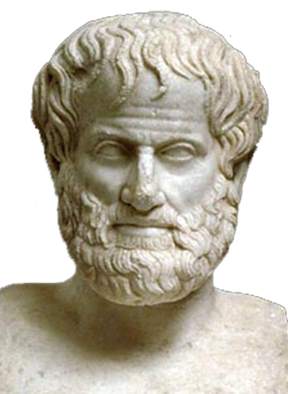
Archetype: Tragic Hero
A character whose fate matters, figuratively (through symbolism) or literally, to a nation or people.
A character who challenges fate; struggles against supernatural forces or doom.
A character who has a tragic flaw
A character who fails in the end; they make choices that bring about their destruction and/or fate prevent success.
A character who develops deeper self-knowledge through suffering.

Slide 4
Archetype: Tragic Hero
The character who usually goes on a quest.
The character has both good and bad in his personality.
Can be protagonists or antagonists (“good guy” or “bad guy”)

Slide 5
Modern Tragic Hero
Modern twists:
Society may be oppressor
Does not have to be high born, more often a common man
May/not result in recognition of tragic flaw
Harsh Punishment: May/not die
May/not be mourned

Slide 6
Common Tragic Flaws (personality flaws)
Hubris: excessive pride or confidence or (for the Greeks going against the gods)
Ambition: the desire to achieve greatness or status
Indecisiveness: failing to make a choice quick enough for fear of being wrong
Misplaced-Trust: the hero trusts the wrong people despite evidence they should not
Lack of Self-control: the character is unable to control their emotions, behavior, reactions, and desires
Lack of Self-Knowledge:
In the novels you’ve read here at SHS, which characters have had these Tragic Flaws?

